Slide 1

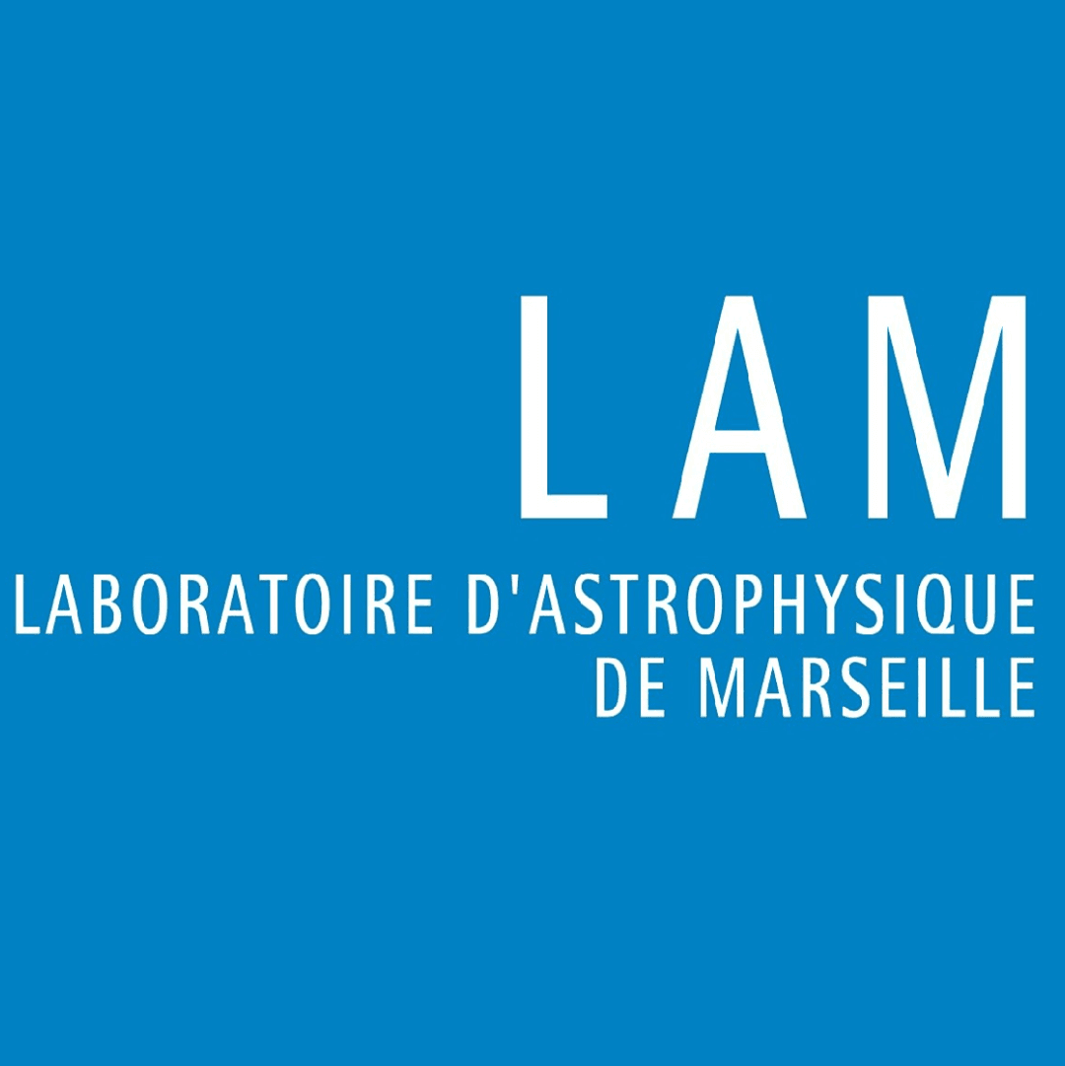

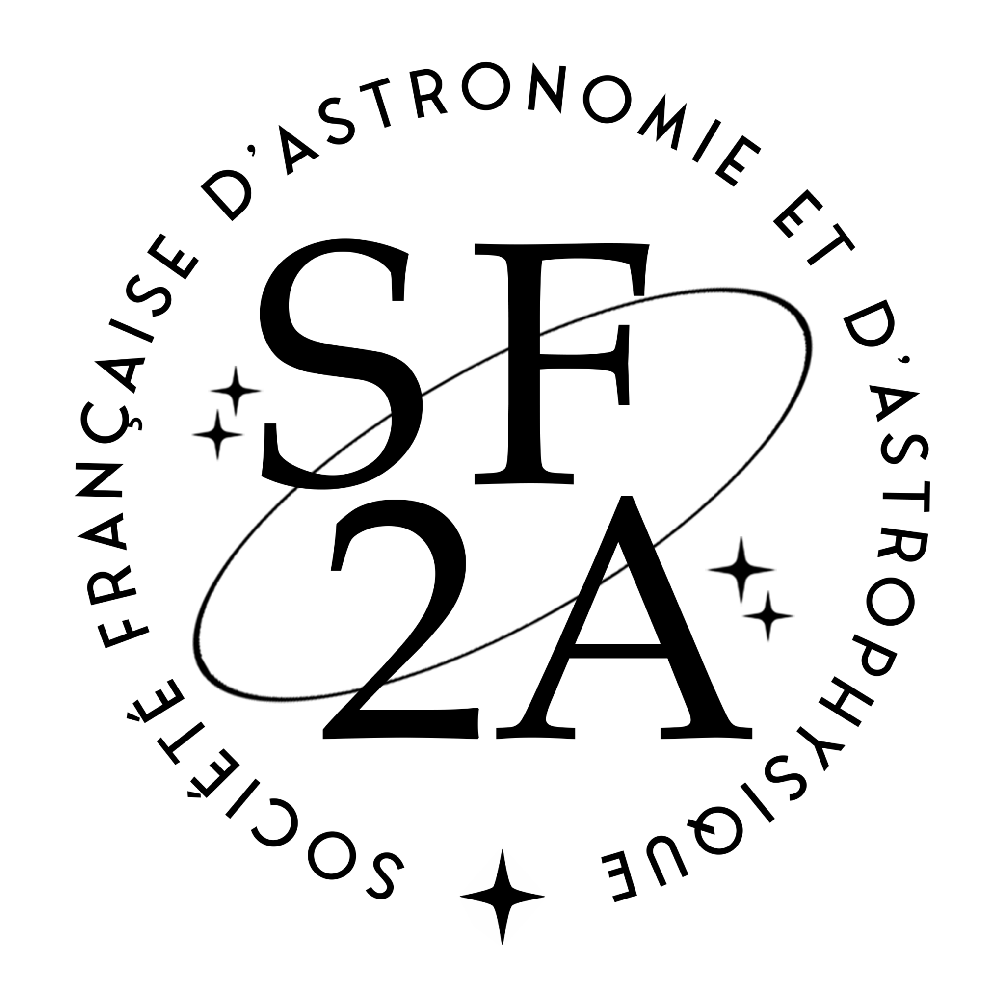
SF2A 2026 · Grenoble
Multi-Epoch Observation Strategy
in Direct Exoplanet Imaging
HARMONI Simulations and Bayesian Extensions of K-Stacker
━━━━━━━━━━━━━━━━━━━━━━━━━━━━━━━━━━━━
Merwan Ould-Elhkim
Postdoctoral Researcher, Laboratoire d’Astrophysique de Marseille (LAM)
Under the supervision of Hervé Le Coroller

Slide 2
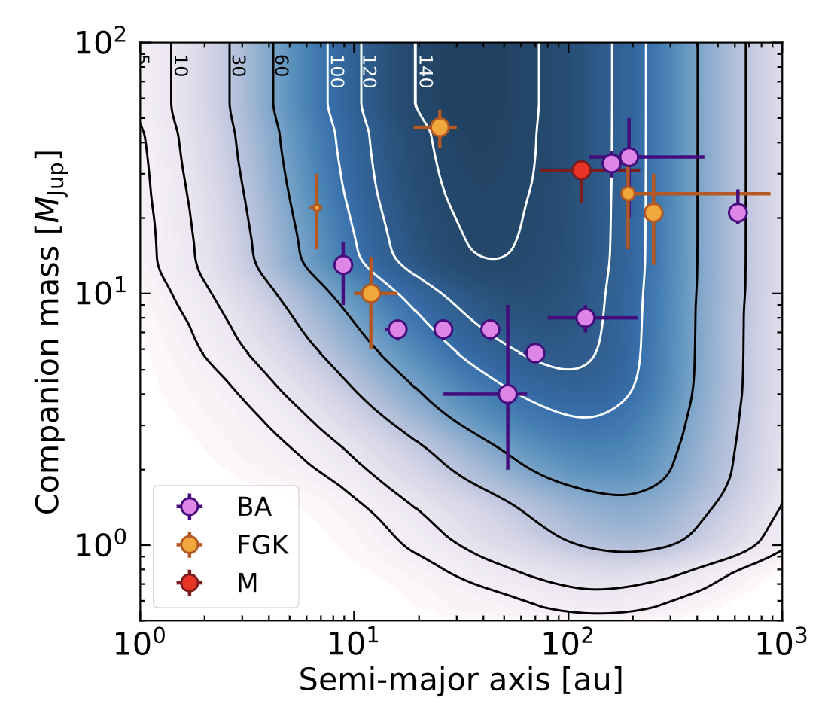
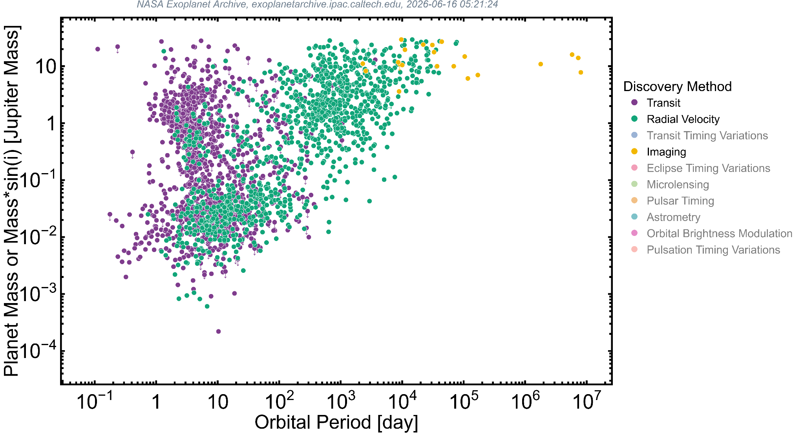
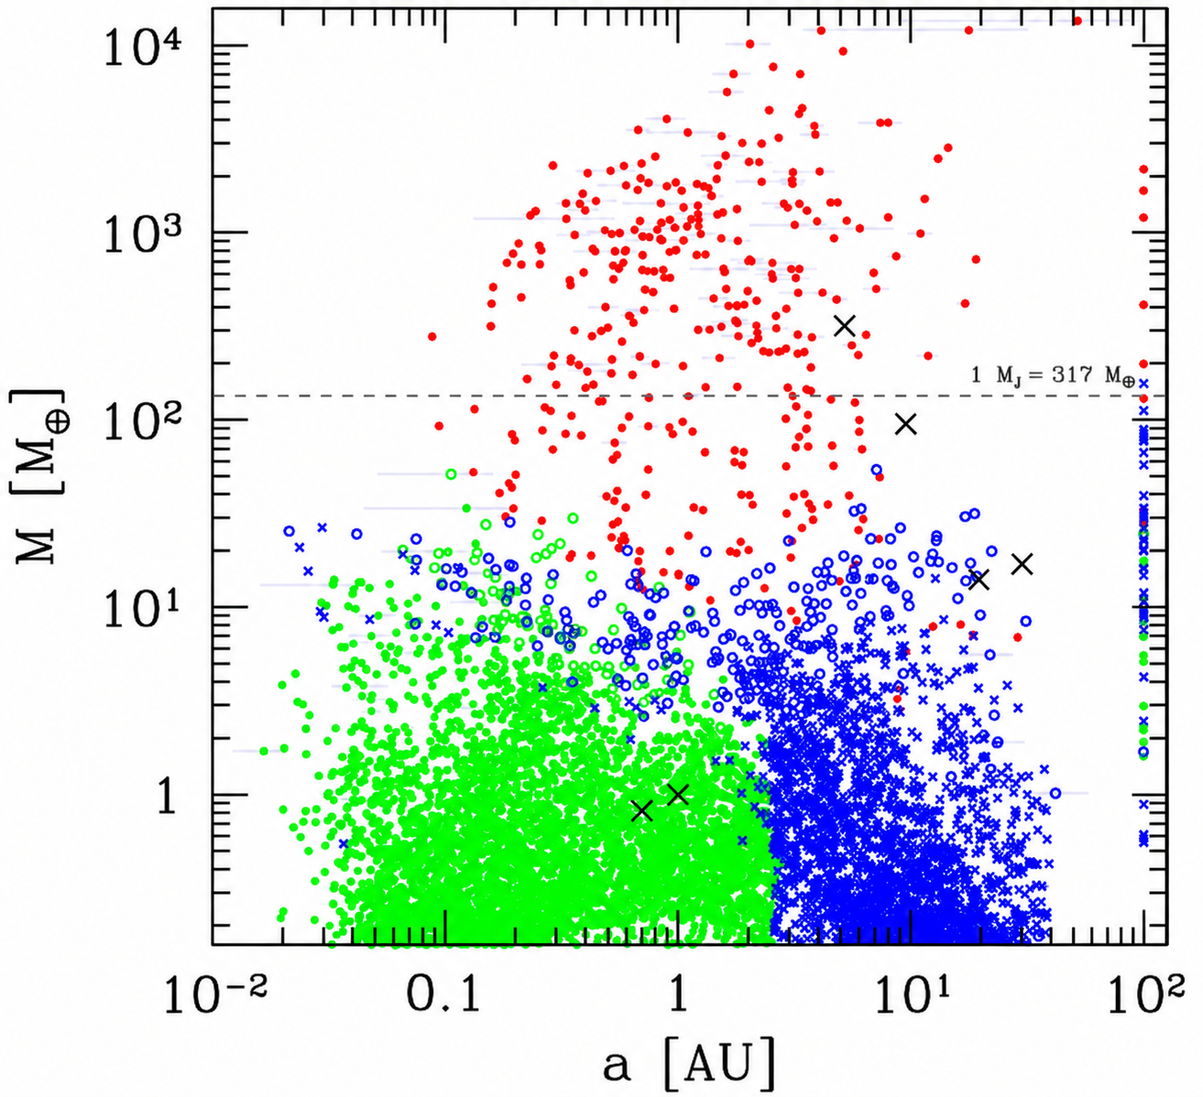
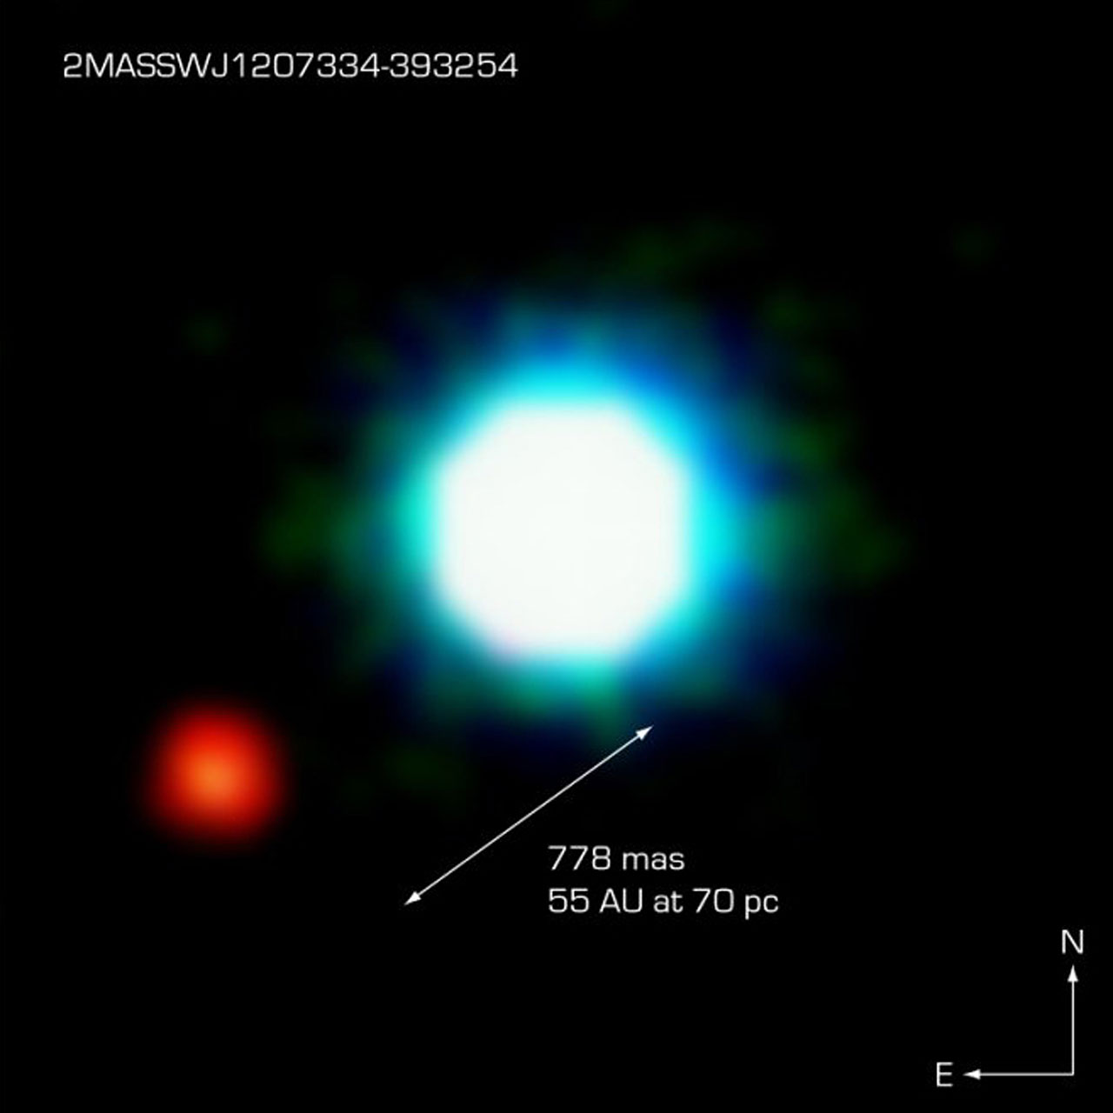
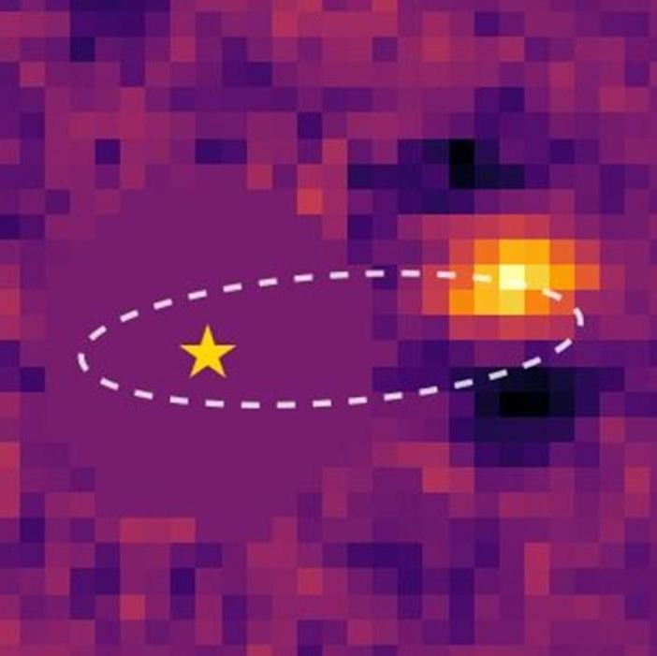
SF2A 2026 · Grenoble · Slide 2/22
Direct imaging: from 20 years of detections to the ELT era
━━━━━━━━━━━━━━━━━━━━━━━━━━━━━━━━━━━━
2M1207 b: 2 M _{J} at 55 AU
HD 135344 Ab: 10 M _{J} at 15-20 AU
G.Chauvin et al. (2004)
T.Stolker et al. (2025)
SHINE/SPHERE demographics
Vigan et al. 2021
Population synthesis
Mordasini 2018
150 stars · 13 detections · 1–75 MJup · 5–300 au · 5.7% occurence rate
Current HCI probes sparse regions, close to denser planet population

Slide 3
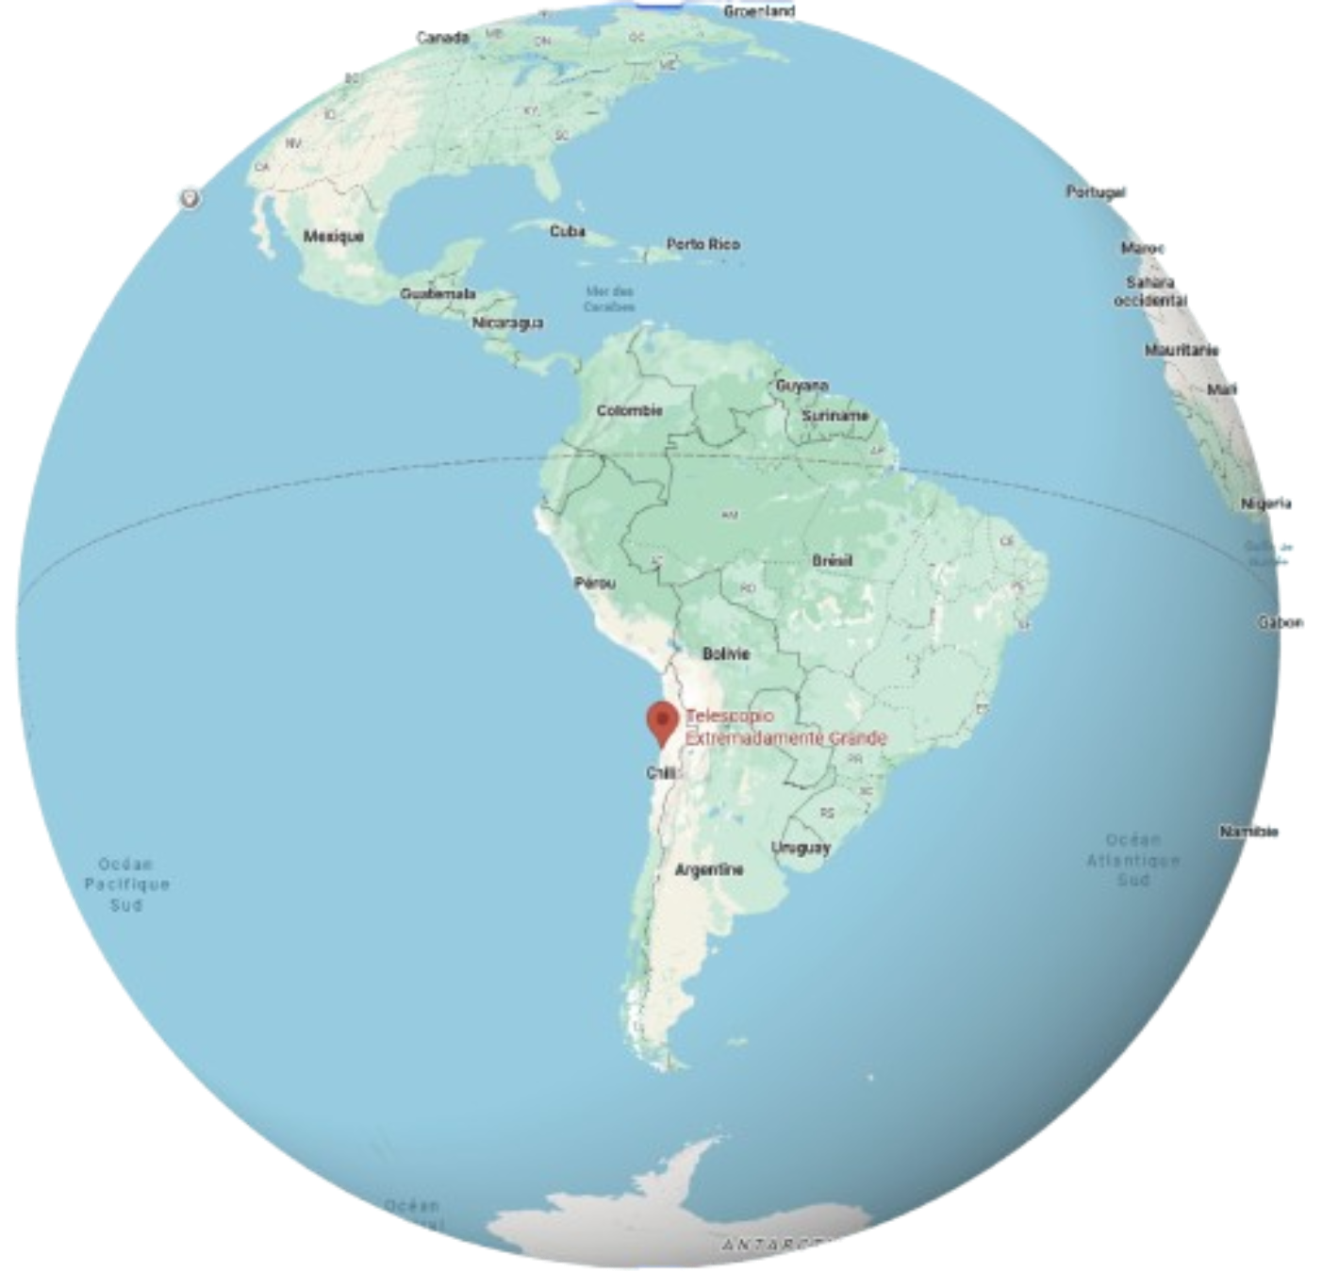
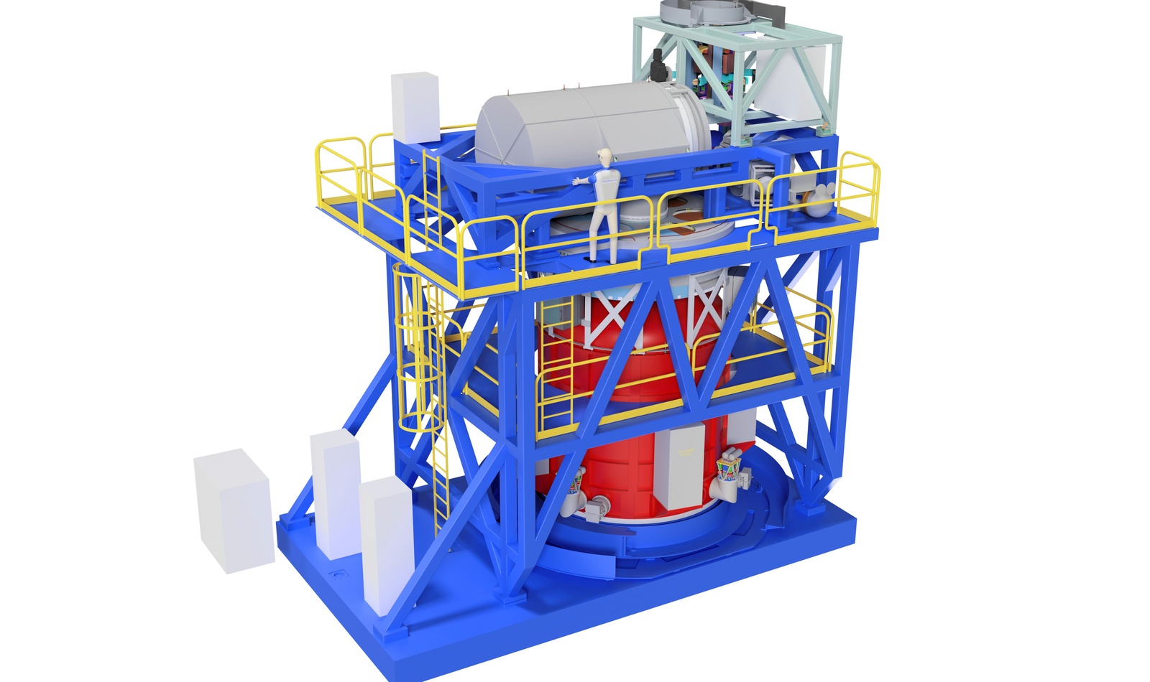
SF2A 2026 · Grenoble · Slide 3/22
HARMONI on the ELT
━━━━━━━━━━━━━━━━━━━━━━━━━━━━━━━━━━━━
First-generation ELT instrument
Instrument
High contrast
Simulations
Injected spectrum
visible / near-IR IFS
AO-assisted 3D spectroscopy
Medium-resolution up to R = 17,000
dedicated HC module
SCAO + coronagraphic mode
End-to-end realistic ELT/HARMONI data
L-type companion
Teff = 1500 K, log g = 4.0
β Pic b-like
Houllé et al. 2021
(Bonnefoy et al. 2013)

Slide 4
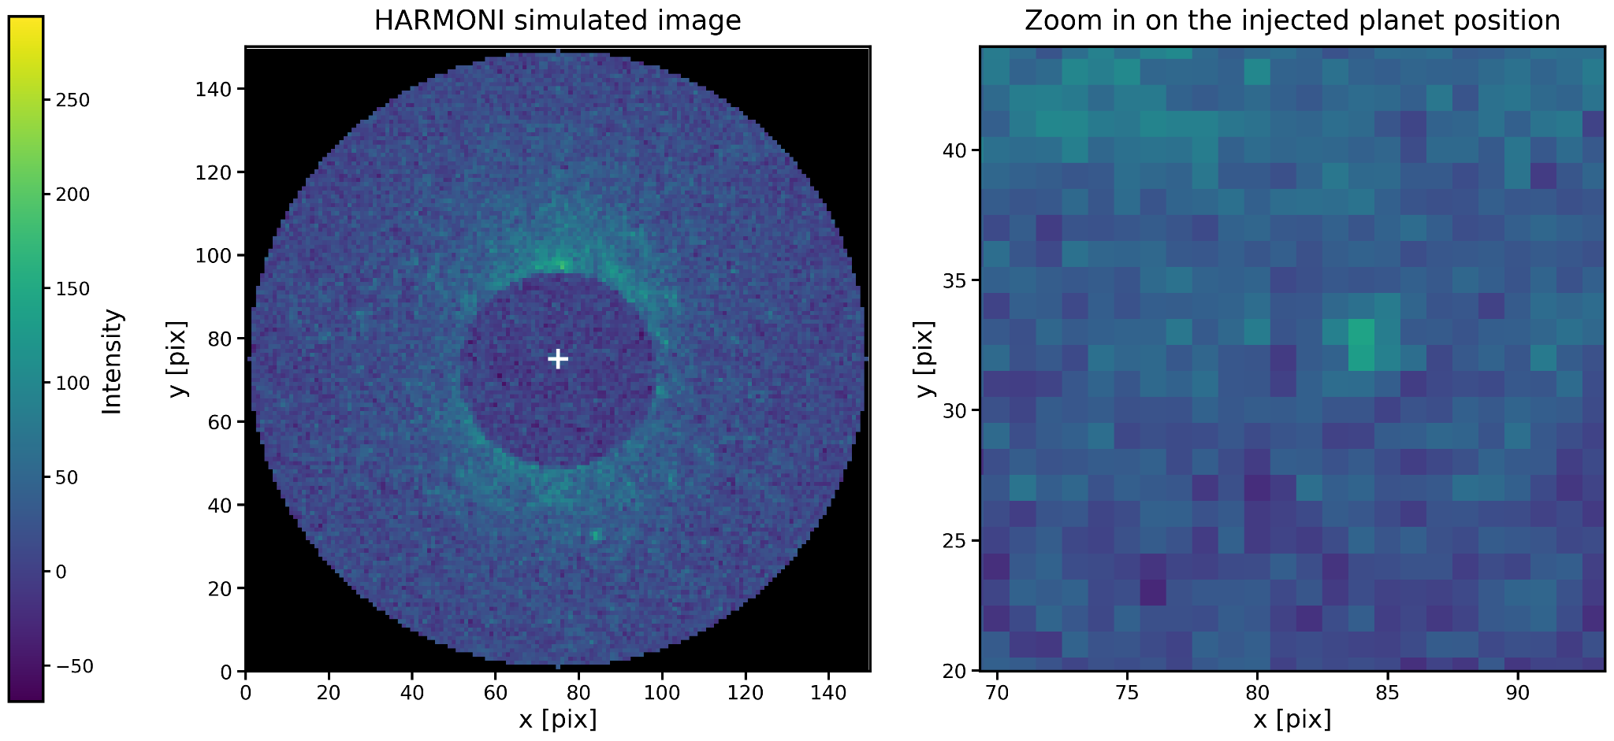
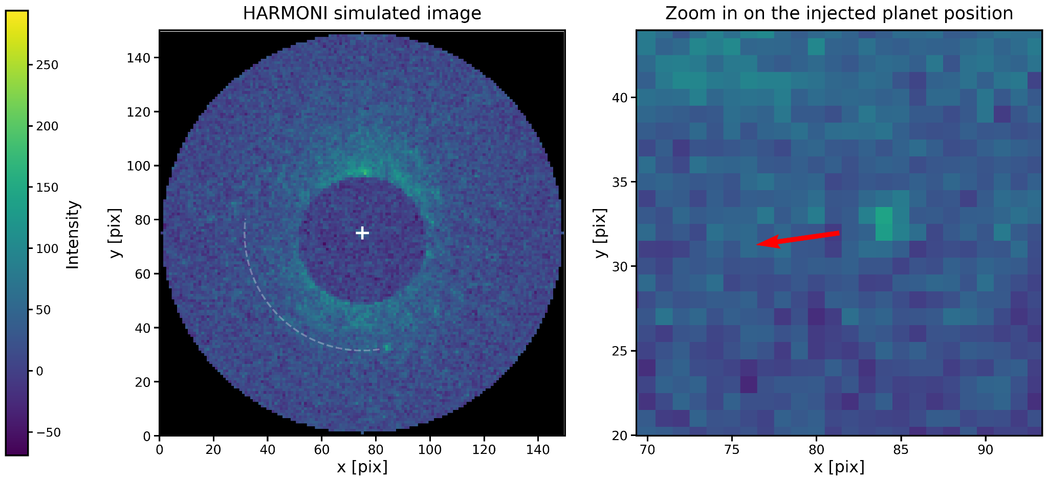
SF2A 2026 · Grenoble · Slide 4/22
From a raw HARMONI image to a detection map
━━━━━━━━━━━━━━━━━━━━━━━━━━━━━━━━━━━━
The speckle challenge
Quasi-static speckles can mimic planets
Simulated HARMONI image at one wavelength
Coronagraphic observations with residual speckle noise and an injected signal at dmag = 10.

Slide 5
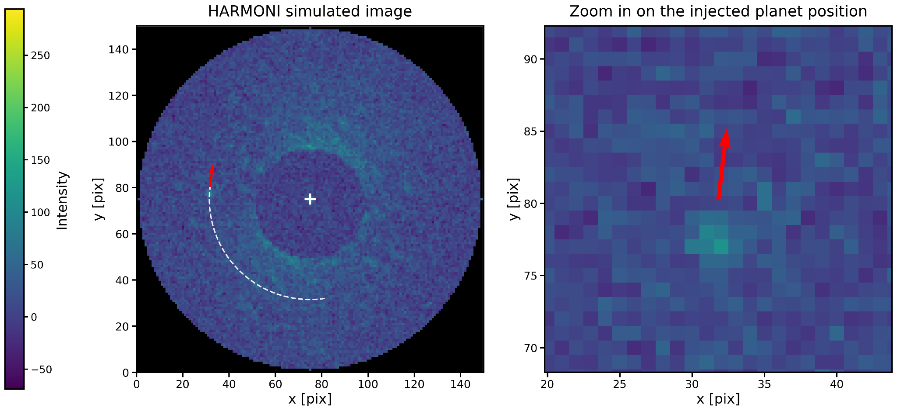

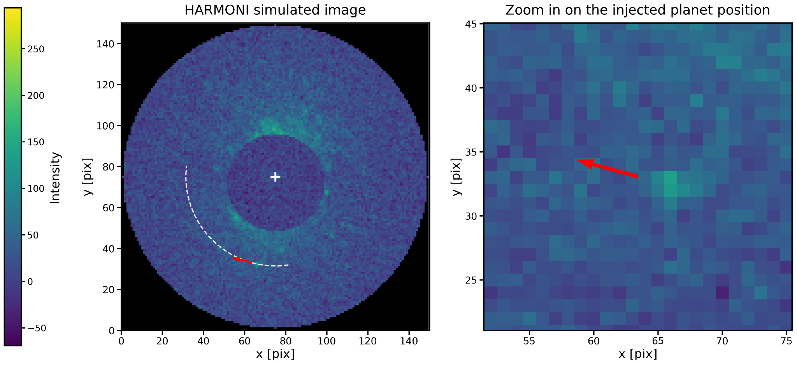
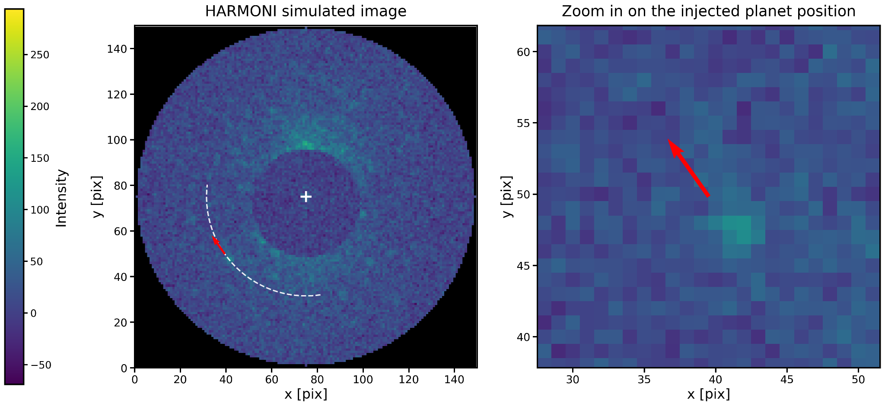
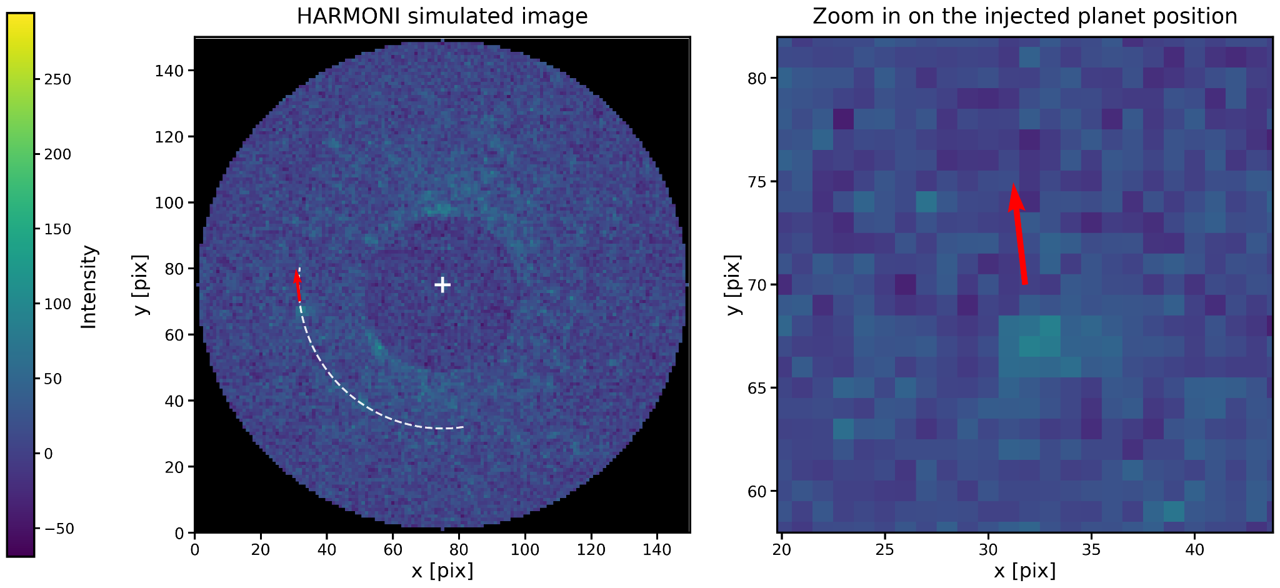
SF2A 2026 · Grenoble · Slide 5/22
From a raw HARMONI image to a detection map
━━━━━━━━━━━━━━━━━━━━━━━━━━━━━━━━━━━━
The speckle challenge
Quasi-static speckles can mimic planets
Angular Differential Imaging (ADI)
Uses field rotation to separate them:
• Speckles stay nearly fixed in the instrument frame
• A real planet rotates with parallactic angle
Simulated HARMONI image at one wavelength
Coronagraphic observations with residual speckle noise and an injected signal at dmag = 10.

Slide 6
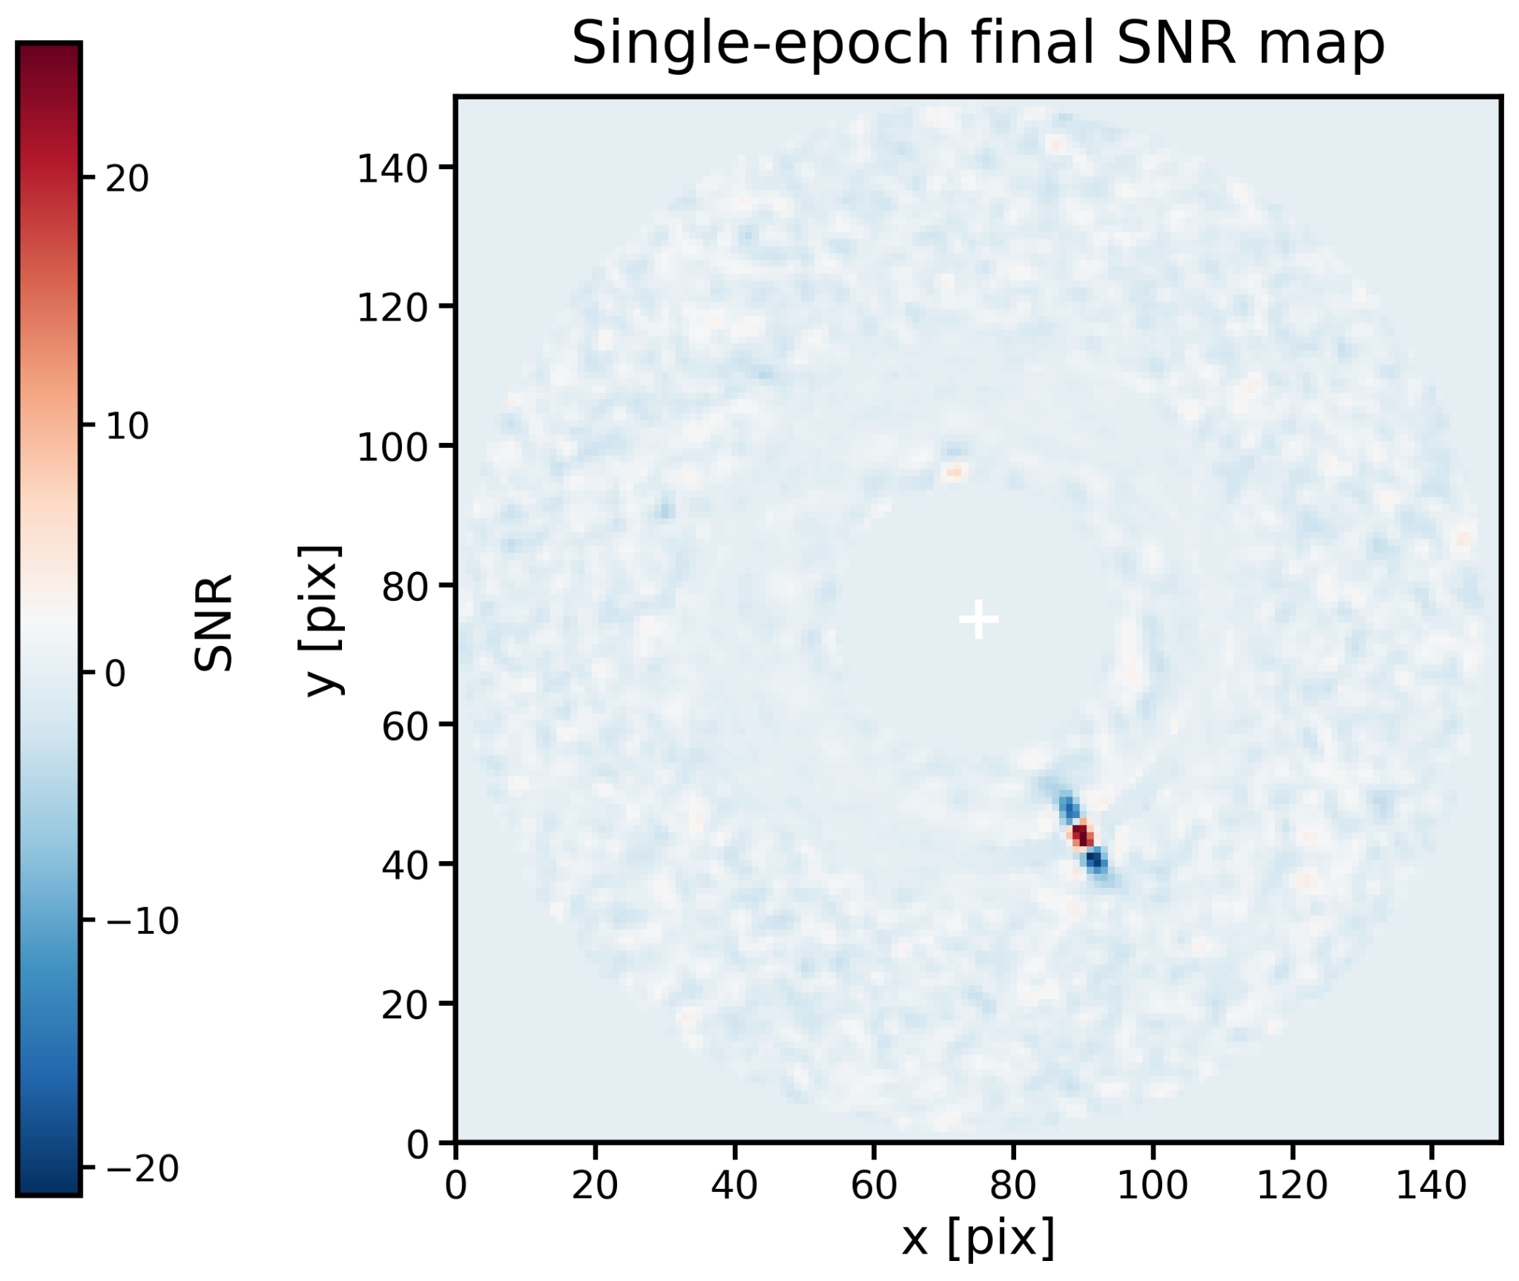
SF2A 2026 · Grenoble · Slide 6/22
Single-epoch detection maps
━━━━━━━━━━━━━━━━━━━━━━━━━━━━━━━━━━━━
SNR map
Computed with VIP using ASDI on the simulated HARMONI spectral cube
Christiaens et al. 2023
ASDI = ADI + SDI
ADI uses field rotation.
SDI uses the wavelength-dependent behaviour of speckles and planet signal.

Slide 7
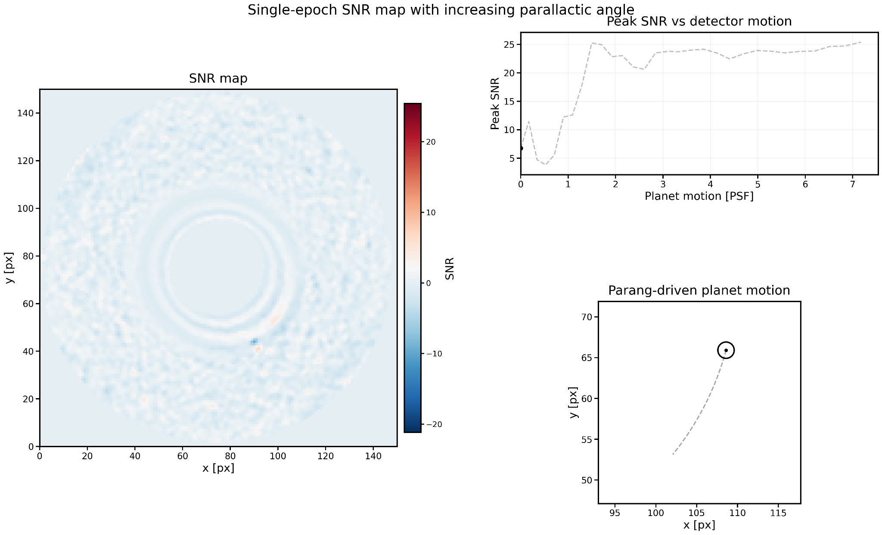
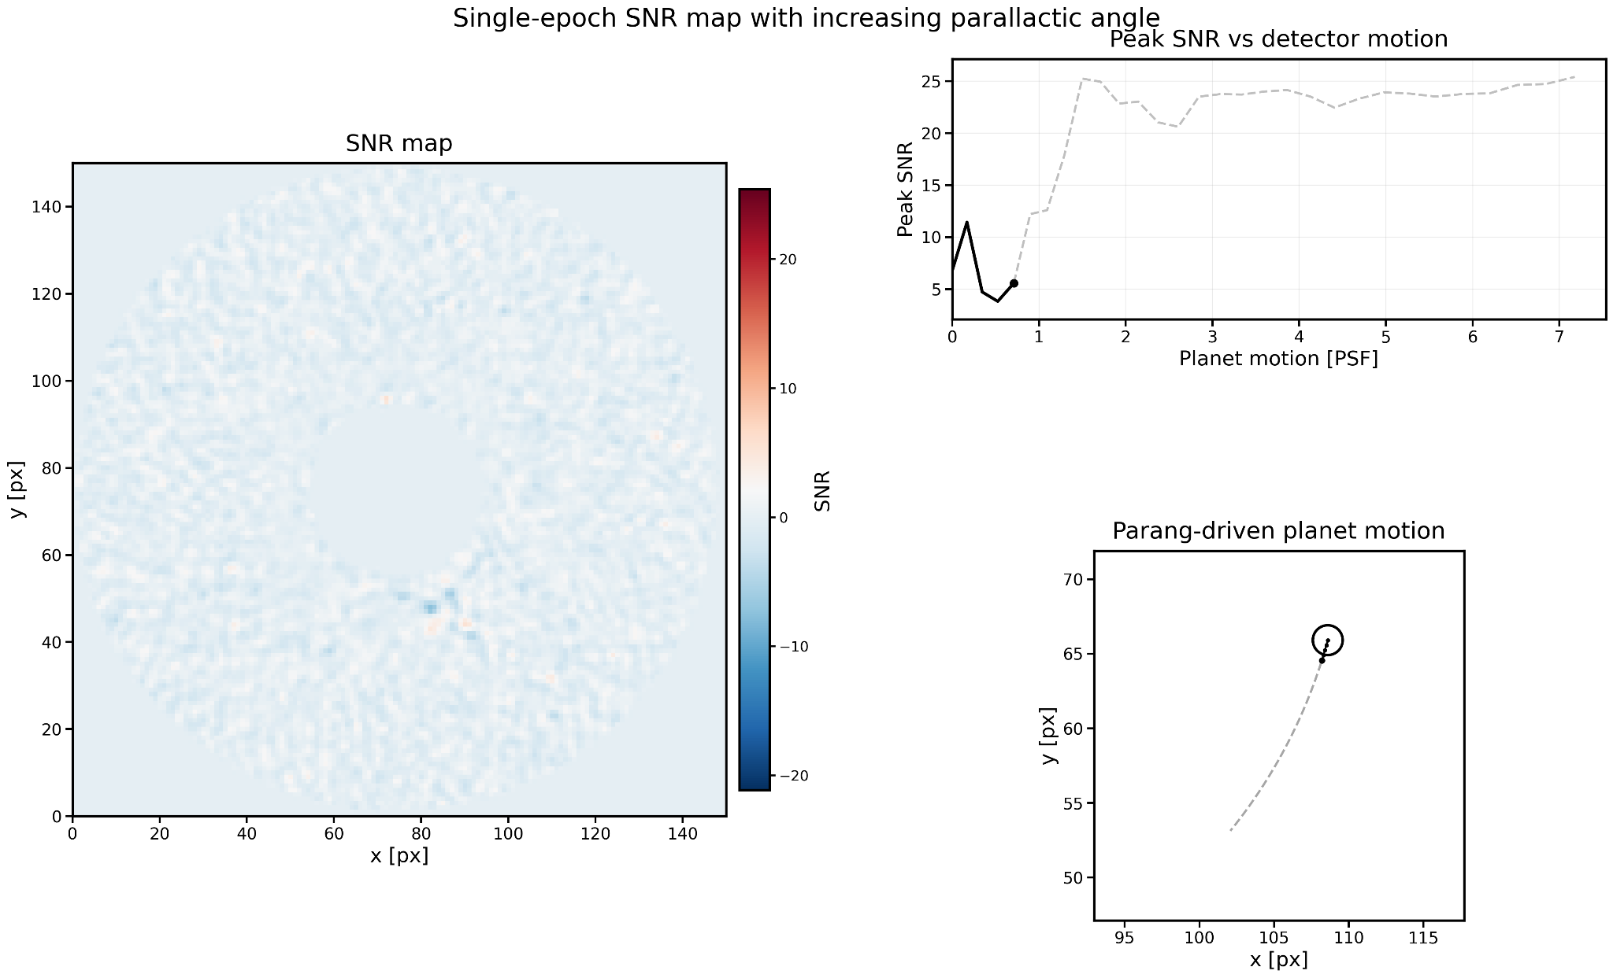


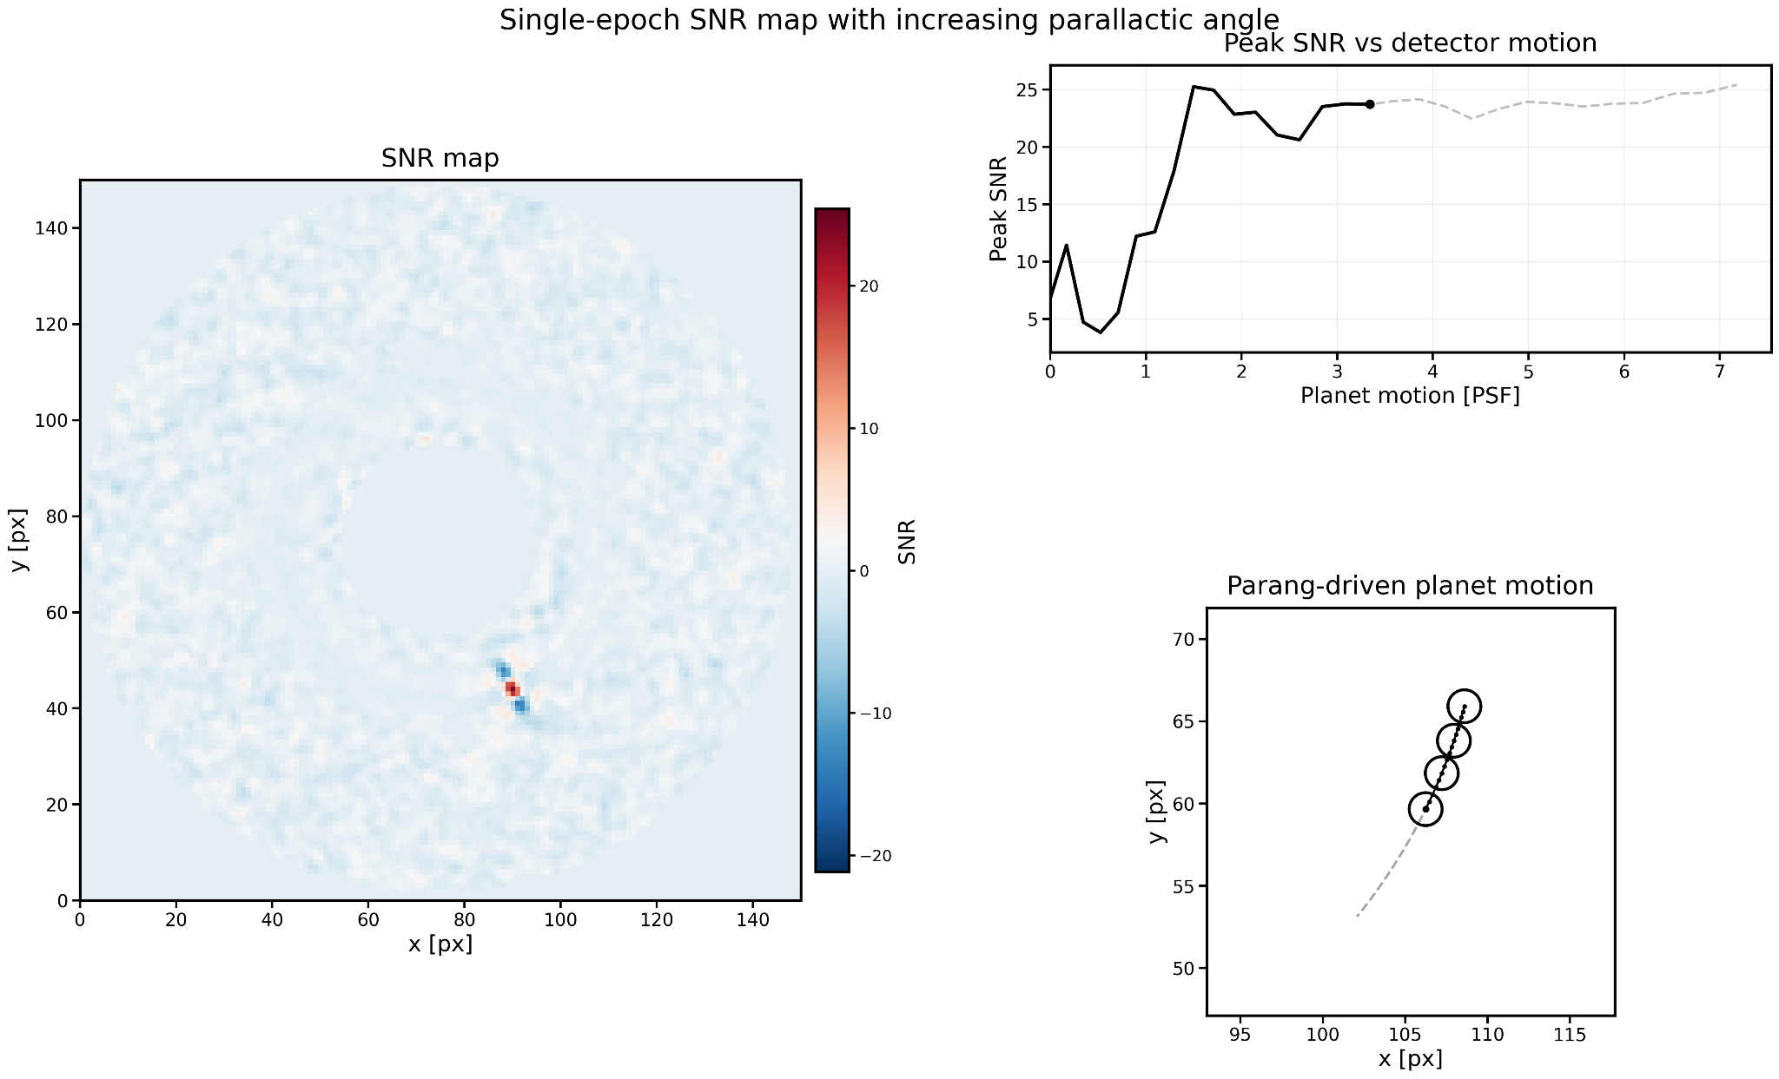
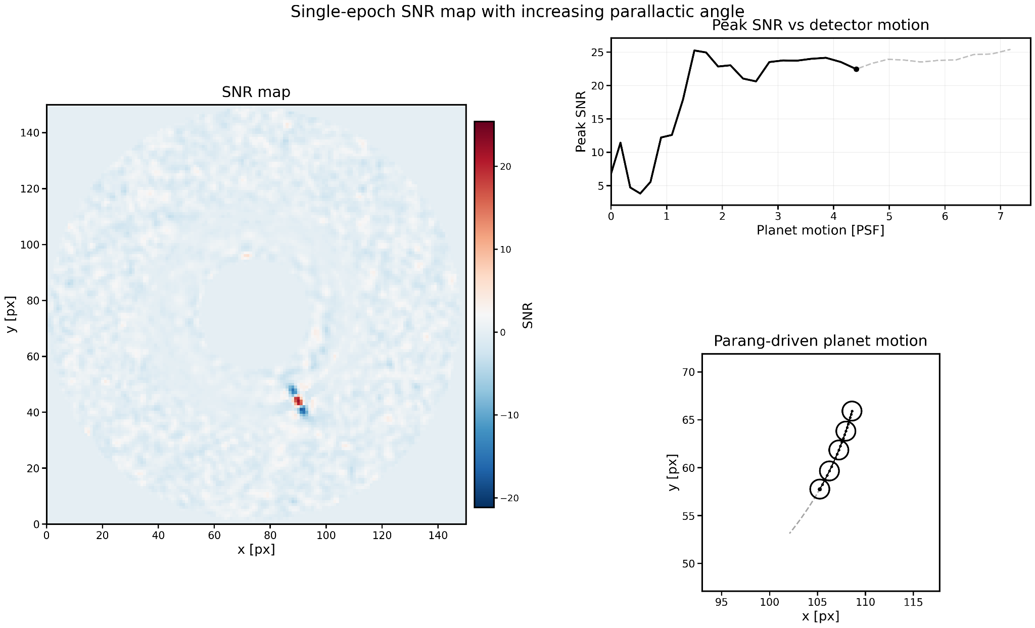

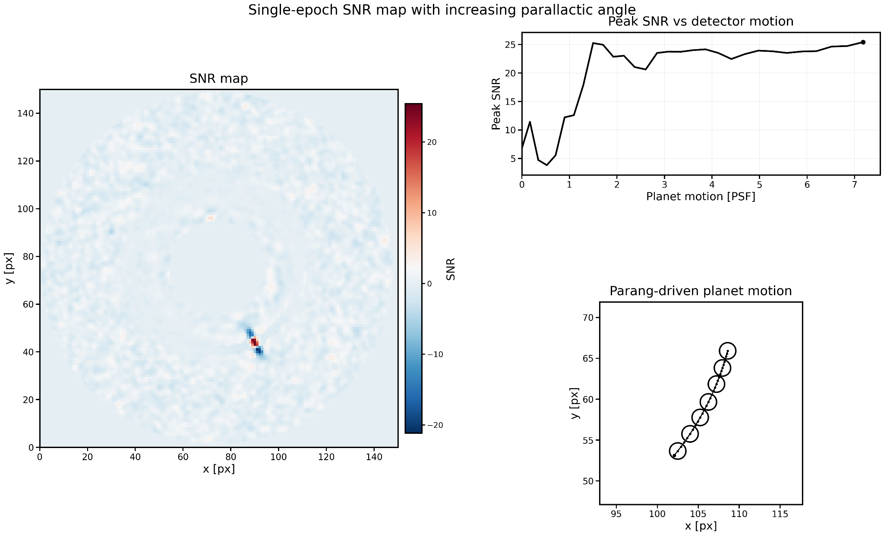
SF2A 2026 · Grenoble · Slide 6/22
ADI gain depends on PSF-scale motion
━━━━━━━━━━━━━━━━━━━━━━━━━━━━━━━━━━━━
SNR map
Computed with VIP using ASDI on the simulated HARMONI spectral cube
Christiaens et al. 2023
ASDI = ADI + SDI
ADI uses field rotation.
SDI uses the wavelength-dependent behaviour of speckles and planet signal.
KEY POINT
Enough planet motion
is required for ADI
to pay off
motion ≳ 3 PSF

Slide 8
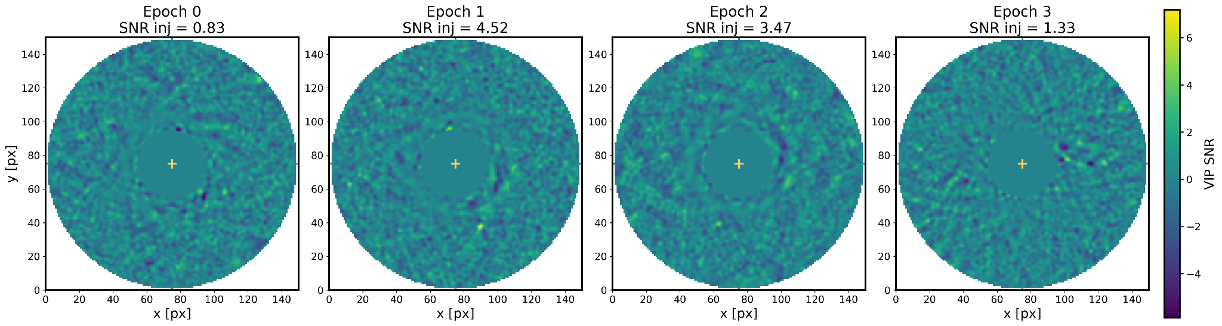
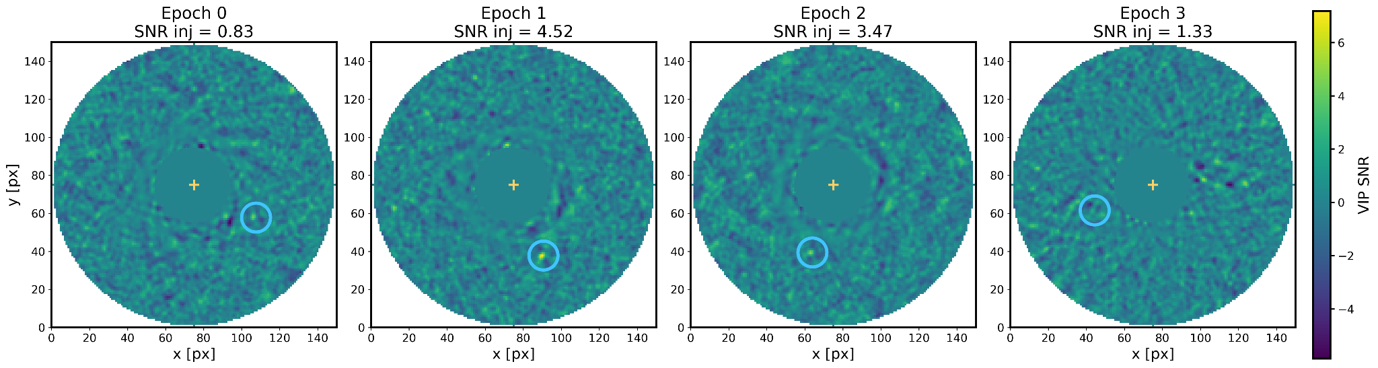
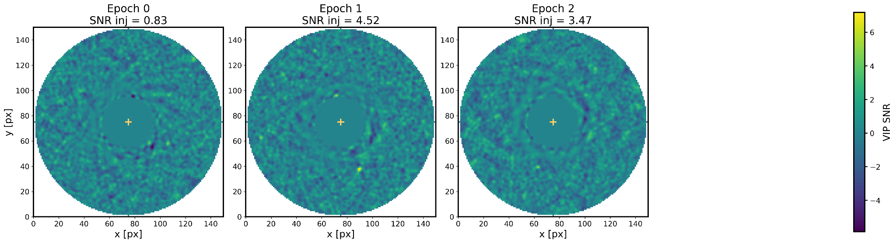
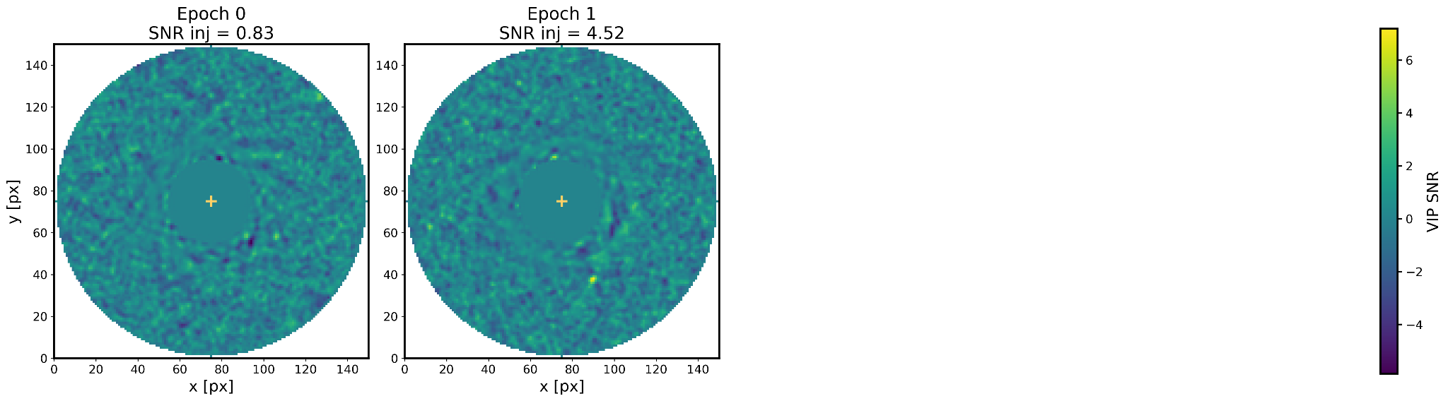
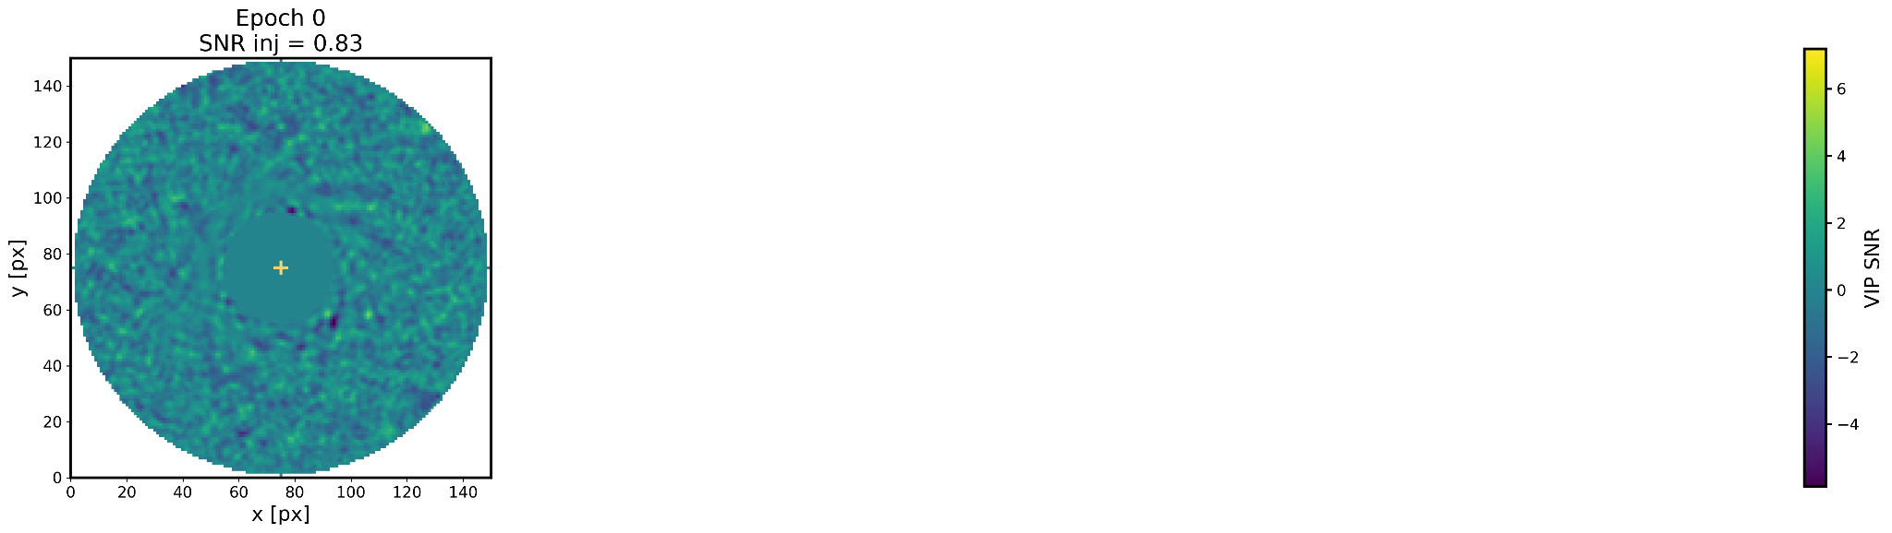
SF2A 2026 · Grenoble · Slide 7/22
Sometime one epoch is not enough
━━━━━━━━━━━━━━━━━━━━━━━━━━━━━━━━━━━━

Slide 9
SF2A 2026 · Grenoble
From single-epoch maps to orbit-stacked detection

Slide 10
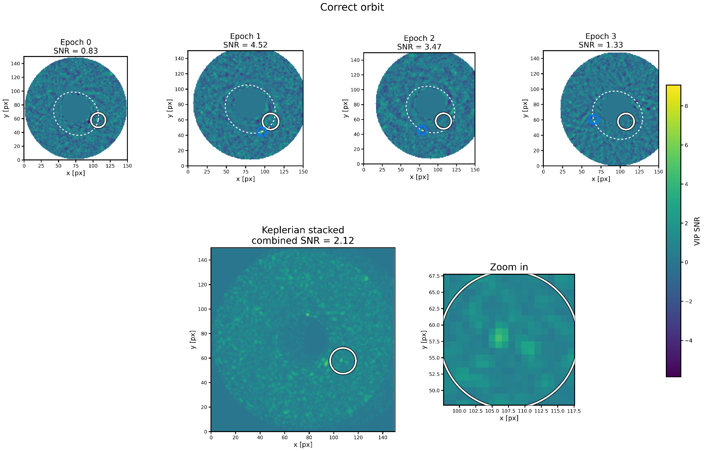
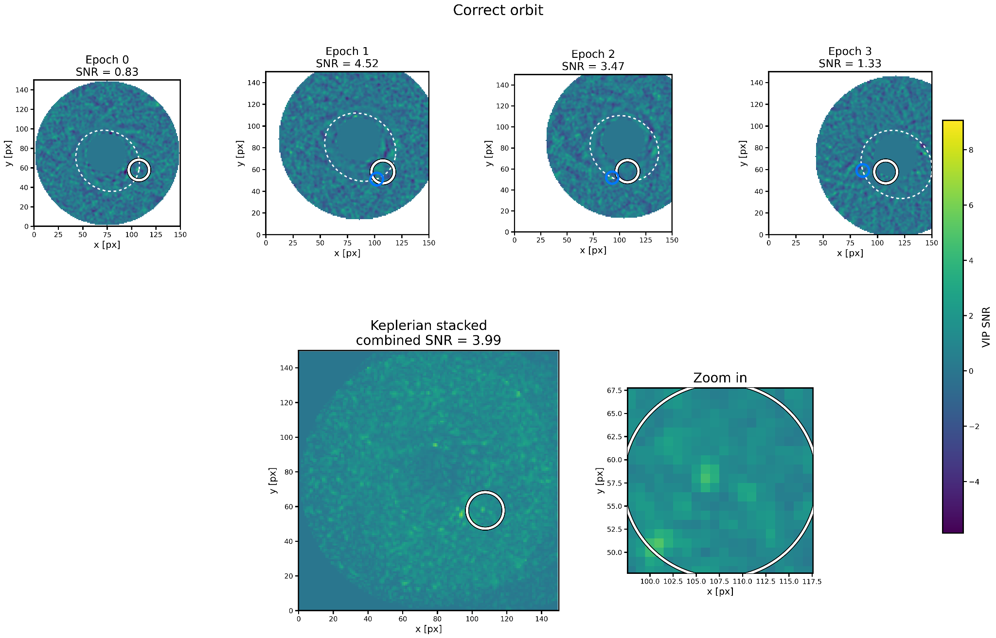
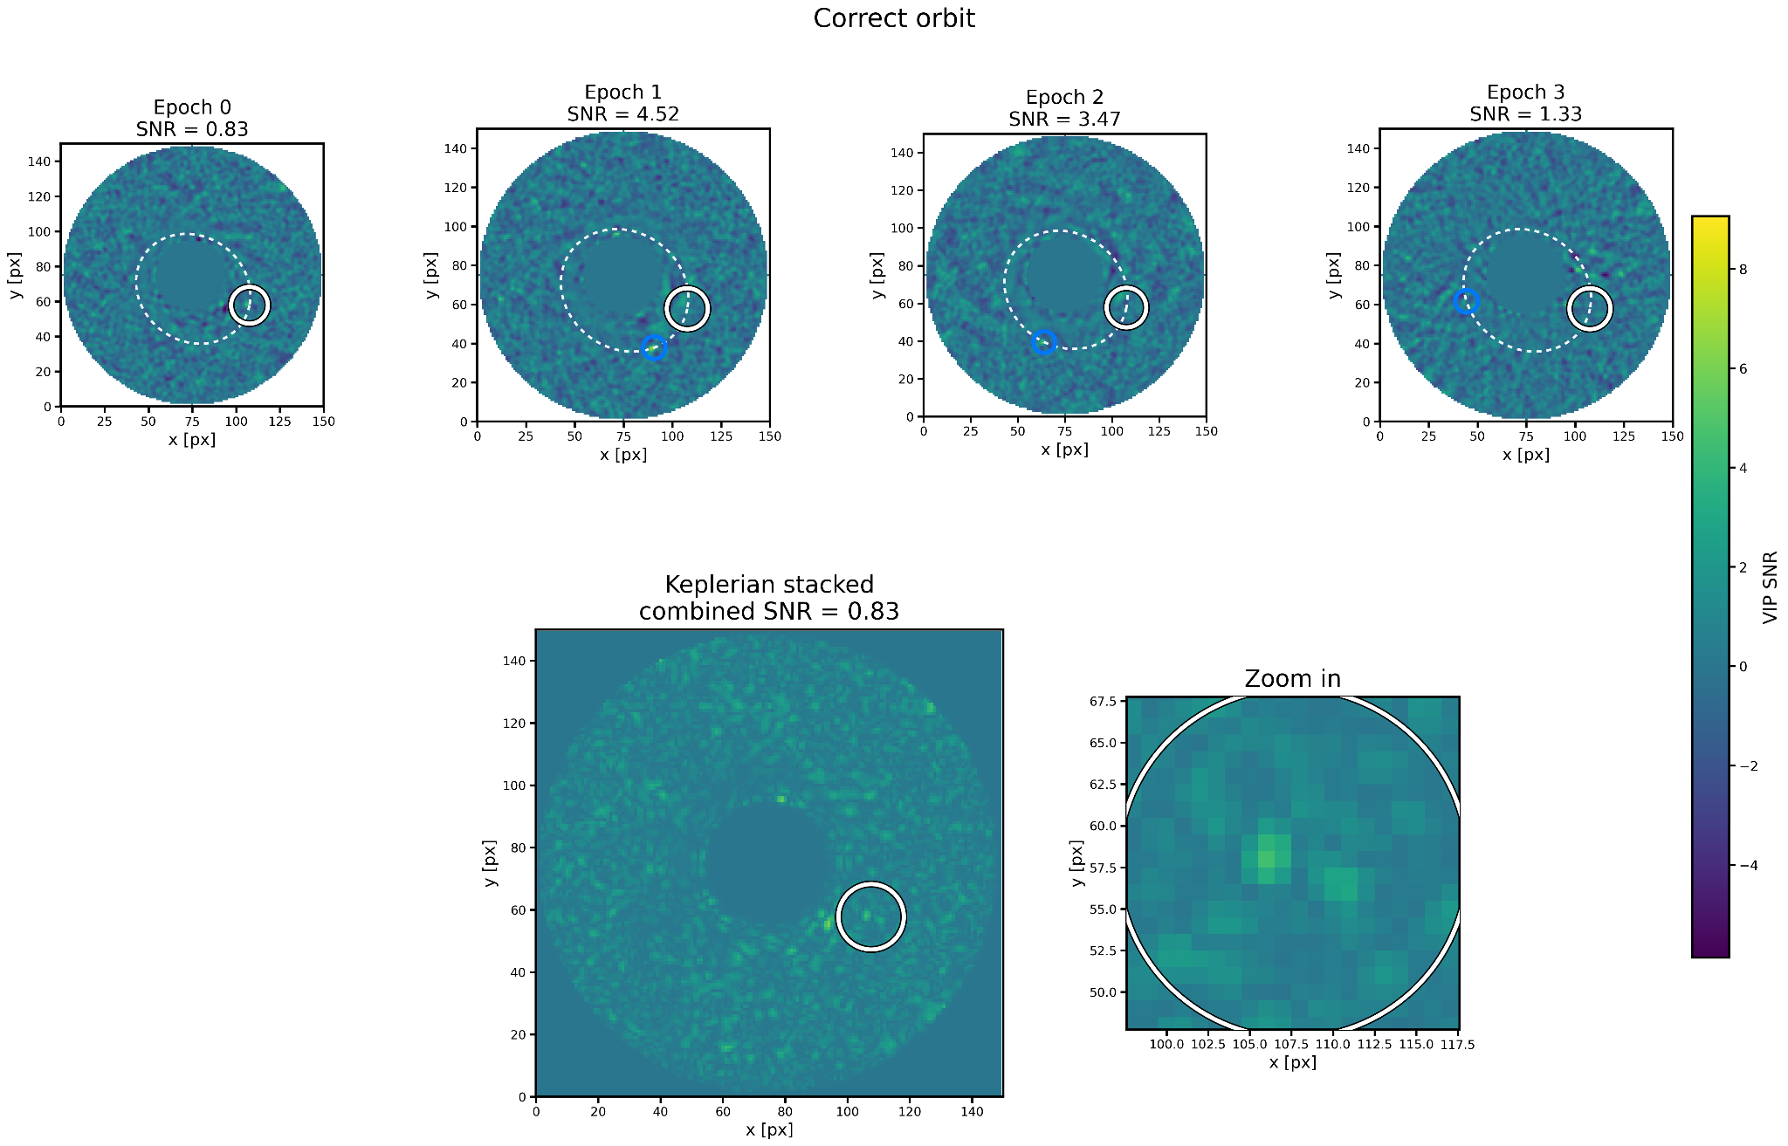
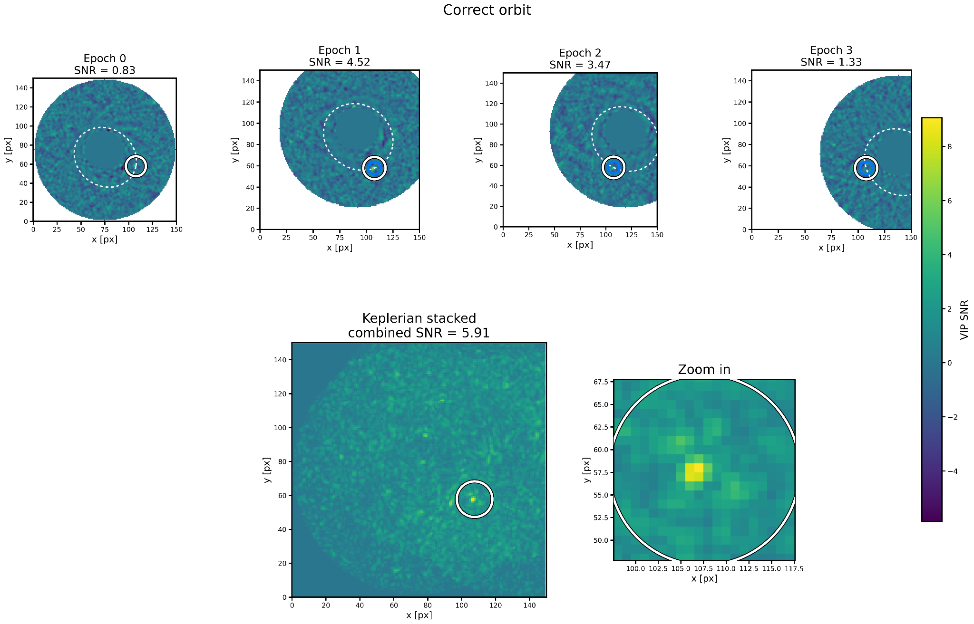
SF2A 2026 · Grenoble · Slide 9/22
K-Stacker: follow the orbit, recover the planet
━━━━━━━━━━━━━━━━━━━━━━━━━━━━━━━━━━━━
Le Coroller et al. 2015; Nowak et al. 2018; Le Coroller et al. 2020, 2022
Core idea
1. Predict
Choose a trial Keplerian orbit and predict the planet position at each epoch.
2. Sample
Read the SNR value in each map at those predicted positions.
3. Combine
Rank the orbit using a multi-epoch score. The right orbit accumulates coherent evidence.
A real planet is coherent along the correct orbit; speckles are not

Slide 11
SF2A 2026 · Grenoble · Slide 10/22
Observing strategy trade-off
MAIN QUESTION
How should we split a fixed observing time?
━━━━━━━━━━━━━━━━━━━━━━━━━━━━━━━━━━━━
A
One long epoch
Several shorter epochs
A
B
120x5min
120x5min split
VS
2×60
Maximizes field rotation
4×30
but no orbital sampling between epochs
8×15
Adds Keplerian leverage
but less PSF motion per epoch
Conservative assumption
Each epoch may miss the maximum field rotation
because of weather, scheduling or zenith constraints.
Question: if each epoch still has enough PSF-scale ADI motion, can K-Stacker gain SNR with the same total observing time?

Slide 12
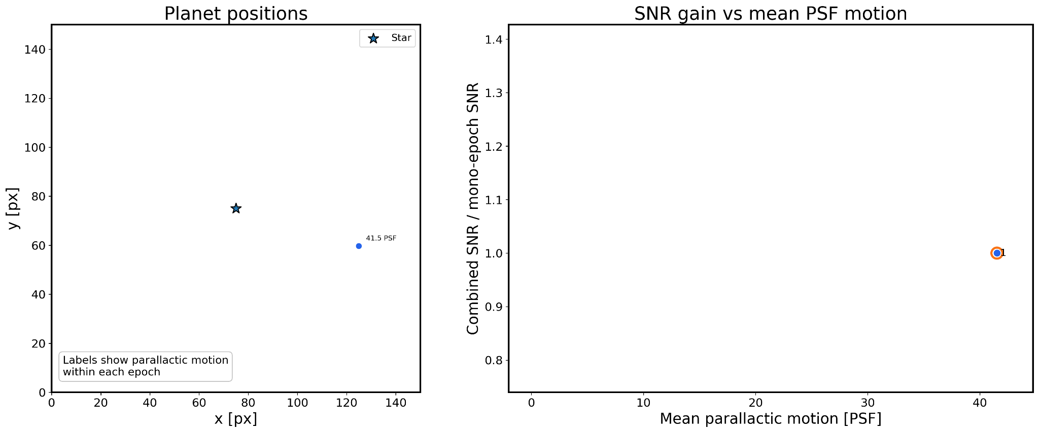
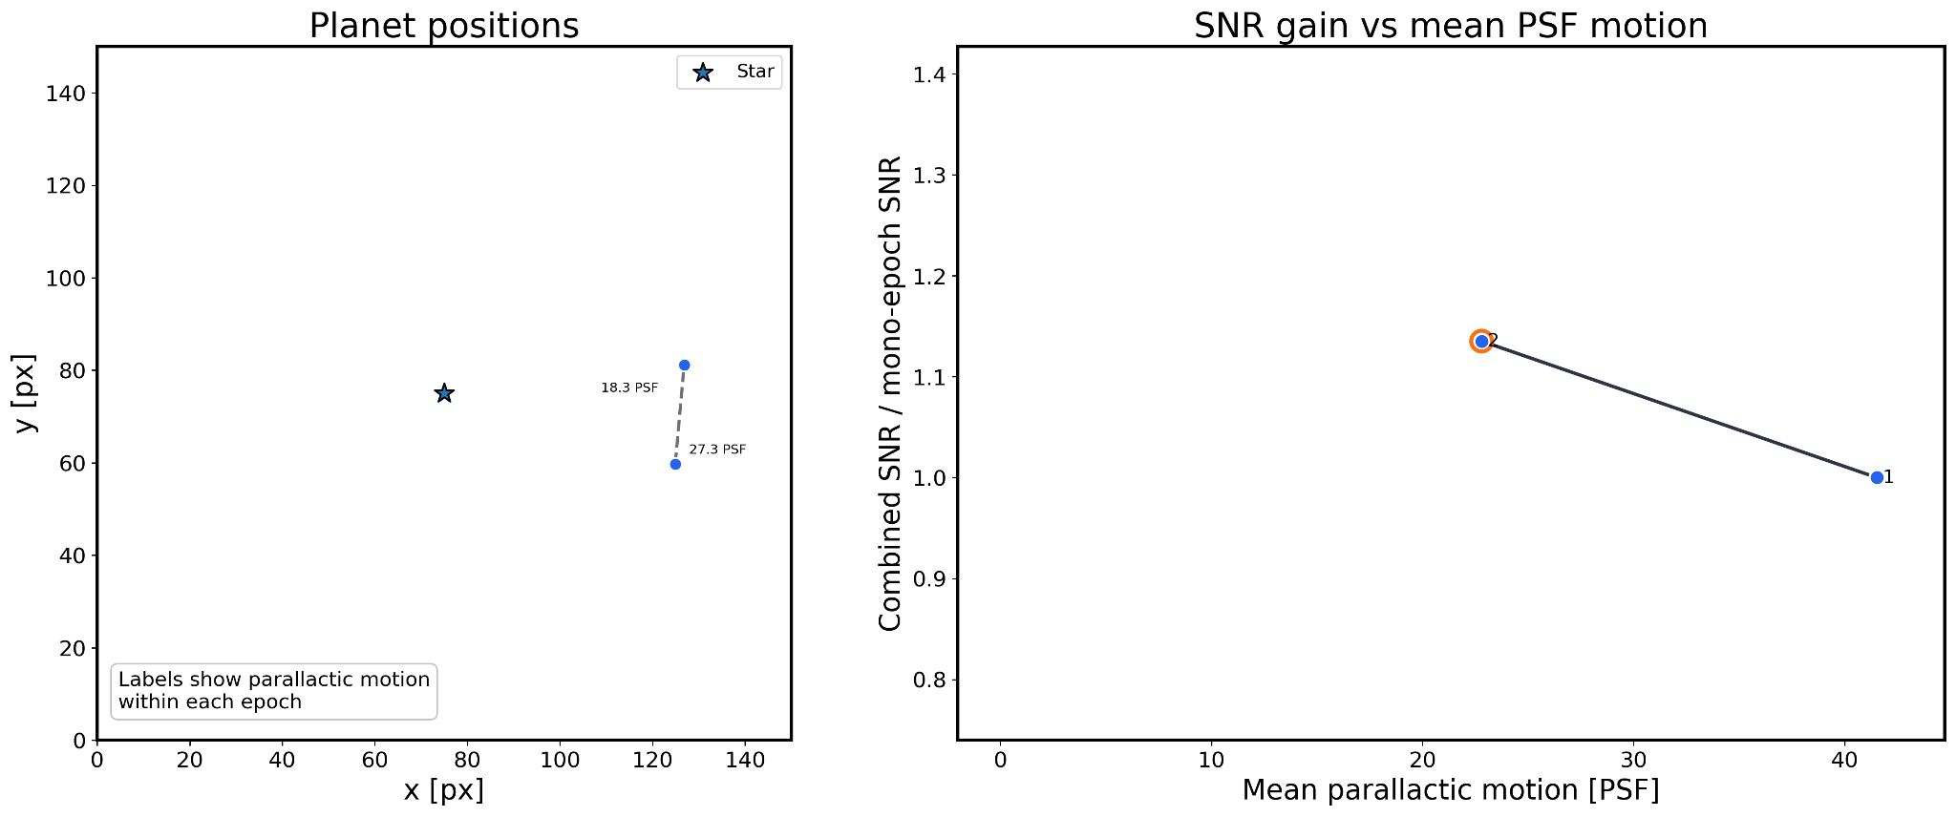
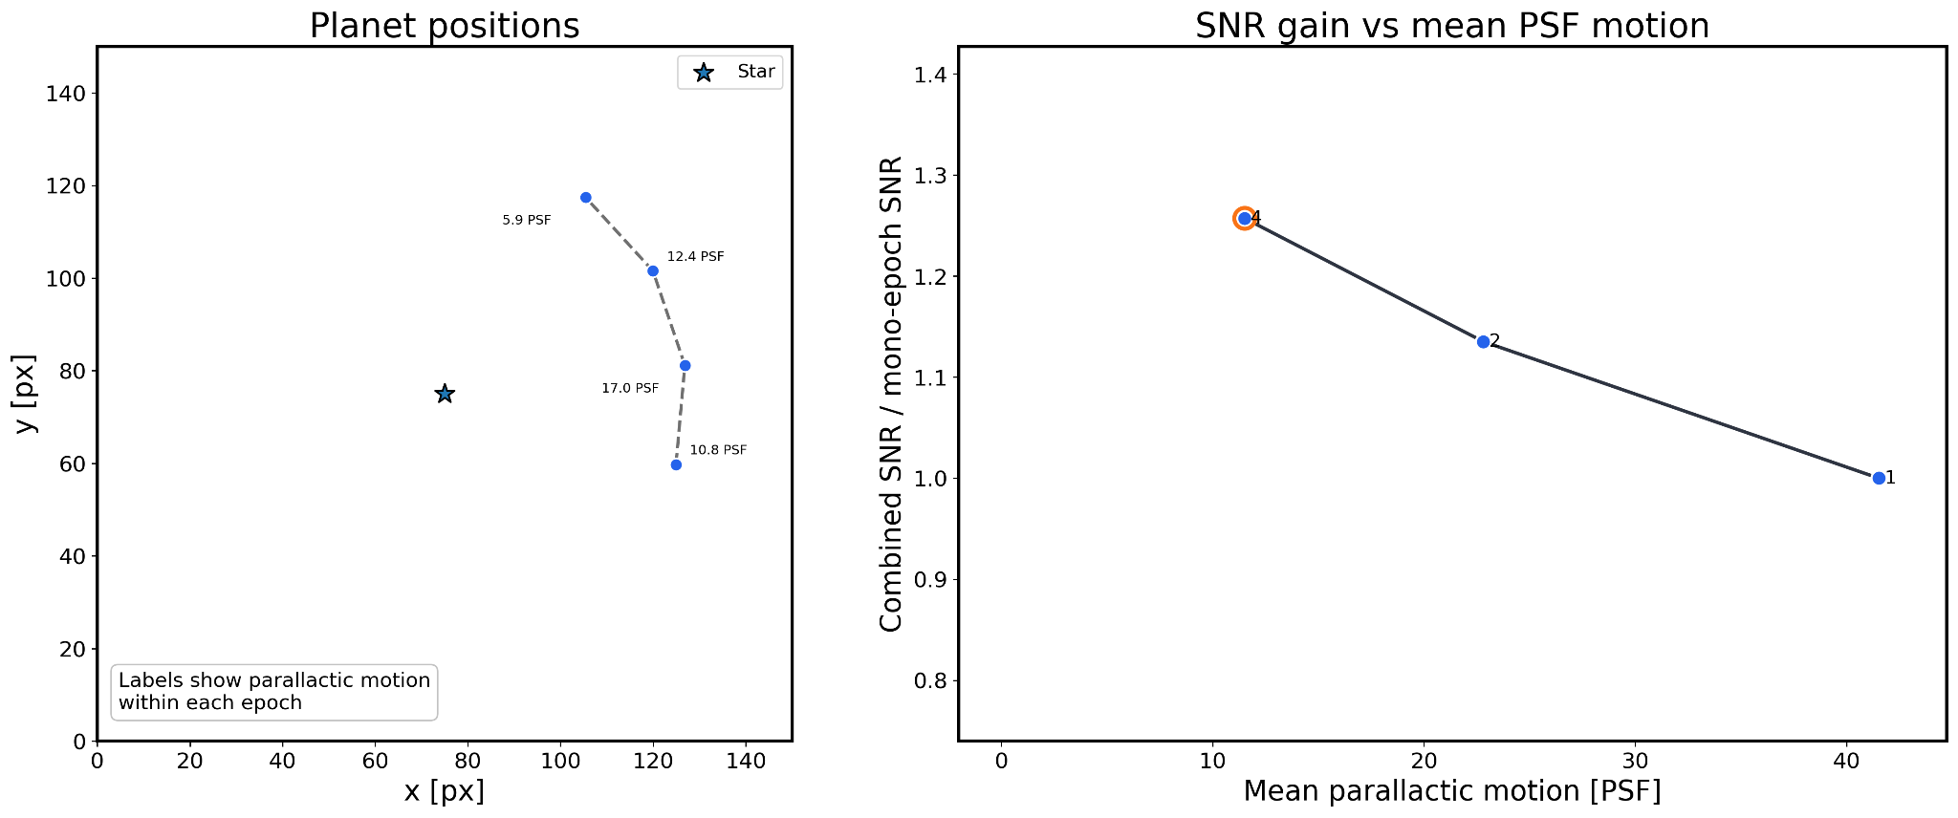
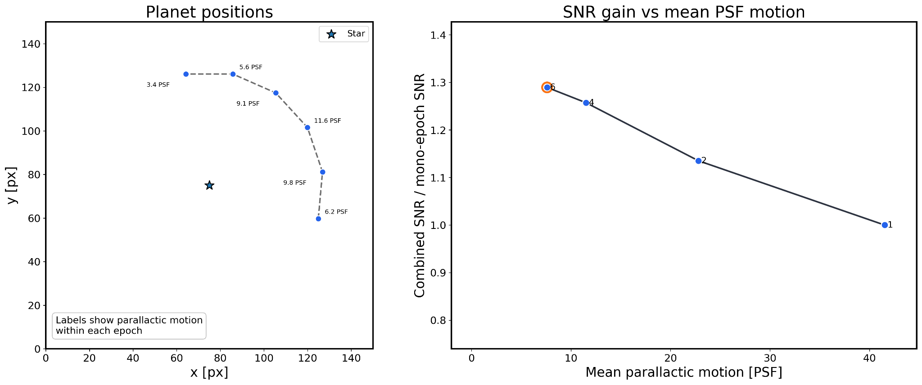
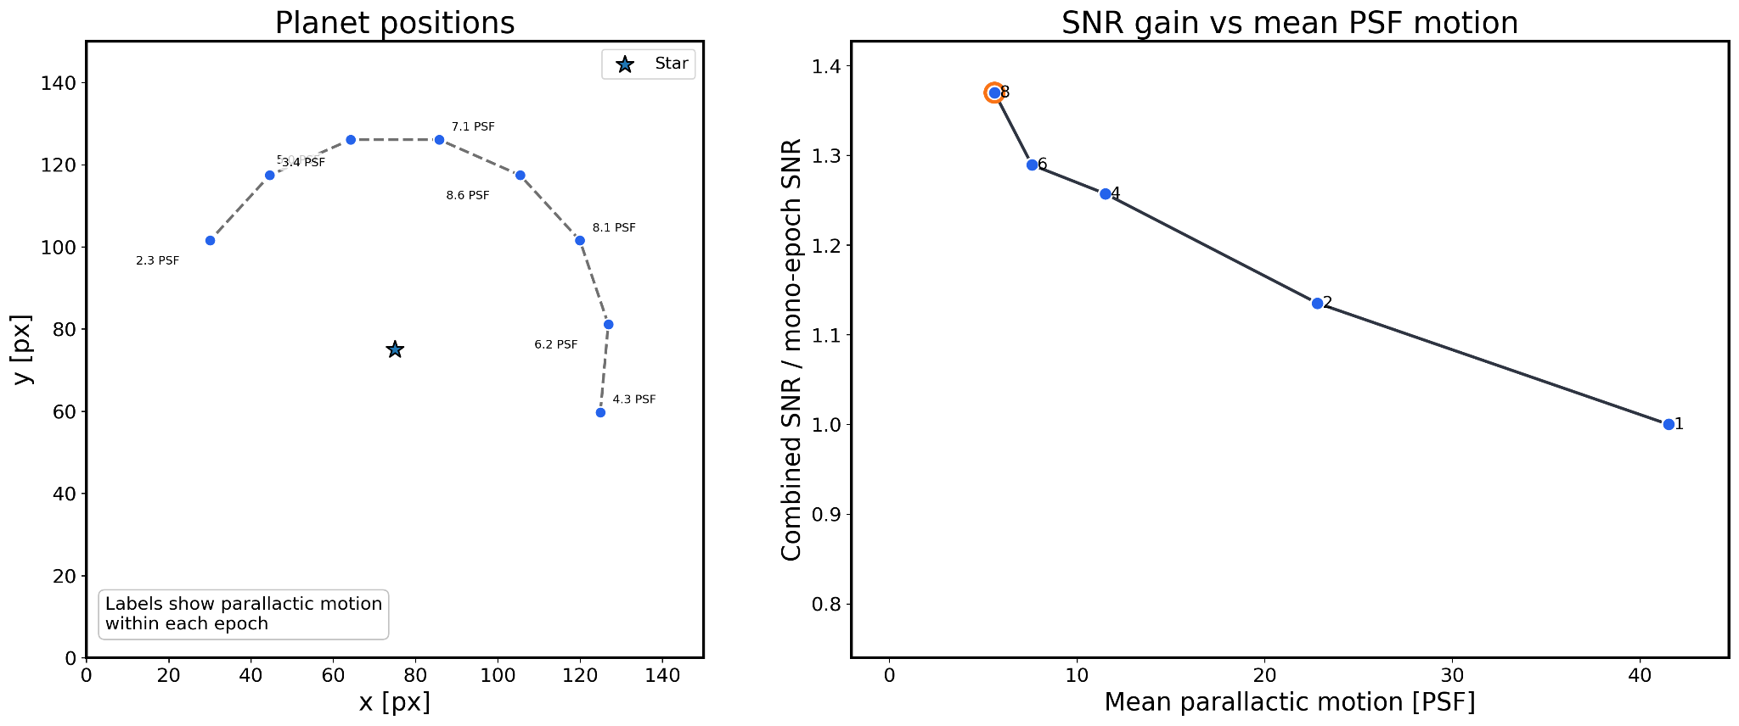
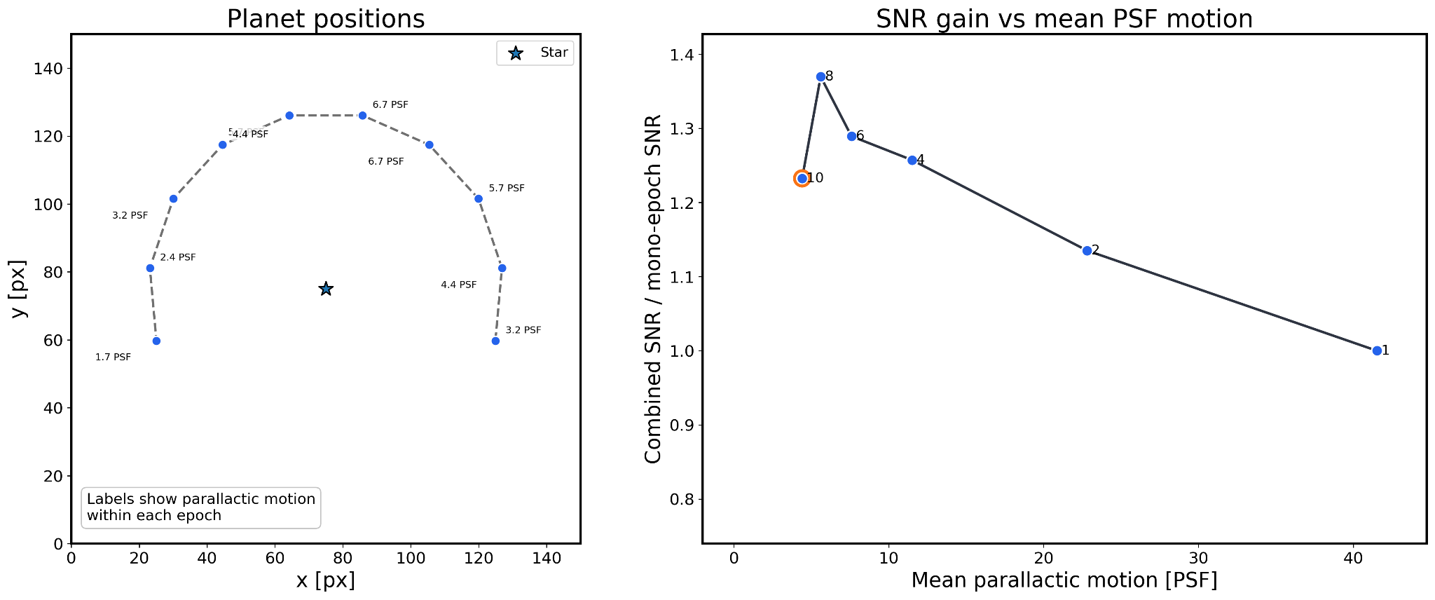
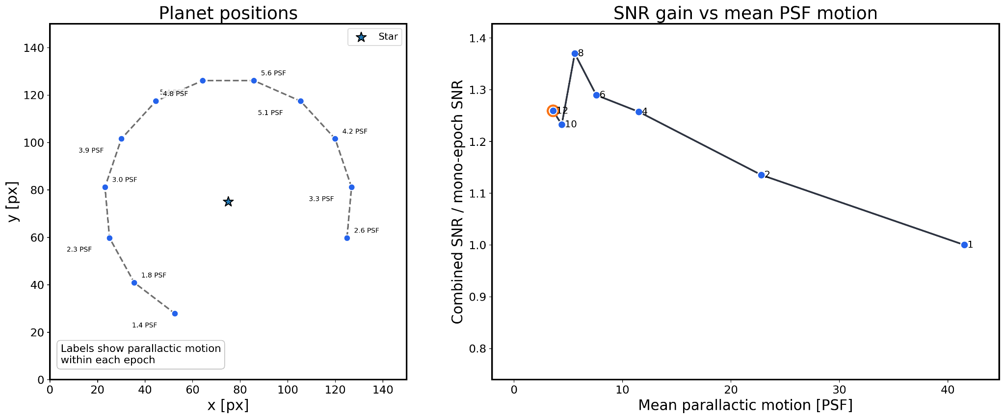
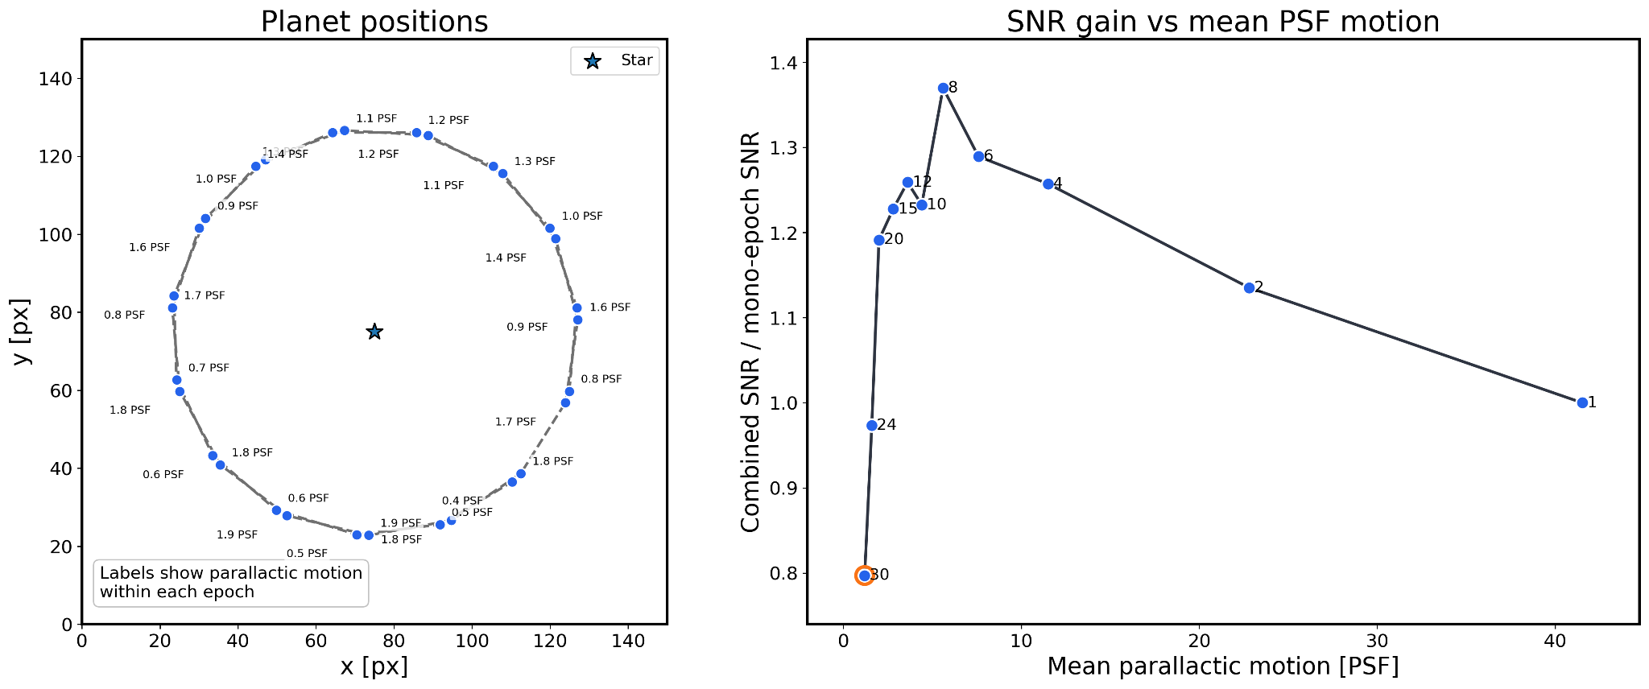
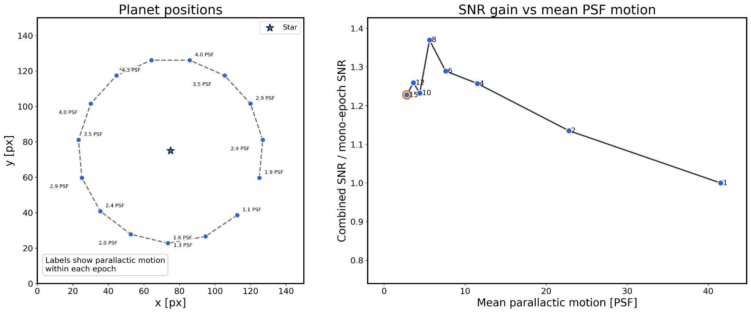
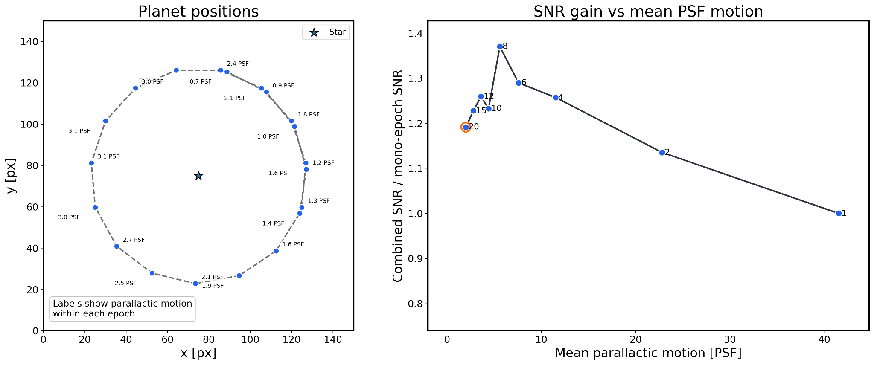
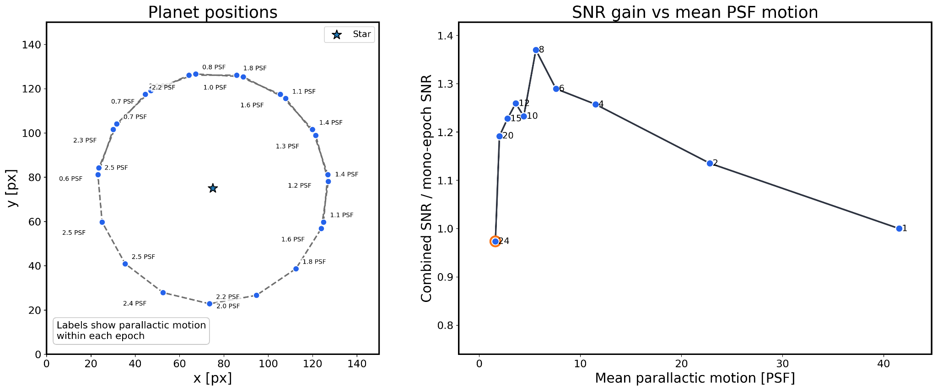
SF2A 2026 · Grenoble · Slide 11/22
Toy example: splitting fixed observing time
━━━━━━━━━━━━━━━━━━━━━━━━━━━━━━━━━━━━
Circular injected planet at 18 au • one epoch every 4 years • Δmag = 13
A
A
We can see the expected trade-off between the number of epochs and the PSF-scale motion within each epoch in this toy example

Slide 13
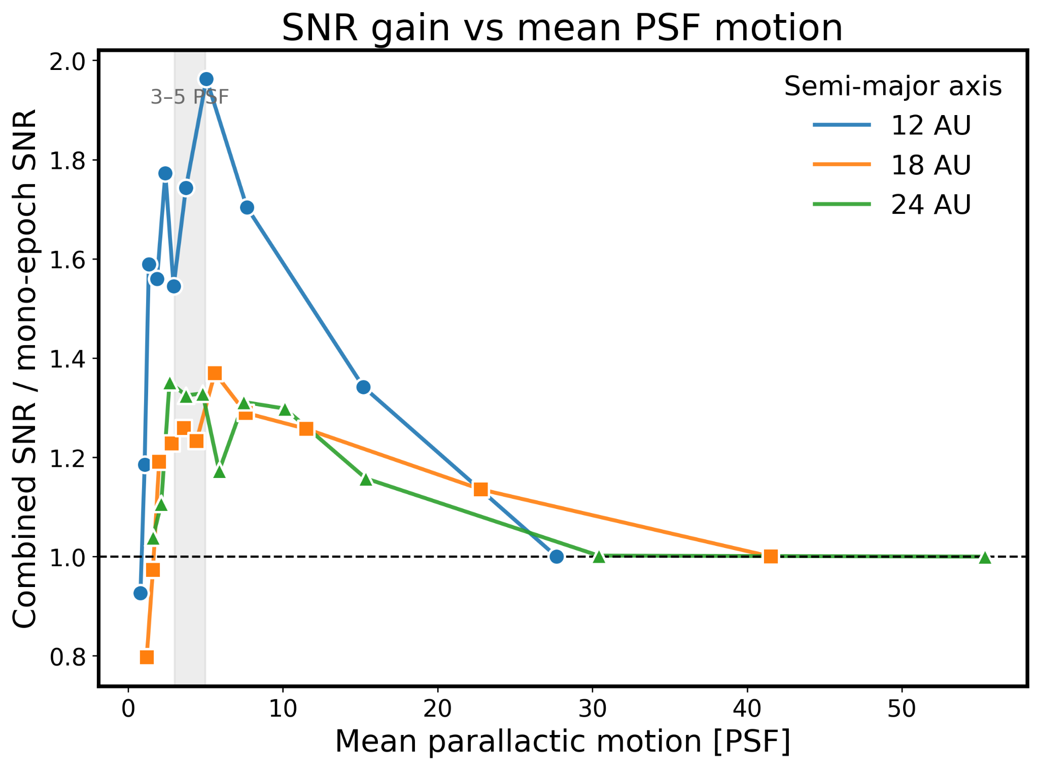
SF2A 2026 · Grenoble · Slide 11/22
Toy example: splitting fixed observing time
━━━━━━━━━━━━━━━━━━━━━━━━━━━━━━━━━━━━
A
A
We can see the expected trade-off between the number of epochs and the PSF-scale motion within each epoch in this toy example

Slide 14
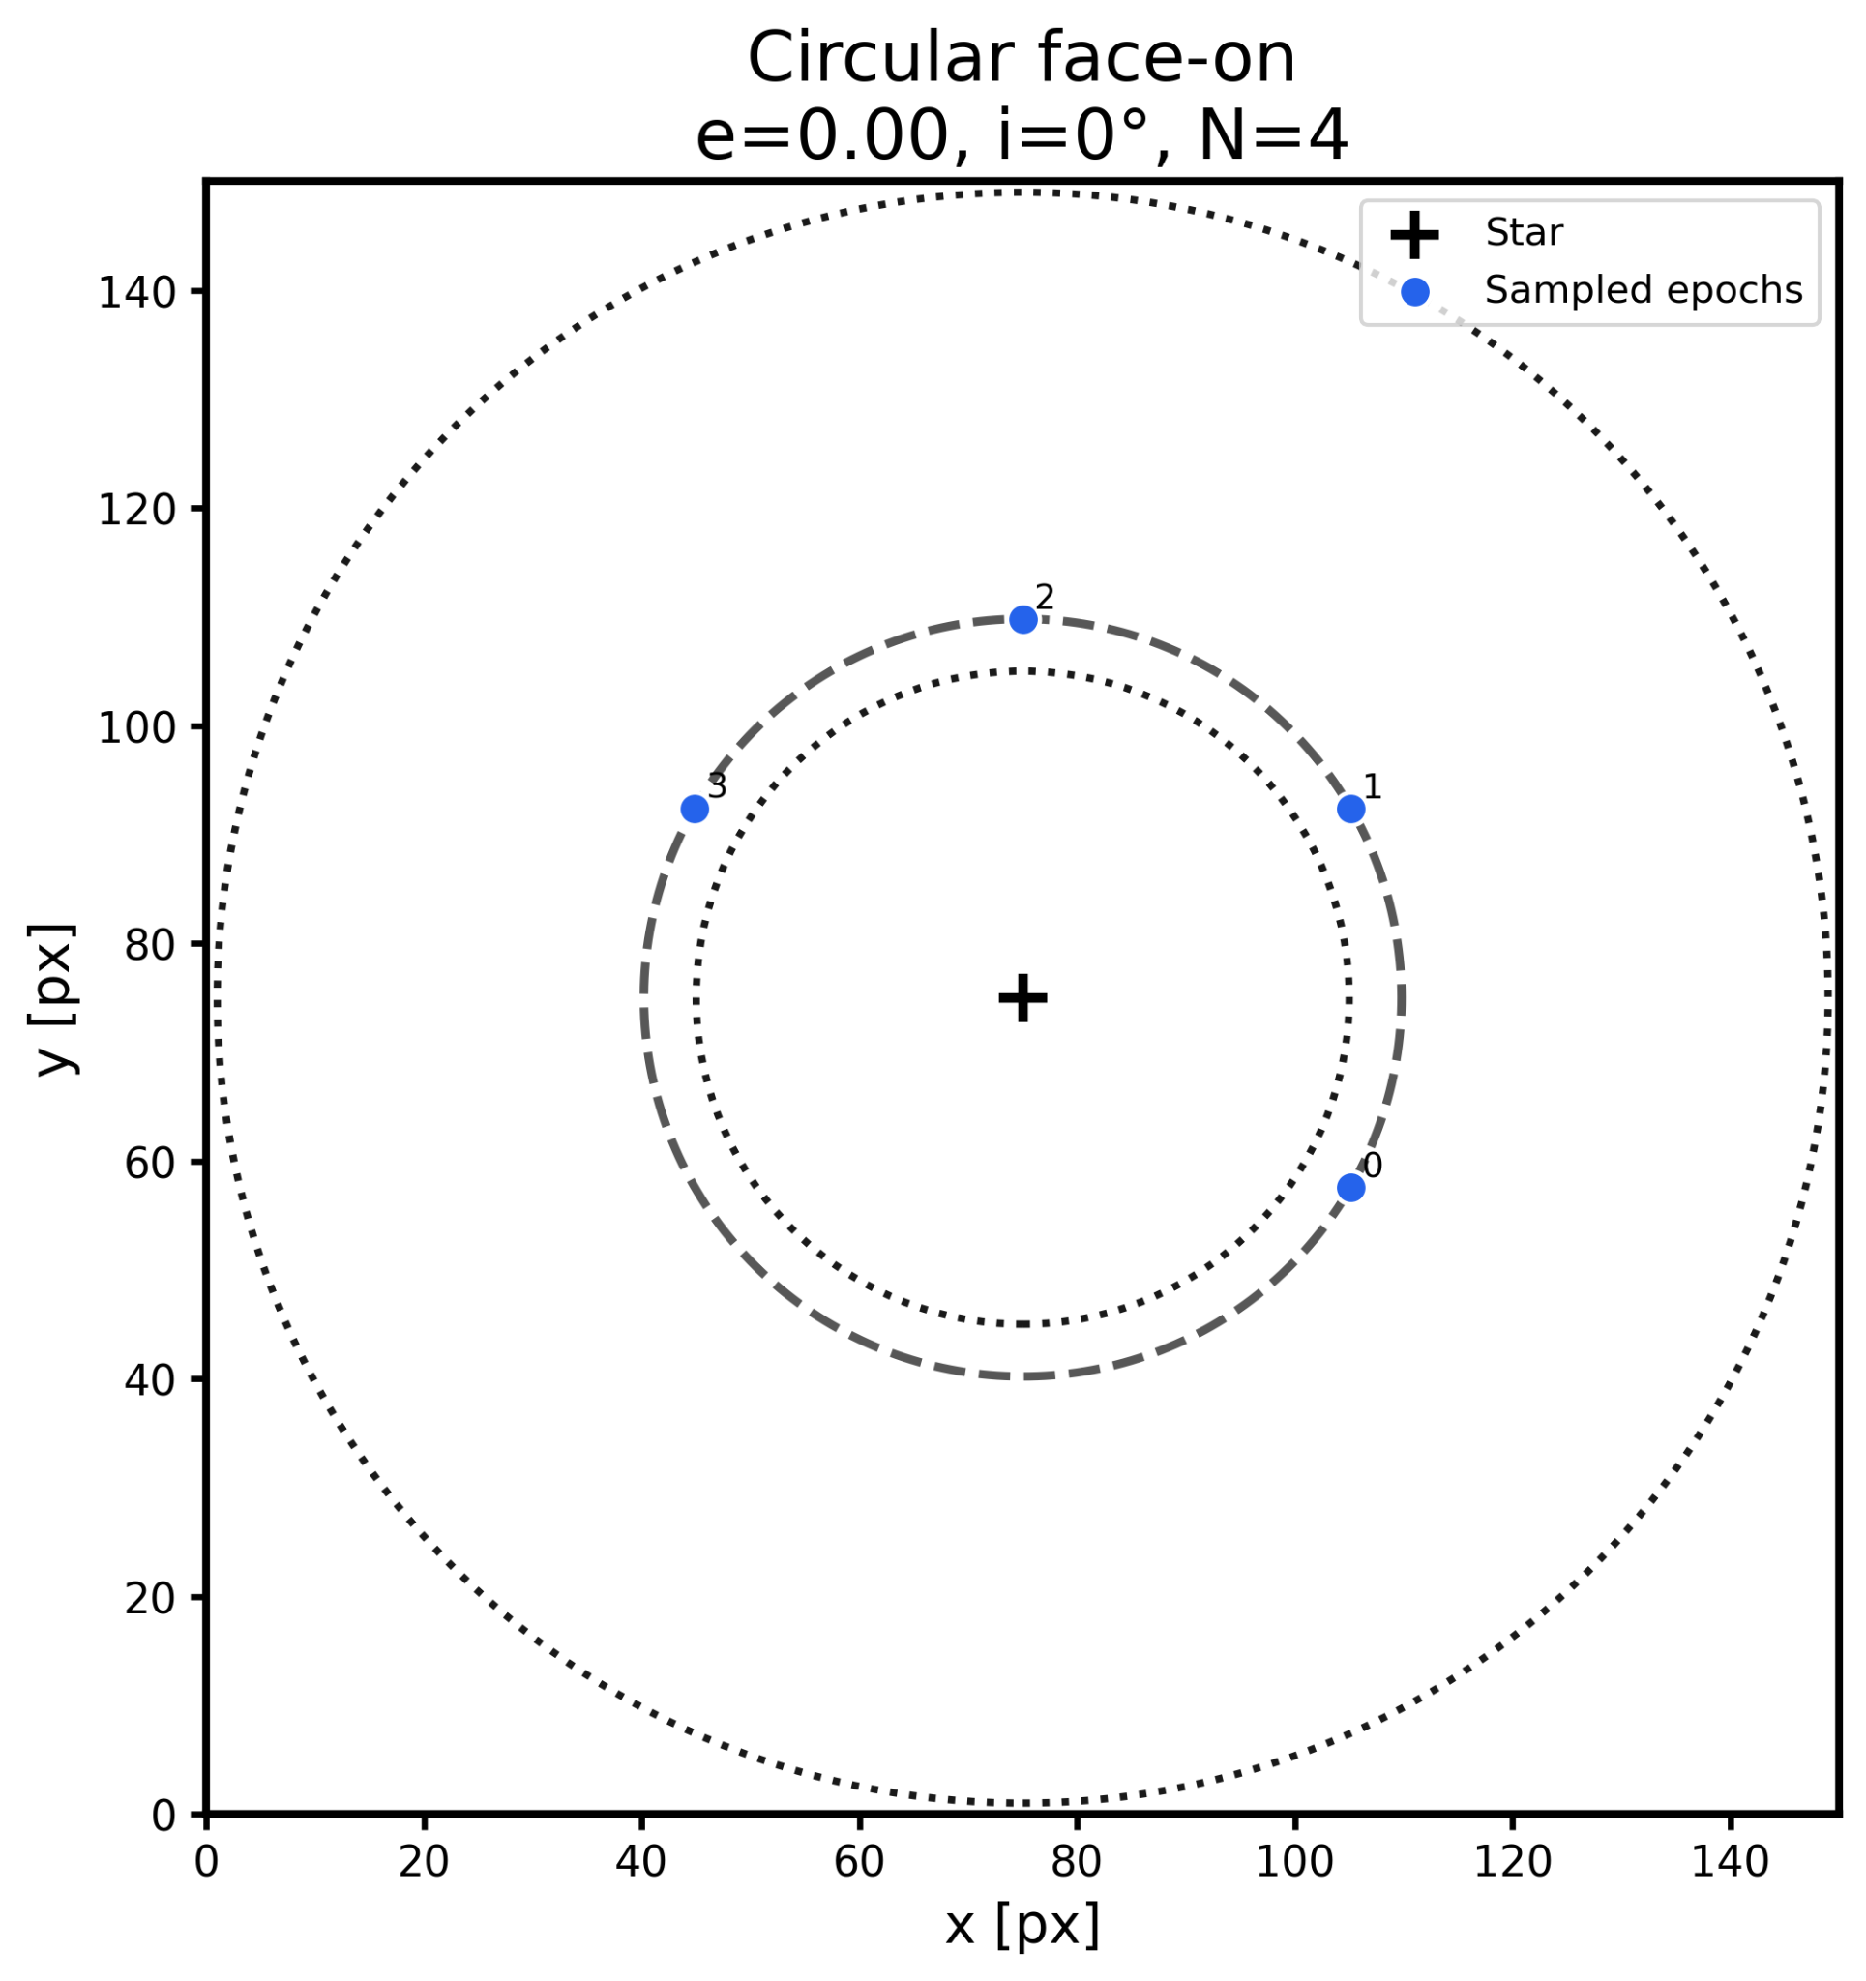
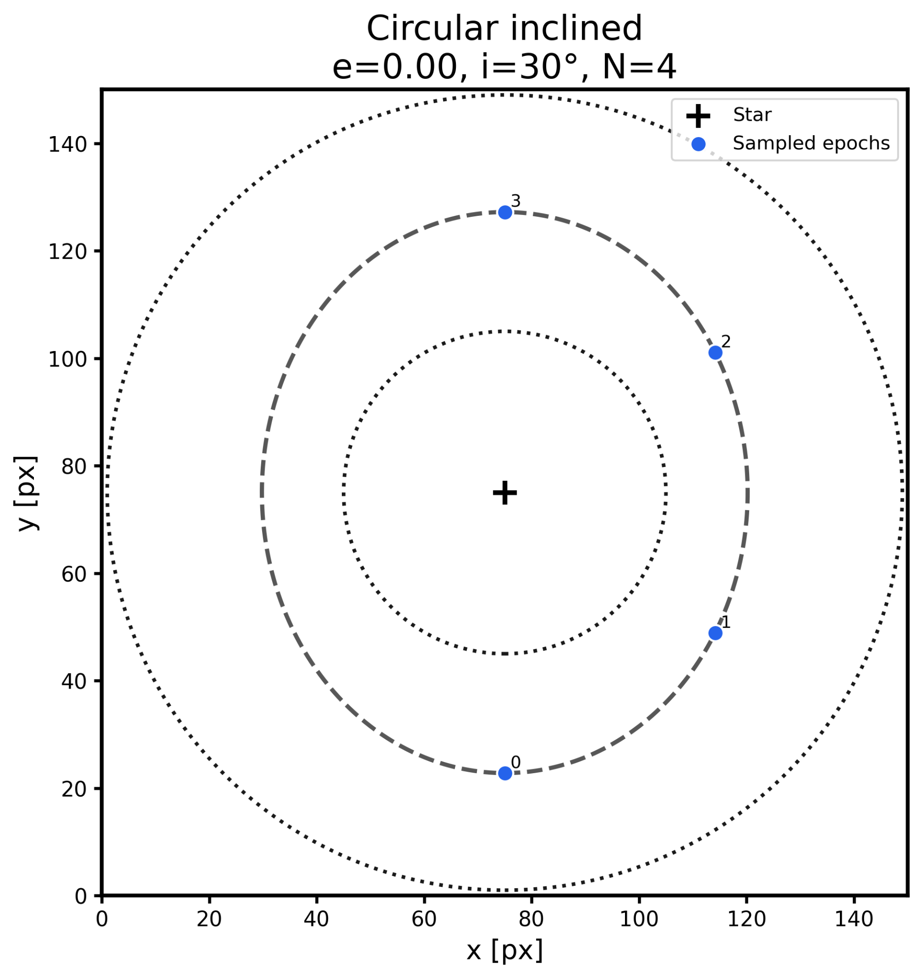
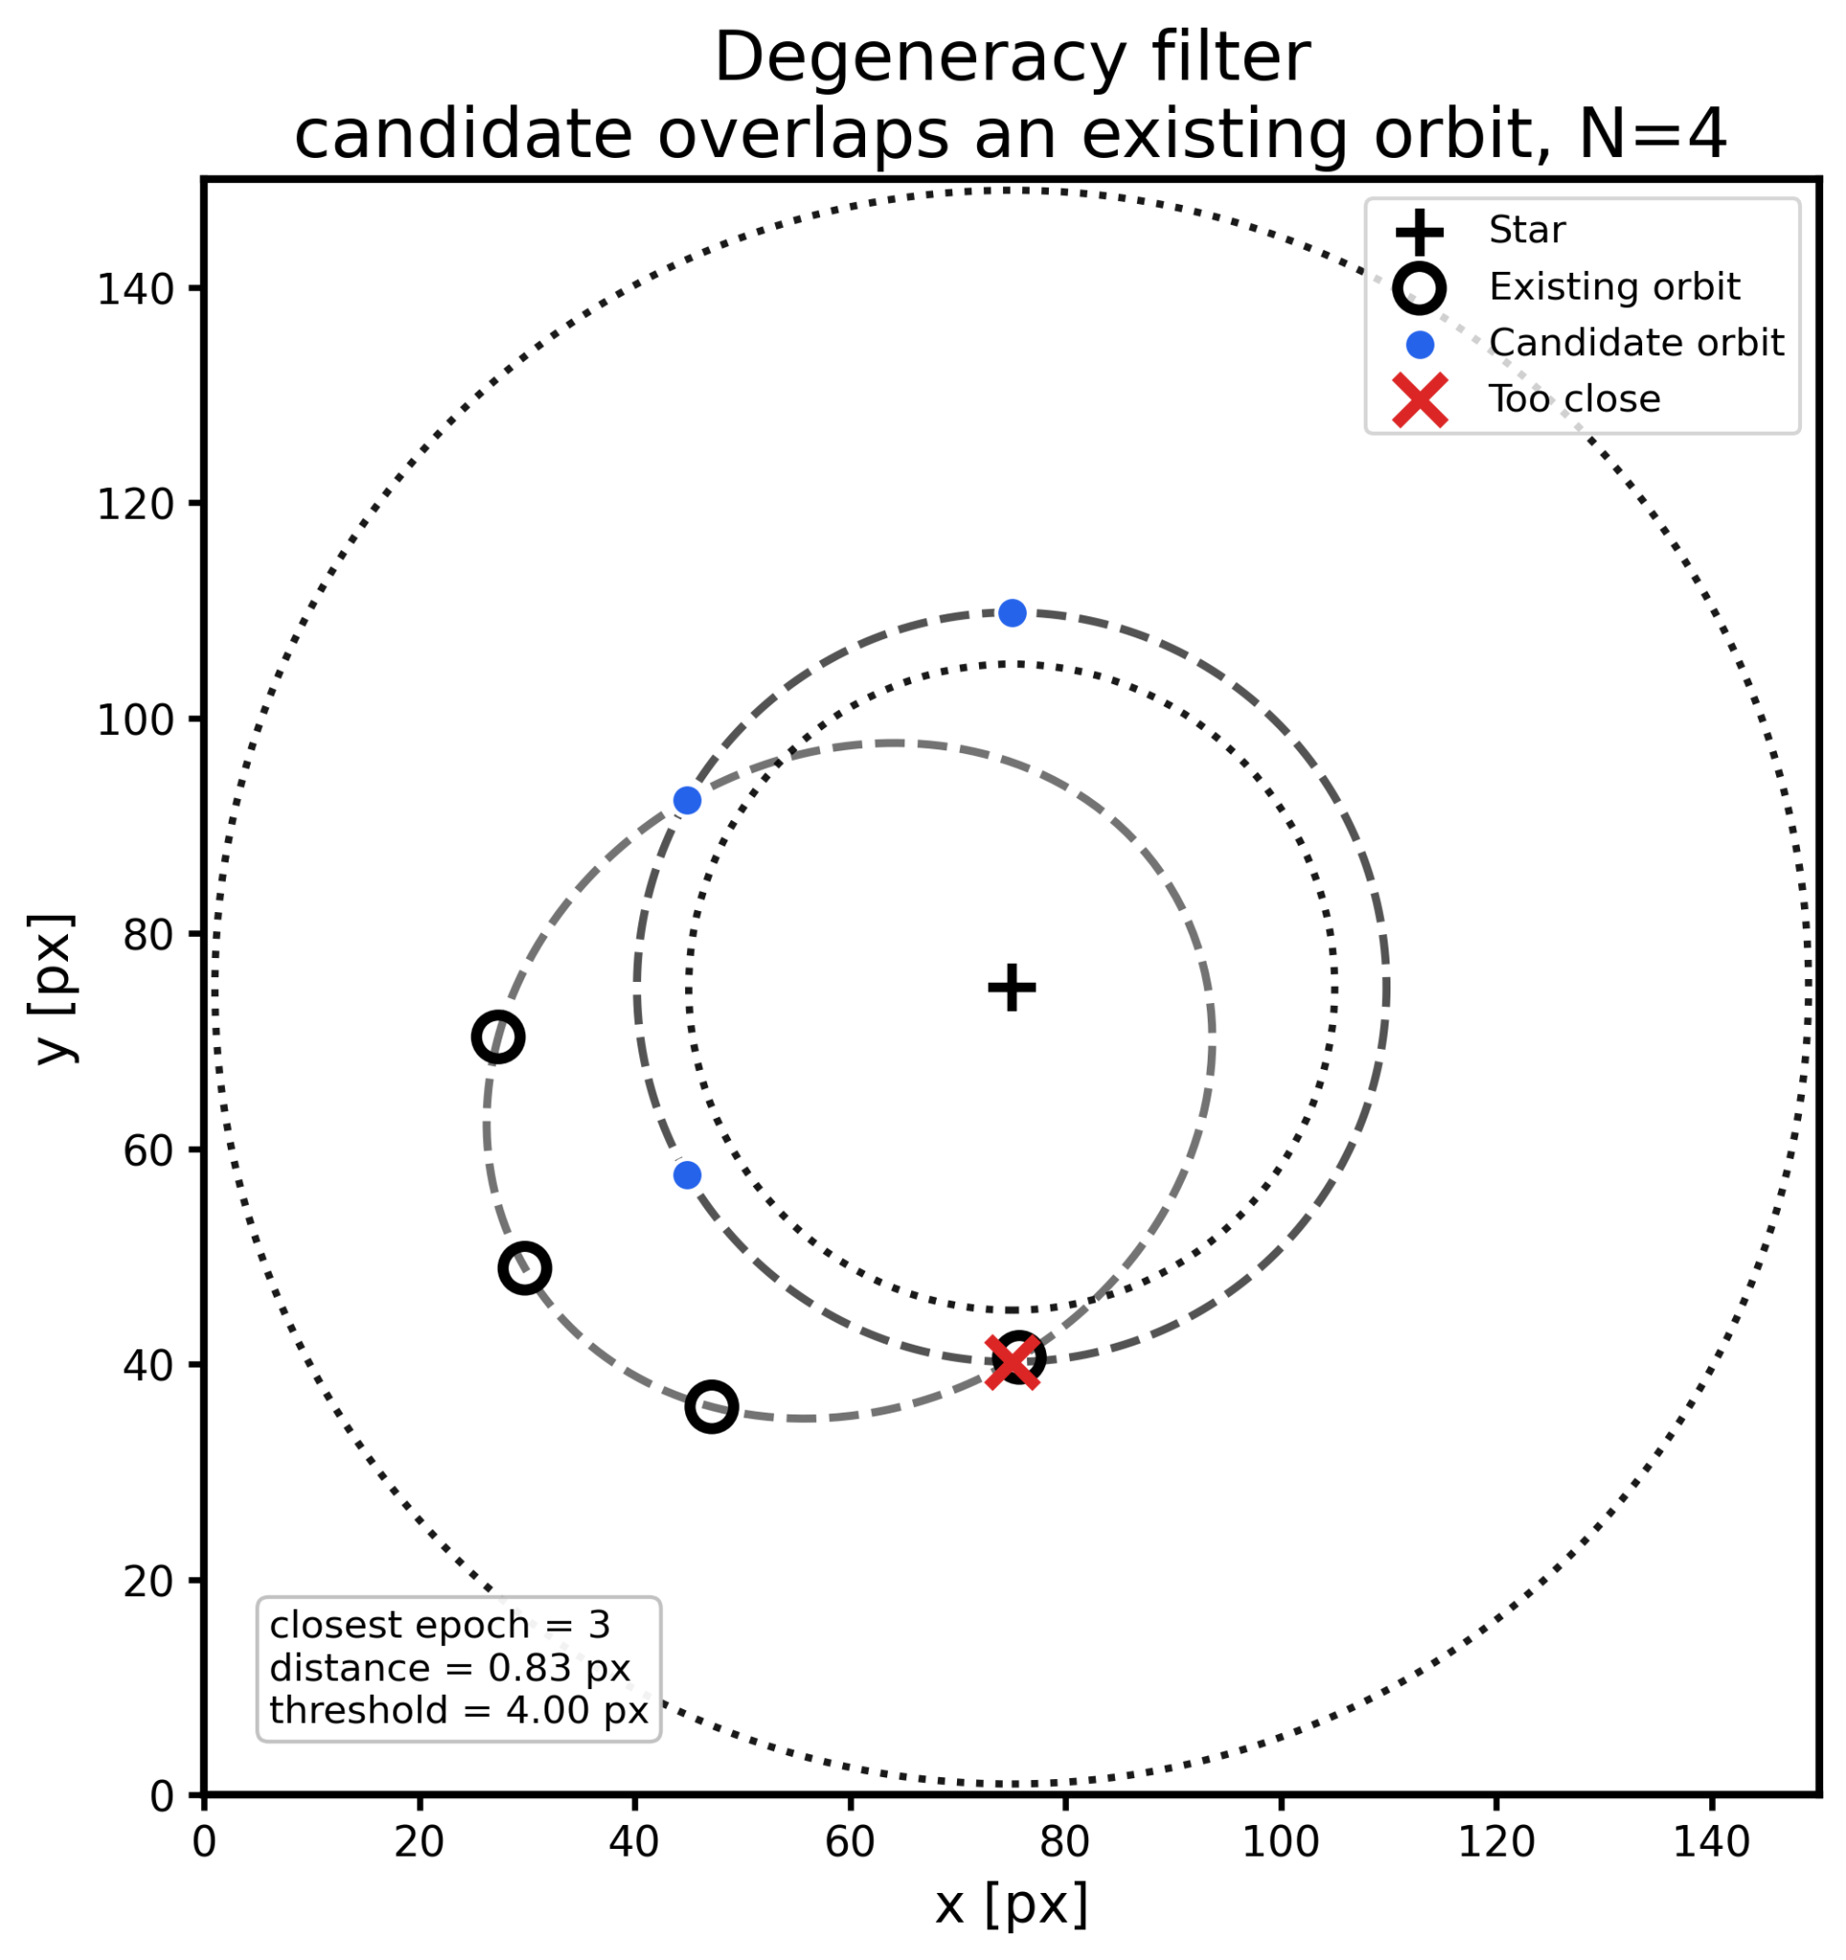
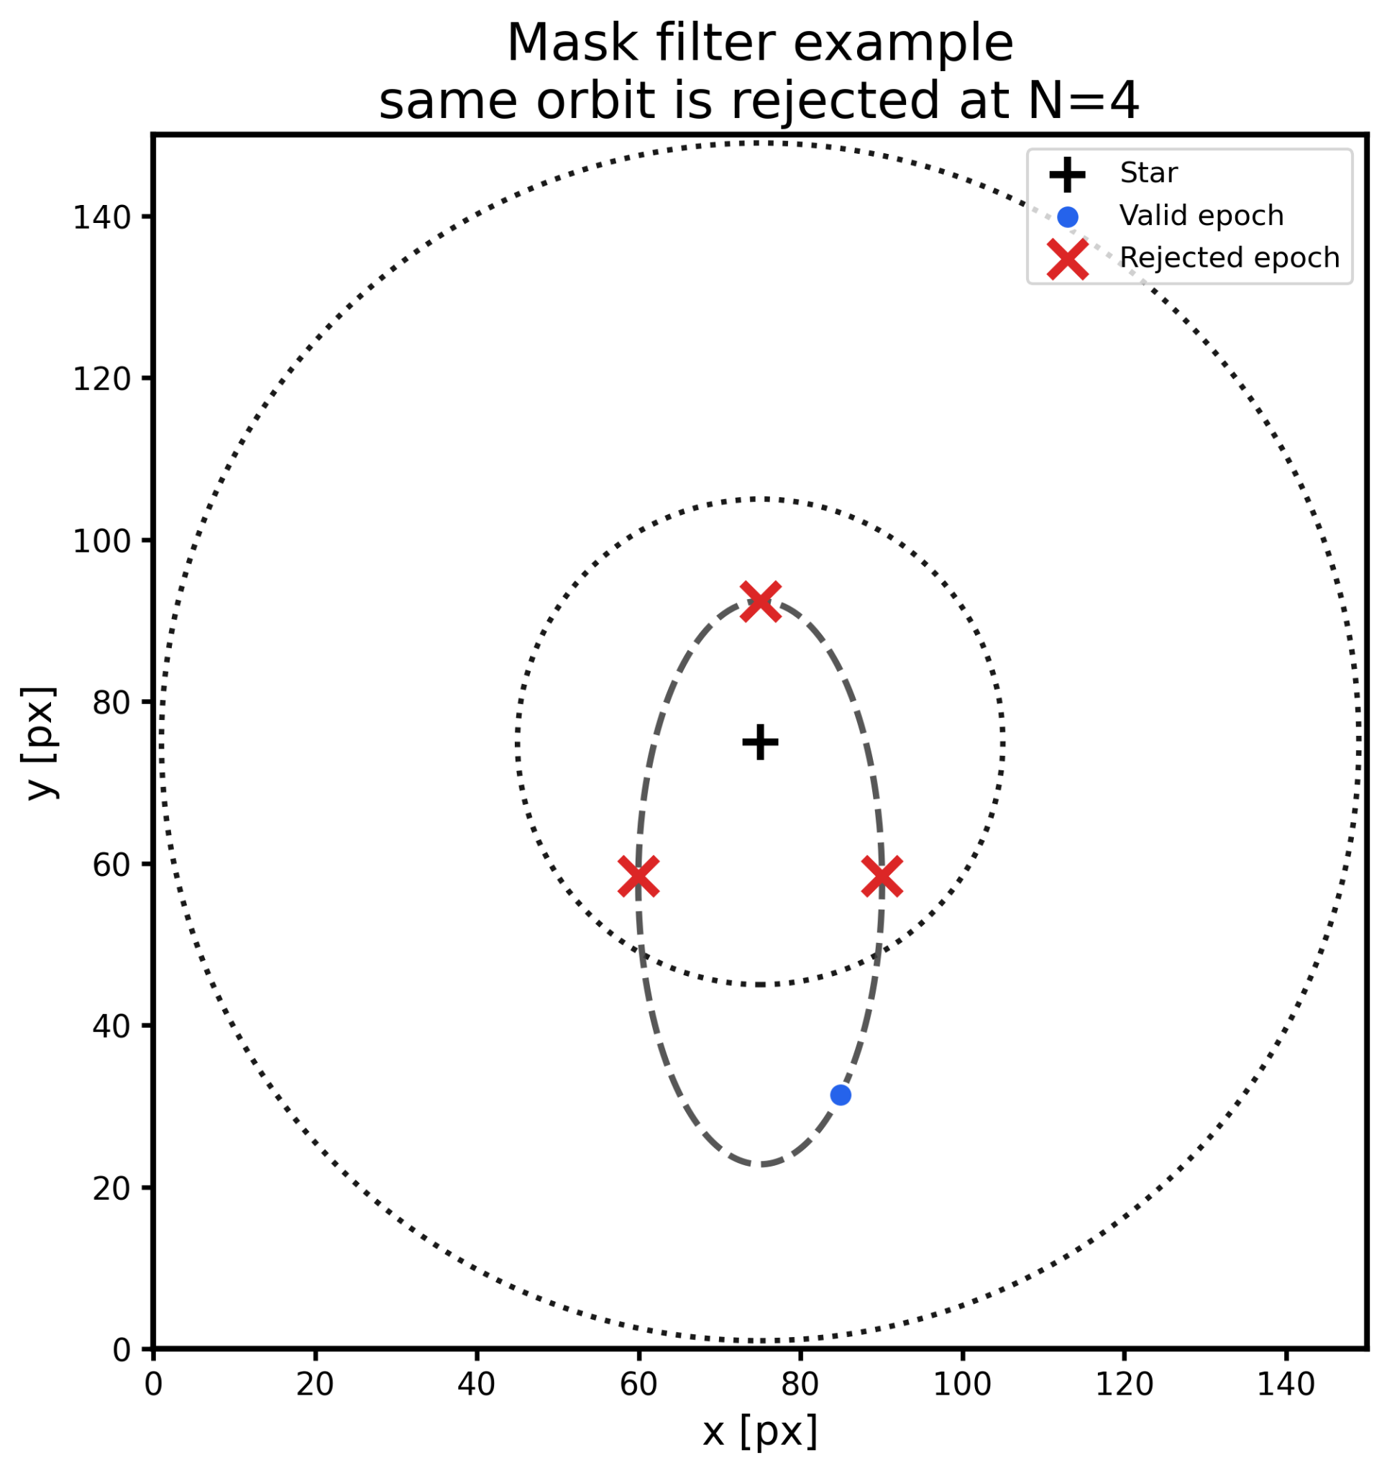
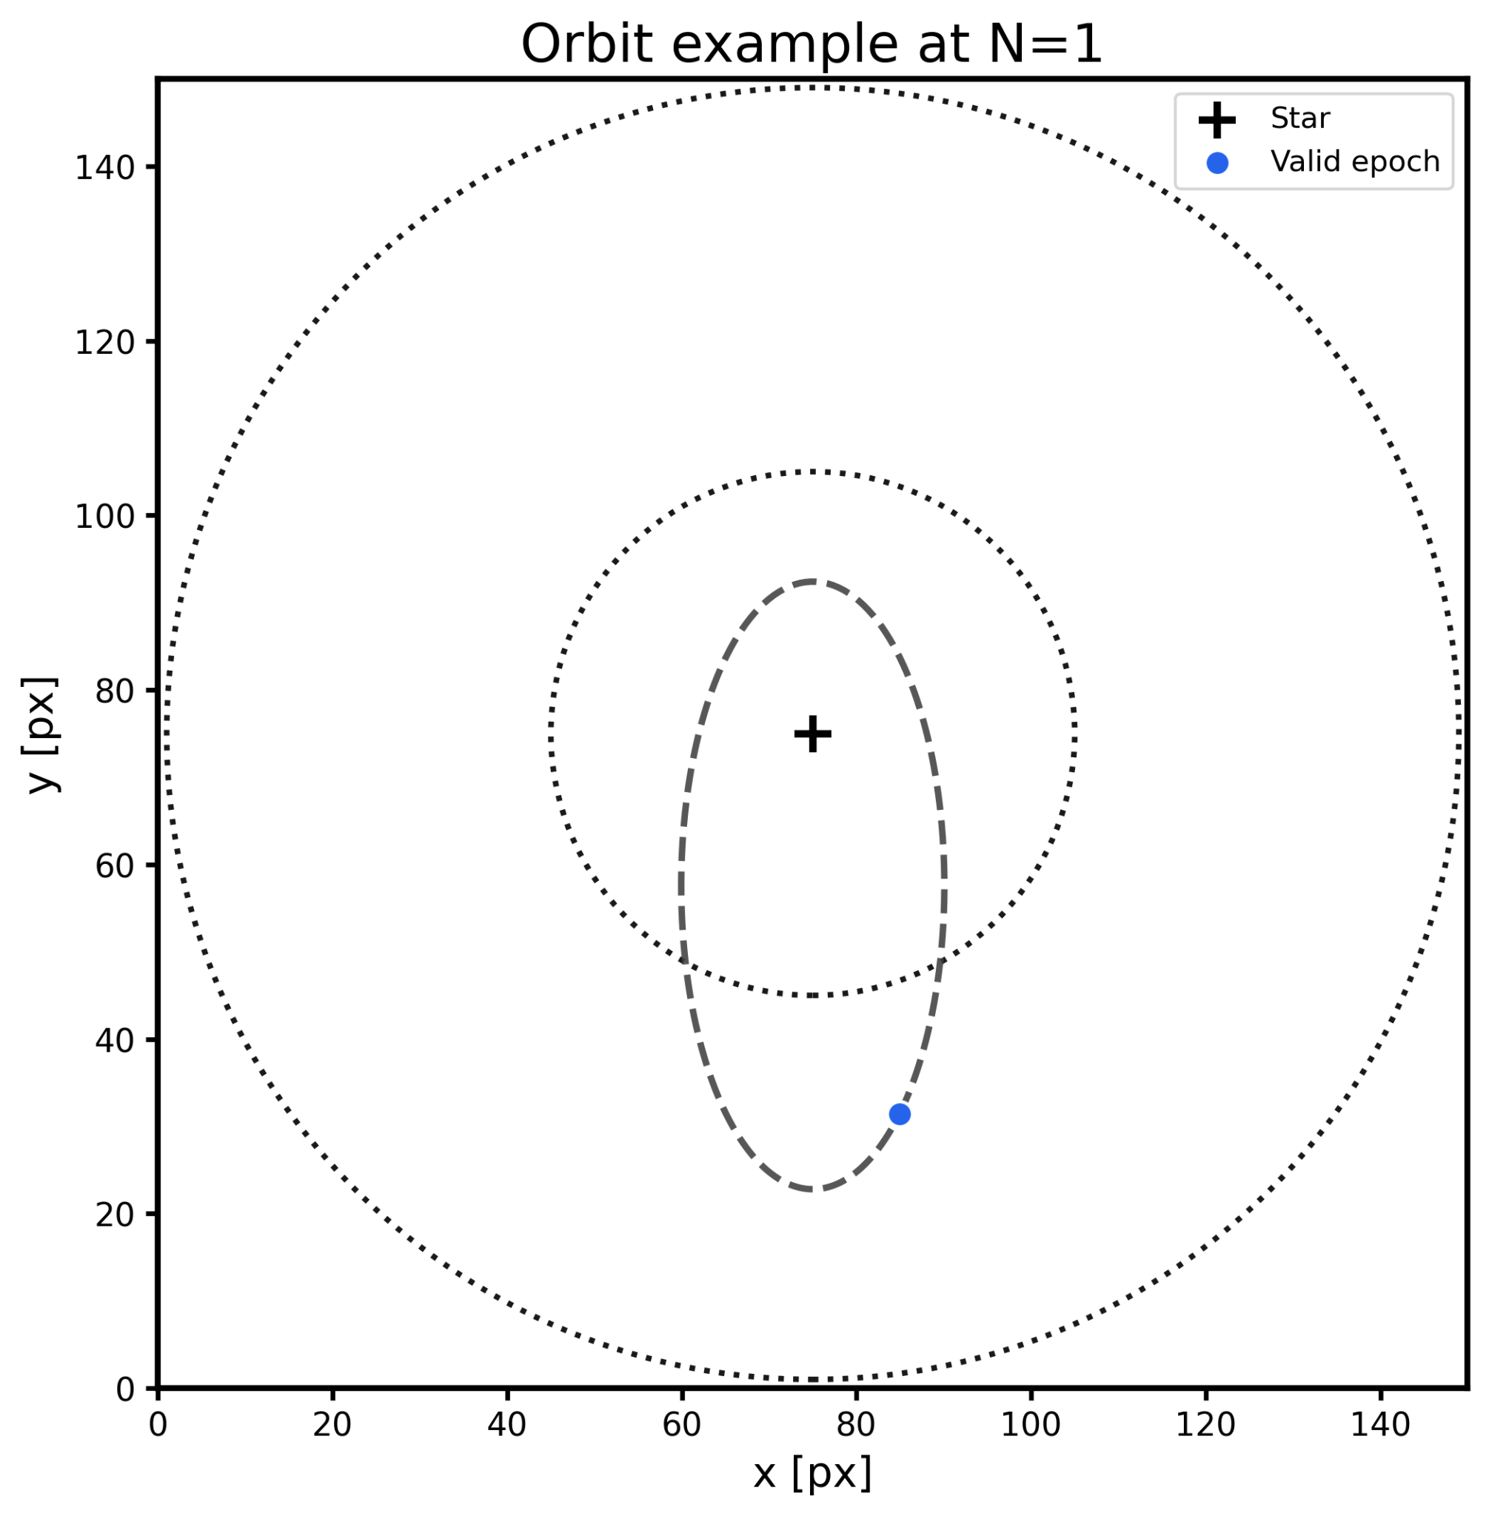
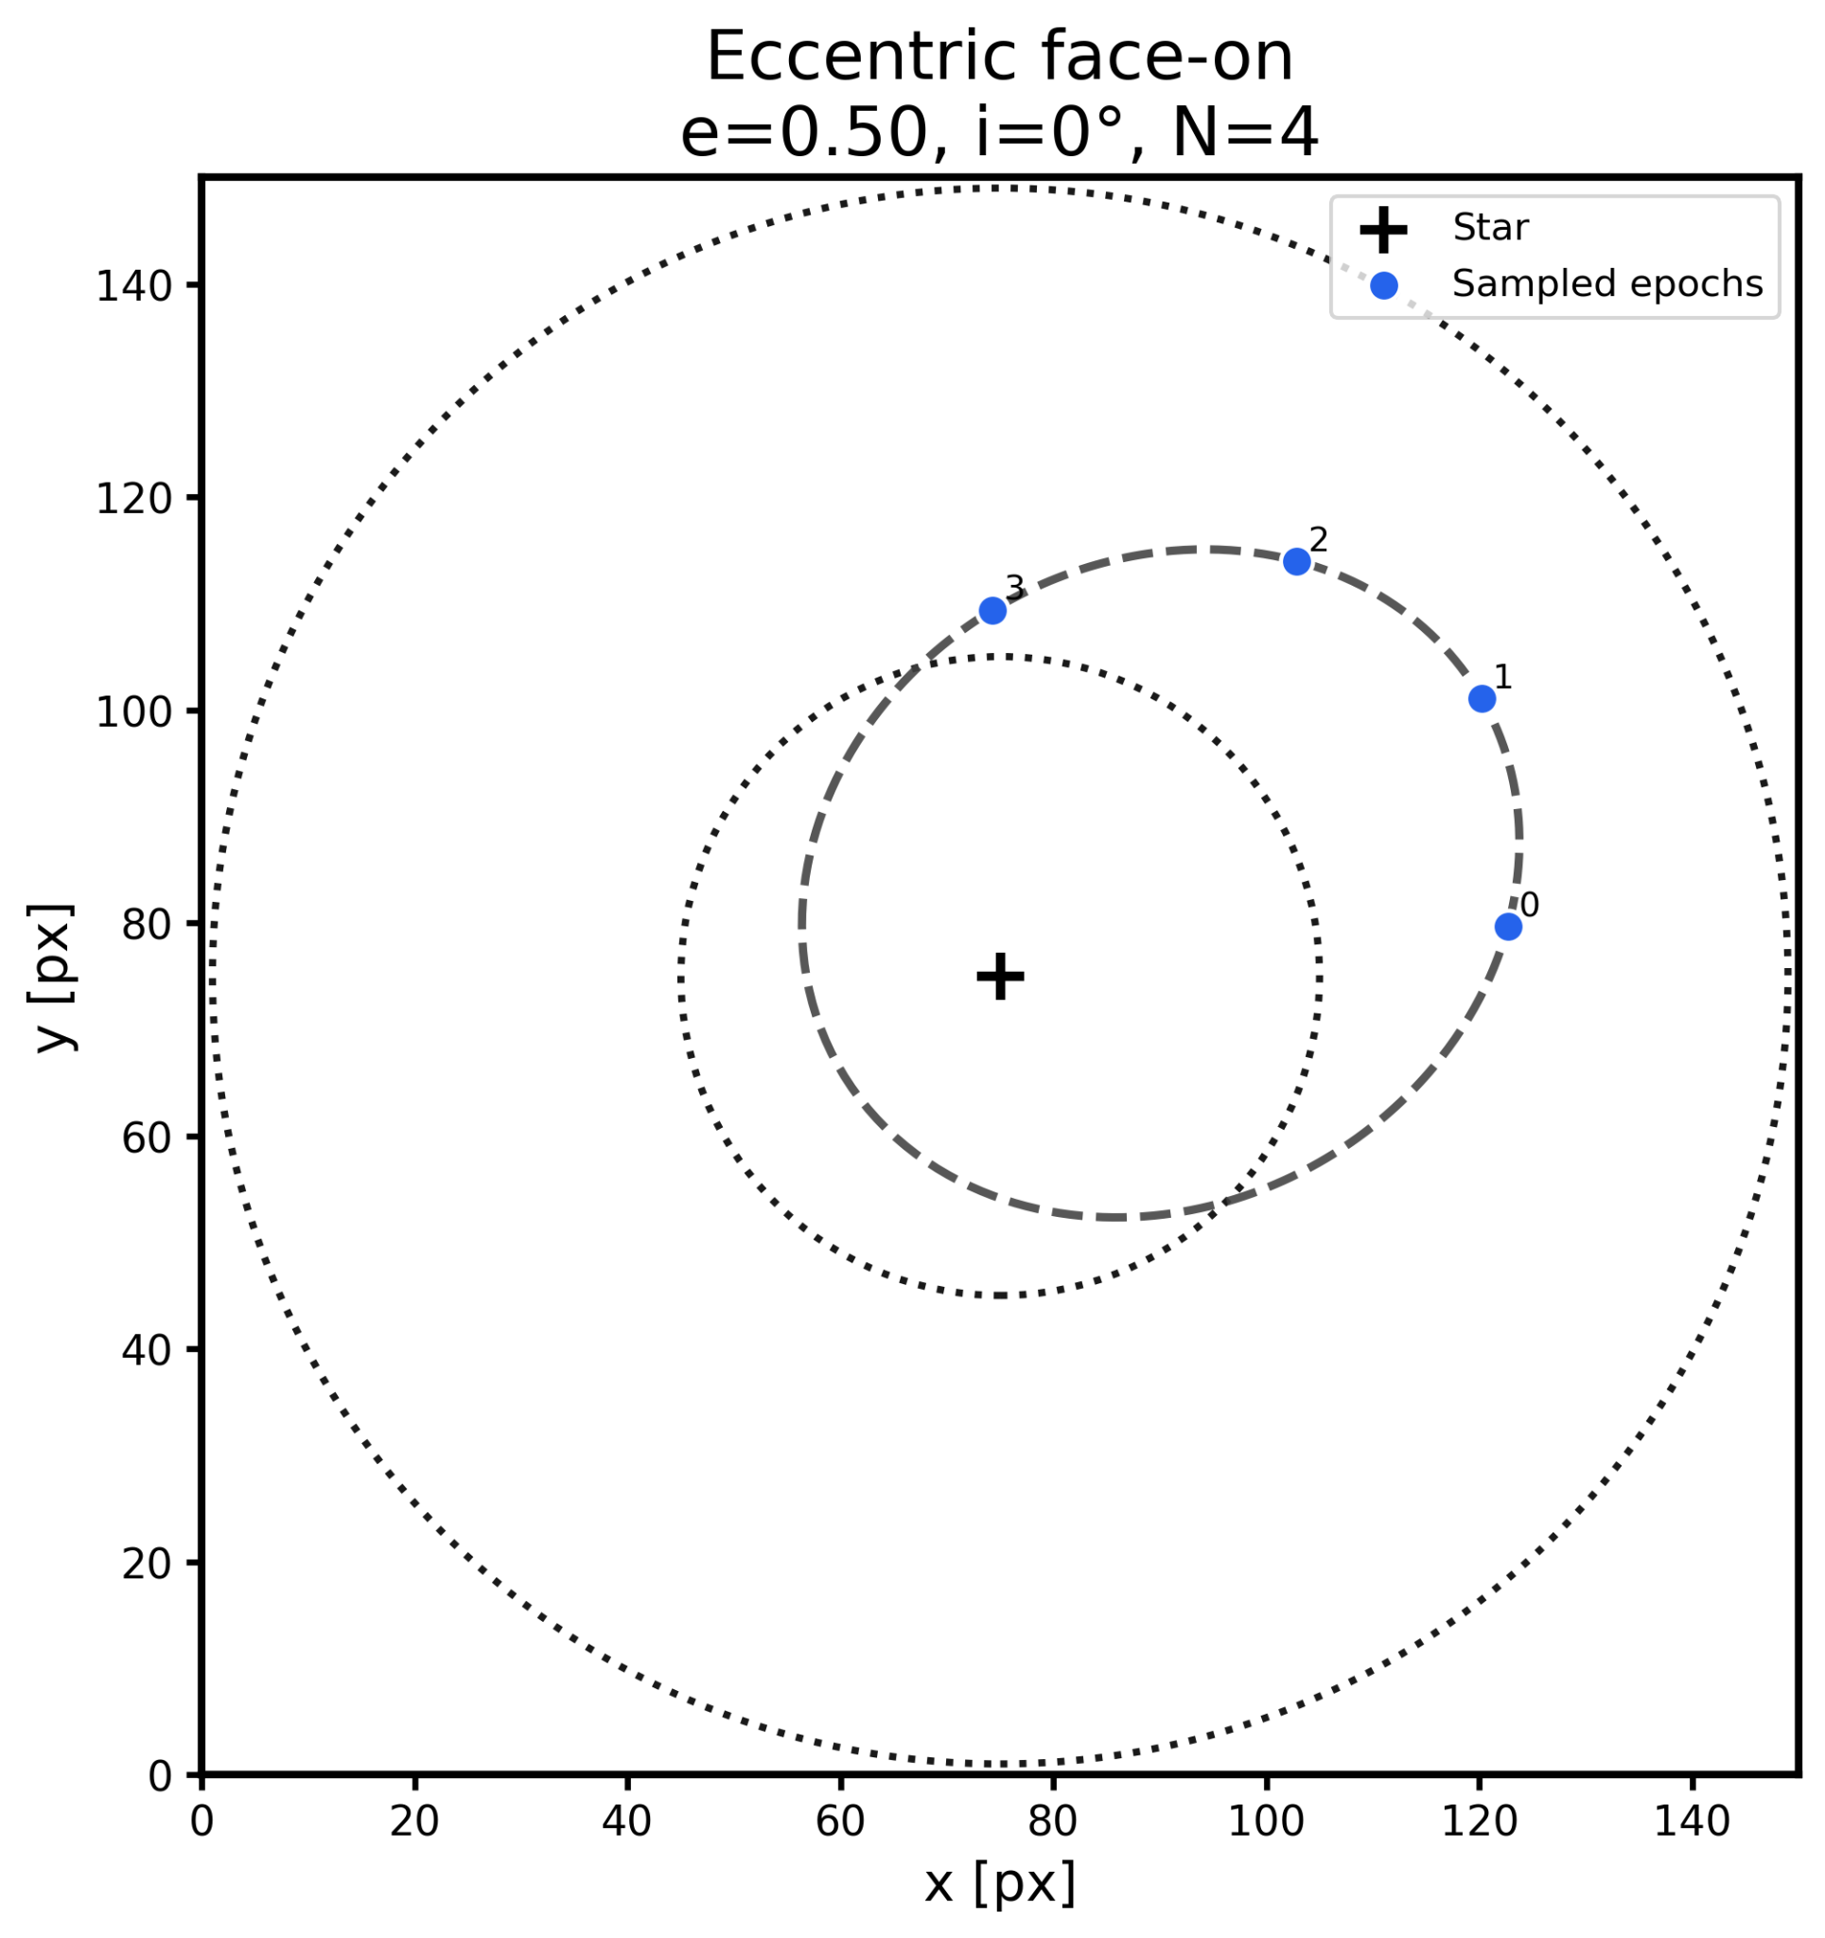
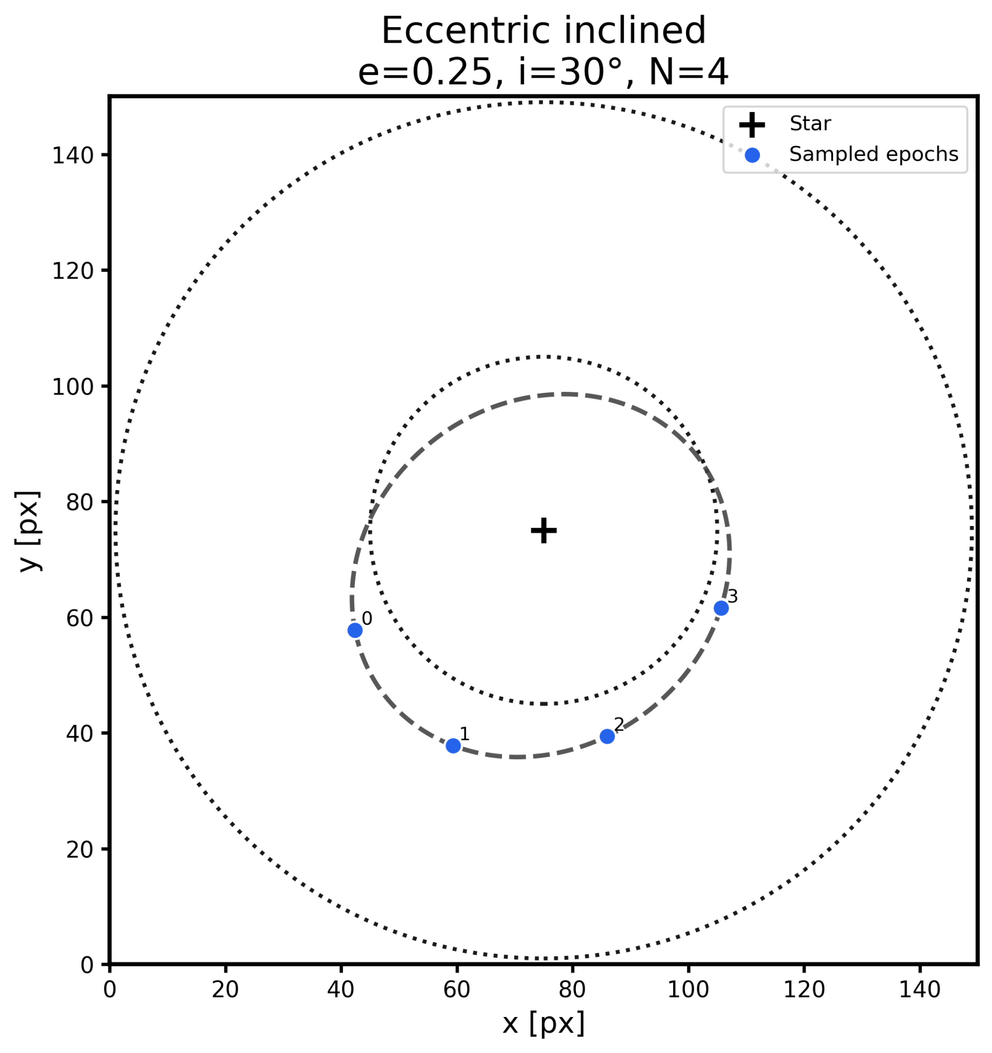
SF2A 2026 · Grenoble · Slide 12/22
Strategy test: building a representative orbit sample
━━━━━━━━━━━━━━━━━━━━━━━━━━━━━━━━━━━━
Goal: test whether the multi-epoch gain survives beyond one favorable orbit
Dense orbit library
A
Physical parameters
A
a = 12, 18, 24 au
e = 0, 0.25, 0.5
Angular grids
Ω: 6 values
ω: 6 values
M₀: 12 values
evenly space from 0 to 2π
Epoch sampling
Nepochs = 1, 4
t ∈ [0, P/2]
equal spacing for N > 1
11,664 candidate orbits
Filtering selections
Stage
Criterion
Removed
Kept
Start
0
11,664
Filter 1
Not outside mask for all tested epochs
7,536
4,128
Filter 2
Strict non-degeneracy (~2 PSF)
4,062
66
Filter 3
Final balanced selection
18
48

Slide 15
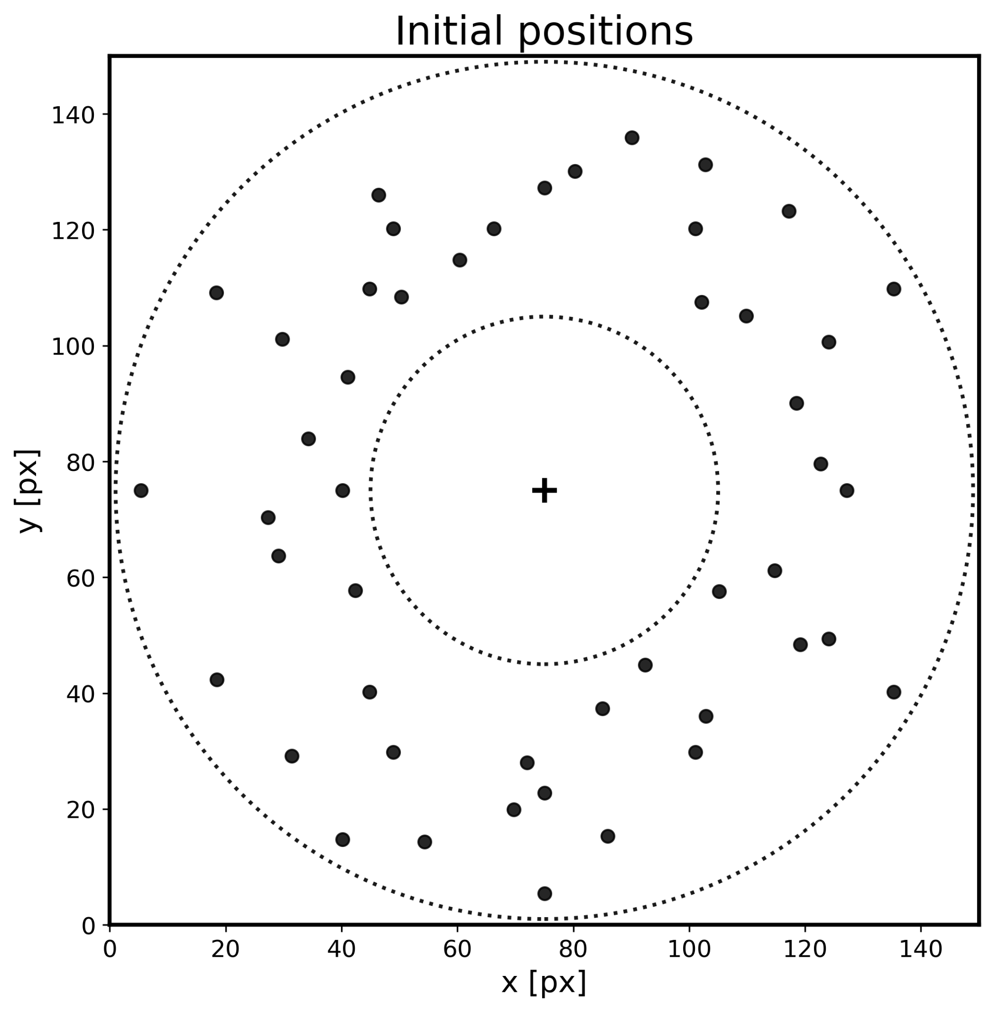
SF2A 2026 · Grenoble · Slide 13/22
Strategy test: building a representative orbit sample
━━━━━━━━━━━━━━━━━━━━━━━━━━━━━━━━━━━━
Initial injected positions are well spread across the detector.
48 orbits
12 per class
well spread
The sample covers a broad range of projected detector positions.
Each orbit family remains observable and sufficiently distinct from the others.
Next step
For each orbit, we now compare the multi-epoch combined SNR at the injected positions against the single-epoch case

Slide 16


SF2A 2026 · Grenoble · Slide 14/22
Result: multi-epoch gain across the detector
━━━━━━━━━━━━━━━━━━━━━━━━━━━━━━━━━━━━
Takeaway
Even without maximum field rotation at every epoch, most multi-epoch cases see a gain in SNR

Slide 17
SF2A 2026 · Grenoble
From SNR gain to orbit inference

Slide 18



SF2A 2026 · Grenoble · Slide 16/22
Bayesian K-Stacker example: circular face-on orbit
━━━━━━━━━━━━━━━━━━━━━━━━━━━━━━━━━━━━
Injected vs MAP · Δmag = 15
MAP = maximum a posteriori sample
Param.: injected → MAP value
a: 12.00 → 12.05 AU
e: 0.00 → 0.00005
i: 0° → 9.5°
Ω: 240° → 106.8°
ω: 240° → 60.3°
M₀: 270° → 284.7°

Slide 19


SF2A 2026 · Grenoble · Slide 17/22
Bayesian extension: why sample non-singular variables?
━━━━━━━━━━━━━━━━━━━━━━━━━━━━━━━━━━━━
Sampling variables
θ = (a, λ₀, m★, h, k, p, q)
λ₀ = M₀ + Ω + ω
(h,k) = e · [sin, cos](Ω+ω)
(p,q) = sin(i/2) · [cos, sin](Ω−ω)
Why it helps
• e → 0: no singular periapsis angle
• i → 0: no singular node angle
• MCMC samples a smoother posterior

Slide 20


SF2A 2026 · Grenoble · Slide 19/22
Injected parameters recovery test
━━━━━━━━━━━━━━━━━━━━━━━━━━━━━━━━━━━━

Slide 21

SF2A 2026 · Grenoble · Slide 20/22
Posterior samples in image space
━━━━━━━━━━━━━━━━━━━━━━━━━━━━━━━━━━━━
Most orbits have a low minimum position error, meaning the posterior contains a trajectory close to the injected one.

Slide 22



SF2A 2026 · Grenoble · Slide 21/22
Bayesian K-Stacker: eccentric inclined example
━━━━━━━━━━━━━━━━━━━━━━━━━━━━━━━━━━━━
Injected vs MAP · Δmag = 15
Param.: injected → MAP value
a: 24.00 → 24.04 AU
e: 0.25 → 0.26
i: 60° → 62.7°
Ω: 240° → 235.7°
ω: 0° → 355.7°
M₀: 270° → 277.4°

Slide 23
SF2A 2026 · Grenoble · Conclusion
Conclusions and perspectives
Multi-epoch strategies and Bayesian K-Stacker should be optimized together.
Observation strategy
Bayesian K-Stacker
Perspectives
4 epochs improve the SNR in most cases tested.
MCMC replaces brute-force-only exploration.
Allow motion during one epoch for future instruments such as PCS.
The key condition is enough planet motion per epoch, typically ≳ 3 PSF.
Non-singular variables avoid angular degeneracies.
Extend the simulations to the Roman Space Telescope.
This is encouraging for non-ideal scheduling: weather, visibility, or zenith constraints.
K-Stacker is public; the update will be released soon.
Combine direct imaging with RV and astrometry in K-Stacker.
Final takeaway:
Future direct-imaging searches should be designed jointly with the algorithm that will combine and infer them.

Slide 24
SF2A 2026 · Grenoble
Thanks!

