Slide 1


New Insights into Pluto’s Atmospheric Radiative Balance
Bruno de Batz de Trenquelléon
LIRA, Paris Observatory
T. Bertrand, A. Falco, E. Lellouch, P. Lavvas, E. Sciamma-O’Brien, E. Millour, F. Forget
Journées SF2A 2026
23 June 2026, Grenoble, France

Slide 2
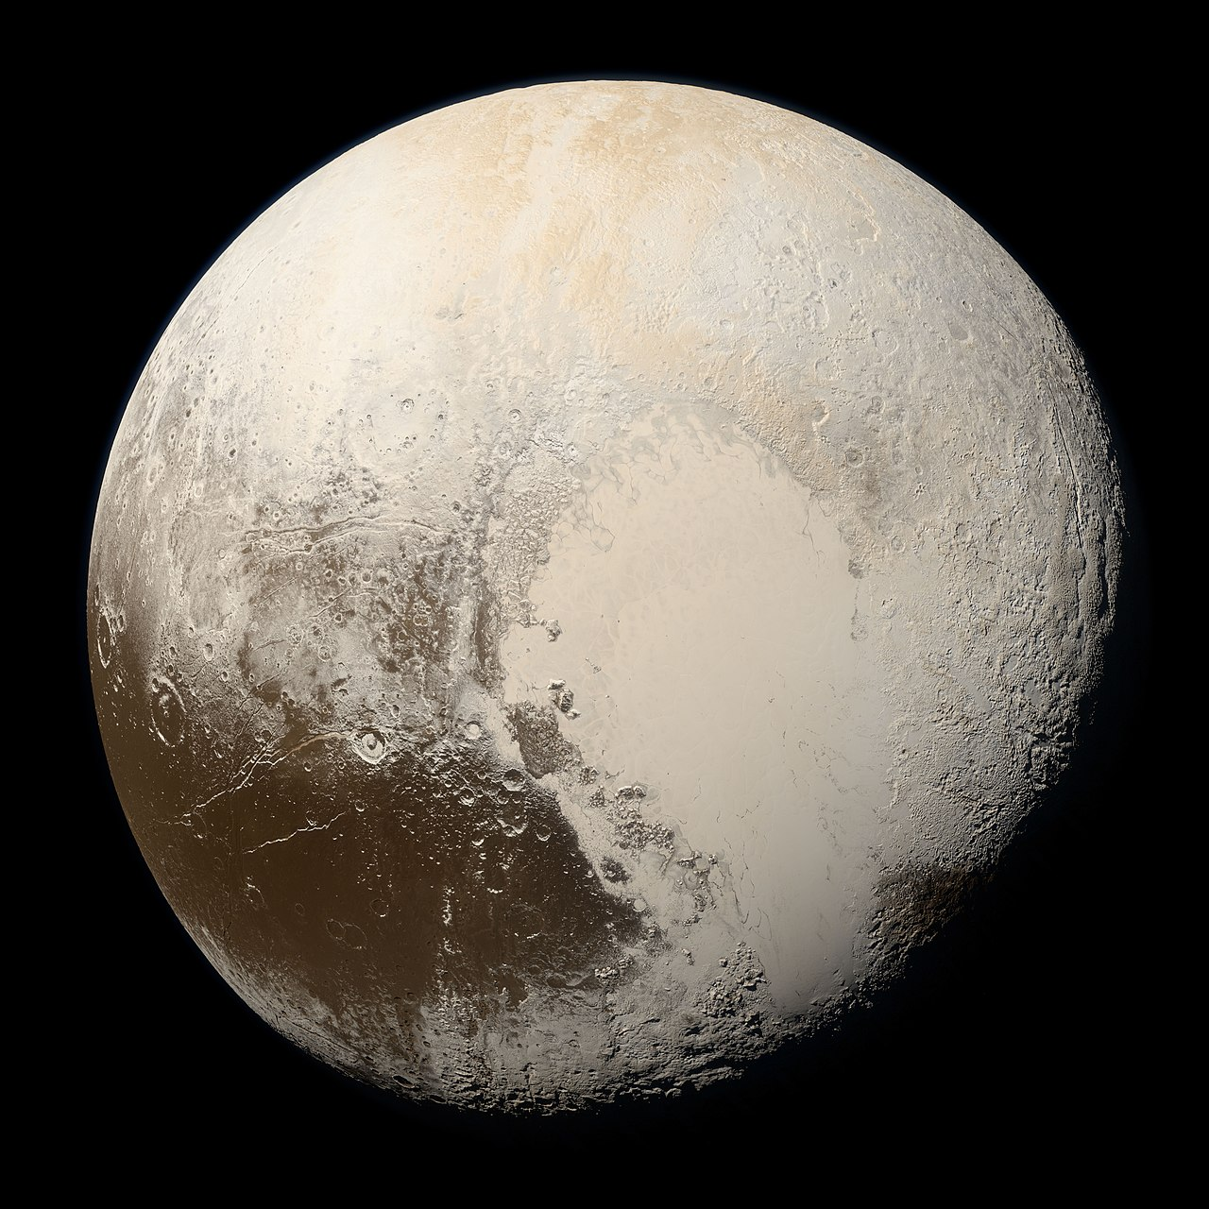
The Plutonian atmospheric structure
Gladstone et al. 2016
New Horizons (LORRI)
Phase angle of 169°.
14 July 2015.
Radius: 1185 km.
Distance from the Sun: 30 to 49 au.
N₂ (> 99%) ; CH₄ (~ 0.7 %) ; CO (~ 0.05 %)
Global, extensive (> 200 km altitude), optically thin layer of haze.
Many haze layers of thickness 1 to 10 km.

Slide 3
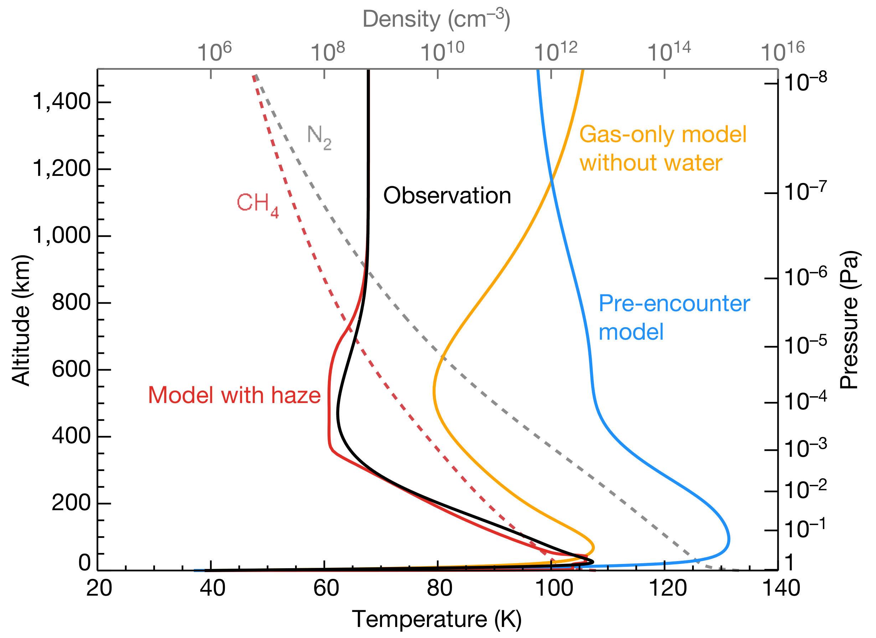
Understanding the radiative balance of Pluto’s atmosphere
A long-standing mystery surrounding the cooling of the atmosphere.
Temperature profile derived by the New Horizons spacecraft.
Strong negative gradient between the stratosphere at 110 K and the upper atmosphere at 70 K.
Pre-encounter and gas-only (HCN + C₂H₂) models fail to reproduce the observed profile.
Zhang's model with a prescribed haze distribution manages to reproduce the cooling.
Zhang et al., 2017

Slide 4
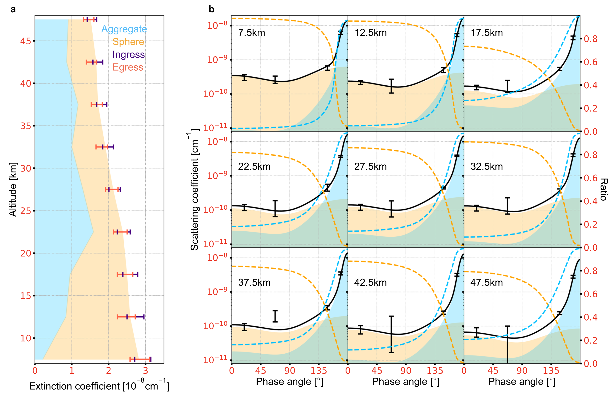
Mechanisms of haze formation: 2 suggested scenarios
Gladstone et al. 2016
New Horizons (LORRI)
Phase angle of 169°.
14 July 2015.
A bimodal distribution of haze
Rayleigh scattering suggests very small particles (~ 10 nm).
More visible at high phase angles (strongly forward scattering).
Large high- to low-phase brightness ratio suggests aggregate particles (> 100 nm).
Fan et al., 2022

Slide 5
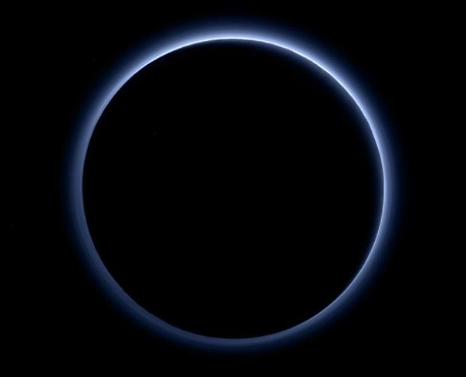
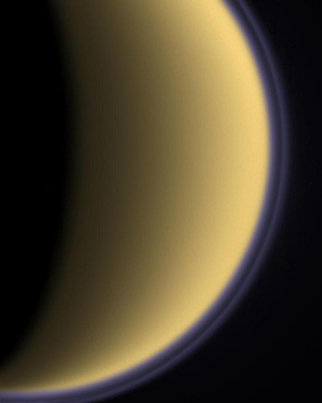
Mechanisms of haze formation: 2 suggested scenarios
Gladstone et al. 2016
New Horizons (LORRI)
Phase angle of 169°.
14 July 2015.
A bimodal distribution of haze
Rayleigh scattering suggests very small particles (~ 10 nm).
More visible at high phase angles (strongly forward scattering).
Large high- to low-phase brightness ratio suggests aggregate particles (> 100 nm).
Photochemical haze?
Pluto’s atmosphere ~ Titan’s atmosphere at > 400 km.
Atmosphere of N₂ with CH₄.
Blue color of the haze.

Slide 6
Mechanisms of haze formation: 2 suggested scenarios
Gladstone et al. 2016
New Horizons (LORRI)
Phase angle of 169°.
14 July 2015.
A bimodal distribution of haze
Rayleigh scattering suggests very small particles (~ 10 nm).
More visible at high phase angles (strongly forward scattering).
Large high- to low-phase brightness ratio suggests aggregate particles (> 100 nm).
Photochemical haze?
Pluto’s atmosphere ~ Titan’s atmosphere at > 400 km.
Atmosphere of N₂ with CH₄.
Blue color of the haze.
Icy haze?
Pluto’s upper atmosphere is much colder than Titan’s (~ 70 K compared to ~150 K).

Slide 7
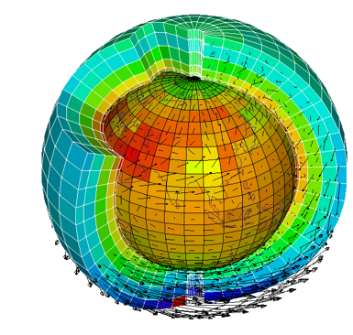
Adaptation of a haze and cloud microphysical model in moments for GCM
Photochemical haze:
Evolution of a bimodal aerosol population (spherical & fractal)
Production
Sedimentation
Brownian coagulation
Icy haze:
Icy particles = photochemical core + C₂H₂/C₂H₆/C₄H₂/C₆H₆/HCN ices
Pluto/Triton PCM
(Forget et al. 2017 ; Bertrand et al. 2017,2020)
Heterogenous nucleation
Sedimentation
Condensation / Evaporation
Brownian coagulation

Slide 8
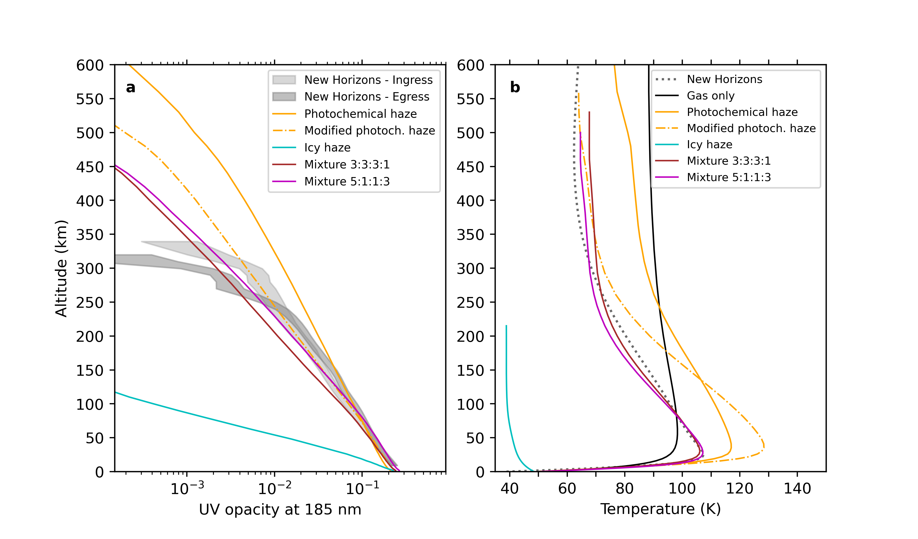
Impact of the haze on Pluto’s atmospheric structure
Reference simulations:
“Gas only” – No haze. The radiative transfer accounts for gasous CH₄, C₂H₂, CO, and HCN.
“Photochemical haze” – Production of photochemical haze (Titan-like).
“Icy haze” – Photochemical haze and icy haze, assuming the optical properties of pure ices.
“Mixture 3:3:3:1/ 5:1:1:3” – Photochemical and icy haze. Optical properties for tholins, and for different tholin:C₄H₂:C₆H₆:HCN mixing ratios: 3:3:3:1 (Bertrand et al., 2025) / 5:1:1:3 (Best agreement with the observations).

Slide 9
Impact of the haze on Pluto’s atmospheric structure
UV opacity & temperature profiles observed by New Horizons in 2015
Gas opacity in the UV is negligible compared to that of hazes.
“Photochemical haze” overestimates both the observed UV opacity and the temperature.
“Icy haze” underestimates both the observed UV opacity and the temperature.
“Mixtures” successfully reproduce both the trend and the magnitude of the UV opacity observed, along with Pluto’s thermal profile.
Suggests a mixture of photochemical aerosols and ices: the tholin component has a strong influence on the absorption properties and composition of the haze.

Slide 10
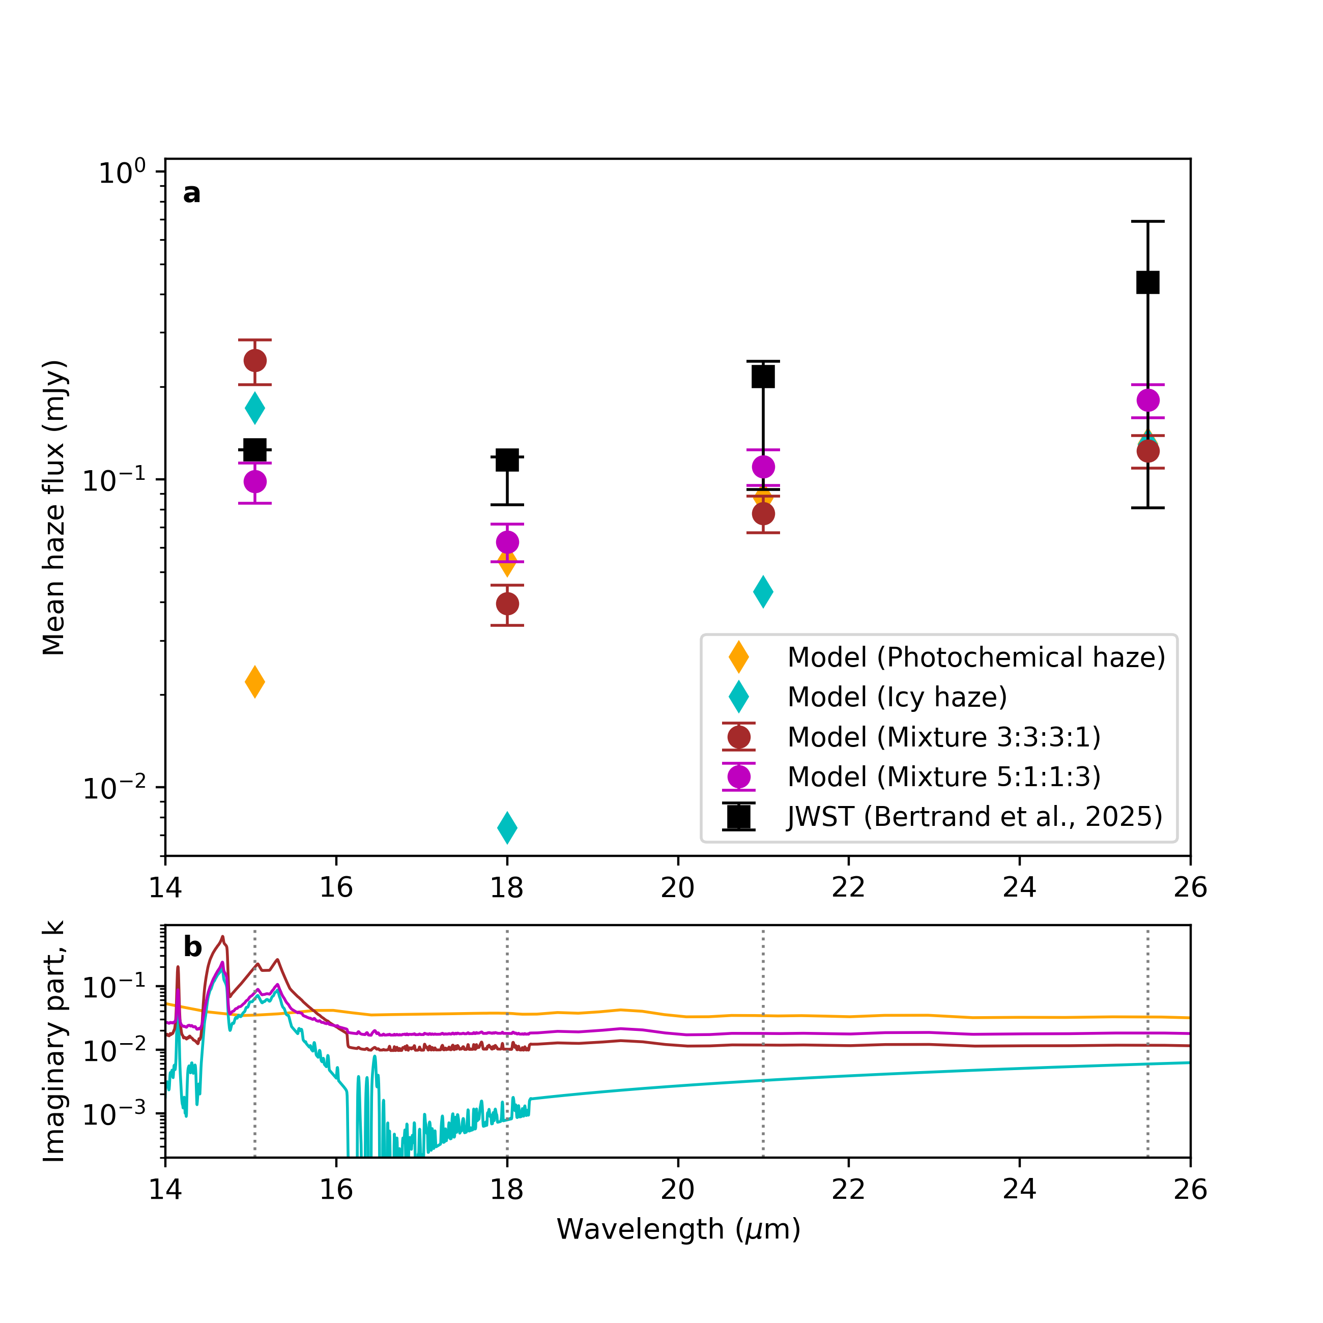
Pluto’s thermal emission from JWST/MIRI
Observations of atmospheric mid-infrared flux in 2022 (Bertrand et al., 2025, Lellouch et al., 2025)
Large contribution of Pluto’s haze to the observed mid-IR flux, icy component confirmed.
Pluto PCM simulations
“Photochemical haze” fails to reproduce the 15 µm flux level (attributed to C₄H₂ and C₆H₆ ices).
“Icy haze” underestimates the emission at 18 and 21 µm (dominated by tholins mid-IR continuum).
The JWST/MIRI-imaging photometry is best explained by the mixed haze.
“Mixture 5:1:1:3” scenario best reproduces the observed spectral shape, although with a slight underestimation of total flux.

Slide 11
Pluto’s thermal emission from JWST/MIRI
Observations of atmospheric mid-infrared flux in 2022 (Bertrand et al., 2025, Lellouch et al., 2025)
Large contribution of Pluto’s haze to the observed mid-IR flux, icy component confirmed.
Pluto PCM simulations
“Photochemical haze” fails to reproduce the 15 µm flux level (attributed to C₄H₂ and C₆H₆ ices).
“Icy haze” underestimates the emission at 18 and 21 µm (dominated by tholins mid-IR continuum).
The JWST/MIRI-imaging photometry is best explained by the mixed haze.
“Mixture 5:1:1:3” scenario best reproduces the observed spectral shape, although with a slight underestimation of total flux.

Slide 12
Pluto’s thermal emission from JWST/MIRI
Observations of atmospheric mid-infrared flux in 2022 (Bertrand et al., 2025, Lellouch et al., 2025)
Large contribution of Pluto’s haze to the observed mid-IR flux, icy component confirmed.
Pluto PCM simulations
“Photochemical haze” fails to reproduce the 15 µm flux level (attributed to C₄H₂ and C₆H₆ ices).
“Icy haze” underestimates the emission at 18 and 21 µm (dominated by tholins mid-IR continuum).
The JWST/MIRI-imaging photometry is best explained by the mixed haze.
“Mixture 5:1:1:3” scenario best reproduces the observed spectral shape, although with a slight underestimation of total flux.

Slide 13
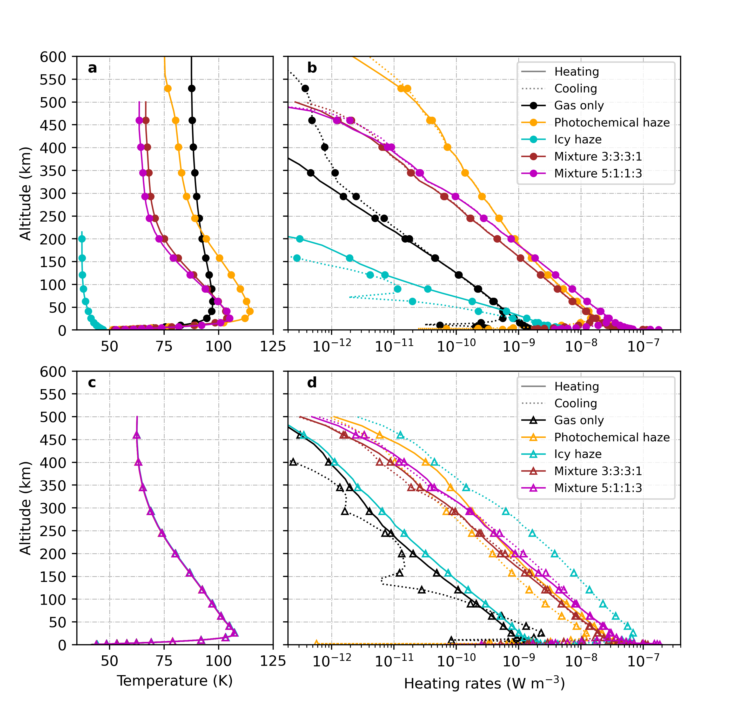
Radiative balance of Pluto’s atmosphere
Modelled heating rates in Pluto’s atmosphere :
(a-b) Temperature and heating/cooling (solid/dotted) rates predicted by the Pluto PCM for 2022.
(c-d) Same as (a-b) but with temperature profiles fixed to the one observed by New Horizons in 2015.
Haze particles dominate the solar heating and thermal cooling rates by a factor 100.
For fixed temperature profile:
  “Photochemical haze” scenario exhibits a net heating.
  “Icy haze” scenario undergoes strong net cooling.
→ Neither configuration is physically stable, supporting the conclusion that Pluto’s atmosphere requires a mixed photochemical–icy haze to maintain radiative balance.

Slide 14
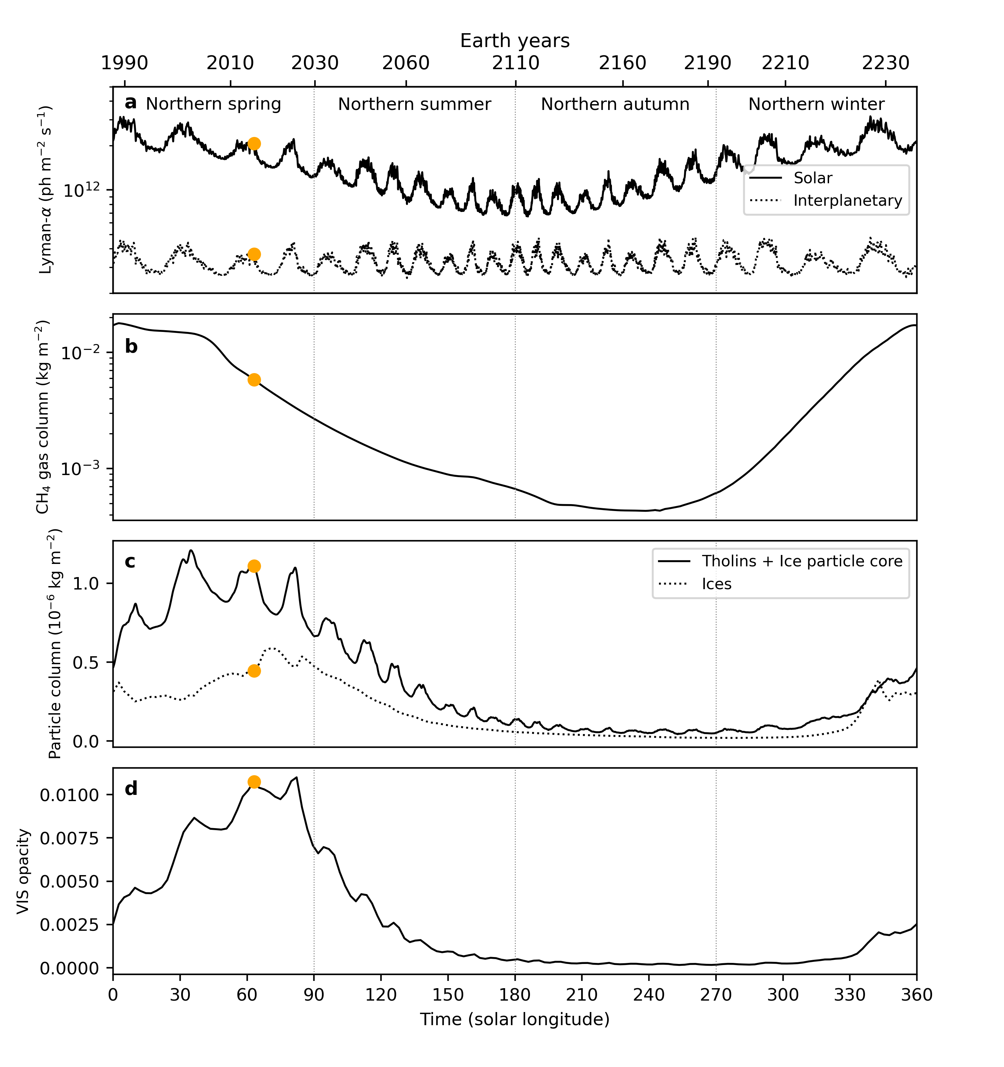
The seasonal cycle of haze – 1D Seasonal model
1D Reference simulation:
“Mixture 5:1:1:3” with surface pressure and CH₄ fixed (based on Bertrand et al., 2016).
Yearly variation in haze production.
Extrapolation of the Lyman-α flux received by Pluto over the course of one year.
Strong dependence between haze production, Lyman-α flux (CH₄ photolysis), and CH₄ gas column (surface pressure).
Haze abundance decreases during northern winter and increases again with the onset of northern summer.
Feedback between temperature and the amount of photochemical and ice aerosols

Slide 15
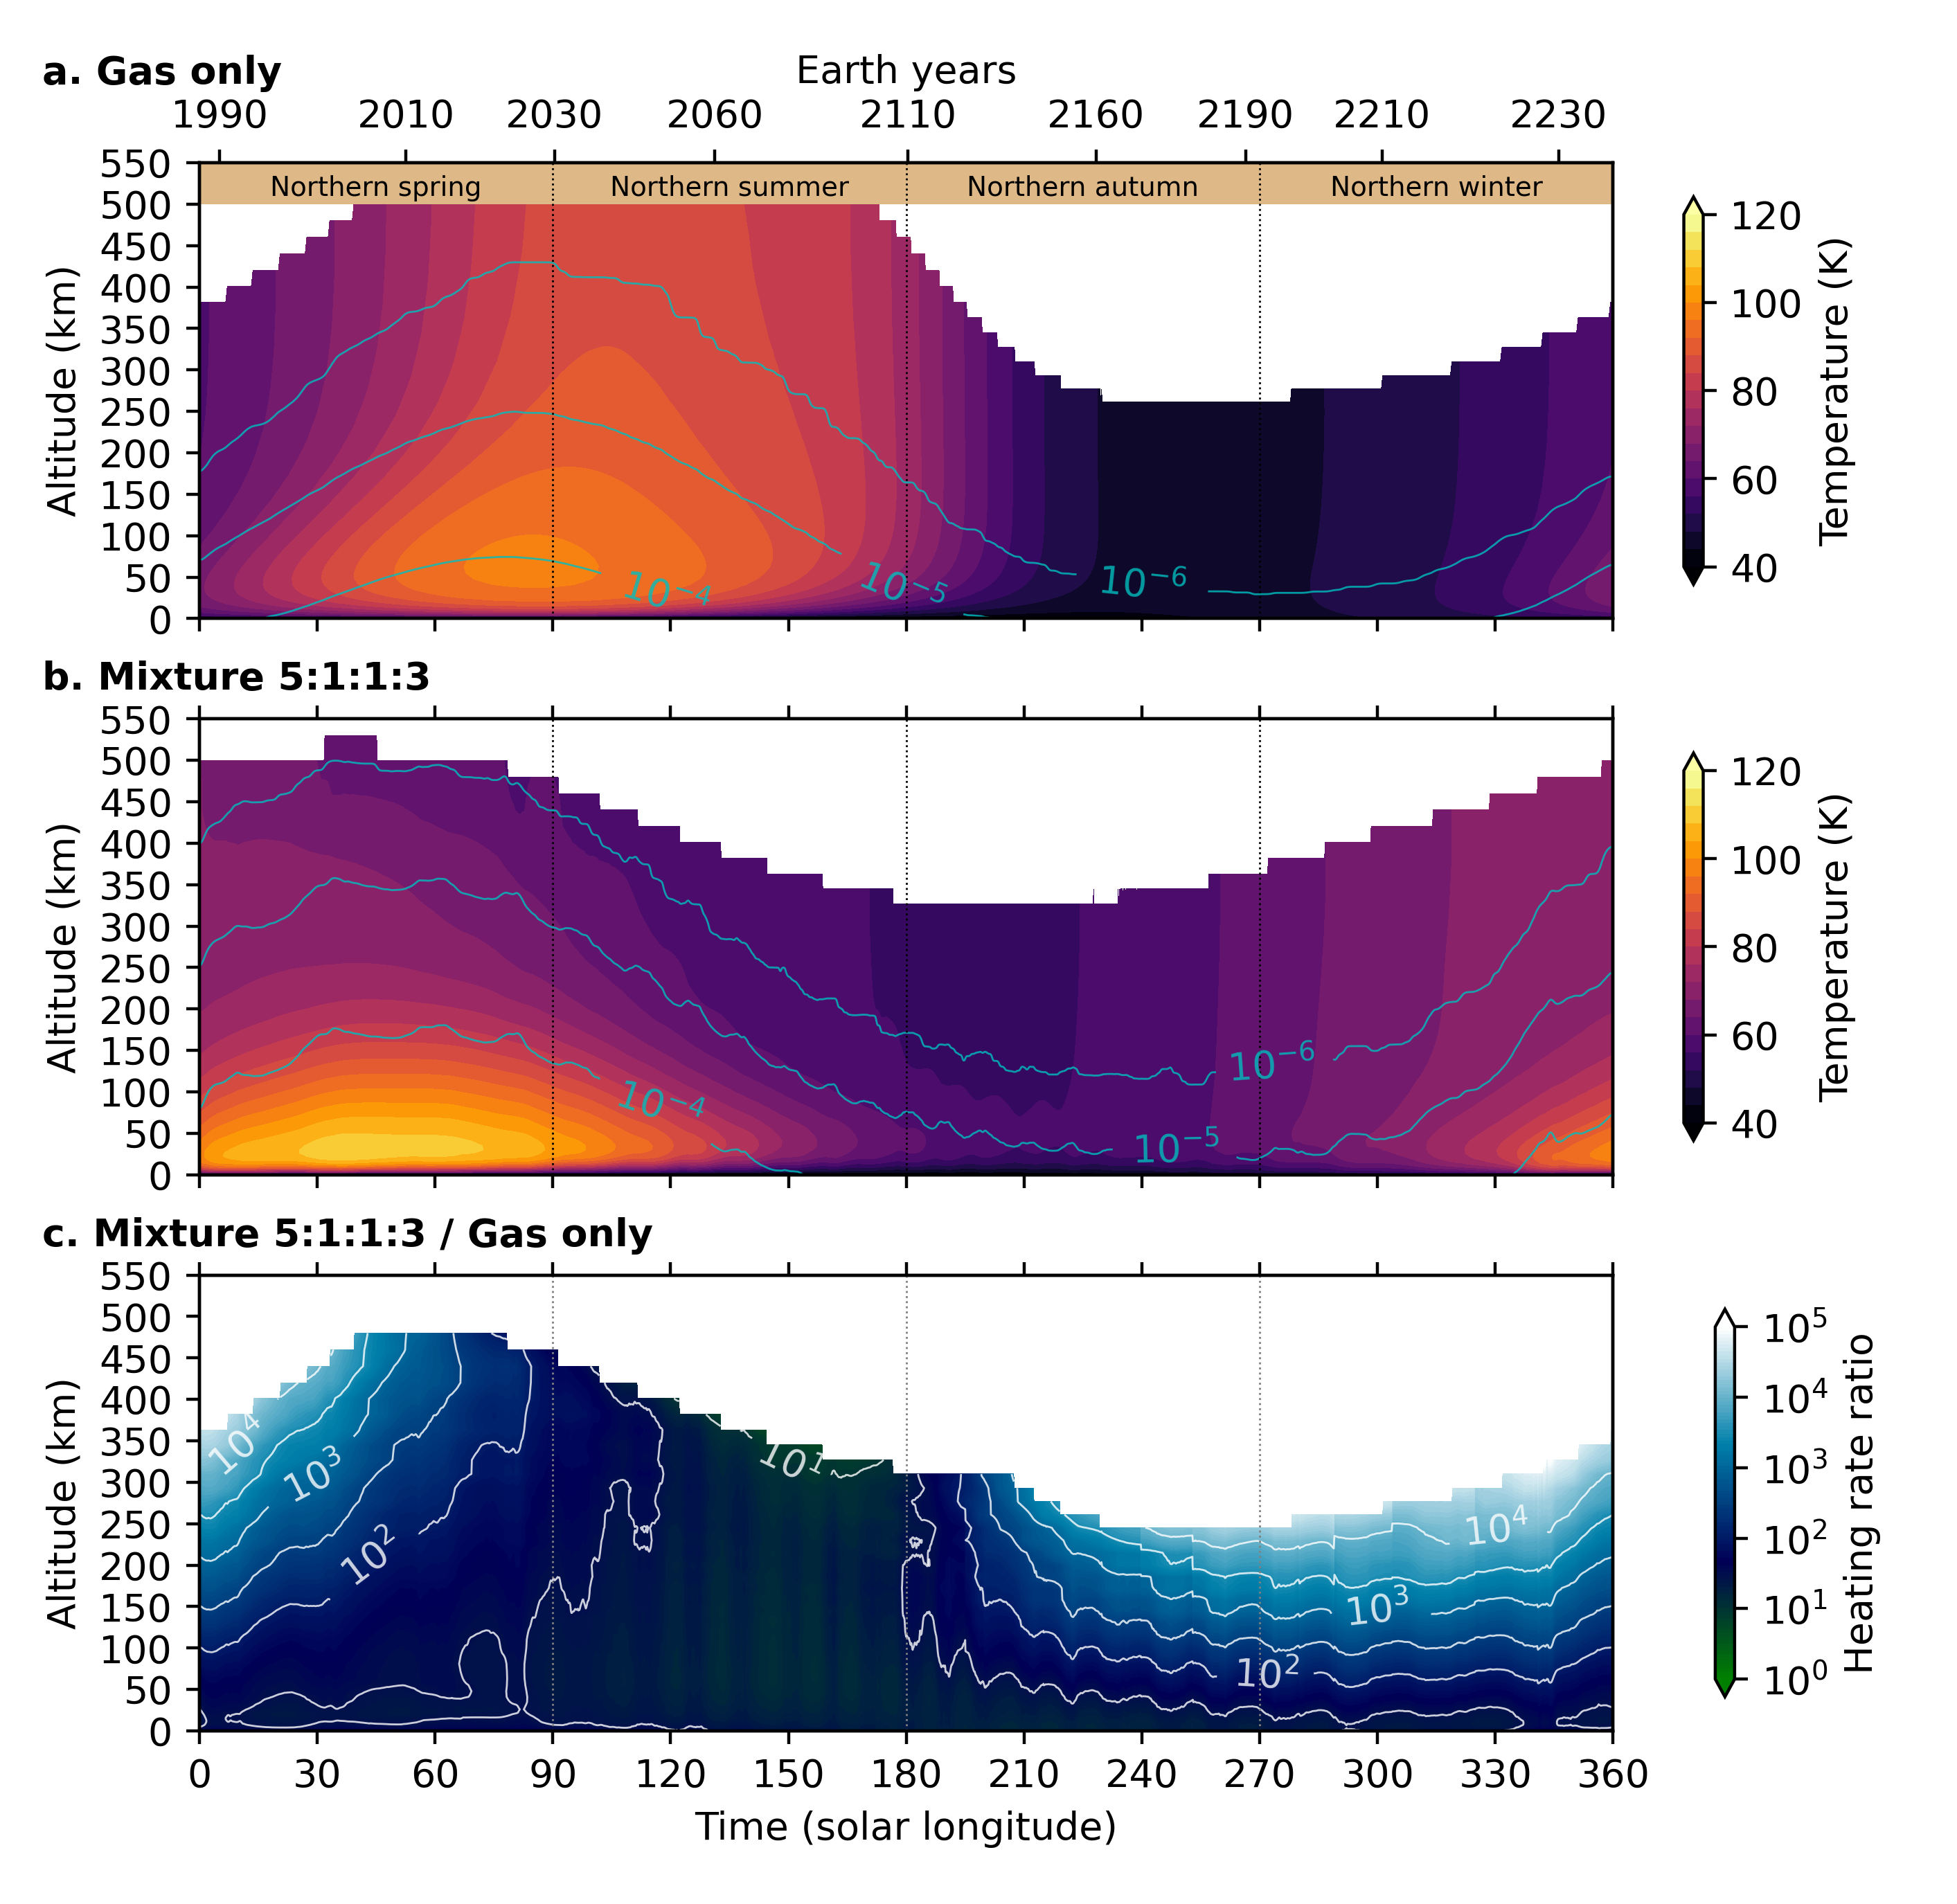
The seasonal cycle of haze – 1D Seasonal model
1D Reference simulation:
“Mixture 5:1:1:3” with surface pressure and CH₄ fixed (based on Bertrand et al., 2016).
Yearly variation in haze production.
Extrapolation of the Lyman-α flux received by Pluto over the course of one year.
Strong dependence between haze production, Lyman-α flux (CH₄ photolysis), and CH₄ gas column (surface pressure).
Haze abundance decreases during northern winter and increases again with the onset of northern summer.
Feedback between temperature and the amount of photochemical and ice aerosols

Slide 16
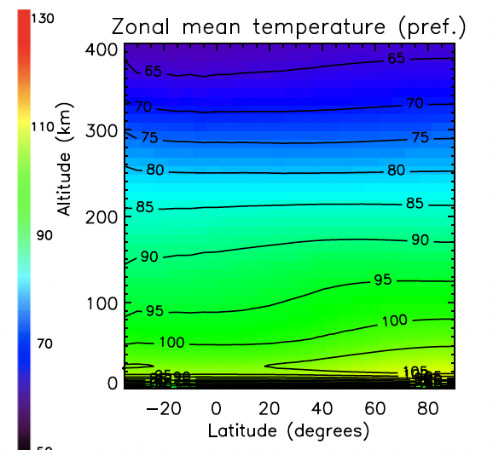
Take home messages
Conclusions:
The Pluto PCM confirms haze plays a major role in the Pluto radiative equilibrium, and explains Pluto’s temperature profile.
Both the “Photochemical haze” and the “Icy haze” scenarios can definitely be excluded; instead, Pluto’s haze is composed of a mixture of photochemical aerosols and organic ices.
Only a mixed photochemical–icy aerosol population simultaneously reconciles the New Horizons UV opacity profile, Pluto’s atmospheric thermal structure, and the infrared emission observed by JWST.
We identify a strong seasonal haze cycle linked to variations in pressure, CH₄ abundance, and UV flux.
Haze dominates radiative equilibrium throughout the year, making Pluto the only known Solar System atmosphere primarily regulated by haze rather than gases.
Perspectives:
Further study on the latitudinal thermal gradient (north 7 ± 3.5 K warmer near 30 km).
Application to Triton.
Lellouch et al., 2022

Slide 17
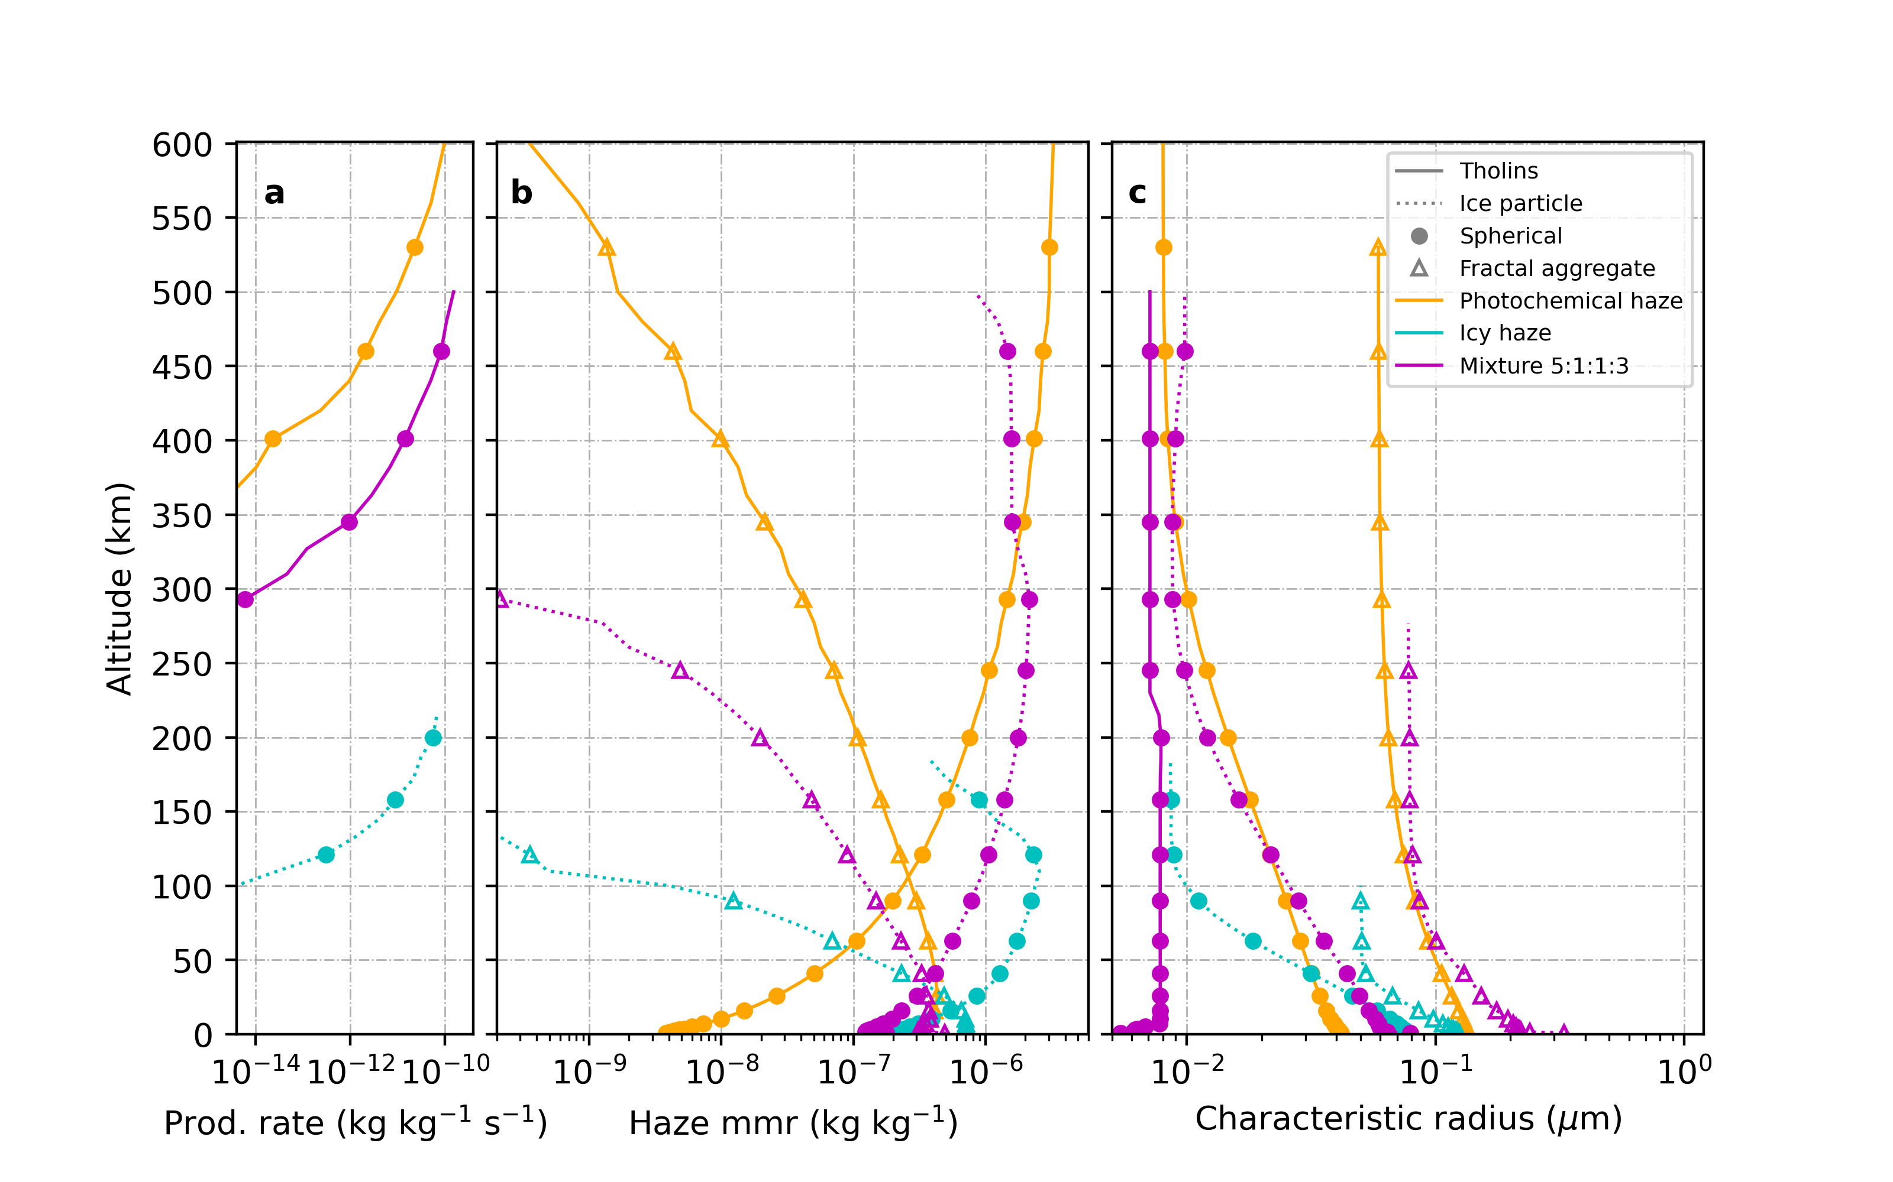
Appendix – Haze structure in Pluto’s atmosphere

Slide 18
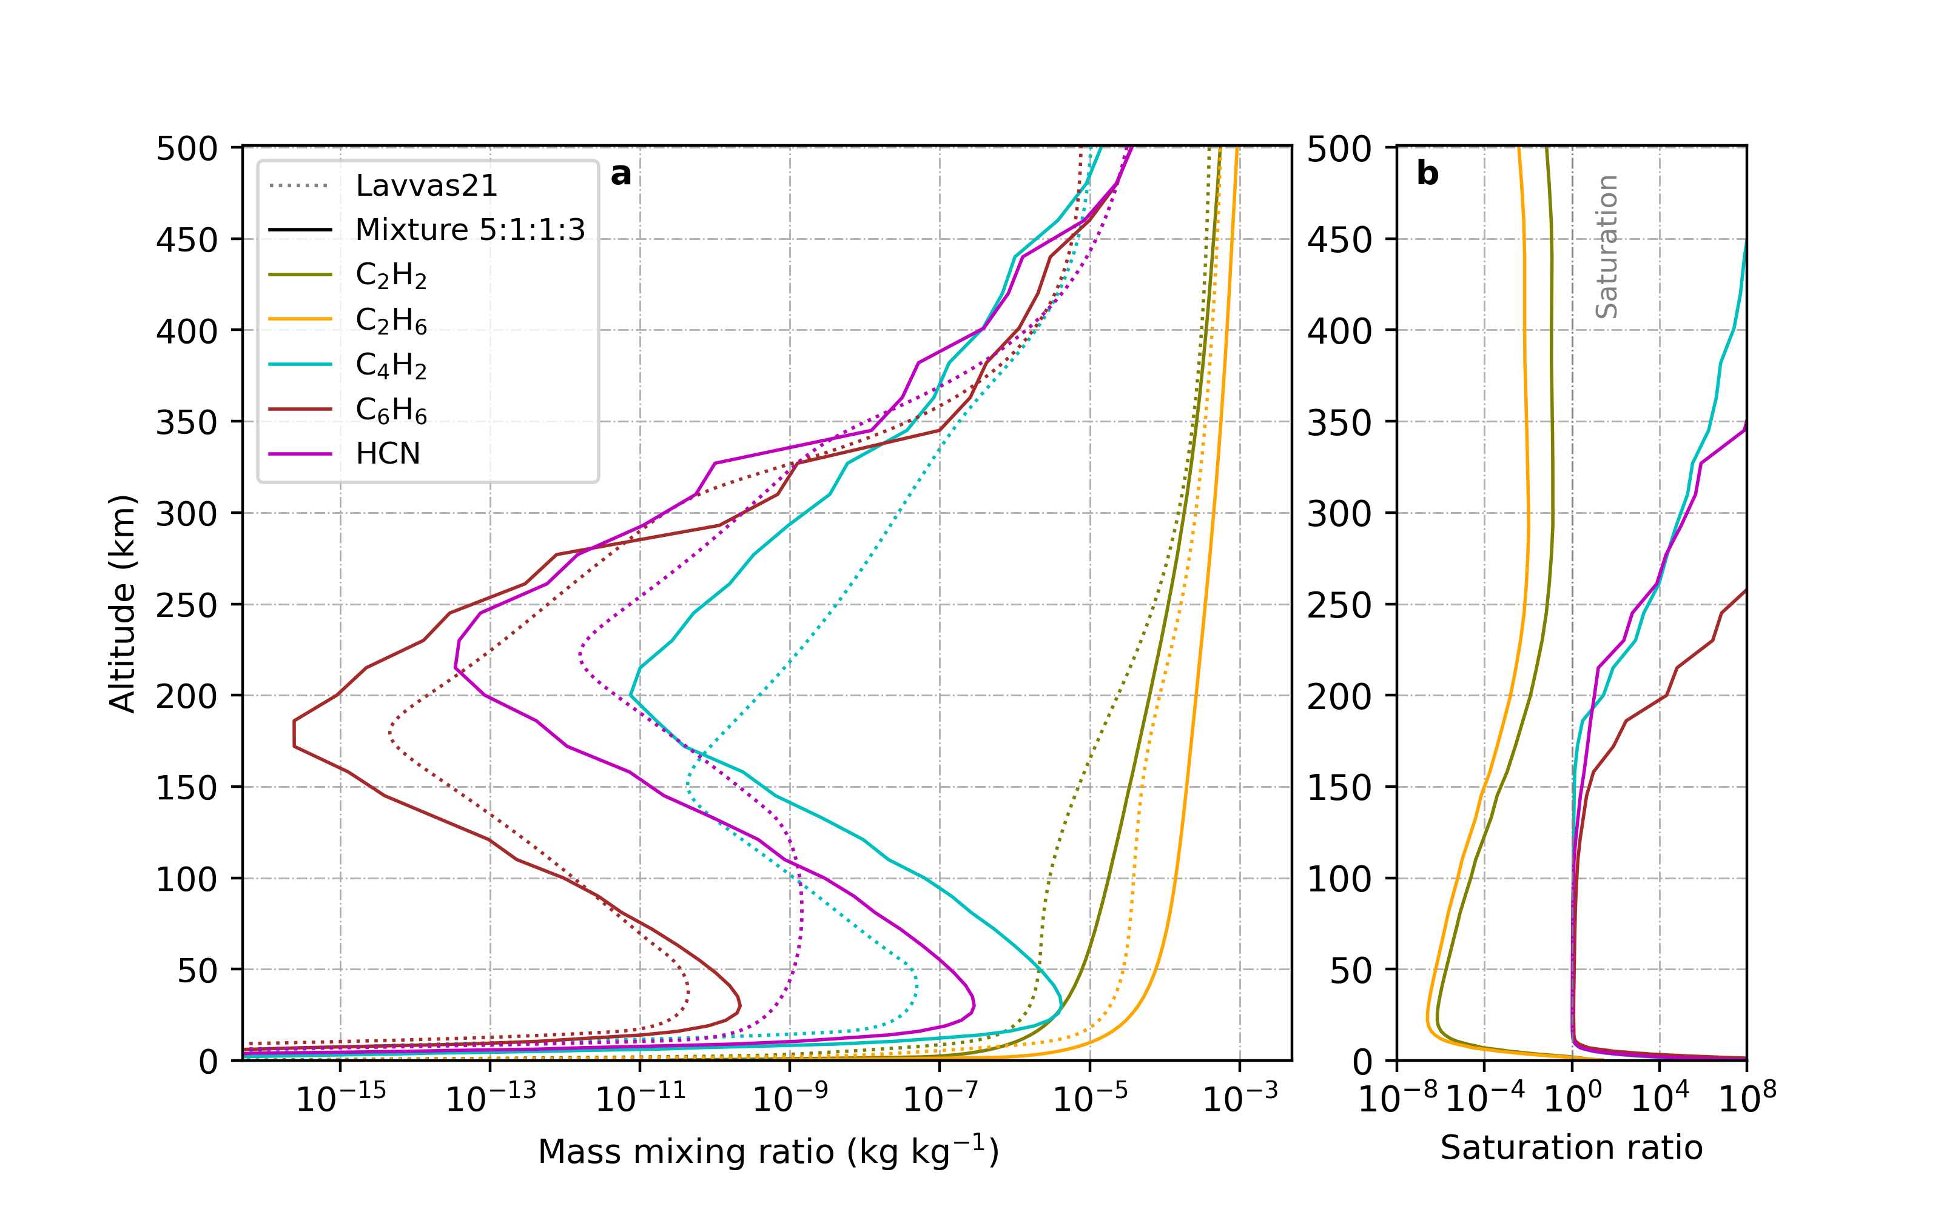
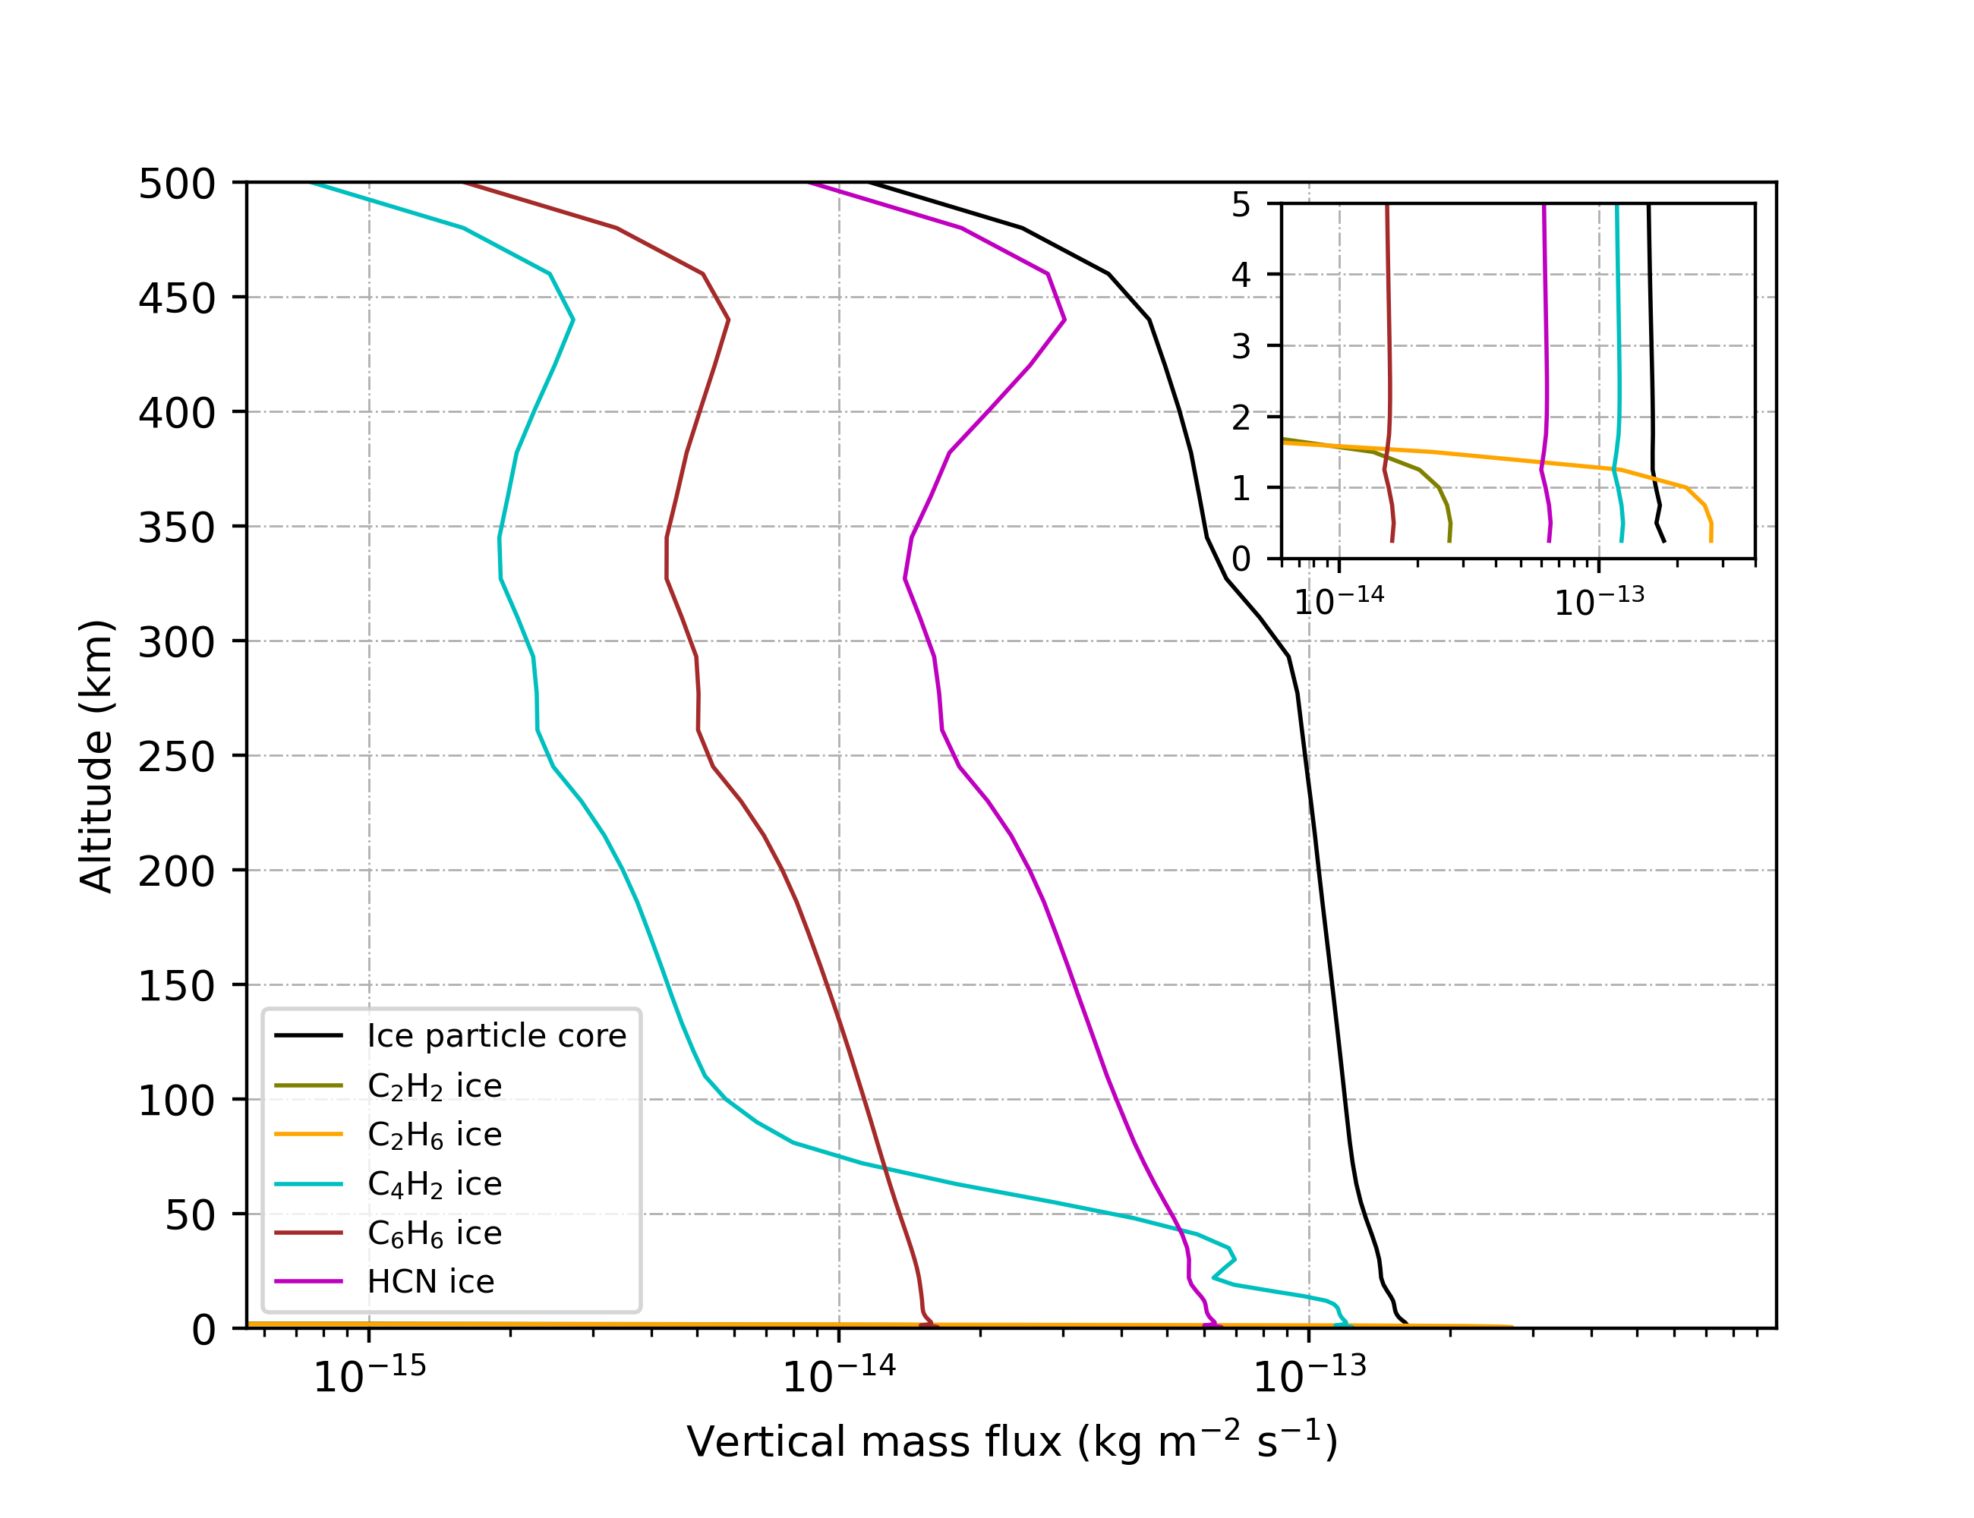
Appendix – Chemical constituents of haze & Mass flux of haze components in Pluto’s atmosphere

Slide 19
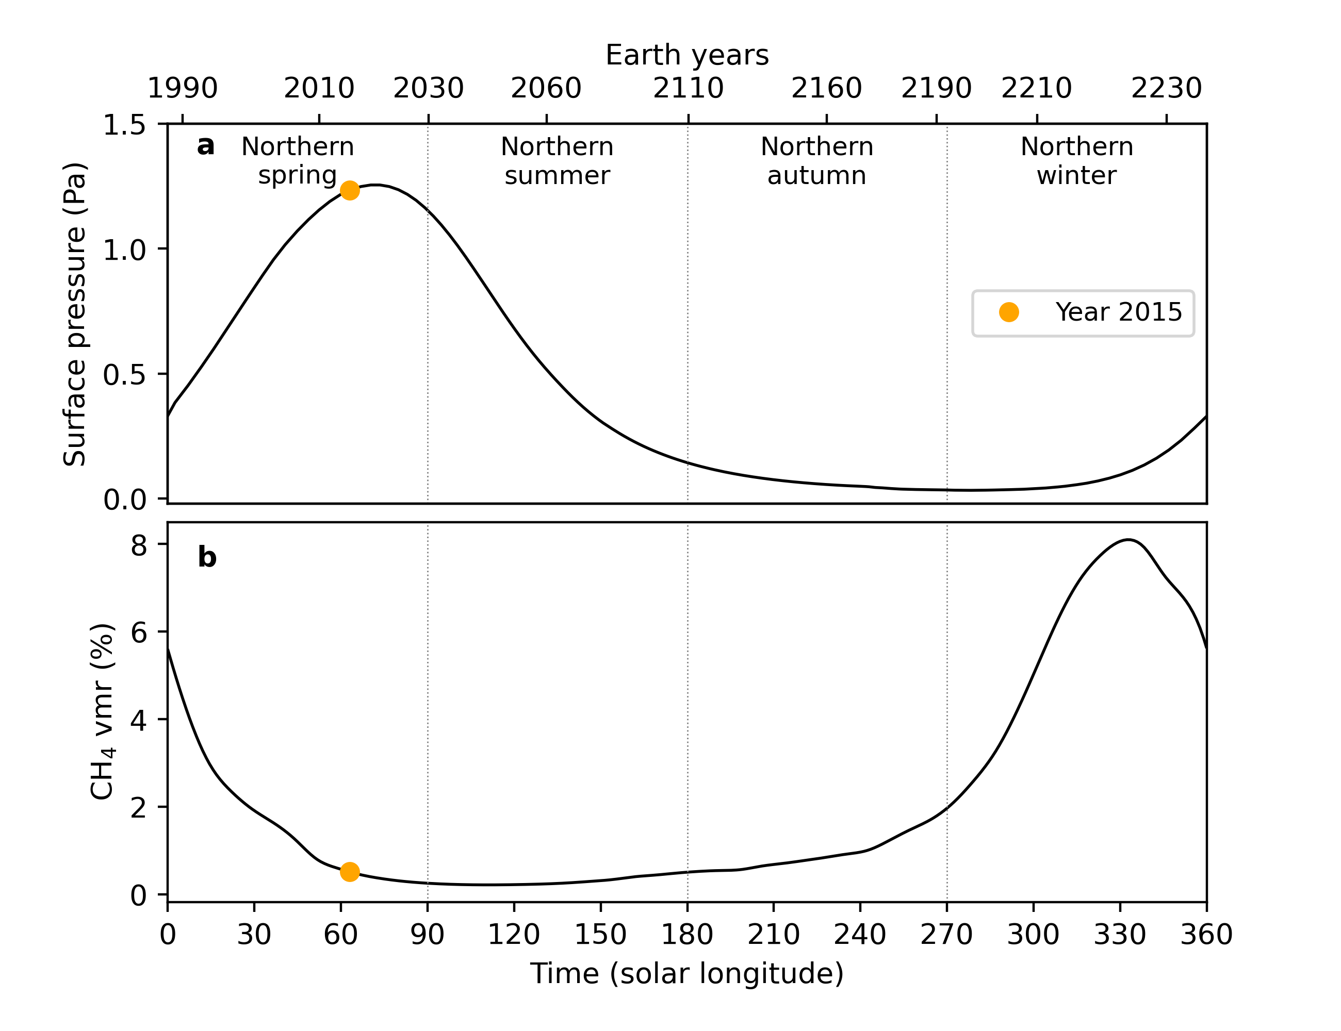
Appendix – Annual variation of Pluto’s surface pressure and methane volume mixing ratio.

Slide 20
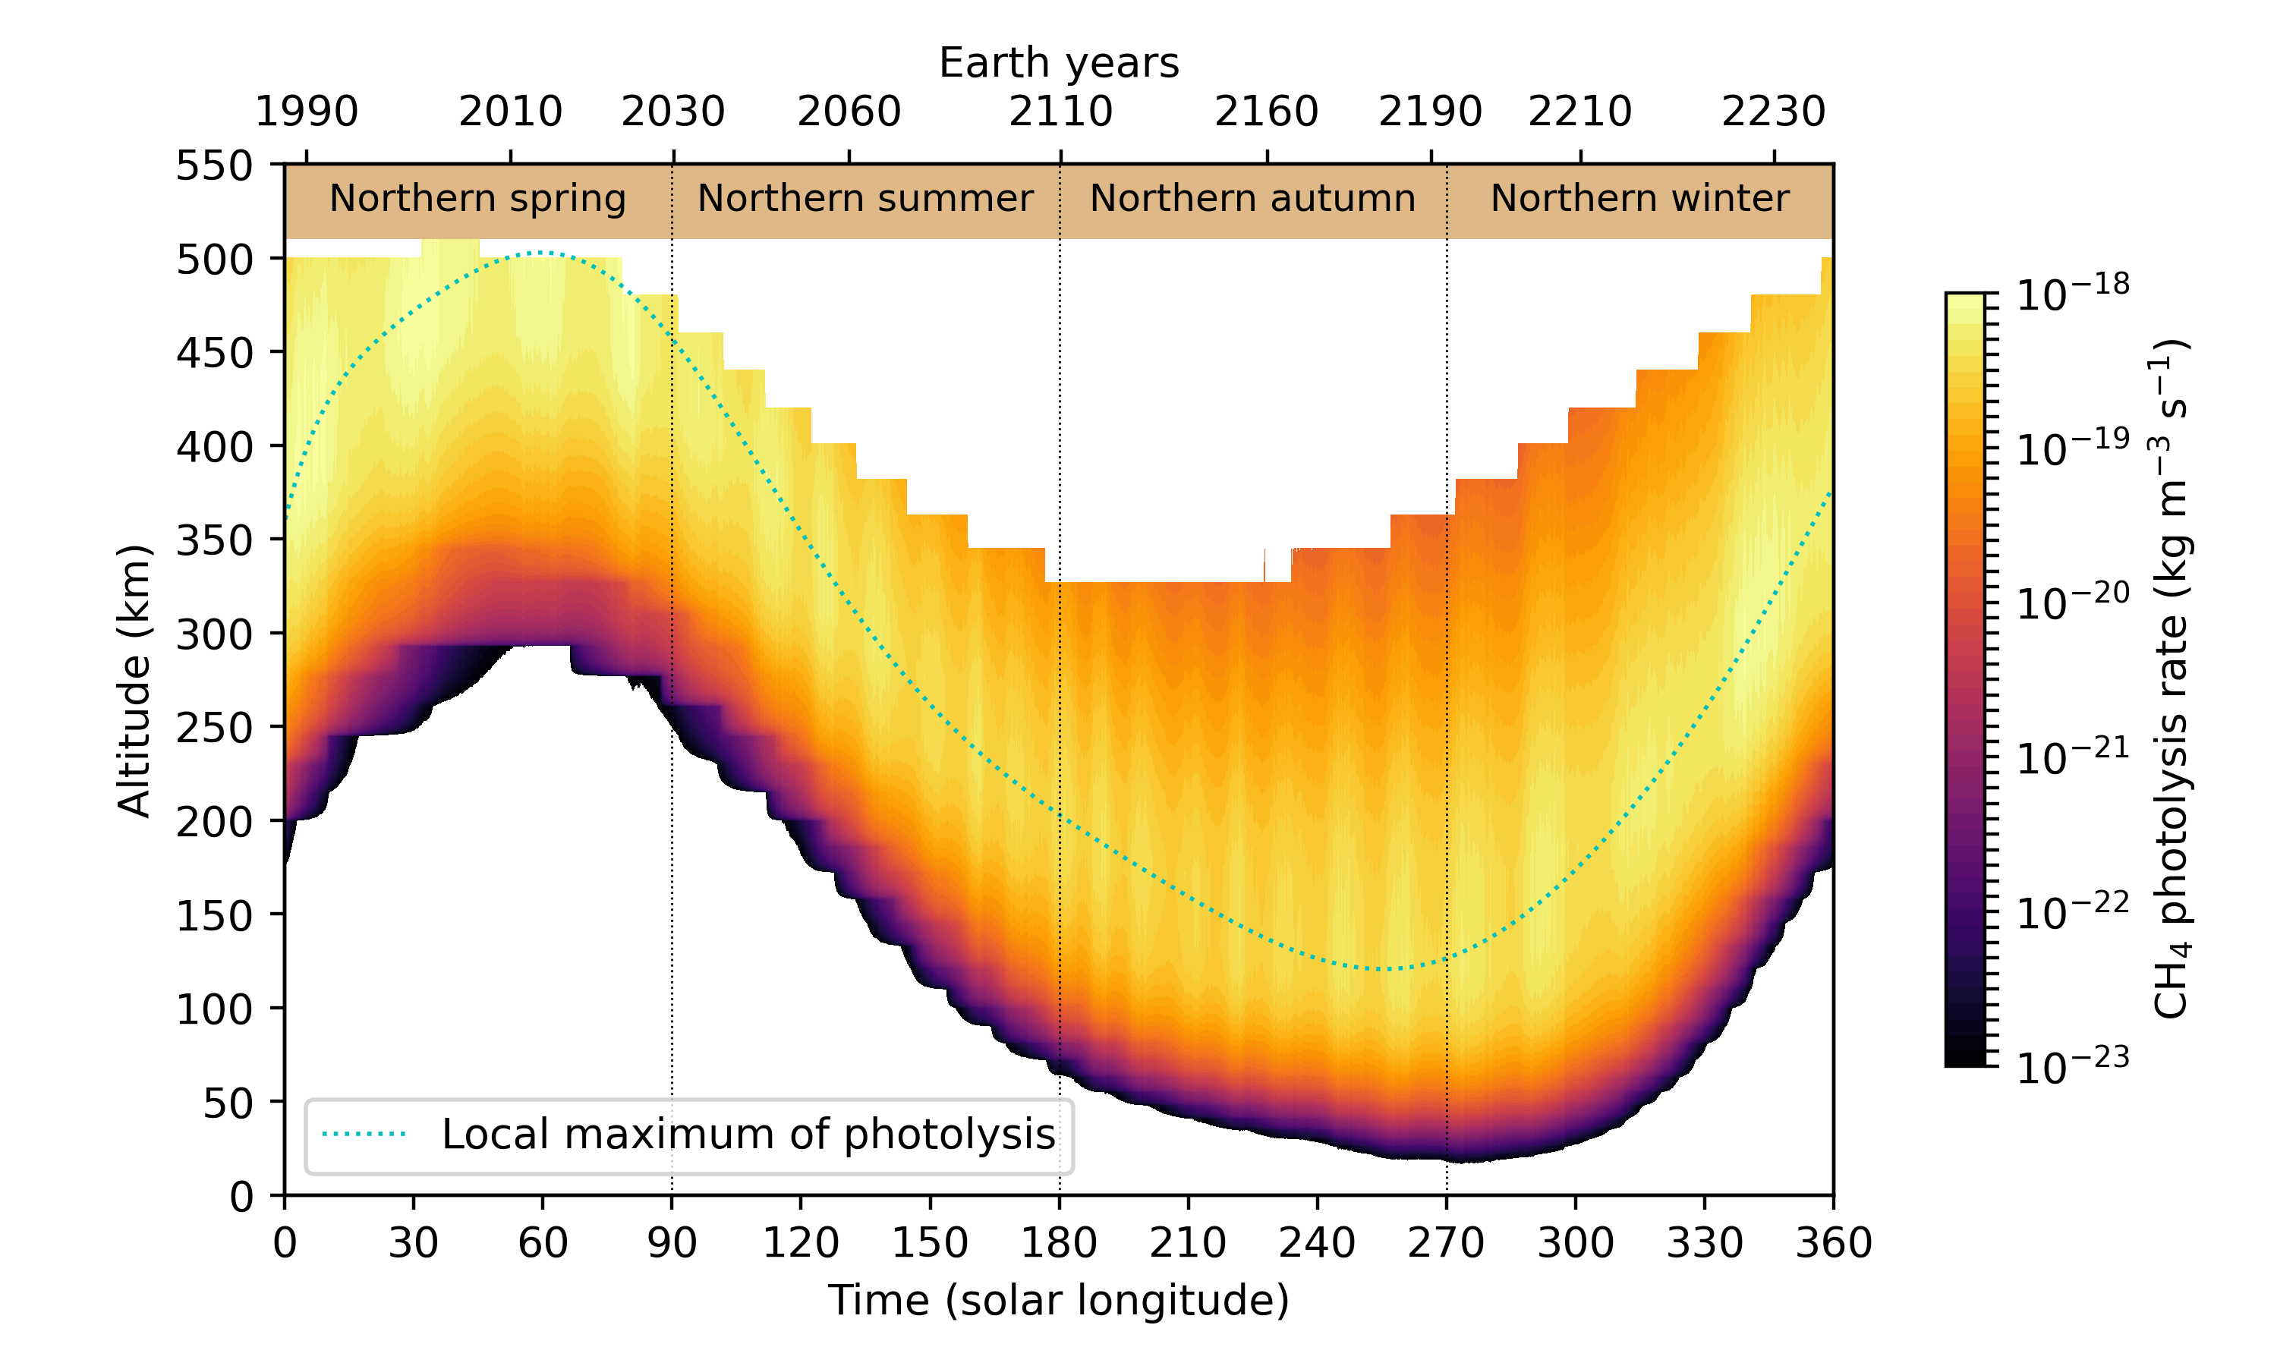
Appendix – Annual variation of methane photolysis in Pluto’s atmosphere

Slide 21
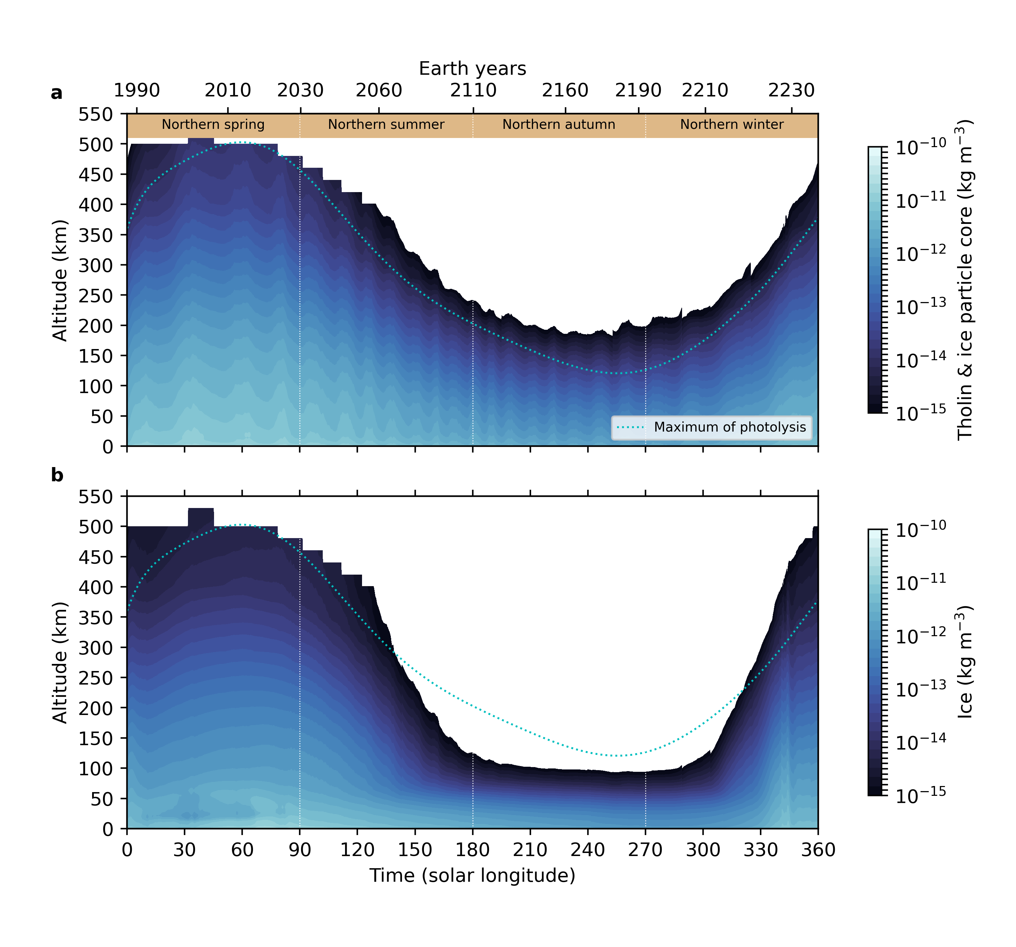
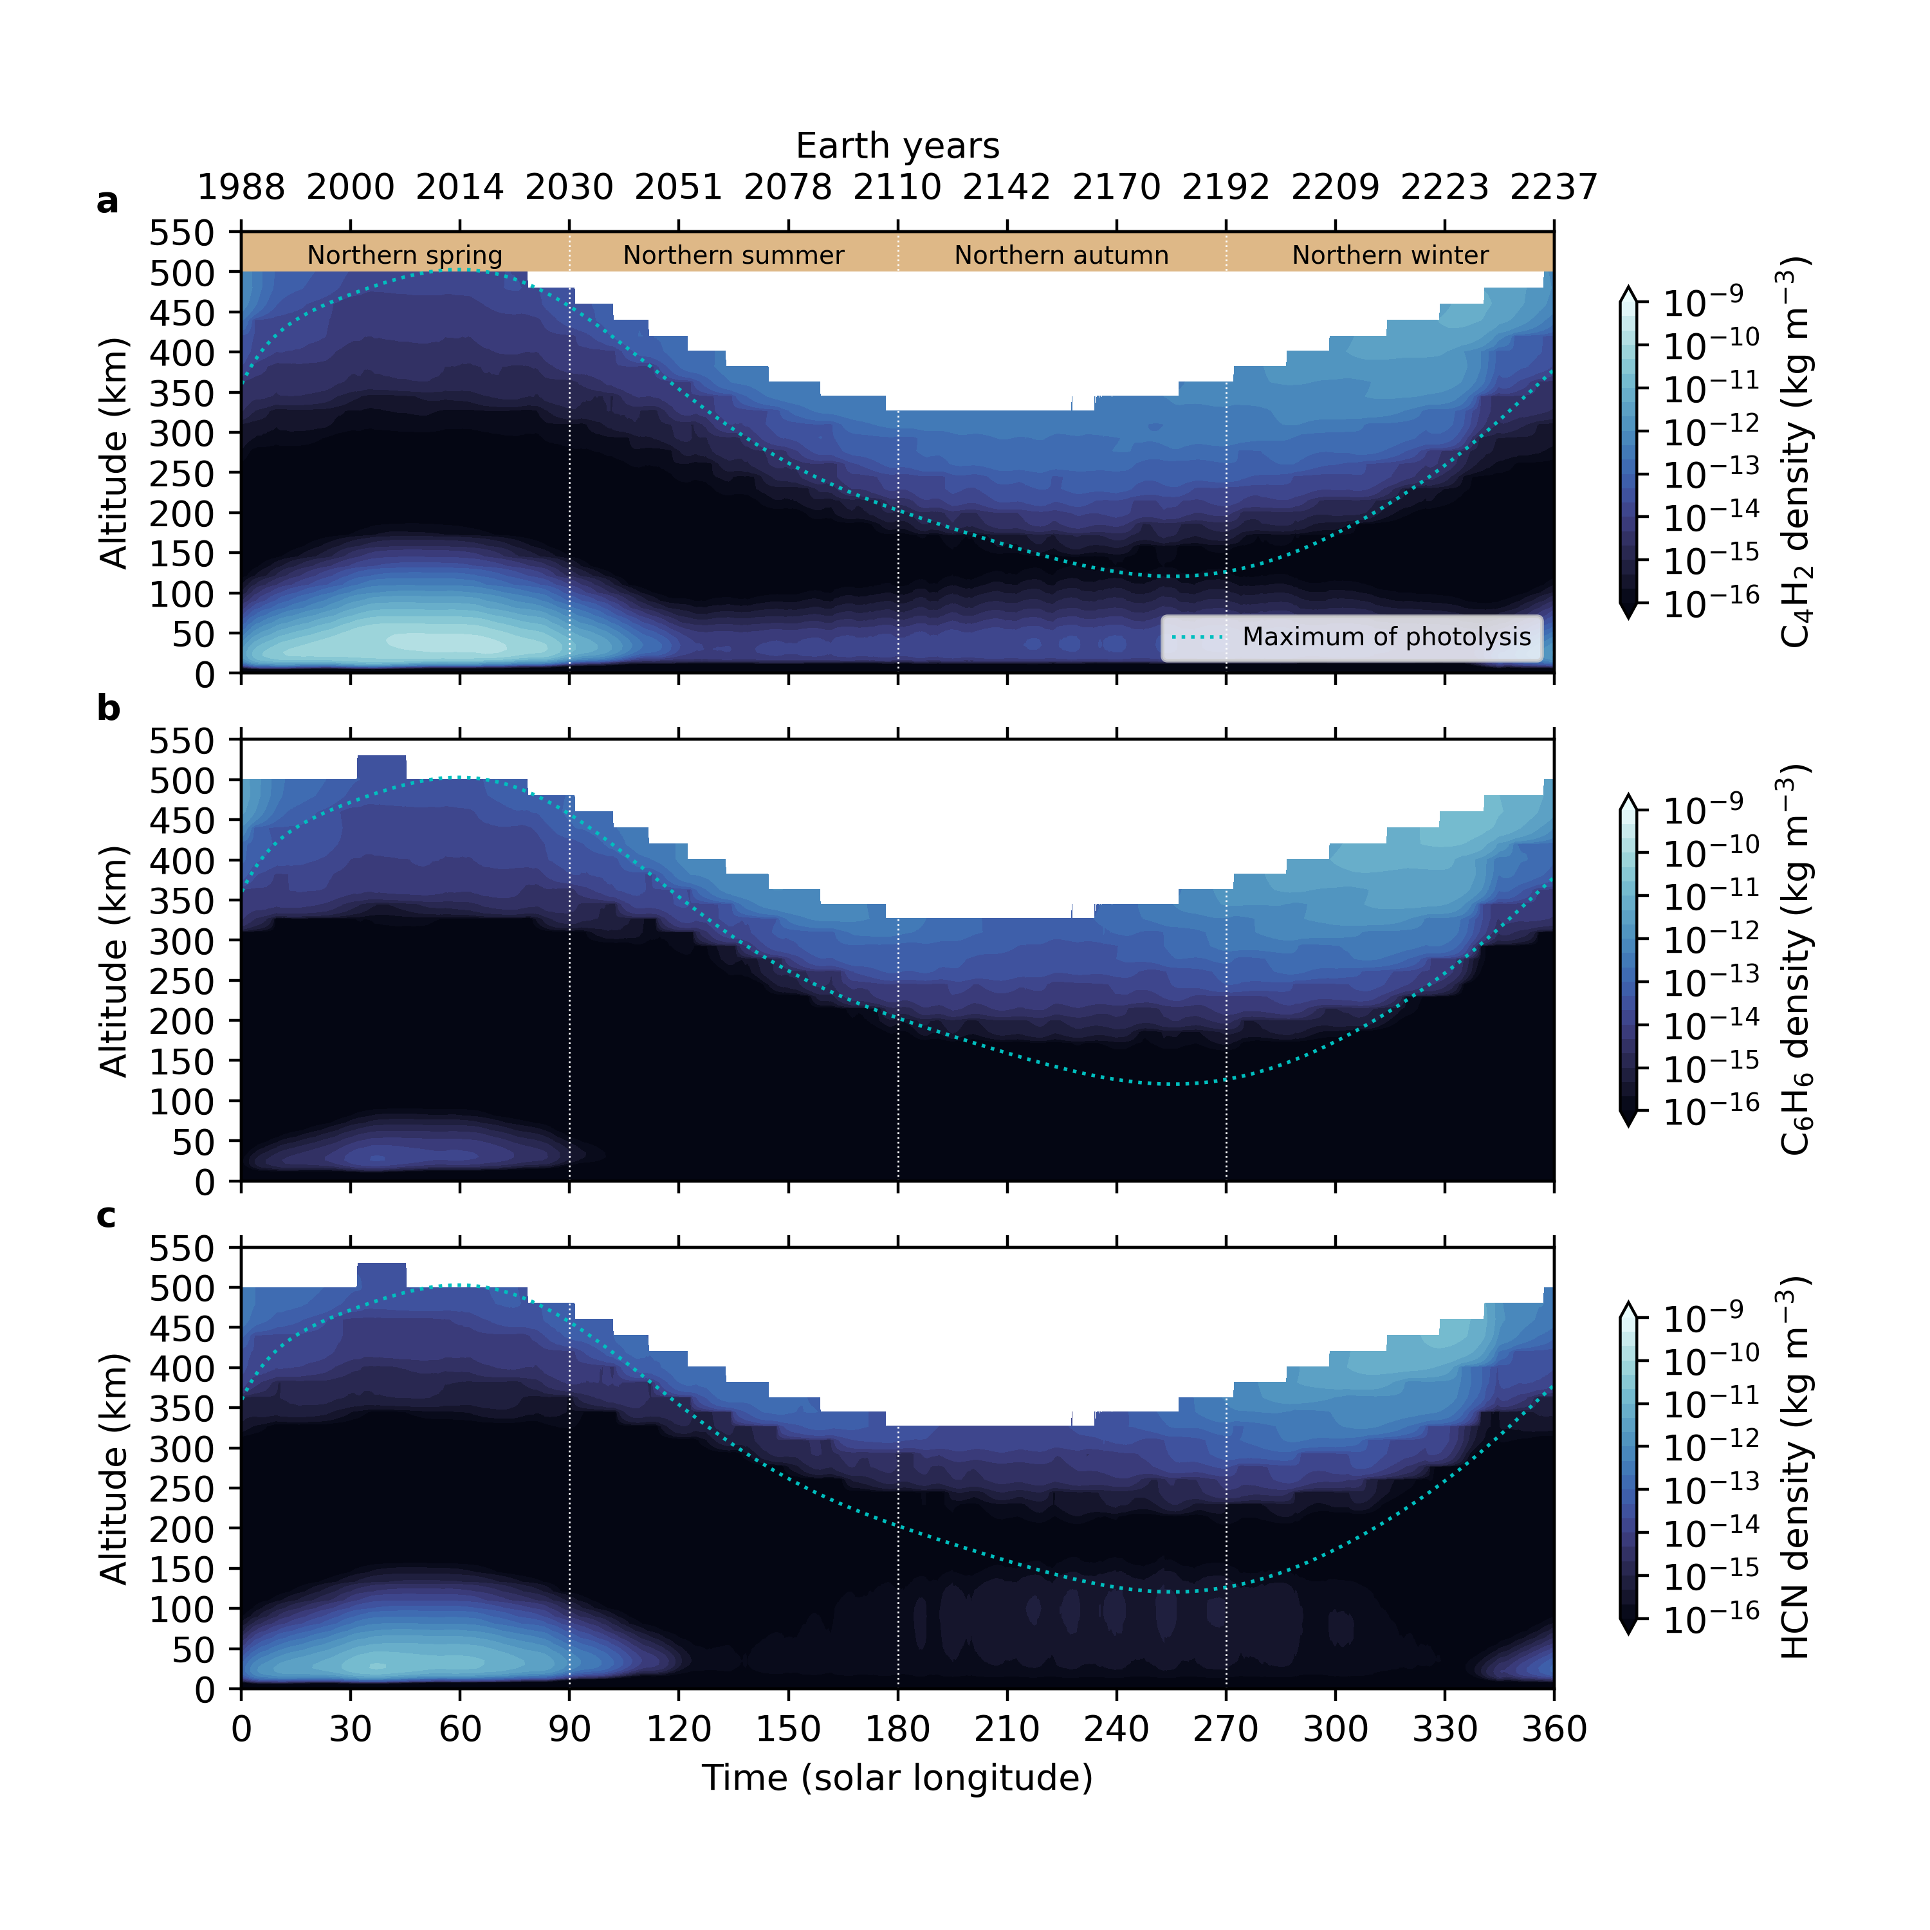
Appendix – Annual variation of haze components and gazes in Pluto’s atmosphere

Slide 22
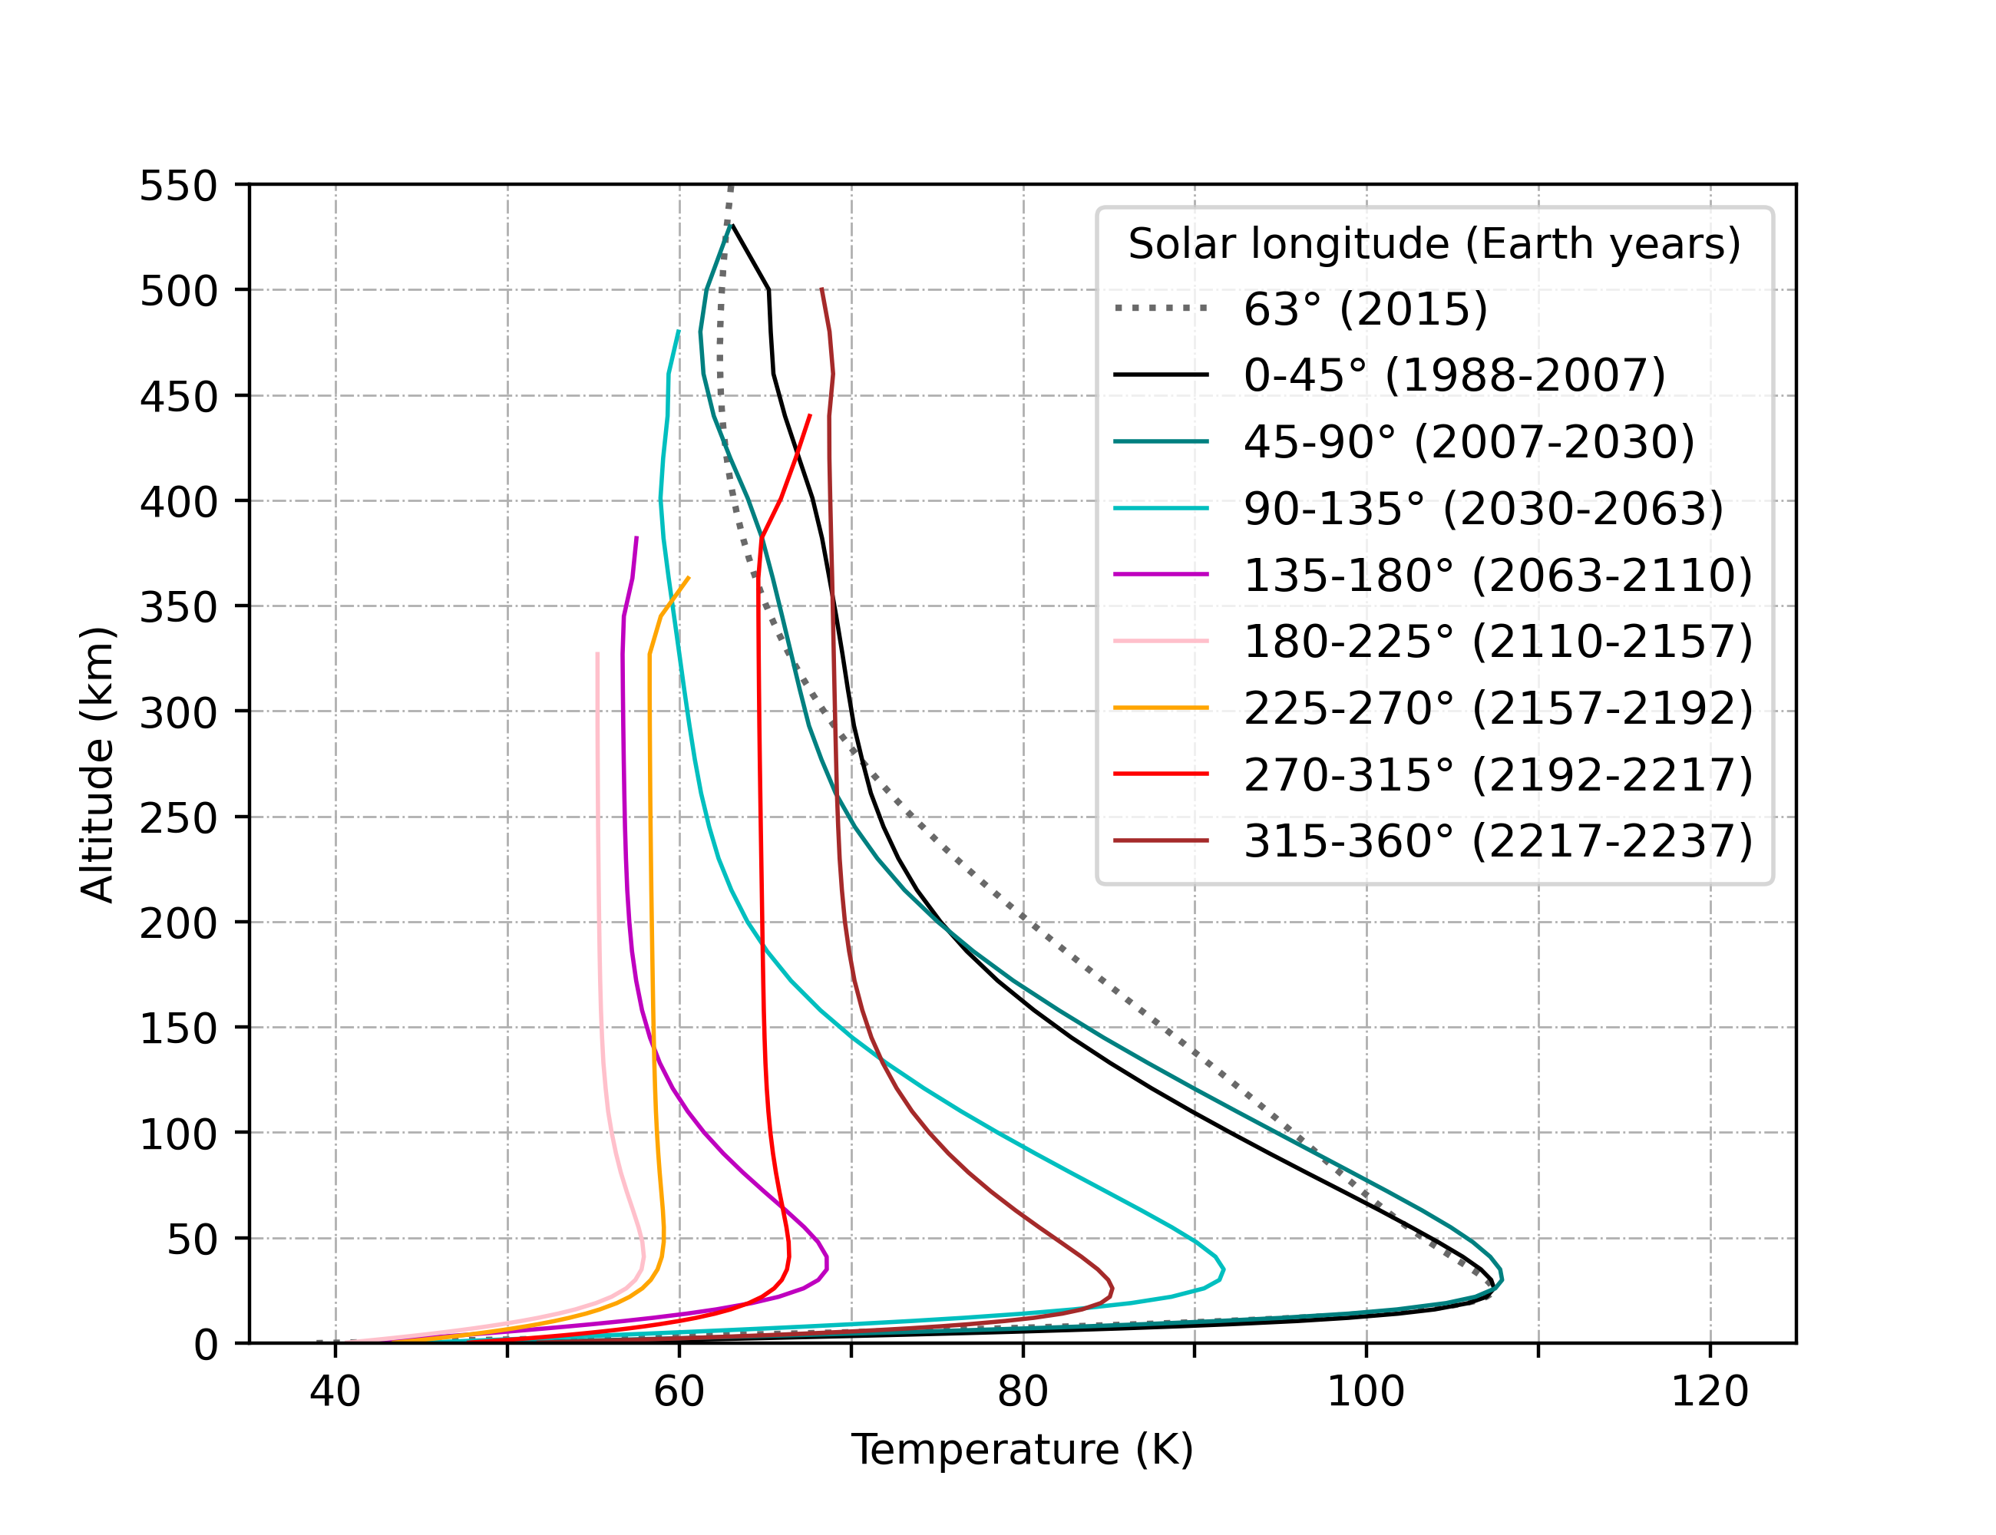
Appendix – Evolution of the temperature profile over a Pluto year

Slide 23
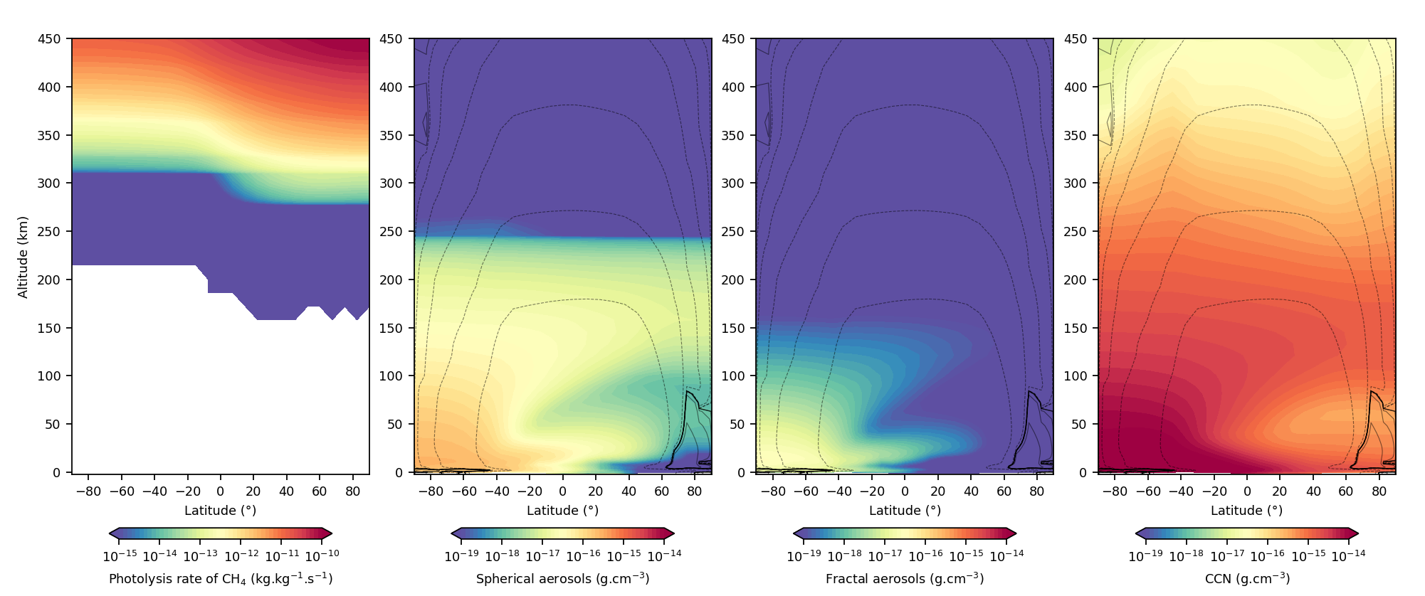
Appendix – Latitudinal distribution of Pluto’s haze
Production: Spherical aerosols in the upper atmosphere of the Northern Hemisphere (> 350 km).
Evolution: Once formed, the spherical aerosols act as condensation nuclei for chemical species.
Below 200 km, the increase in temperature allows a fraction of these spherical aerosols to persist.
Transport: Haze particles follow the atmospheric circulation and enrich of the south pole in aerosols (< 200 km).

Slide 24
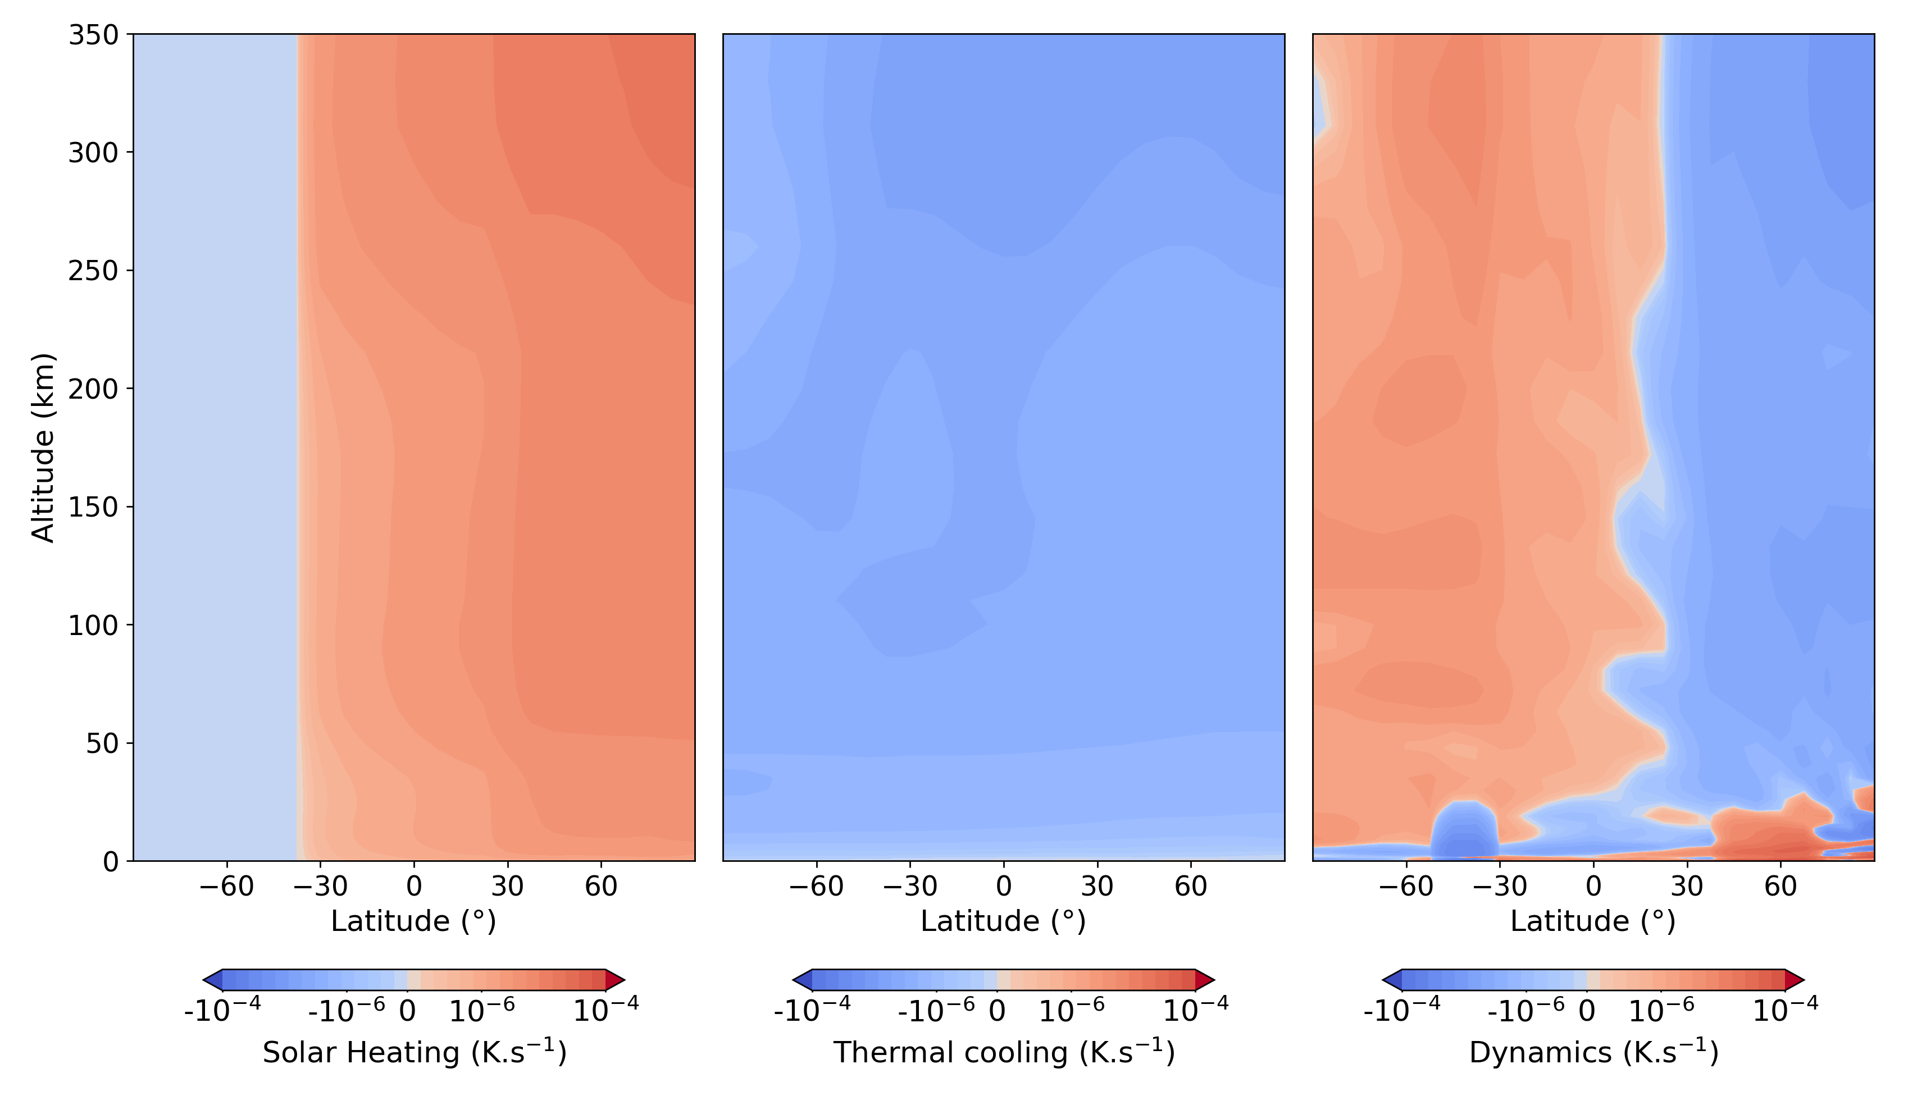
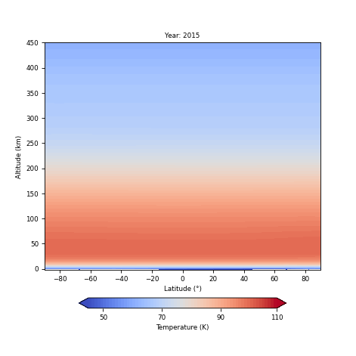
Appendix – Atmospheric radiative balance
Despite the asymmetry of the haze, the temperature shows no latitudinal variation.
Heating: Shortwave absorption by haze in the Northern Hemisphere.
Cooling: South polar night + Radiative cooling in the Southern Hemisphere.
Effective atmospheric mixing through dynamics.

Slide 25
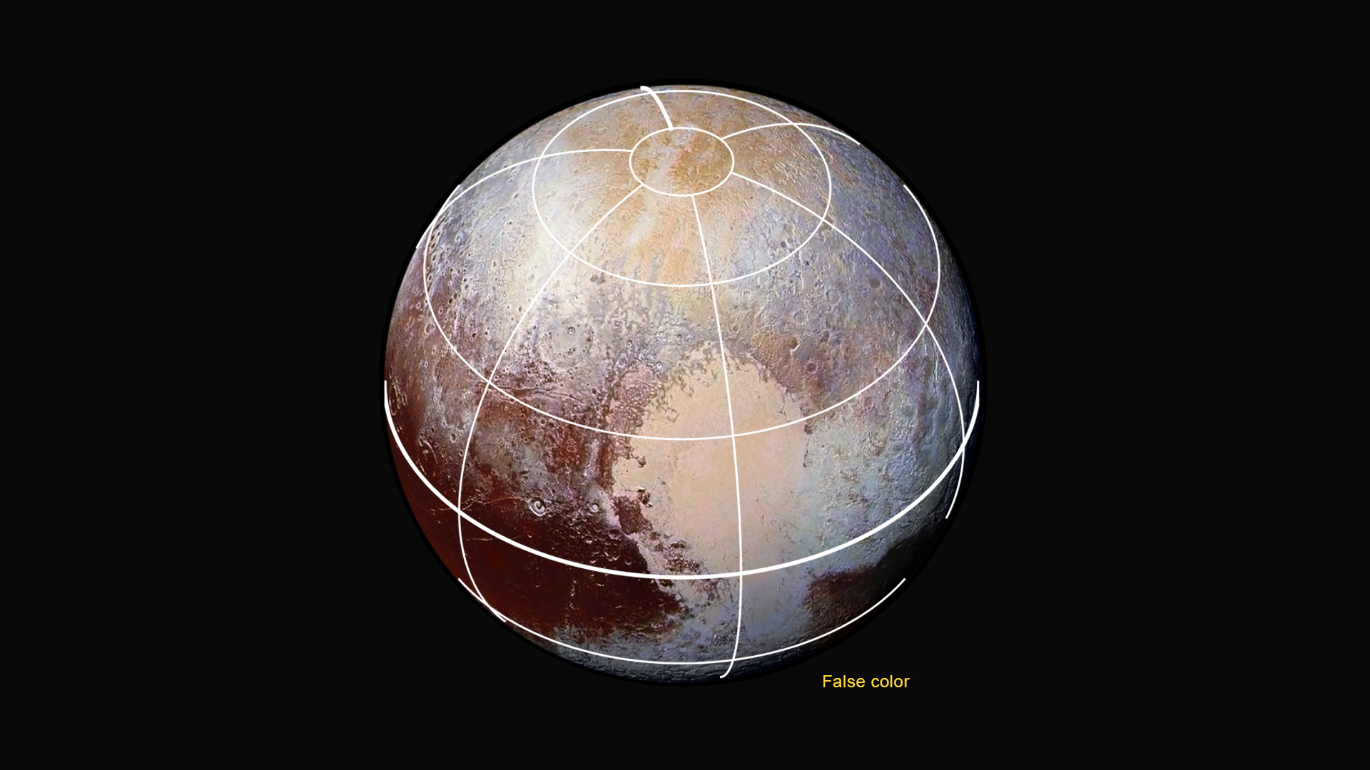
Appendix – Impact of haze on Pluto’s surface
CH₄-rich
“gold terrains”
Mixtures
of N₂-rich ices
Mixtures
of CH₄-rich ices
Tholins-covered terrains “Cthulhu”
CH₄-rich Bladed Terrain
Sputnik Planitia ice sheet
N₂ (+ CH₄ + CO)

