Slide 1






What would be the magnetic field of the Earth if it spun as slowly as Venus?
Henri-Claude Nataf¹, Nathanaël Schaeffer¹, Quentin Noraz², Allan Sacha Brun³ & Antoine Strugarek³
¹ISTerre, Univ. Grenoble Alpes, CNRS, Grenoble
²KU Leuven, Leuven, Belgique
³AIM, CEA, Univ. Paris-Saclay
Journées SF2A, June 23rd 2026
Notes:
A ajouter :
update PREM ~2008 ?
Badro

Slide 2
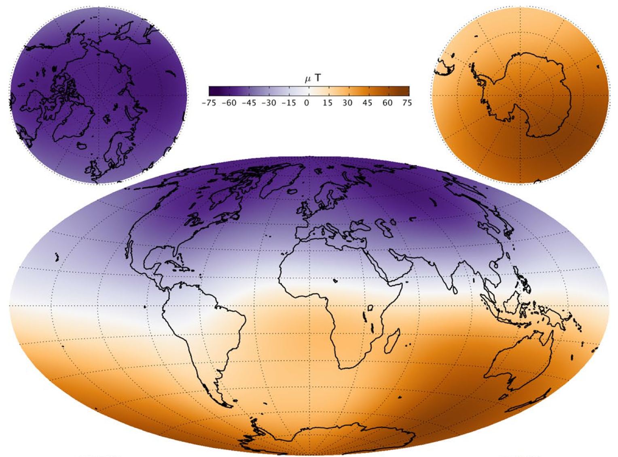
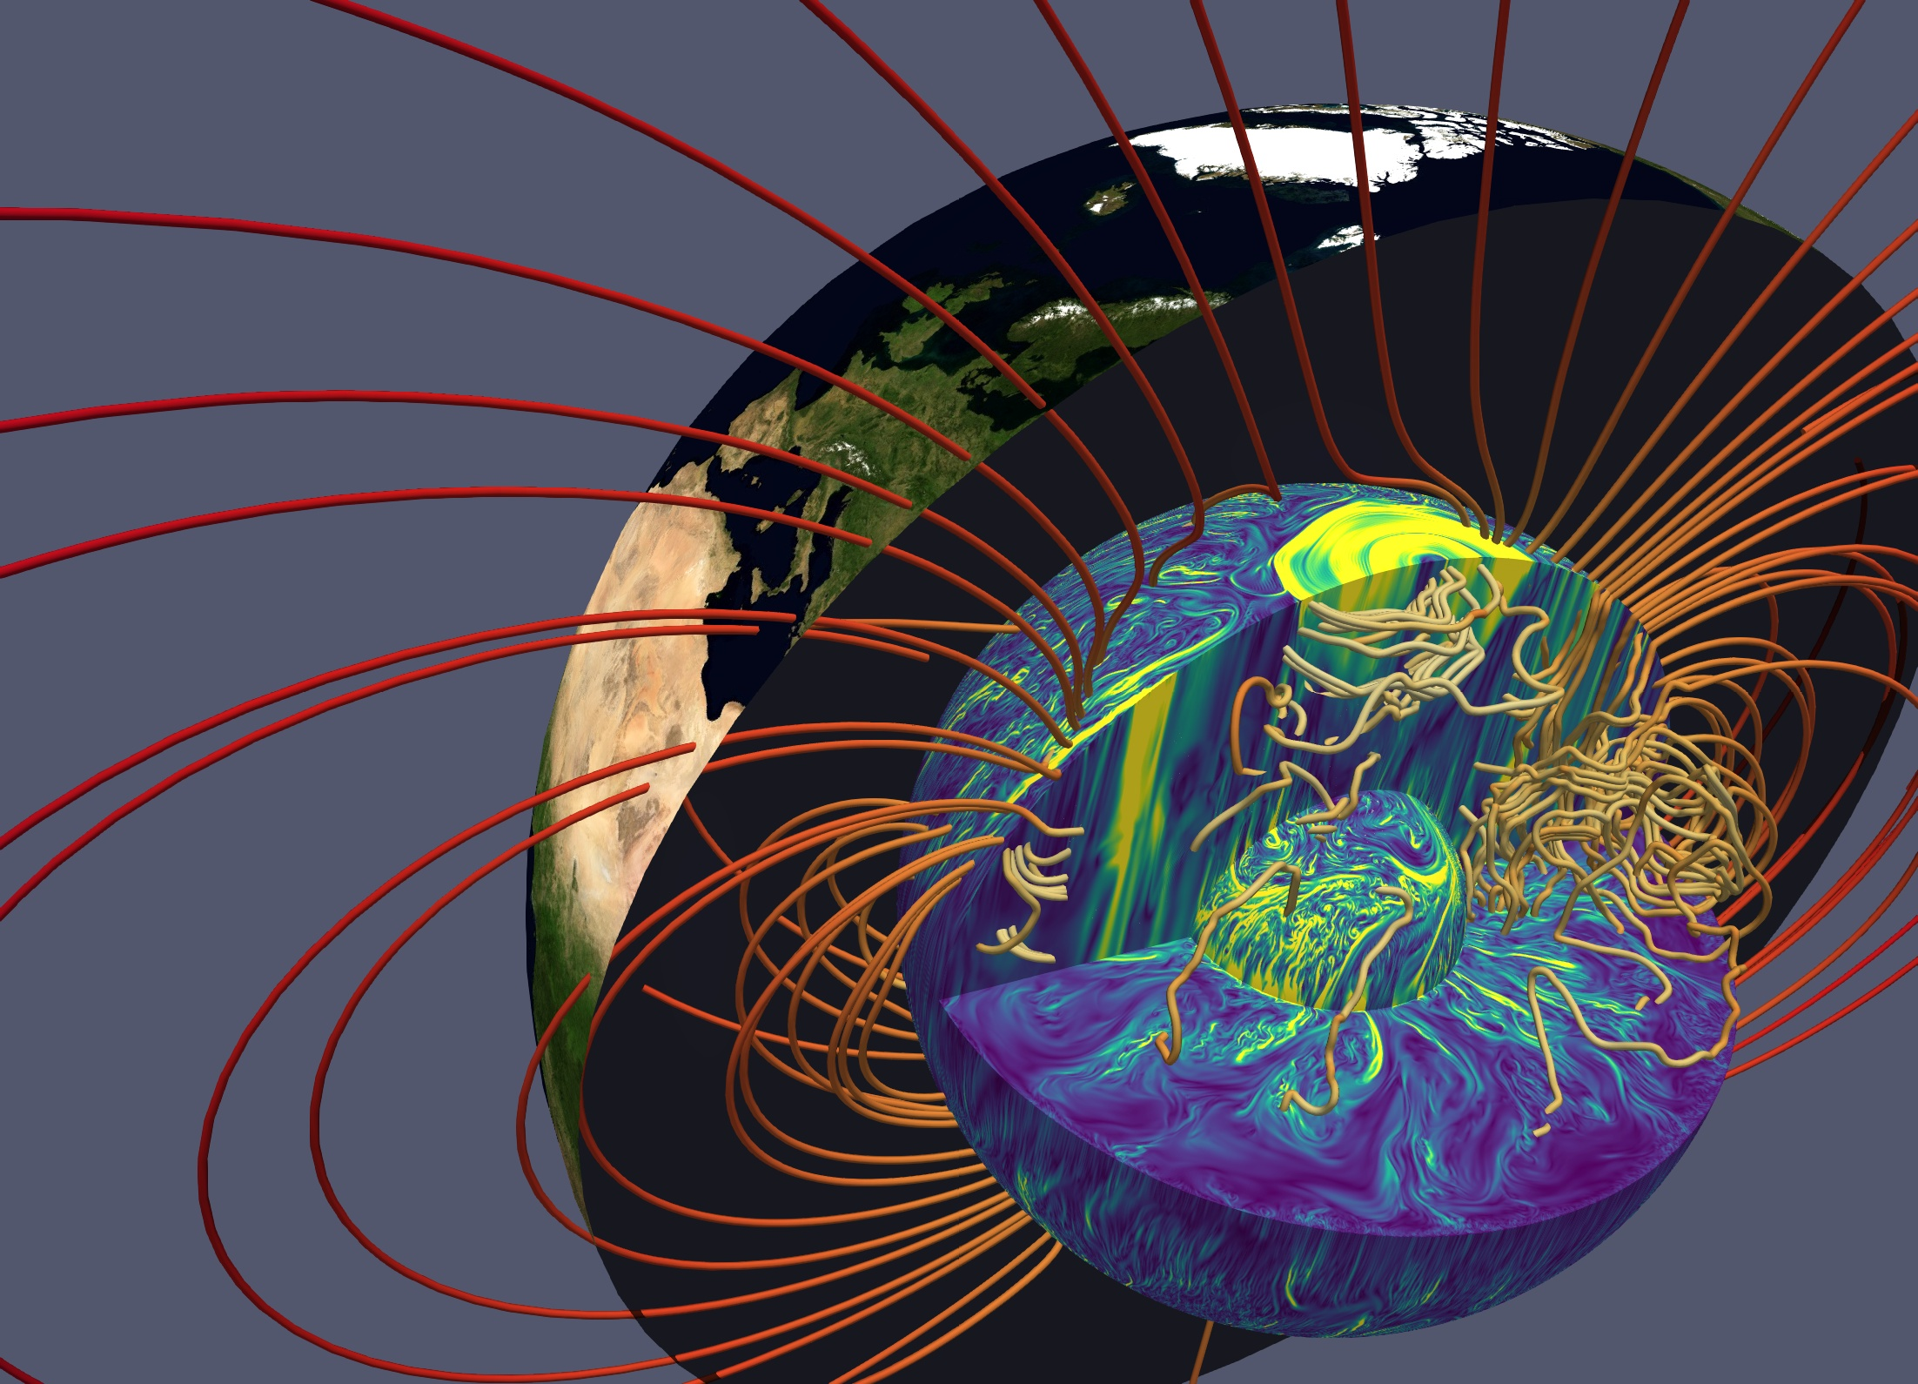
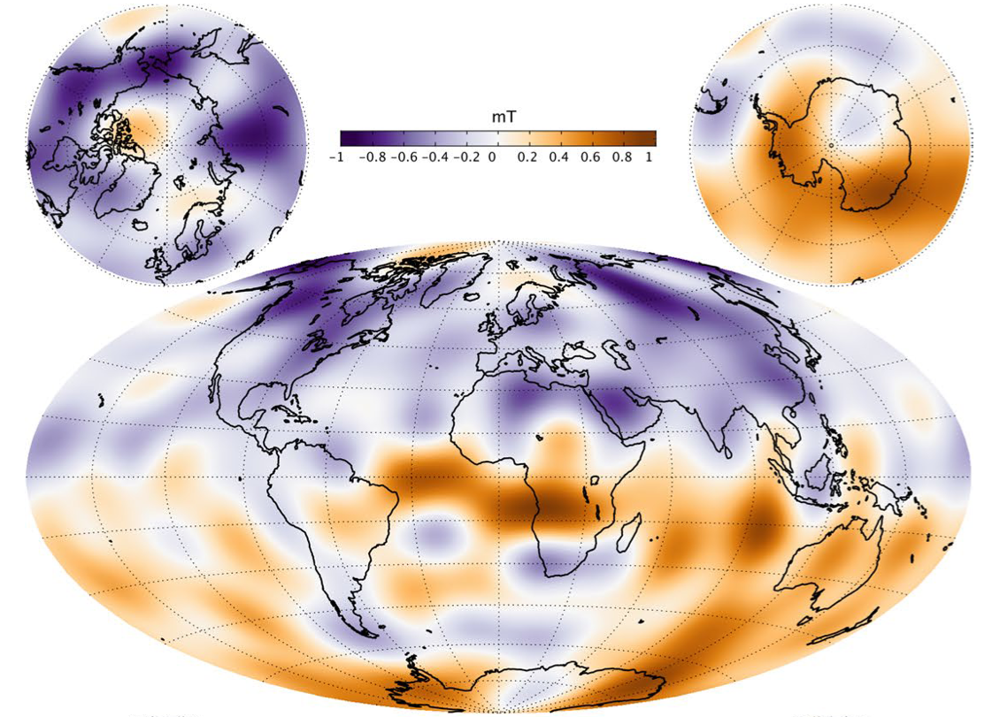
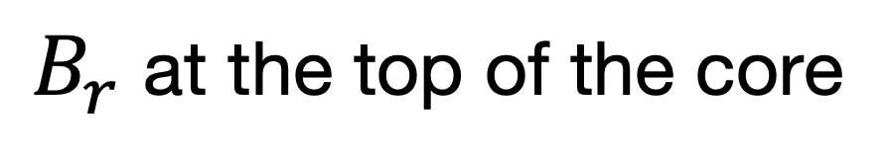
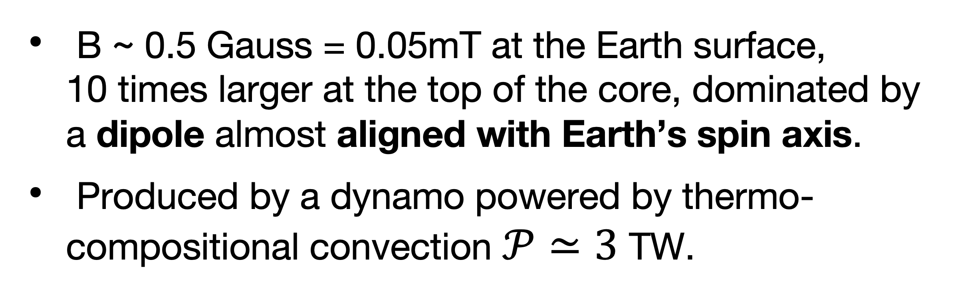
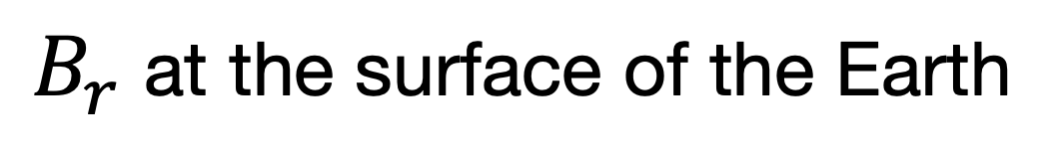
The magnetic field of the Earth
$B_{r}$ at the surface of the Earth
B ~ 0.5 Gauss = 0.05mT at the Earth surface, 10 times larger at the top of the core, dominated by a dipole almost aligned with Earth’s spin axis.
Produced by a dynamo powered by thermo-compositional convection $𝒫≃3$ TW.
$B_{r}$ at the top of the core
Finlay+ 2020
Schaeffer+ 2017
Notes:
Human power consumption ~20 TW

Slide 3
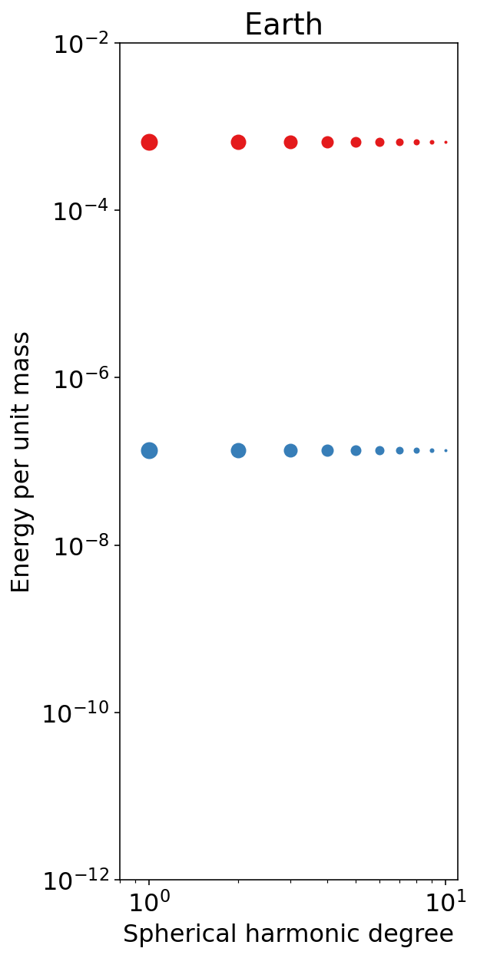
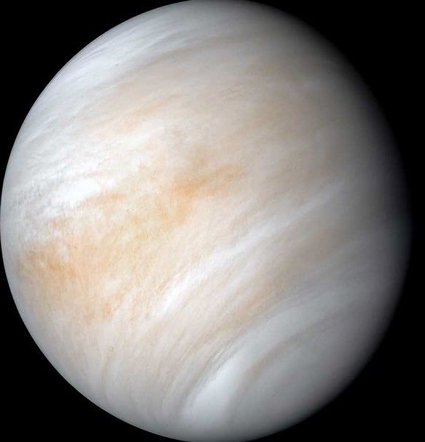
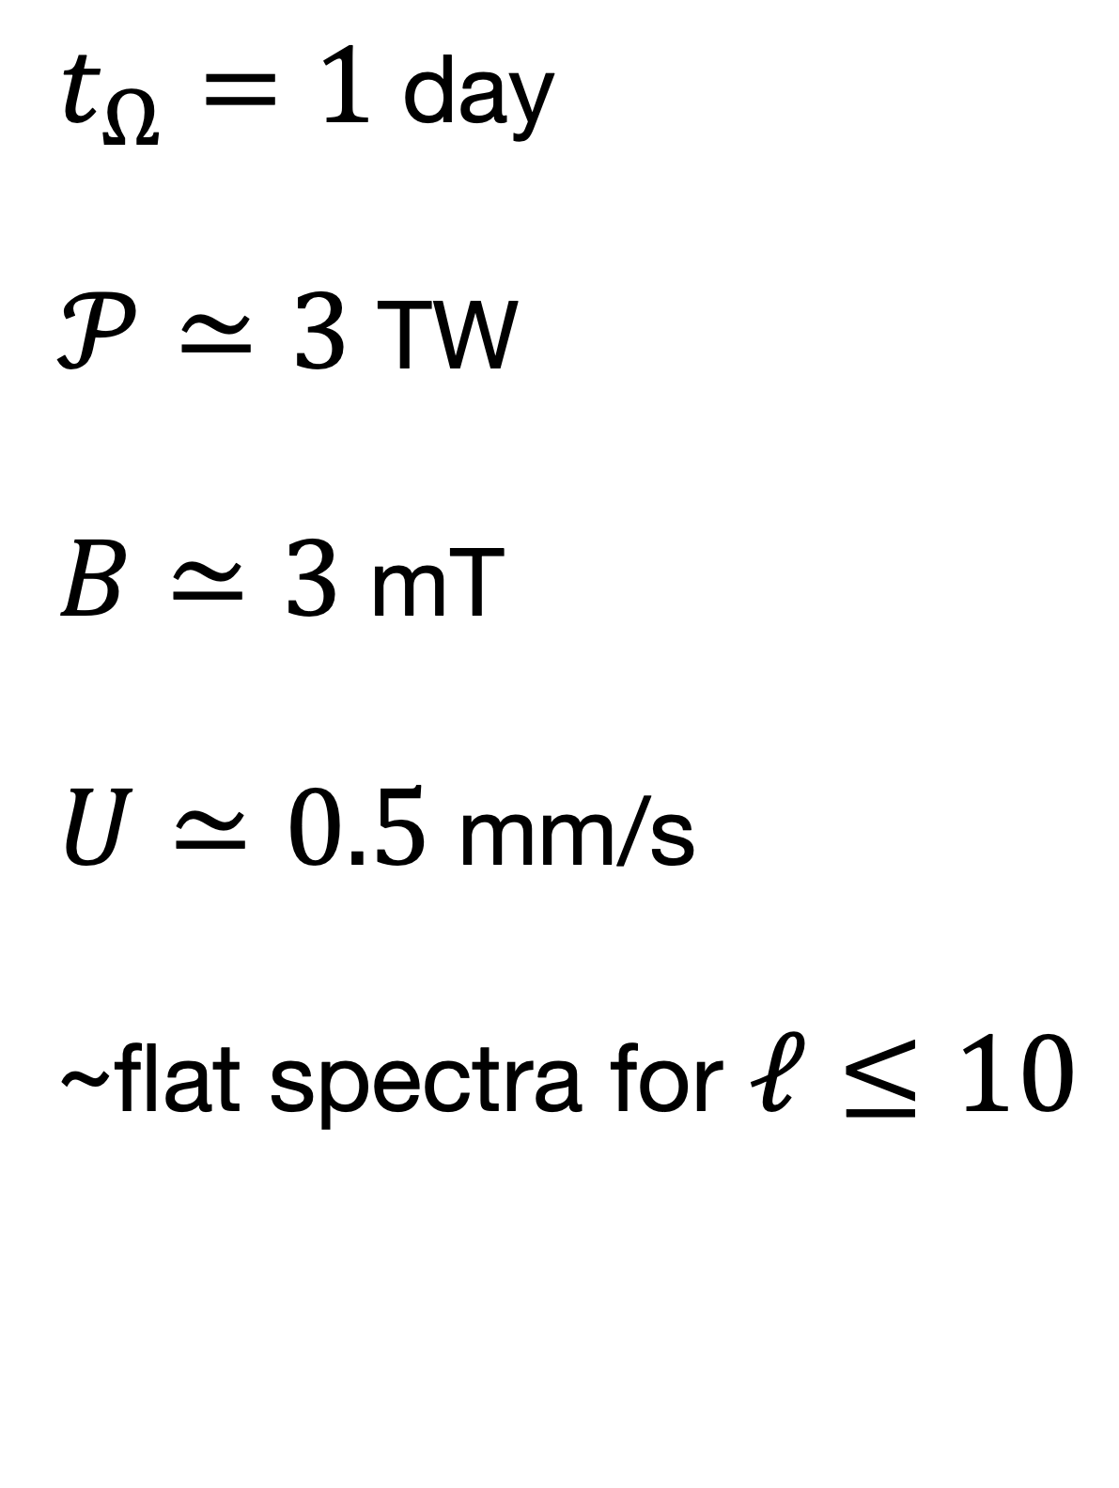
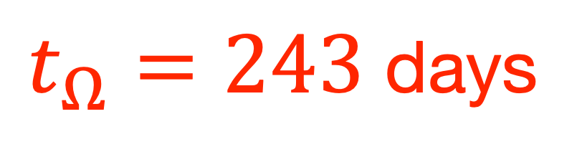
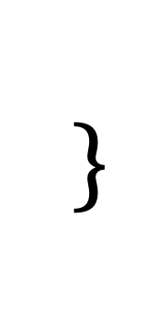
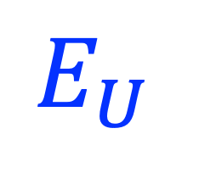

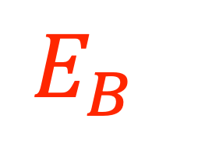
Important properties of the Earth dynamo
How would they change if the Earth spun as slowly as Venus?
$$E_{B}$$
$t_{Ω}=1$ day
$𝒫≃3$ TW
$B≃3$ mT
$U≃0.5$ mm/s
~flat spectra for $ℓ≤10$
$$E_{U}$$
$$\}$$
$$⟹\frac{E_{B}}{E_{U}}∼5000$$
$t_{Ω}=243$ days
Roberts+ 2013; Gillet+2015
Notes:
https://science.nasa.gov/image-detail/amf-61883af6-98cf-4d1d-b68e-84db3b21248c/
Venus From Mariner 10
As it sped away from Venus, NASA's Mariner 10 spacecraft captured this seemingly peaceful view of a planet the size of Earth, wrapped in a dense, global cloud layer. But, contrary to its serene appearance, the clouded globe of Venus is a world of intense heat, crushing atmospheric pressure and clouds of corrosive acid. This image updates the original data using modern image processing software.

Slide 4
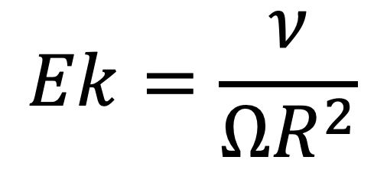
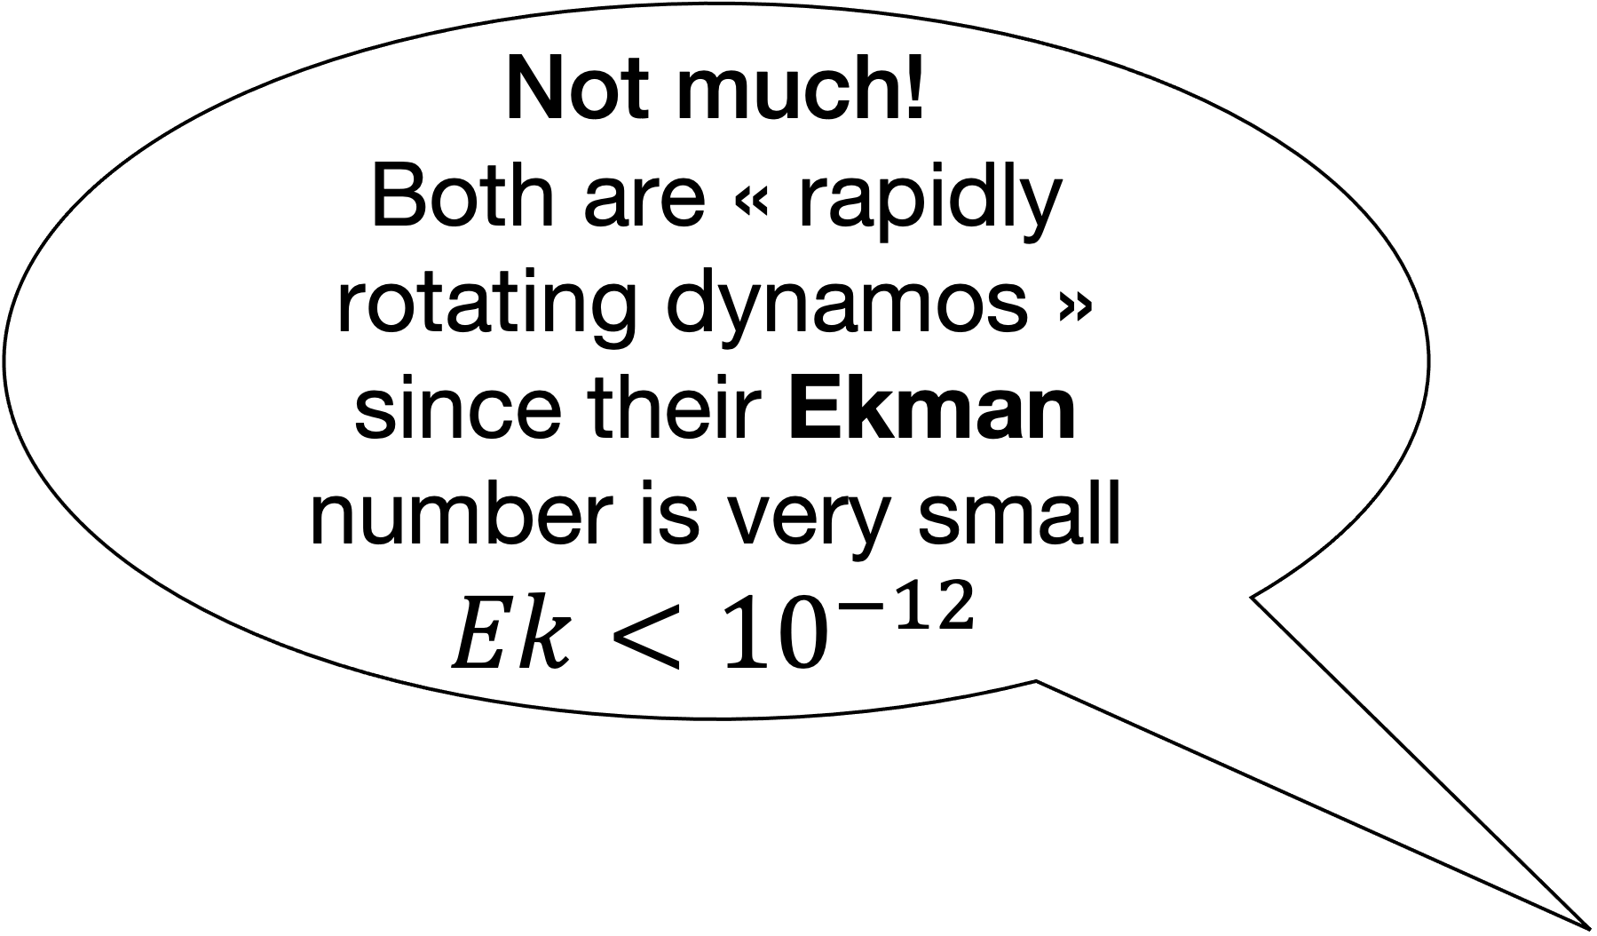
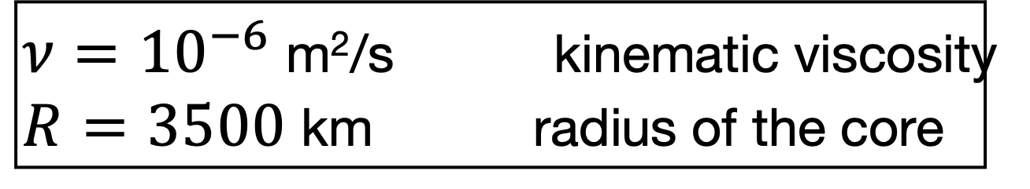
The classical answer is…
Not much!
Both are « rapidly rotating dynamos » since their Ekman number is very small
$$Ek<{10}^{−12}$$
$$Ek=\frac{ν}{ΩR^{2}}$$
$ν={10}^{−6}$ m²/s kinematic viscosity
$R=3500$ km radius of the core

Slide 5
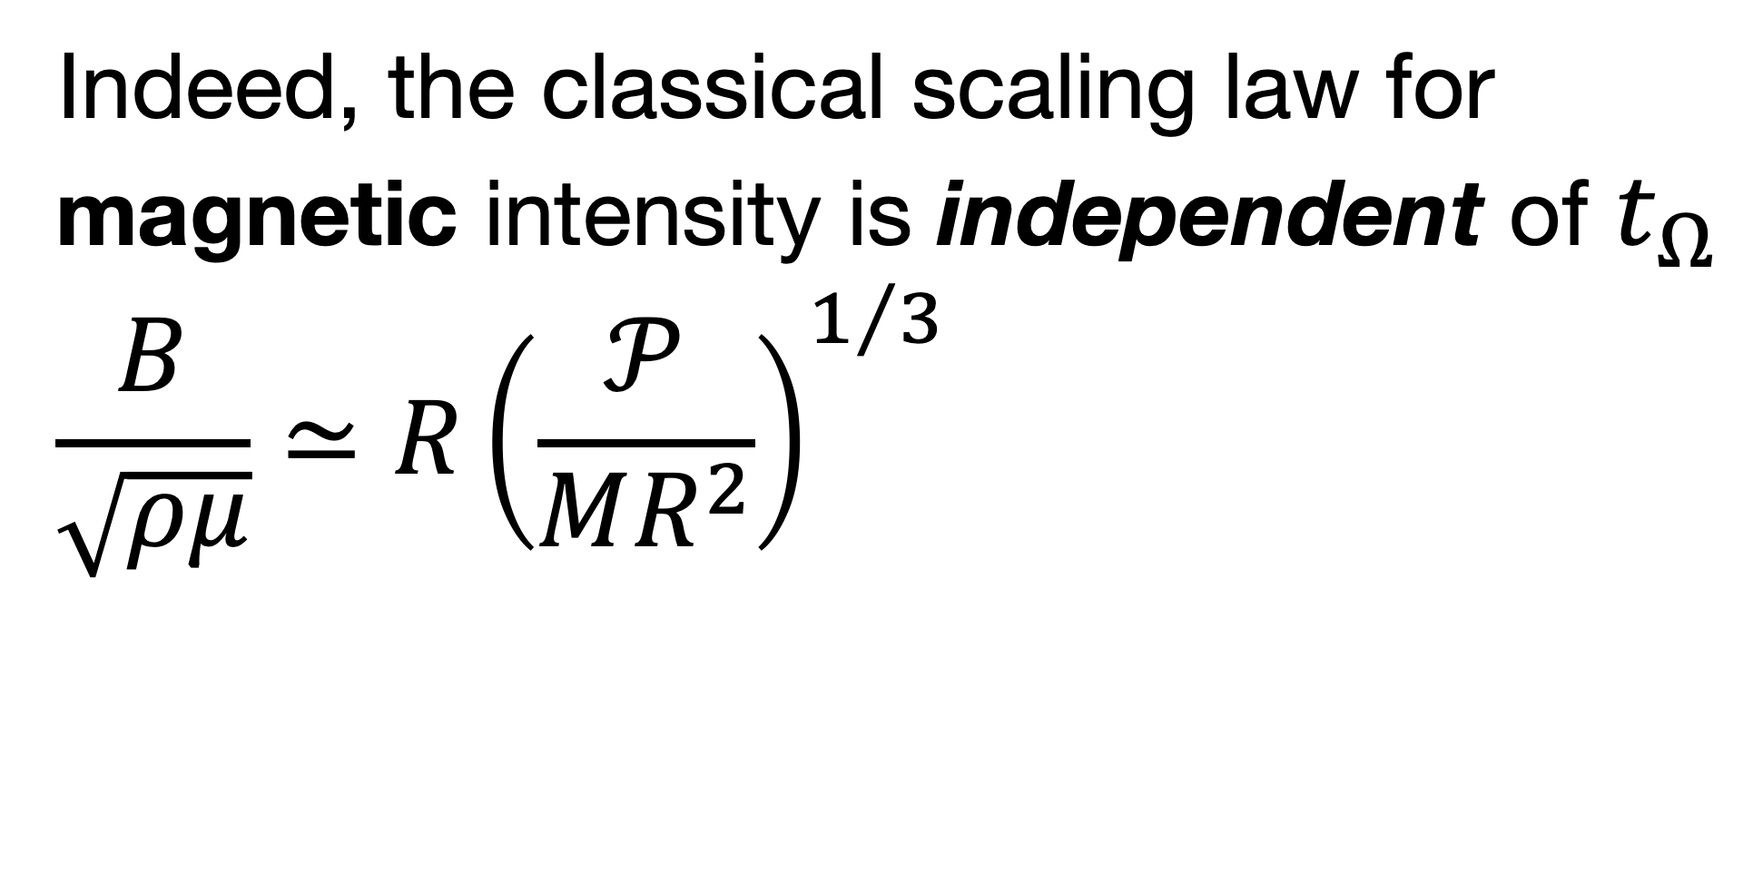
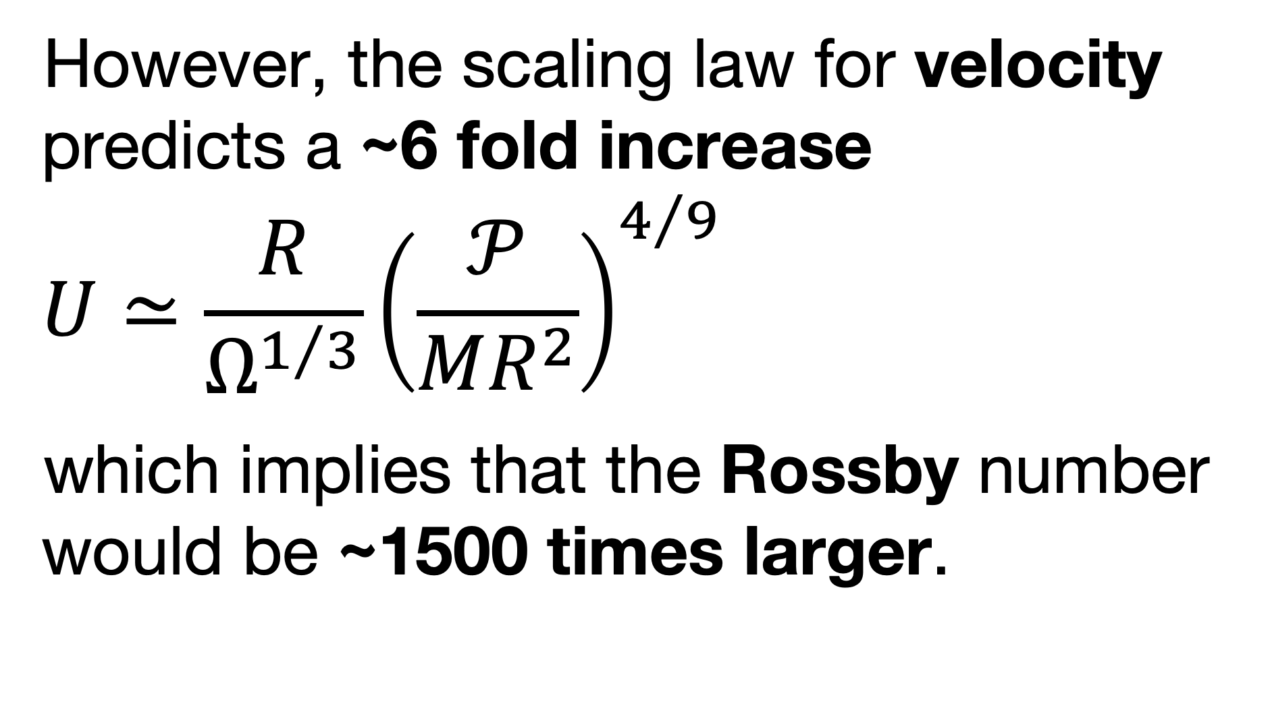
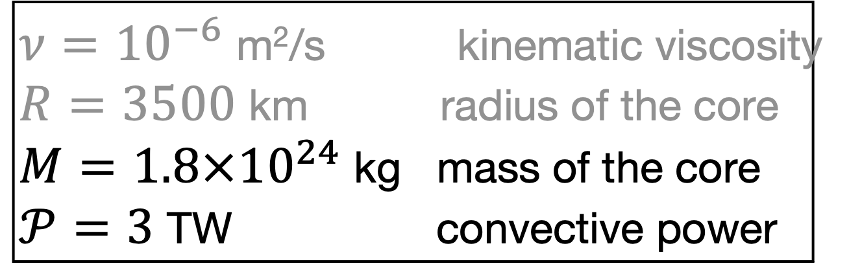
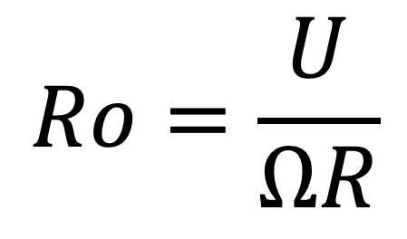
Scaling laws for planetary dynamos
Indeed, the classical scaling law for magnetic intensity is independent of $t_{Ω}$
$$\frac{B}{\sqrt{ρμ}}≃R{\left(\frac{𝒫}{MR^{2}}\right)}^{1/3}$$
However, the scaling law for velocity predicts a ~6 fold increase
$$U≃\frac{R}{Ω^{1/3}}{\left(\frac{𝒫}{MR^{2}}\right)}^{4/9}$$
which implies that the Rossby number would be ~1500 times larger.
Christensen 2010
Davidson 2013
$$Ro=\frac{U}{ΩR}$$
force balance
These laws apply to dynamos in the QG-MAC regime (Quasi-Geostrophic Magneto-Archimedean-Coriolis)
$ν={10}^{−6}$ m²/s kinematic viscosity
$R=3500$ km radius of the core
$M=1.8×{10}^{24}$ kg mass of the core
$𝒫=3$ TW convective power

Slide 6
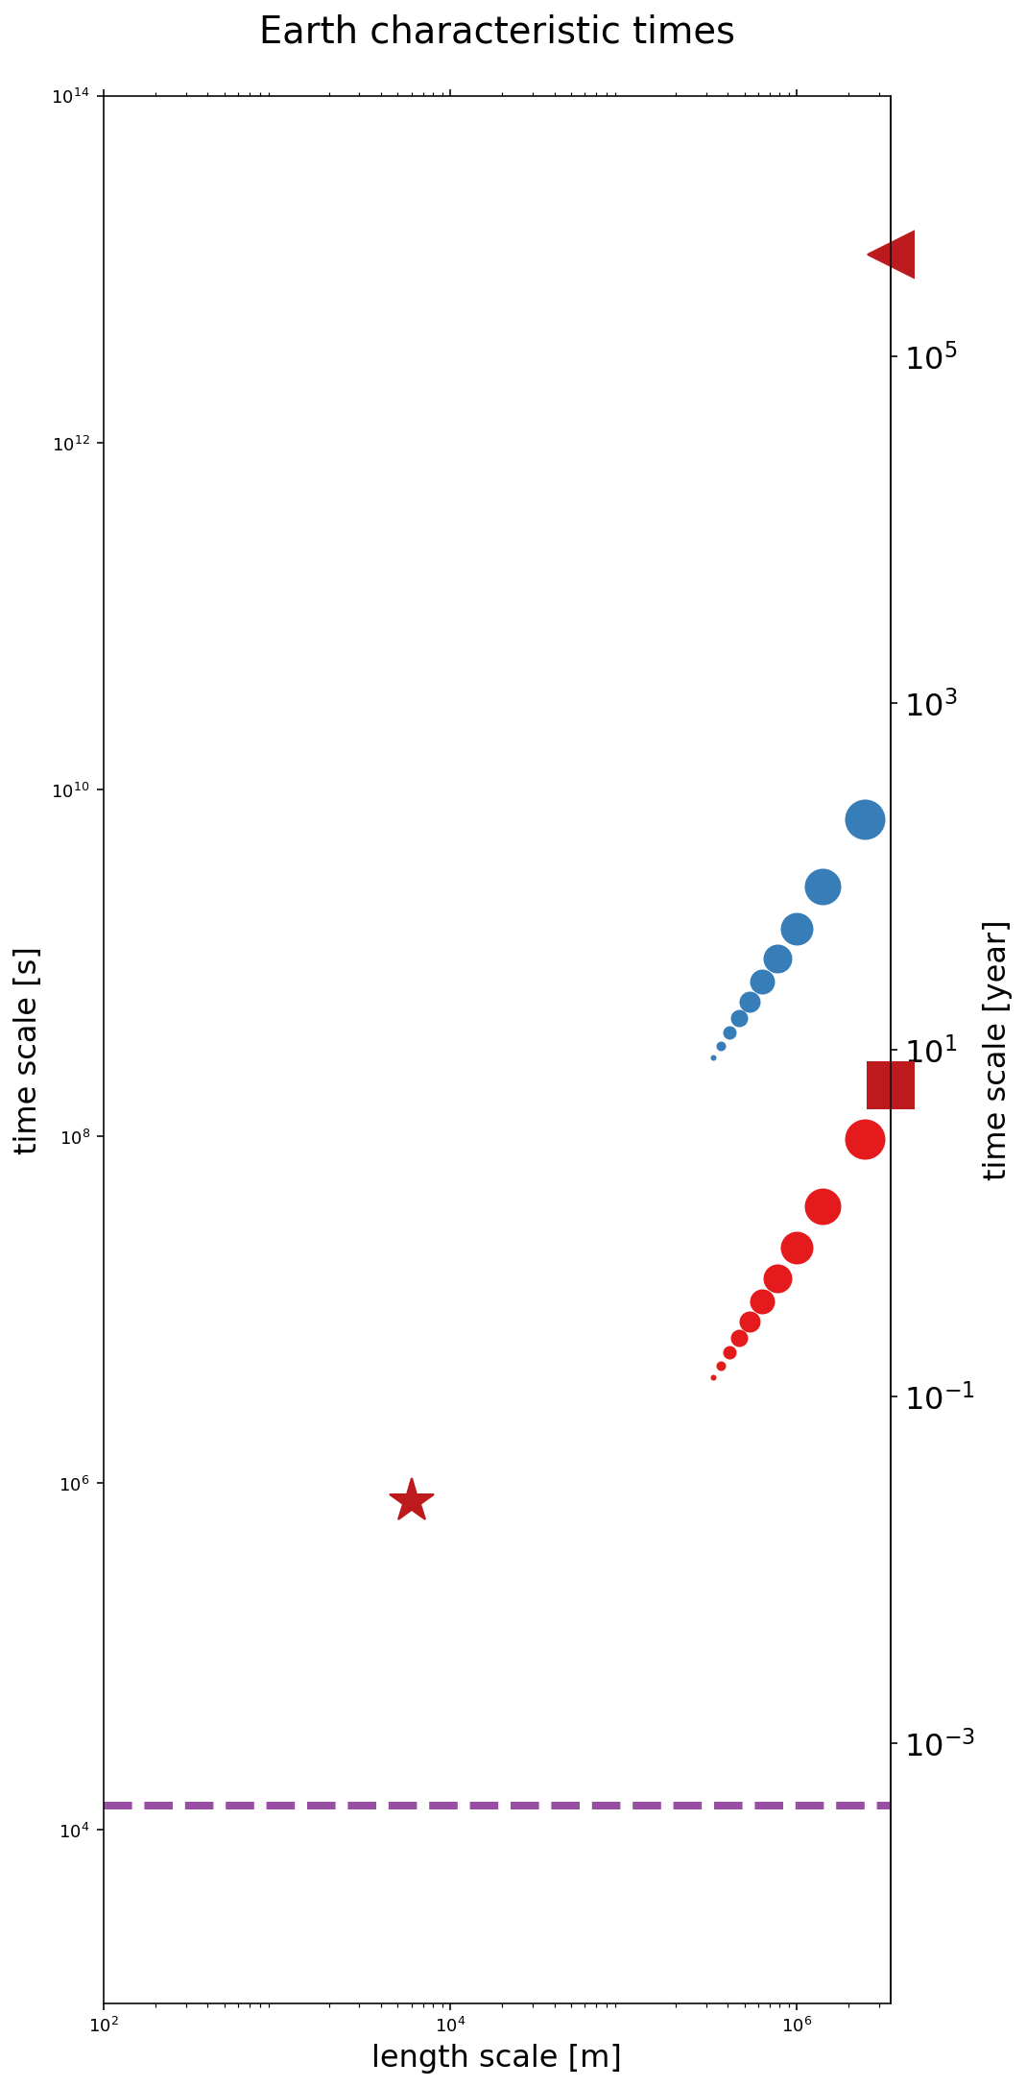
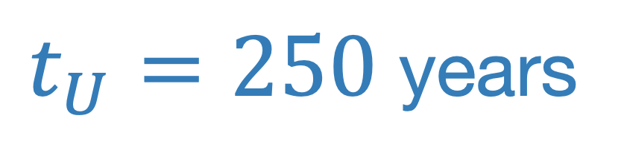
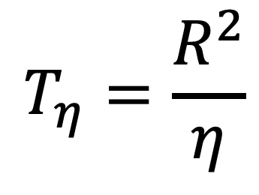
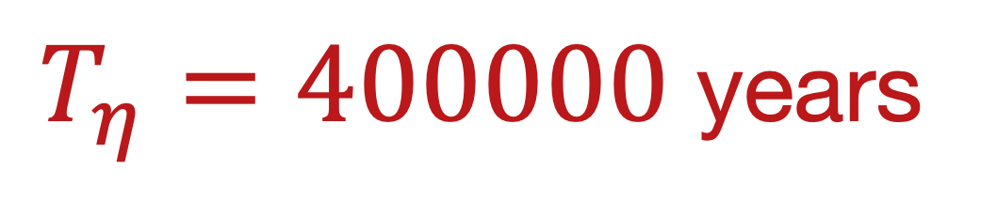
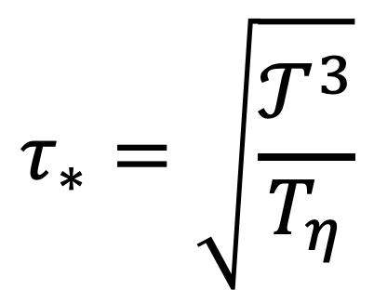
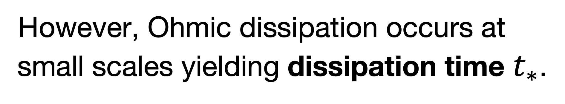
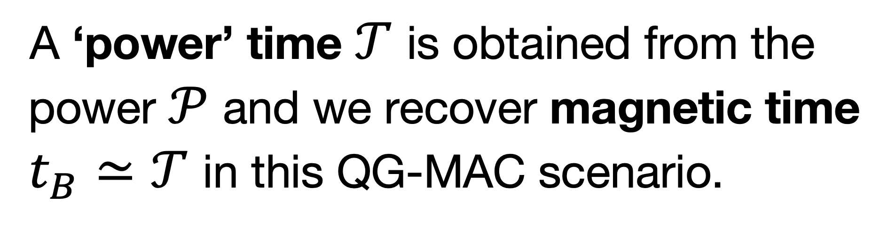
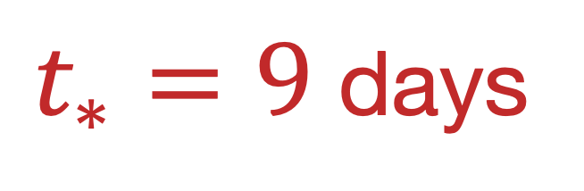
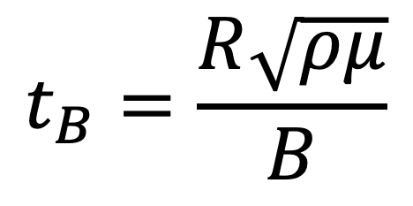
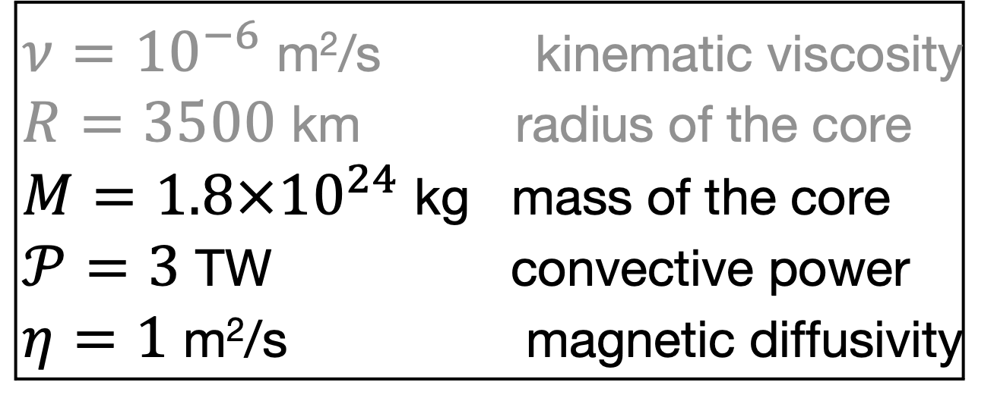
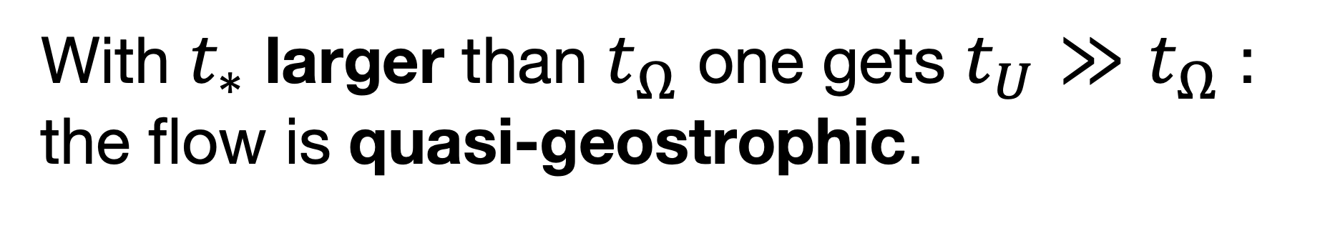
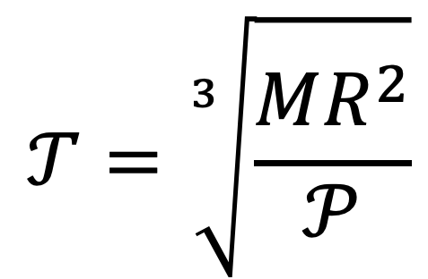
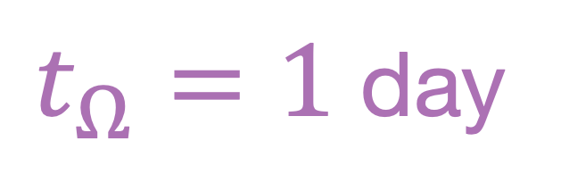
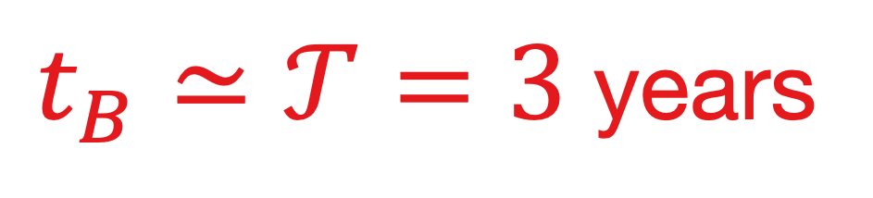
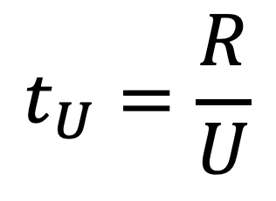
QG-MAC characteristic times for the Earth
time (log scale)
A ‘power’ time $𝒯$ is obtained from the power $𝒫$ and we recover magnetic time $t_{B}≃𝒯$ in this QG-MAC scenario.
$T_{η}=400000$ years
$$T_{η}=\frac{R^{2}}{η}$$
However, Ohmic dissipation occurs at small scales yielding dissipation time $t_{∗}$.
$t_{U}=250$ years
$$t_{U}=\frac{R}{U}$$
$$t_{B}=\frac{R\sqrt{ρμ}}{B}$$
With $t_{∗}$ larger than $t_{Ω}$ one gets $t_{U}≫t_{Ω}$ : the flow is quasi-geostrophic.
$t_{B}≃𝒯=3$ years
$$𝒯=\sqrt[3]{\frac{MR^{2}}{𝒫}}$$
$$τ_{∗}=\sqrt{\frac{𝒯^{3}}{T_{η}}}$$
$t_{∗}=9$ days
$ν={10}^{−6}$ m²/s kinematic viscosity
$R=3500$ km radius of the core
$M=1.8×{10}^{24}$ kg mass of the core
$𝒫=3$ TW convective power
$η=1$ m²/s magnetic diffusivity
$t_{Ω}=1$ day
3D
Notes:
t_eta = 384018 years
t_diss = 194935573s = 6 years
t_A0 = 3 years
Earth :
t_SV = 212 years
t_star = 782091s = 9 days
Venus :
t_star = 782091s = 9 days
t_SV = t_A0

Slide 7
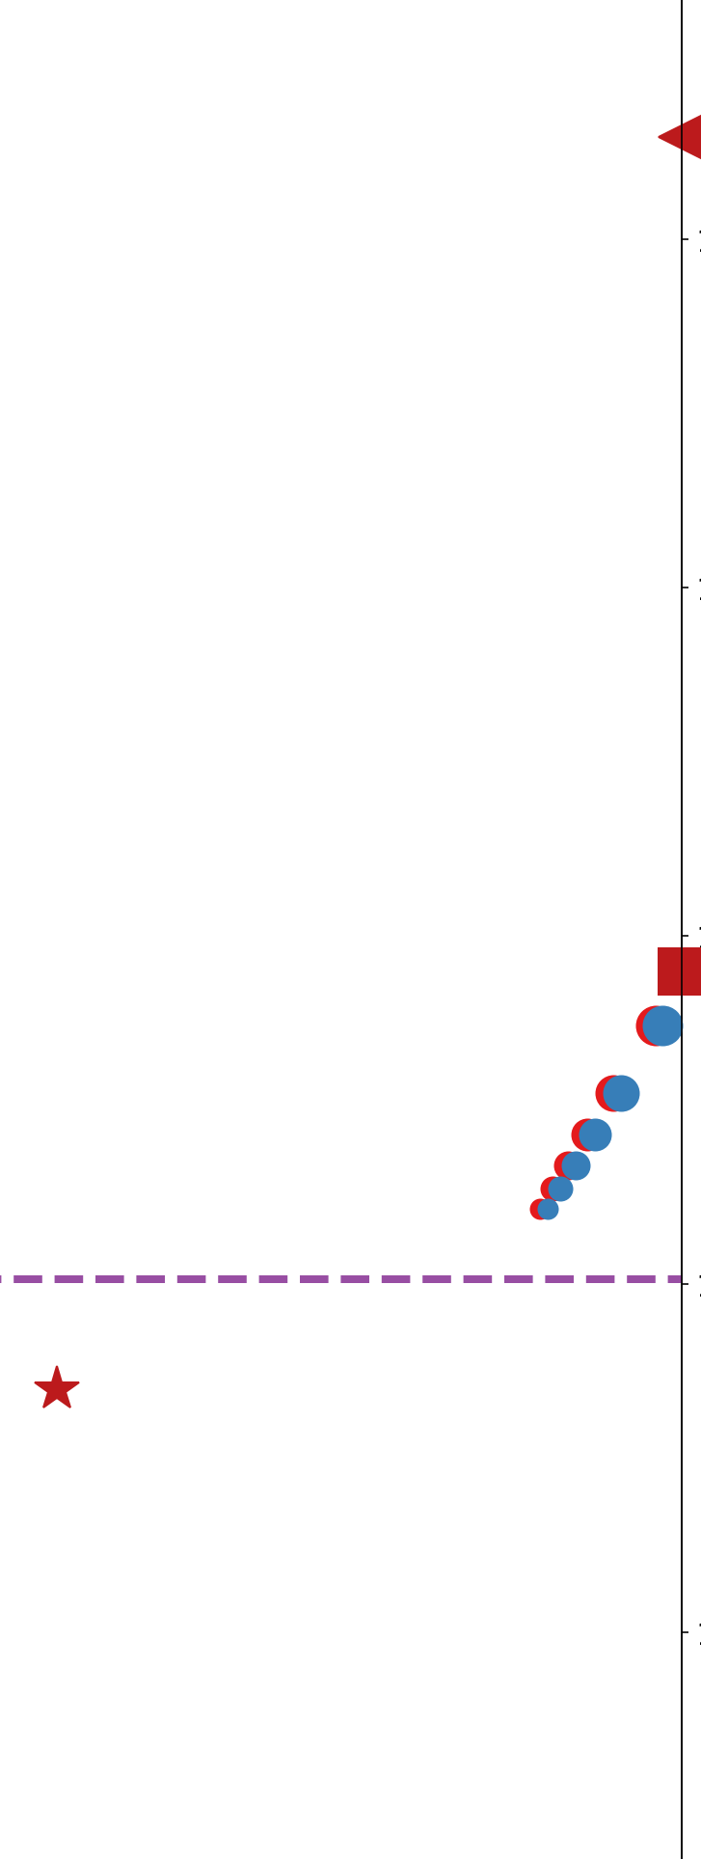
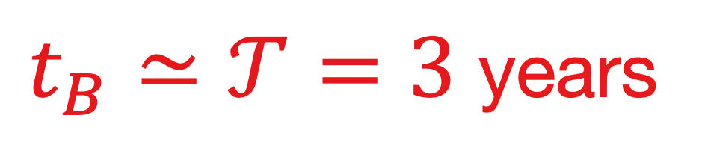


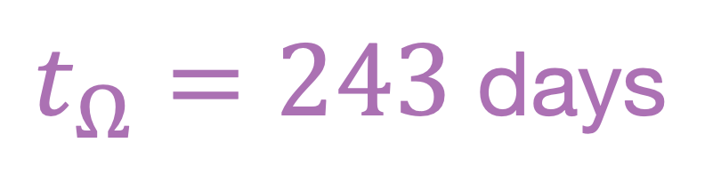
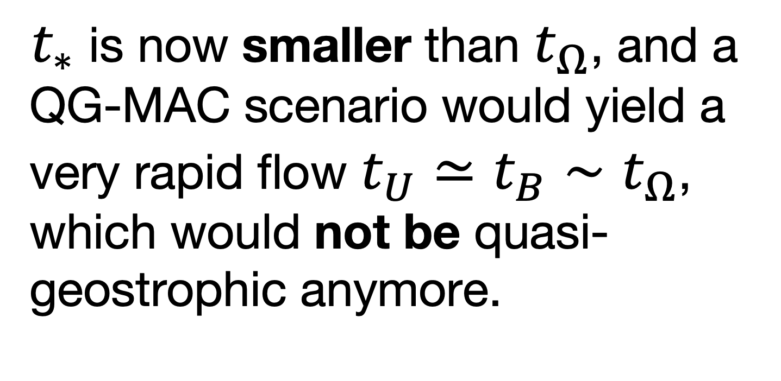

What about Venus?
time
time
$T_{η}=400000$ years
$t_{∗}$ is now smaller than $t_{Ω}$, and a QG-MAC scenario would yield a very rapid flow $t_{U}≃t_{B}∼t_{Ω}$, which would not be quasi-geostrophic anymore.
The QG-MAC scenario fails for Venus
$$t_{U}≃$$
$t_{B}≃𝒯=3$ years
$t_{Ω}=243$ days
$t_{∗}=9$ days
3D
$ν={10}^{−6}$ m²/s kinematic viscosity
$R=3500$ km radius of the core
$M=1.8×{10}^{24}$ kg mass of the core
$𝒫=3$ TW convective power
$η=1$ m²/s magnetic diffusivity
3D
Notes:
t_eta = 384018 years
t_diss = 194935573s = 6 years
t_A0 = 3 years
Earth :
t_SV = 212 years
t_star = 782091s = 9 days
Venus :
t_star = 782091s = 9 days
t_SV = t_A0

Slide 8
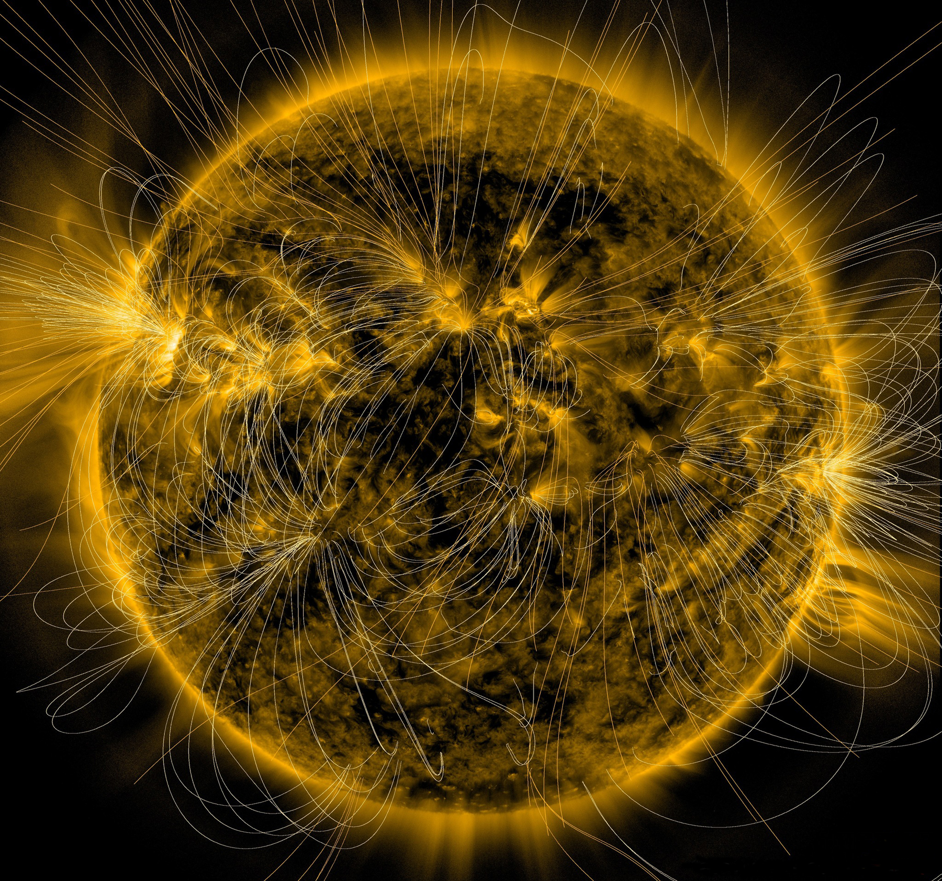
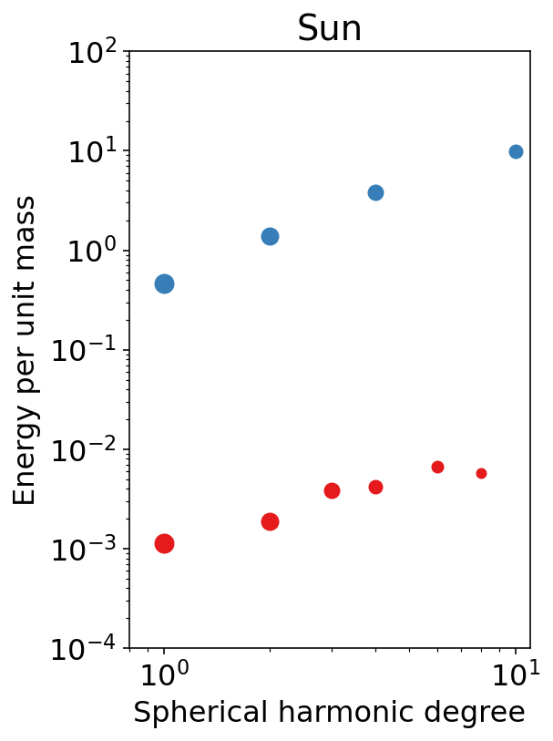
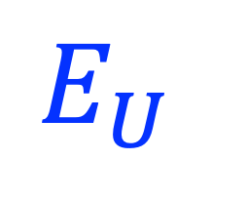
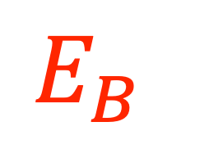
Another object has $t_{∗}$ smaller than $t_{Ω}$ : the Sun
Its kinetic energy is larger than its magnetic energy.
Small-scales dominate over large-scales.
The Solar dynamo can be modeled with an IMAC scenario, in which inertia plays an important role.
$$E_{U}$$
$$E_{B}$$
spectra adapted from
Proxhauf, 2021
and Finley & Brun, 2023
NASA/SDO/AIA/LMSAL image
Notes:
Picturing the Sun’s Magnetic Field
This illustration lays a depiction of the sun's magnetic fields over an image captured by NASA’s Solar Dynamics Observatory on March 12, 2016. The complex overlay of lines can teach scientists about the ways the sun's magnetism changes in response to the constant movement on and inside the sun. Note how the magnetic fields are densest near the bright spots visible on the sun – which are magnetically strong active regions – and many of the field lines link one active region to another. This magnetic map was created using the PFSS – Potential Field Source Surface – model, a model of the magnetic field in the sun’s atmosphere based on magnetic measurements of the solar surface. The underlying image was taken in extreme ultraviolet wavelengths of 171 angstroms. This type of light is invisible to our eyes, but is colorized here in gold. Credits: NASA/SDO/AIA/LMSAL NASA image use policy. NASA Goddard Space Flight Center enables NASA’s mission through four scientific endeavors: Earth Science, Heliophysics, Solar System Exploration, and Astrophysics. Goddard plays a leading role in NASA’s accomplishments by contributing compelling scientific knowledge to advance the Agency’s mission.

Slide 9
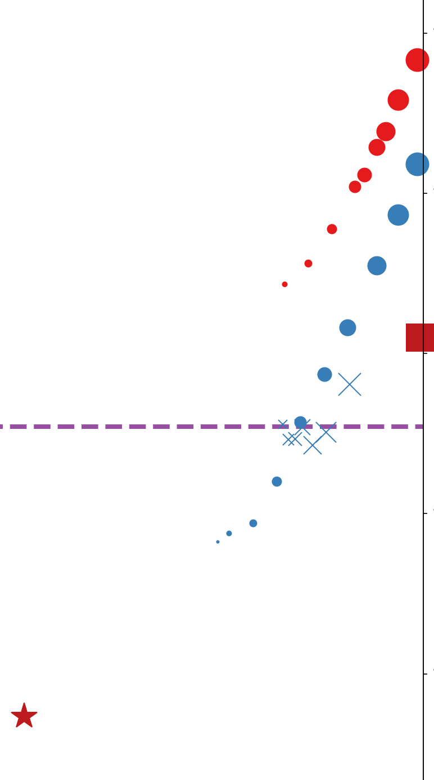
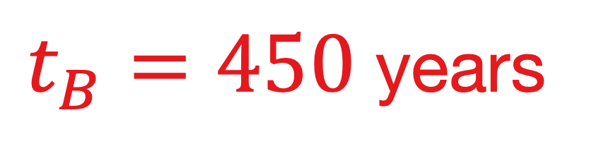
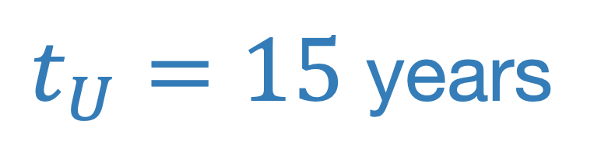
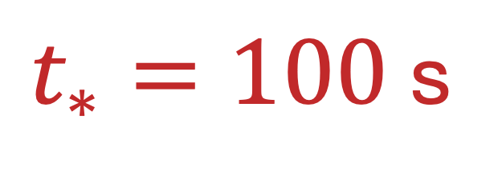
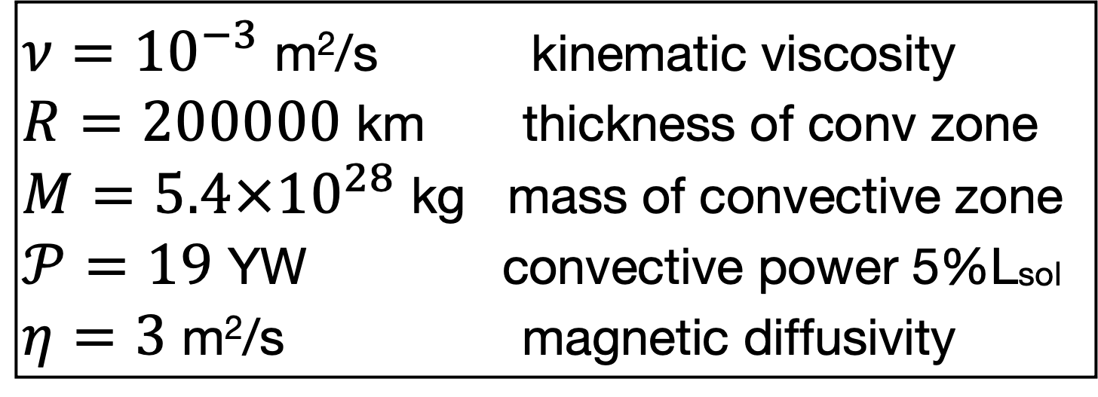
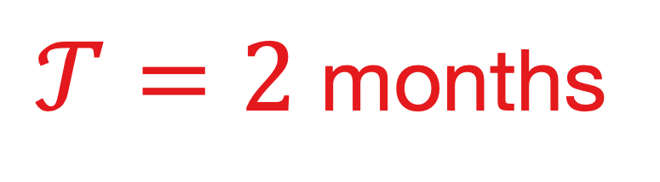


IMAC characteristic times for the Sun
$t_{∗}≪t_{Ω}$ in the convective zone of the Sun. An IMAC force balance controls the dynamo and $t_{U}≪t_{B}$.
time
$t_{B}=450$ years
$t_{U}=15$ years
force balance
Inertia-Magneto-Archimedean-Coriolis
$𝒯=2$ months
$t_{Ω}=25$ days
3D
$ν={10}^{−3}$ m²/s kinematic viscosity
$R=200000$ km thickness of conv zone
$M=5.4×{10}^{28}$ kg mass of convective zone
$𝒫=19$ YW convective power 5%Lsol
$η=3$ m²/s magnetic diffusivity
$t_{∗}=100$ s
Notes:
Sun :
t_eta = 442706410 years
t_diss = 4954564s = 2 months
t_star = 95s
t_A0 = 460 years
t_SV = 16 years
Venus :
t_SV = 200 years
t_A0 =

Slide 10











An IMAC force-balance dynamo for Venus
time
$E_{B}$ (Earth)
An IMAC force-balance scenario for Venus predicts that its large-scale magnetic field would be 10 000 times smaller than that of the Earth.
It would be dominated by small-scales, and might therefore have escaped detection…
Zonal flows could be strong.
$t_{B}=30000$ years
$E_{U}$ (Venus)
$t_{U}=200$ years
$E_{U}$ (Earth)
$𝒯=6$ years
$t_{Ω}=243$ days
$E_{B}$ (Venus)
$t_{∗}=9$ days
3D
Notes:
O’Rourke+ 2023 :
Pioneer Venus Orbiter and Venus Express placed the most precise upper limit so far on the total magnetic moment of Venus, which is at least ∼10^5 times lower than Earth’s modern magnetic moment.

Slide 11
Take-home messages
The classical view is that both Earth and Venus should belong to the same class of « rapidly rotating dynamos ».
Stevenson, 2003, 2010
We show that Venus cannot be
a rapidly rotating dynamo.
The classical explanation for the absence of a magnetic field on Venus is simply that its core would not be convecting today (or not strongly enough).
Stevenson+, 1983; Nimmo, 2002; Christensen, 2010
Our analysis suggests an alternative speculative scenario:
Venus is producing a weak small-scales dominated magnetic field that could have escaped detection…

Slide 12

$$t=t_{allocated}$$
Thank you!

Slide 13

to dwell further with $t>t_{allocated}$
Nataf H-C. & N. Schaeffer, Dynamic regimes in planetary cores: $τ−ℓ$ diagrams, Comptes Rendus Géoscience, 356, 1-30, DOI, 2024.
Noraz Q, A.S. Brun & A. Strugarek, Global turbulent solar convection: a numerical path investigating key force balances in the context of the convective conundrum, The Astrophysical Journal, 981 206, DOI, 2025.

Slide 14


$τ−ℓ$ diagrams

Slide 15


$τ−ℓ$ diagrams

