Slide 1

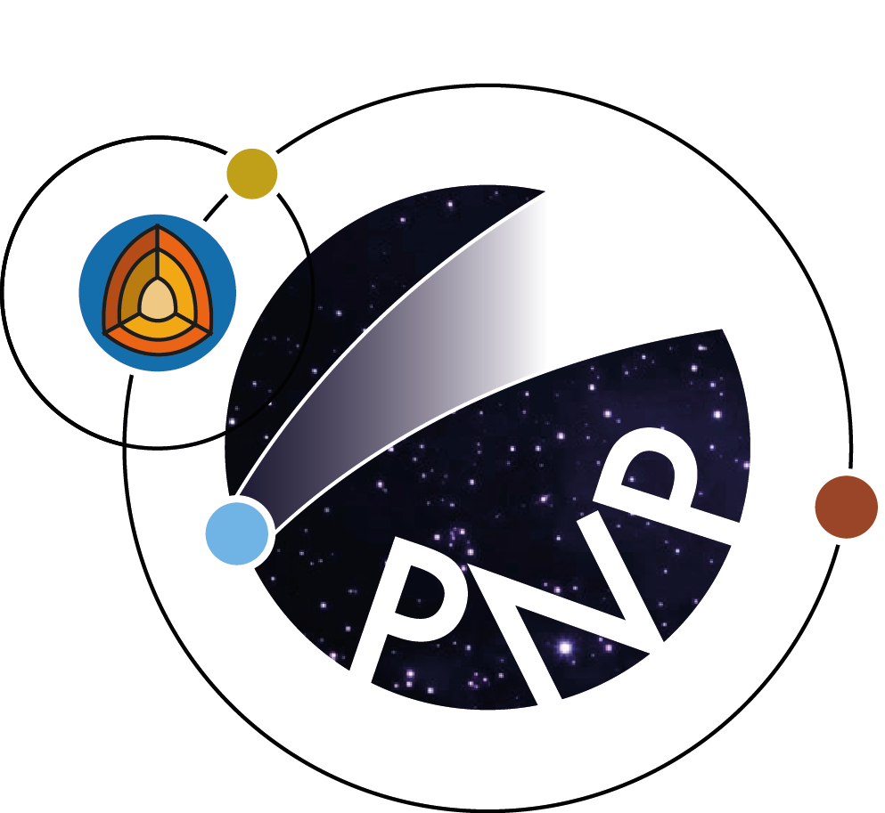
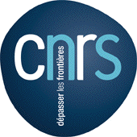

ZoRo: a laboratory experiment to explore the effects of rotation, ellipticity and flows in planetary seismology
Henri-Claude Nataf, Pierre Boué, Philippe Cardin & David Cébron
ISTerre, Univ. Grenoble Alpes, CNRS, Grenoble
Journées SF2A, June 23rd 2026

Slide 2
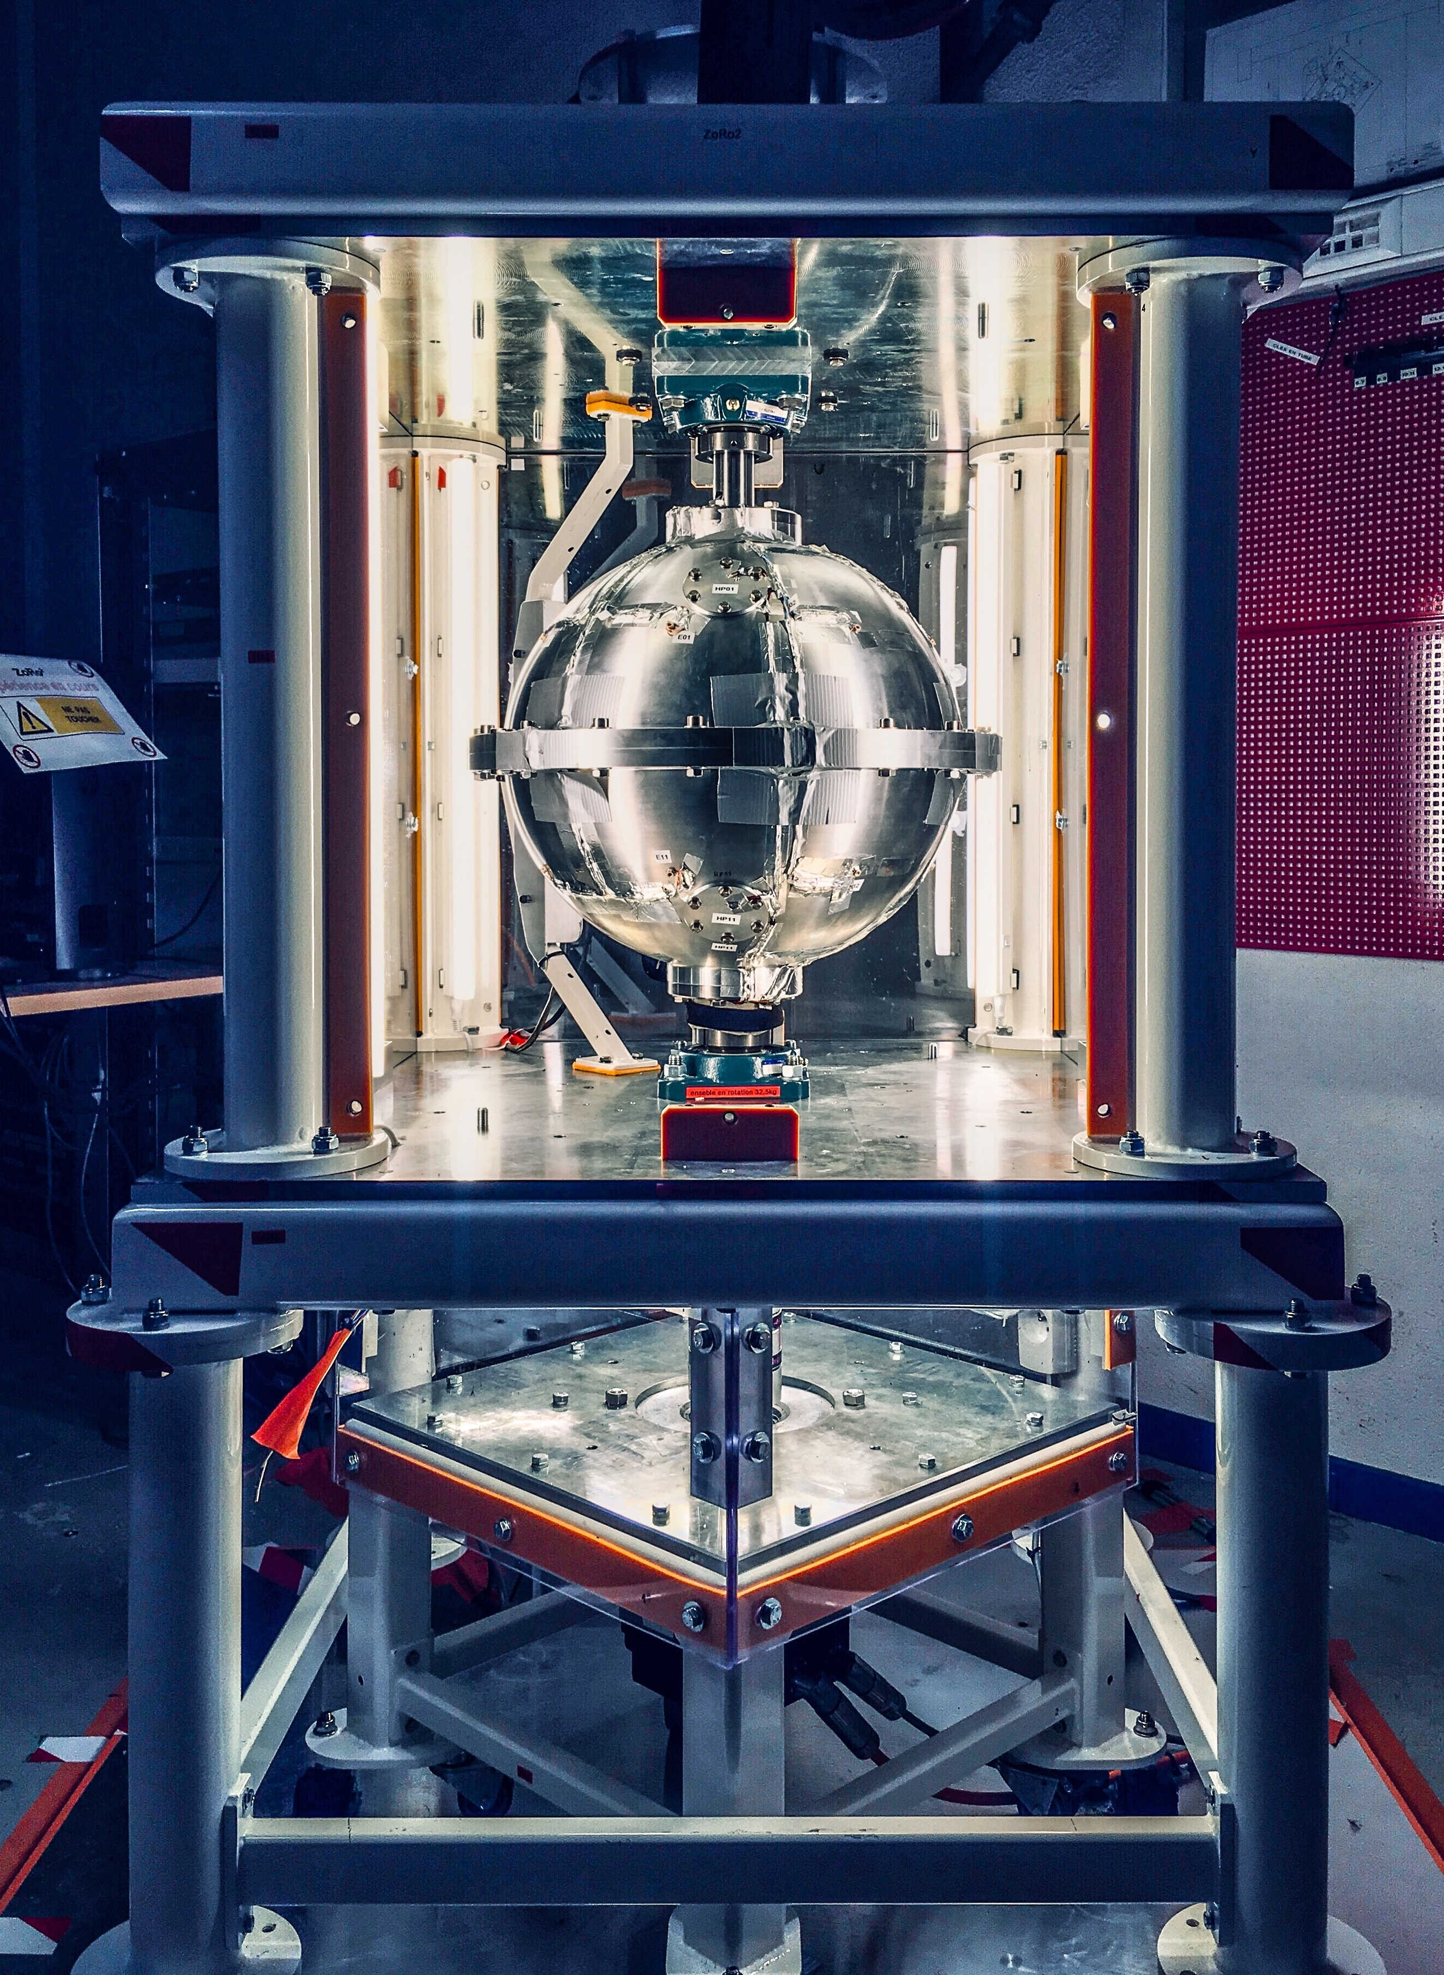
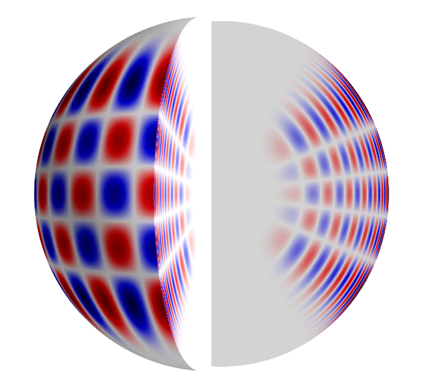
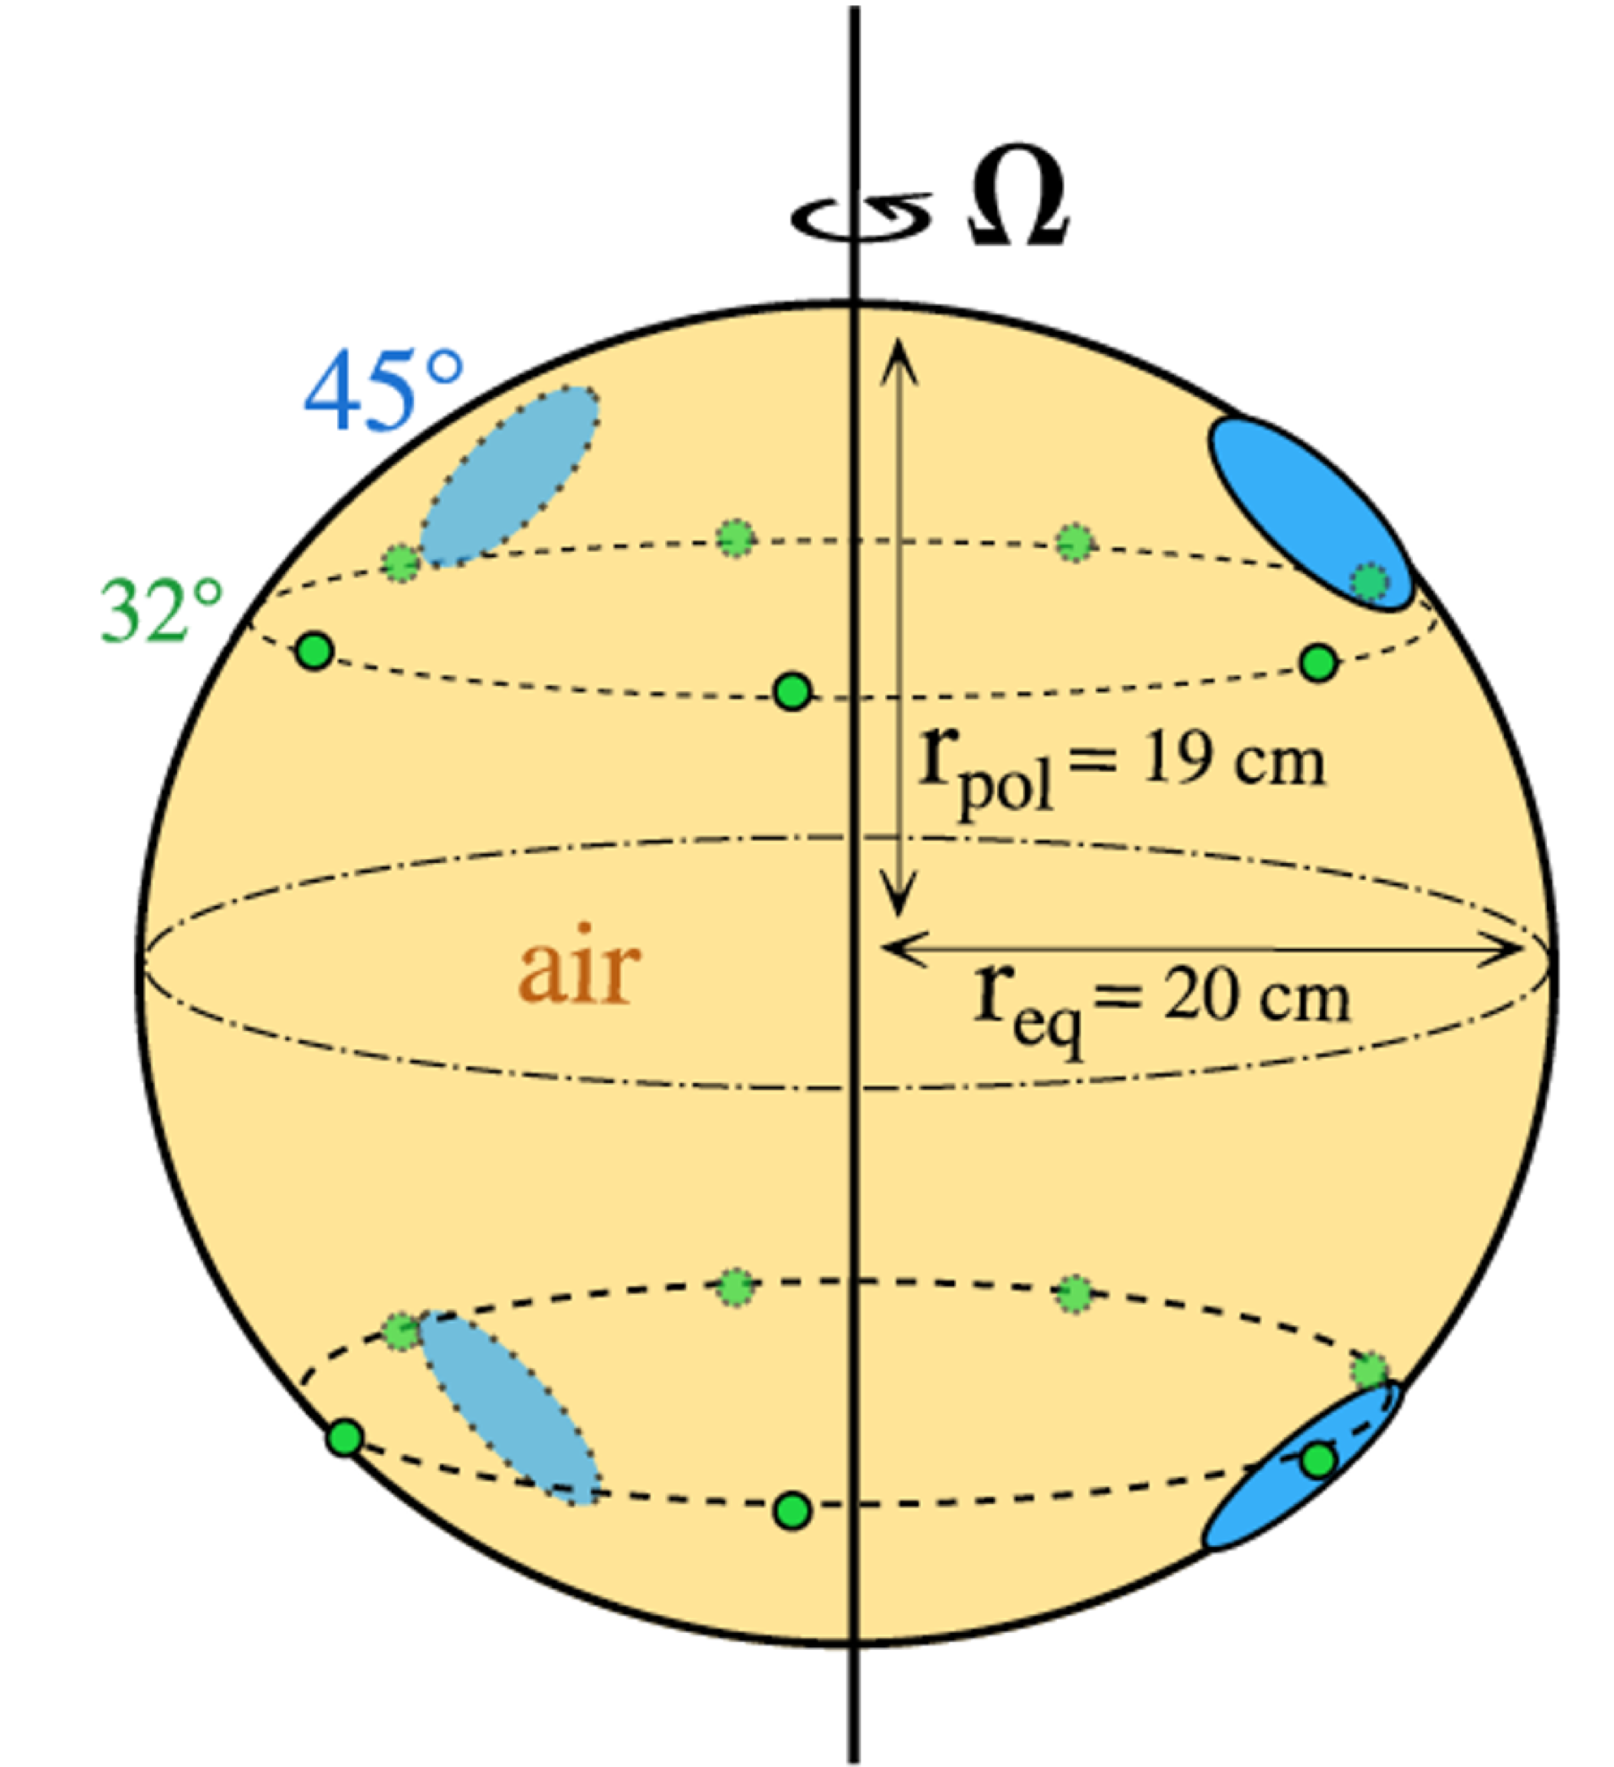
The ZoRo experiment
helioseismology
in a bottle
loudspeaker
microphone
A gas-filled rapidly rotating spheroid, equipped for acoustic diagnostics.
Su+ 2020
credit: Max Solazzo

Slide 3
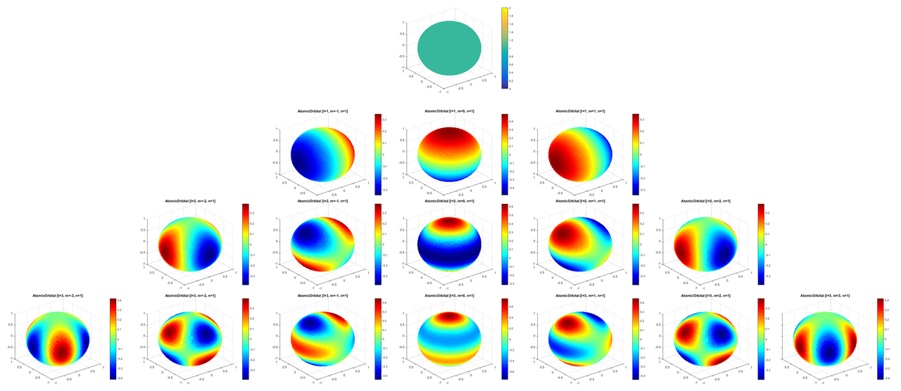
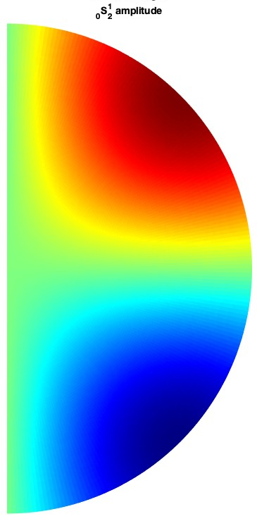
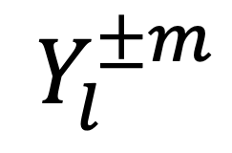
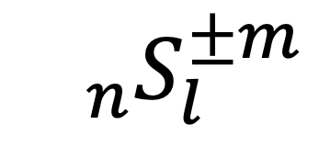
Three examples
Coriolis frequency splitting: measuring Ledoux coefficients.
Flow inversion: recovering Greenspan’s libration flow.
The signature of ellipticity in global cross-correlograms.
$$Y_{l}^{±m}$$
$${}_{n}S_{l}^{±m}$$

Slide 4
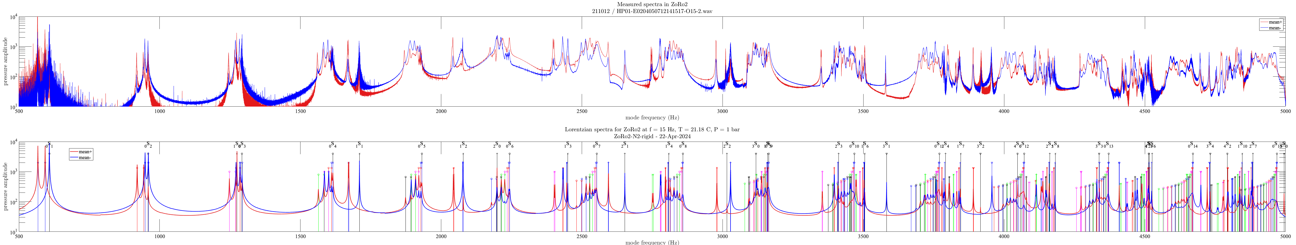

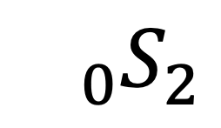
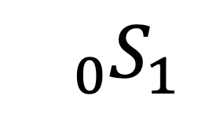
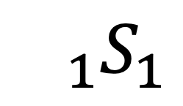
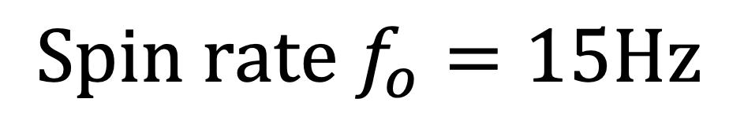
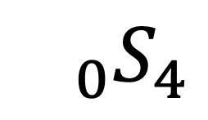
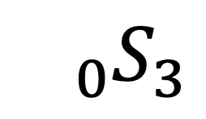
The music of ZoRo : measured and synthetic power spectra
$${}_{0}S_{1}$$
$$Spin rate f_{o}=15Hz$$
$${}_{0}S_{2}$$
$${}_{0}S_{3}$$
$${}_{0}S_{4}$$
$${}_{1}S_{1}$$

Slide 5
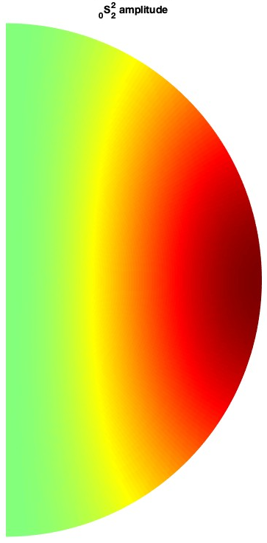
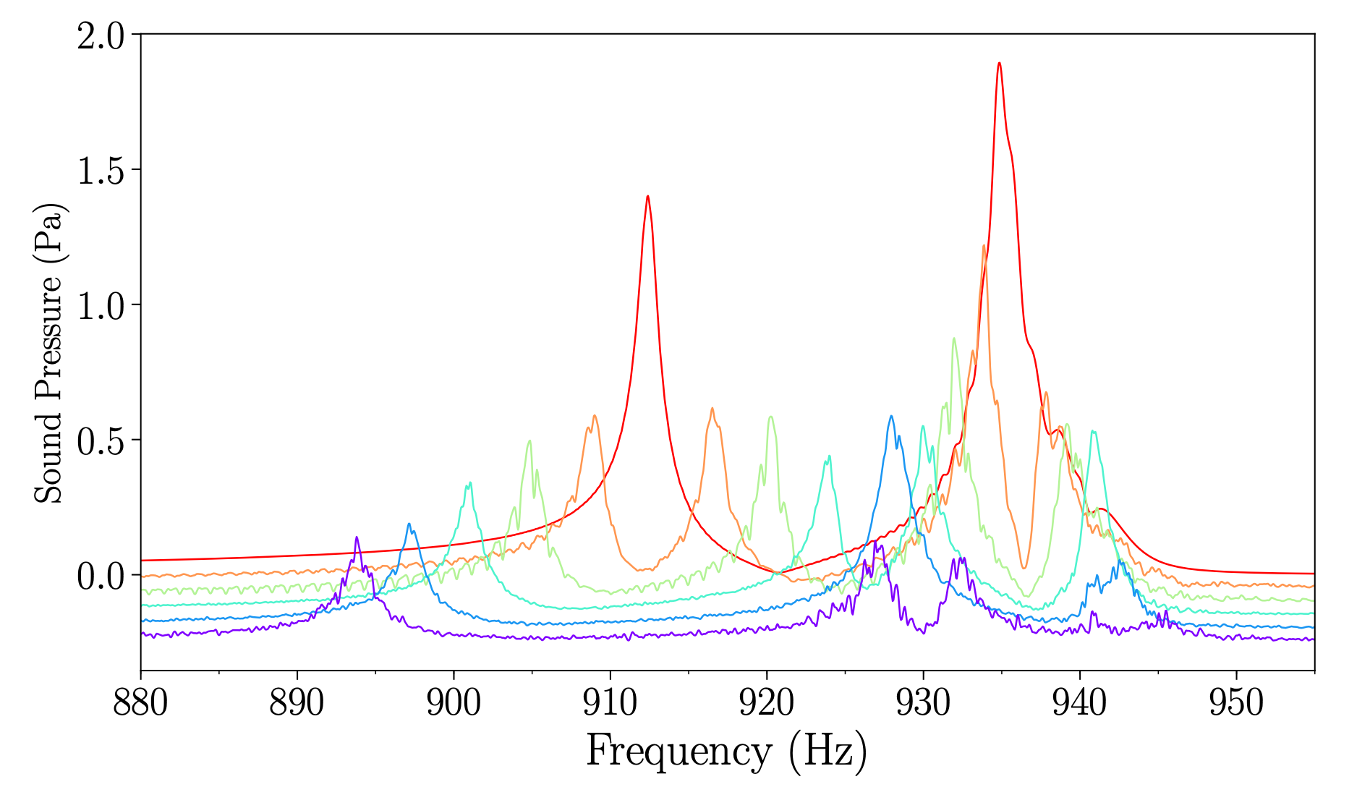
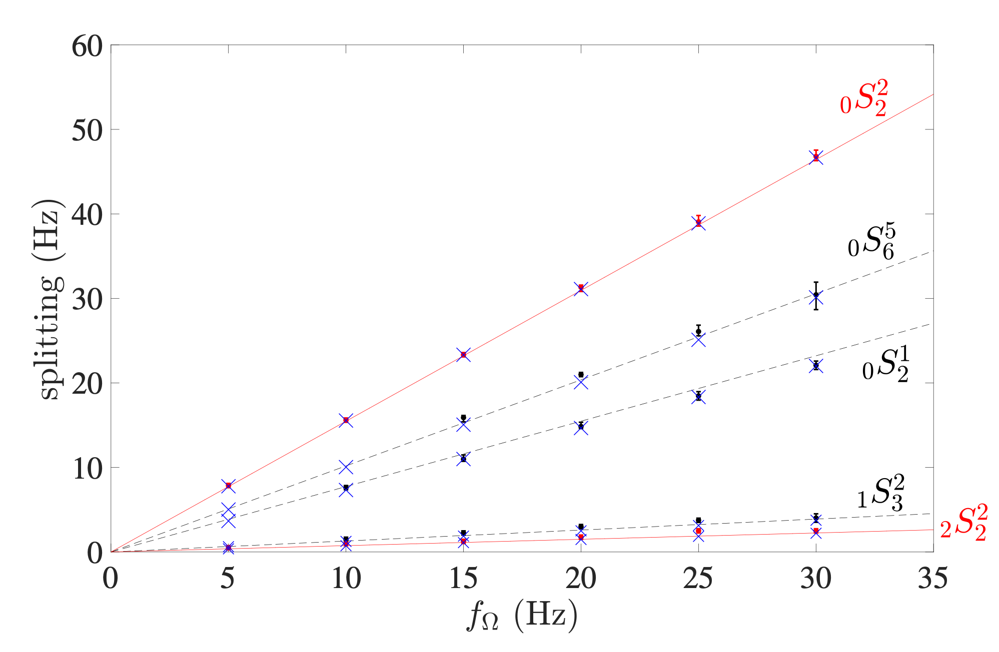
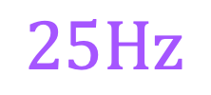
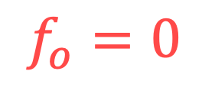

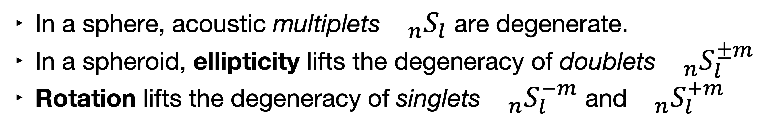
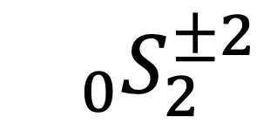

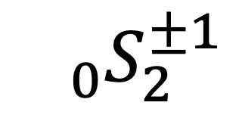


1. Coriolis frequency splitting and Ledoux coefficients
In a sphere, acoustic multiplets${}_{n}S_{l}$ are degenerate.
In a spheroid, ellipticity lifts the degeneracy of doublets${}_{n}S_{l}^{±m}$
Rotation lifts the degeneracy of singlets${}_{n}S_{l}^{−m}$ and${}_{n}S_{l}^{+m}$
$${}_{0}S_{2}^{±1}$$
The frequency splitting is proportional to the rotation frequency and depends upon the mode structure.
Our results confirm the theory of Ledoux (1951).
$${}_{0}S_{2}^{±2}$$
$$f_{o}=0$$
$$5$$
$$10$$
$$15$$
$$20$$
$$25Hz$$

Slide 6
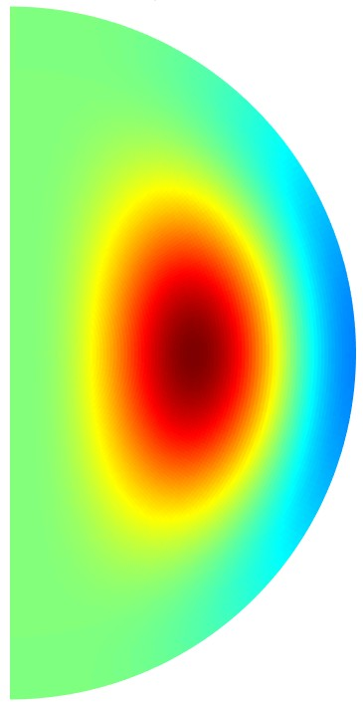
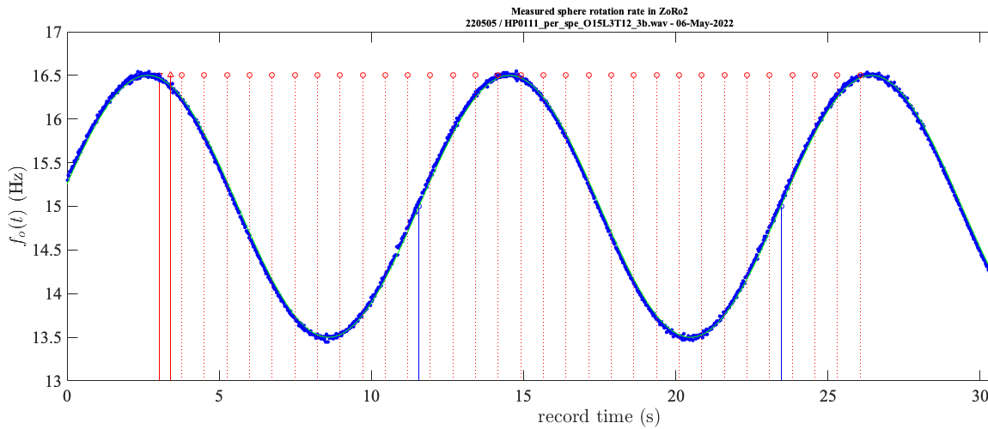

2. Recovering Greenspan’s libration flow
Frequency splitting of singlets${}_{n}S_{l}^{−m}$ and${}_{n}S_{l}^{+m}$ can also be produced by fluid flow.
We trigger libration flows in ZoRo and test the model of Greenspan (1968).
The splitting then varies in time.
We repeat a very short chirp targeting a specific doublet, here${}_{1}S_{3}^{±3}$.
Libration flow: $f_{shell}(t)=f_{o}+Δfsin(2πf_{lib}t)$

Slide 7
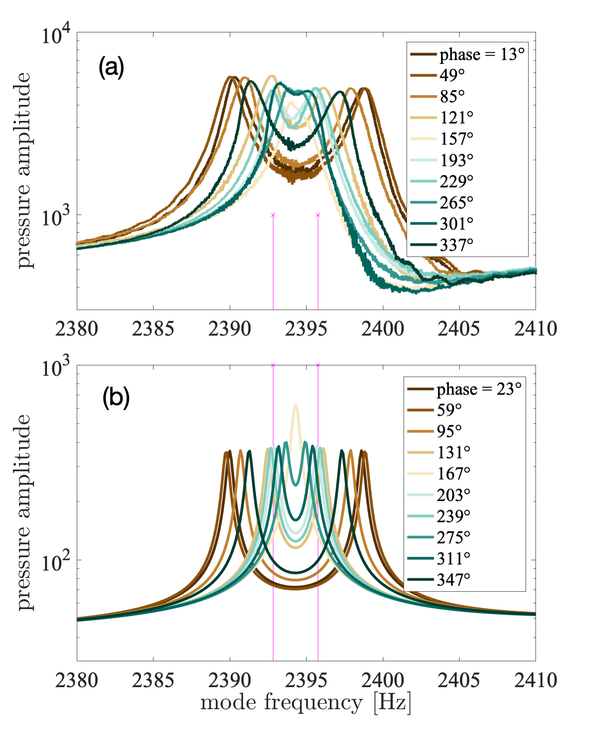
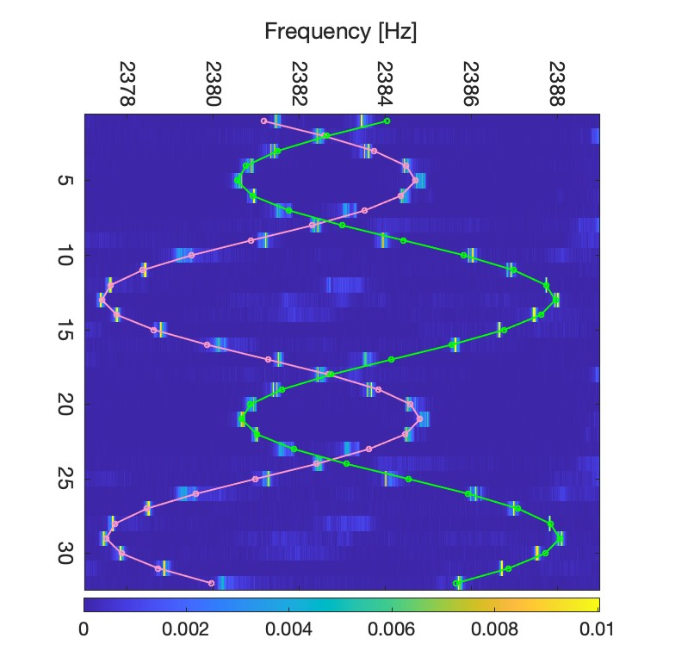

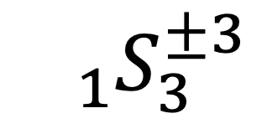
2. Recovering Greenspan’s libration flow
We recover the frequencies of the two singlets by a non-linear high-resolution analysis in the time-domain.
$${}_{1}S_{3}^{±3}$$
Or we repeat complete long chirps and measure the splitting for different libration phases.
$${}_{1}S_{3}^{±3}$$
Time
Chirp index

Slide 8
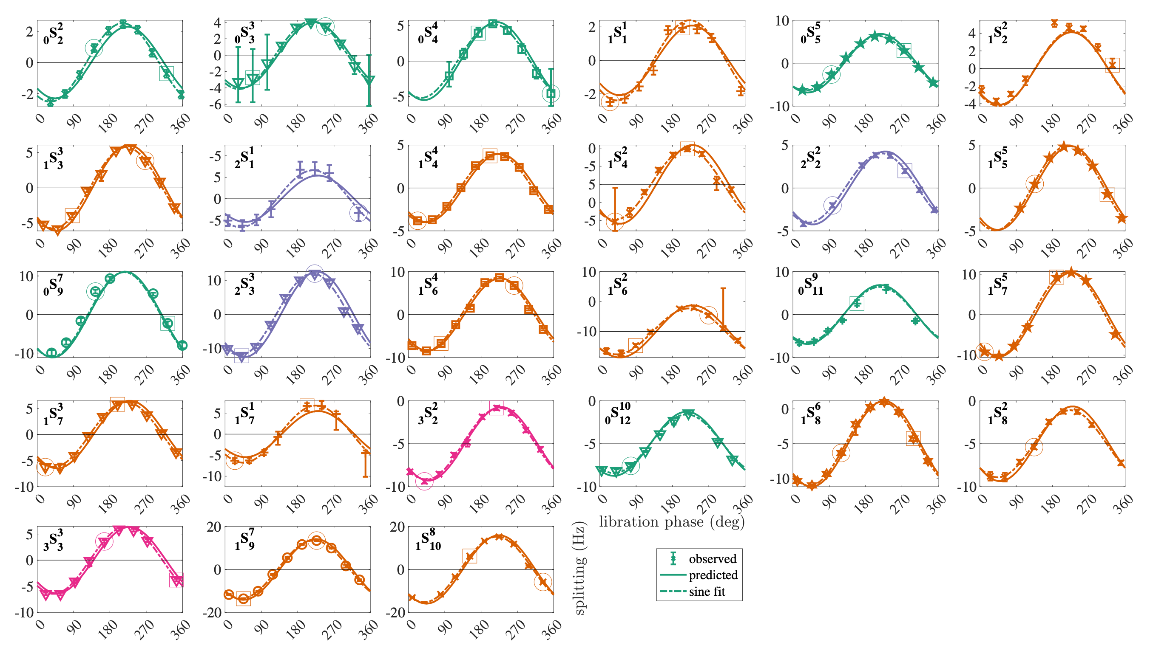
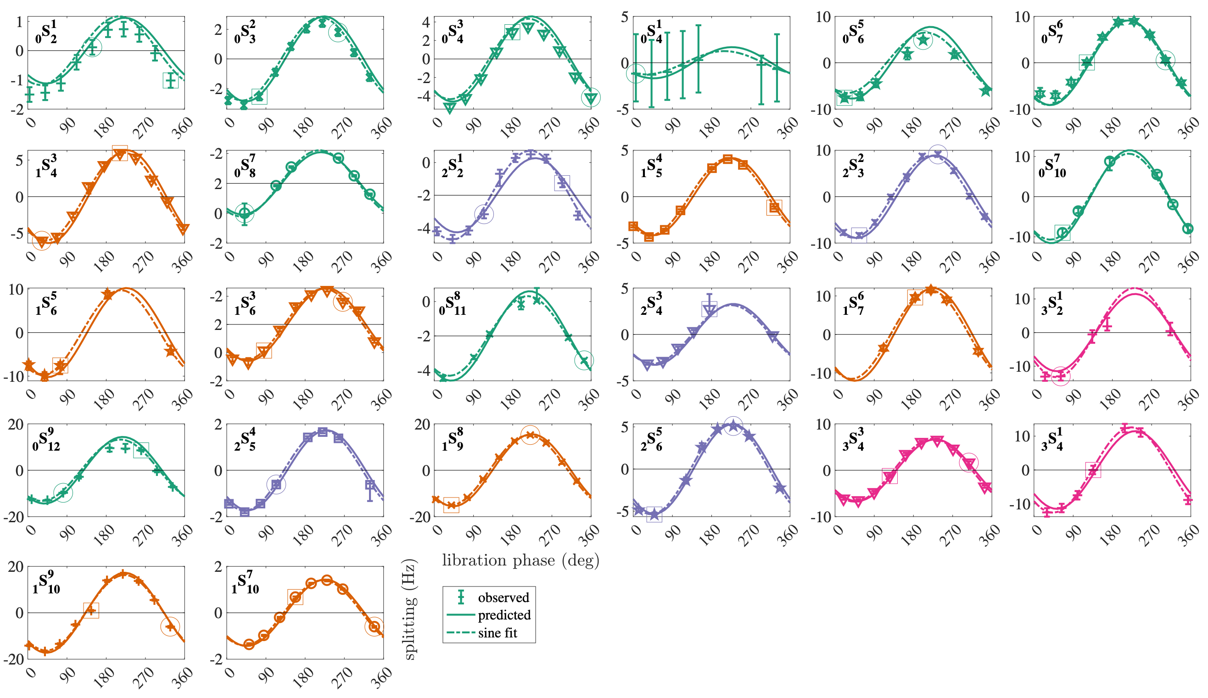
2. Recovering Greenspan’s libration flow
We thus collect the splitting of more than 50 doublets.
Greenspan’s flow is well recovered by inversion.

Slide 9
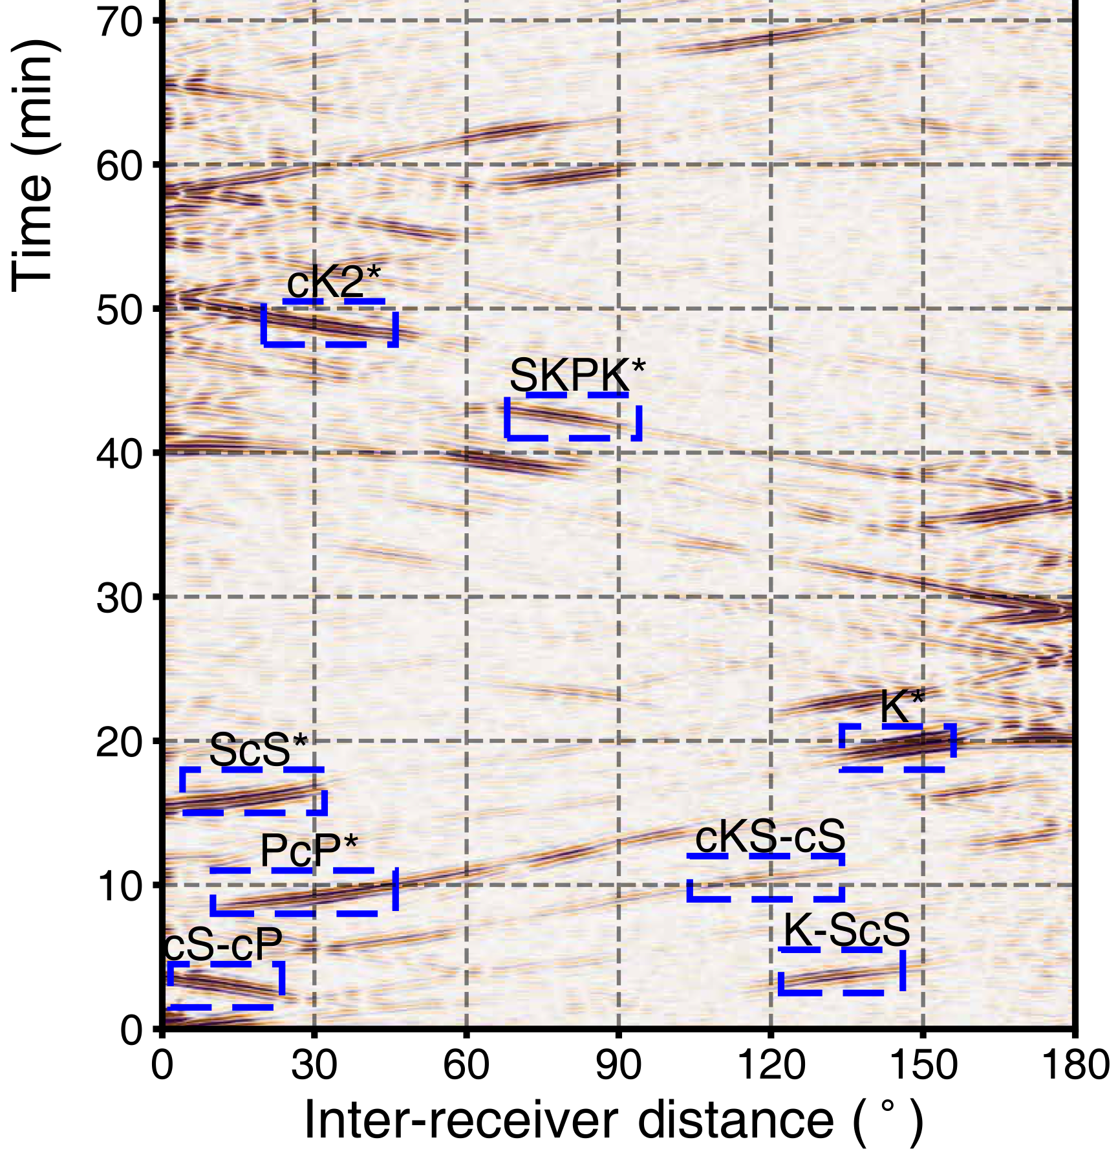
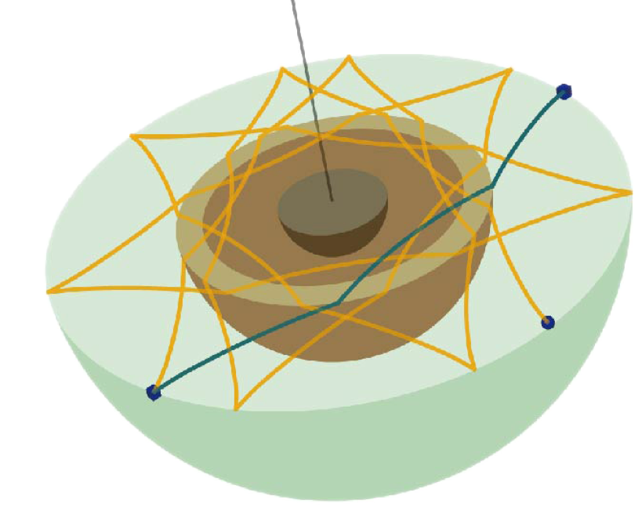
3. Global Cross-correlograms and ellipticity
Ma & Tkalcic, 2024
Global cross-correlograms are a recent powerful tool for exploring the Earth’s deep interior.
It exploits the late coda of large earthquakes, dominated by the reverberation of many seismic waves.
The cross-correlation of seismograms recorded at thousands of station pairs reveals features, related to direct waves.
How do ellipticity and rotation affect the Earth’s global cross-correlogram?

Slide 10
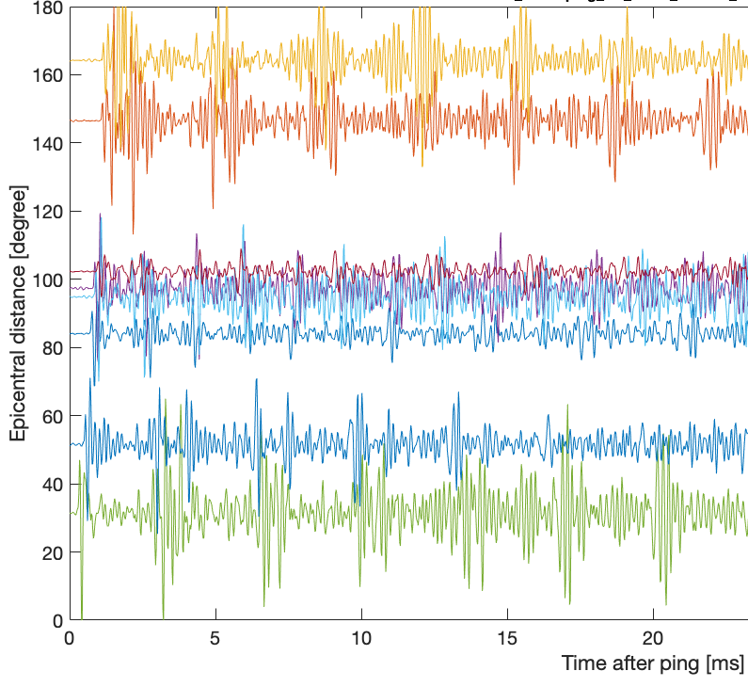
3. Global Cross-correlograms and ellipticity
We mimic a series of earthquake in the ZoRo experiment, record and stack the records.
We compute ZoRo synthetic seismograms, at 100 virtual microphones, taking into account ellipticity and rotation.
We build global cross-correlograms from these records.

Slide 11
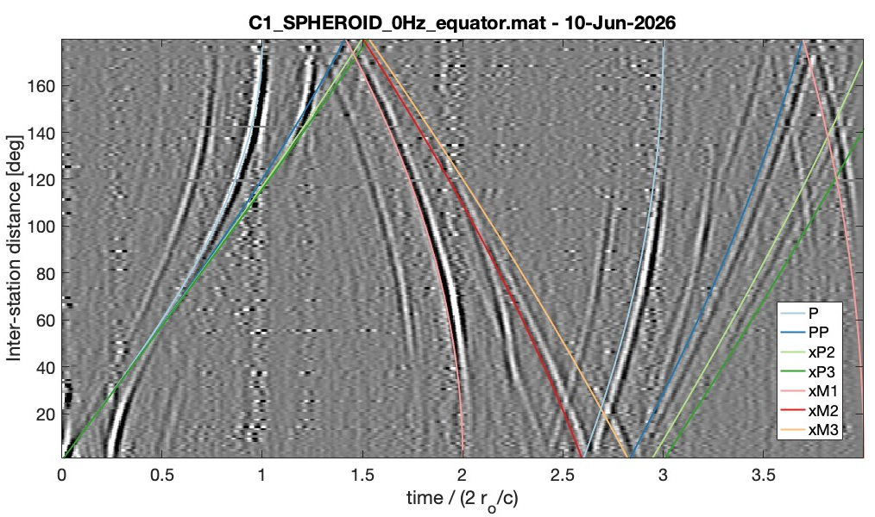
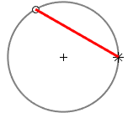
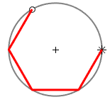
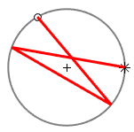
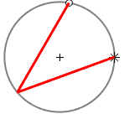
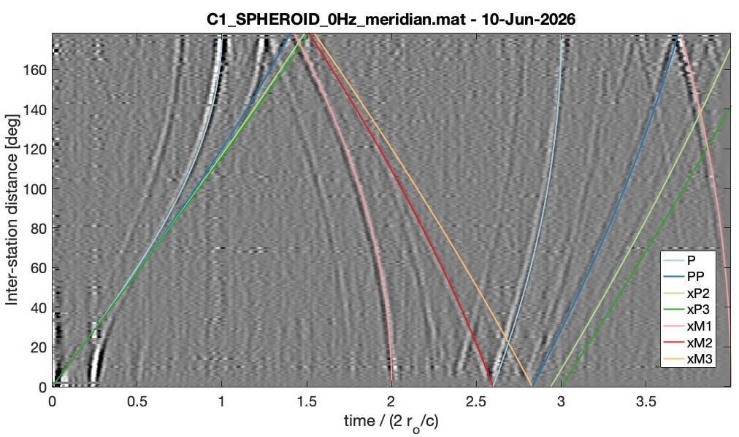
3. Global cross-correlograms and ellipticity
Features clearly show up, aligning with theoretical body wave travel-time curves.
Equatorial cross-correlograms differ from meridian ones in several aspects.
On-going work!…

Slide 12
Thank you

Slide 13
References
Modal Acoustic Velocimetry in libration-driven flows, Nataf H-C, S. Su, P. Roux, P. Cardin, D. Cébron & Y. Do. Experiments in Fluids, 66 (10), 185, 2025.
Acoustic modes of rapidly rotating ellipsoids subject to centrifugal gravity, Vidal J. & D. Cébron, J. Acoustic. Soc. Amer., 150 (2), 1467-1478, 2021.
Compressible fluid modes in rigid ellipsoids: towards modal acoustic velocimetry, Vidal J., S. Su & D. Cébron, J. Fluid Mech., 885, A39, 2020.
Acoustic and inertial modes in planetary-like rotating ellipsoids, Vidal J. & D. Cébron, Proc. of the Royal Society A, 476, 20200131, 2020.
Acoustic spectra of a gas-filled rotating spheroid, Su S., D. Cébron, H-C. Nataf, P. Cardin, J. Vidal, M. Solazzo & Y. Do, European J. Mech. B/Fluids, 84, 302-310, 2020.
Helioseismology in a bottle: Modal acoustic velocimetry, Triana S.A., D.S. Zimmerman, H.-C. Nataf, A. Thorette, V. Lekic & D.P. Lathrop, New Journal of Physics, 16, 113005, 2014.

Slide 14
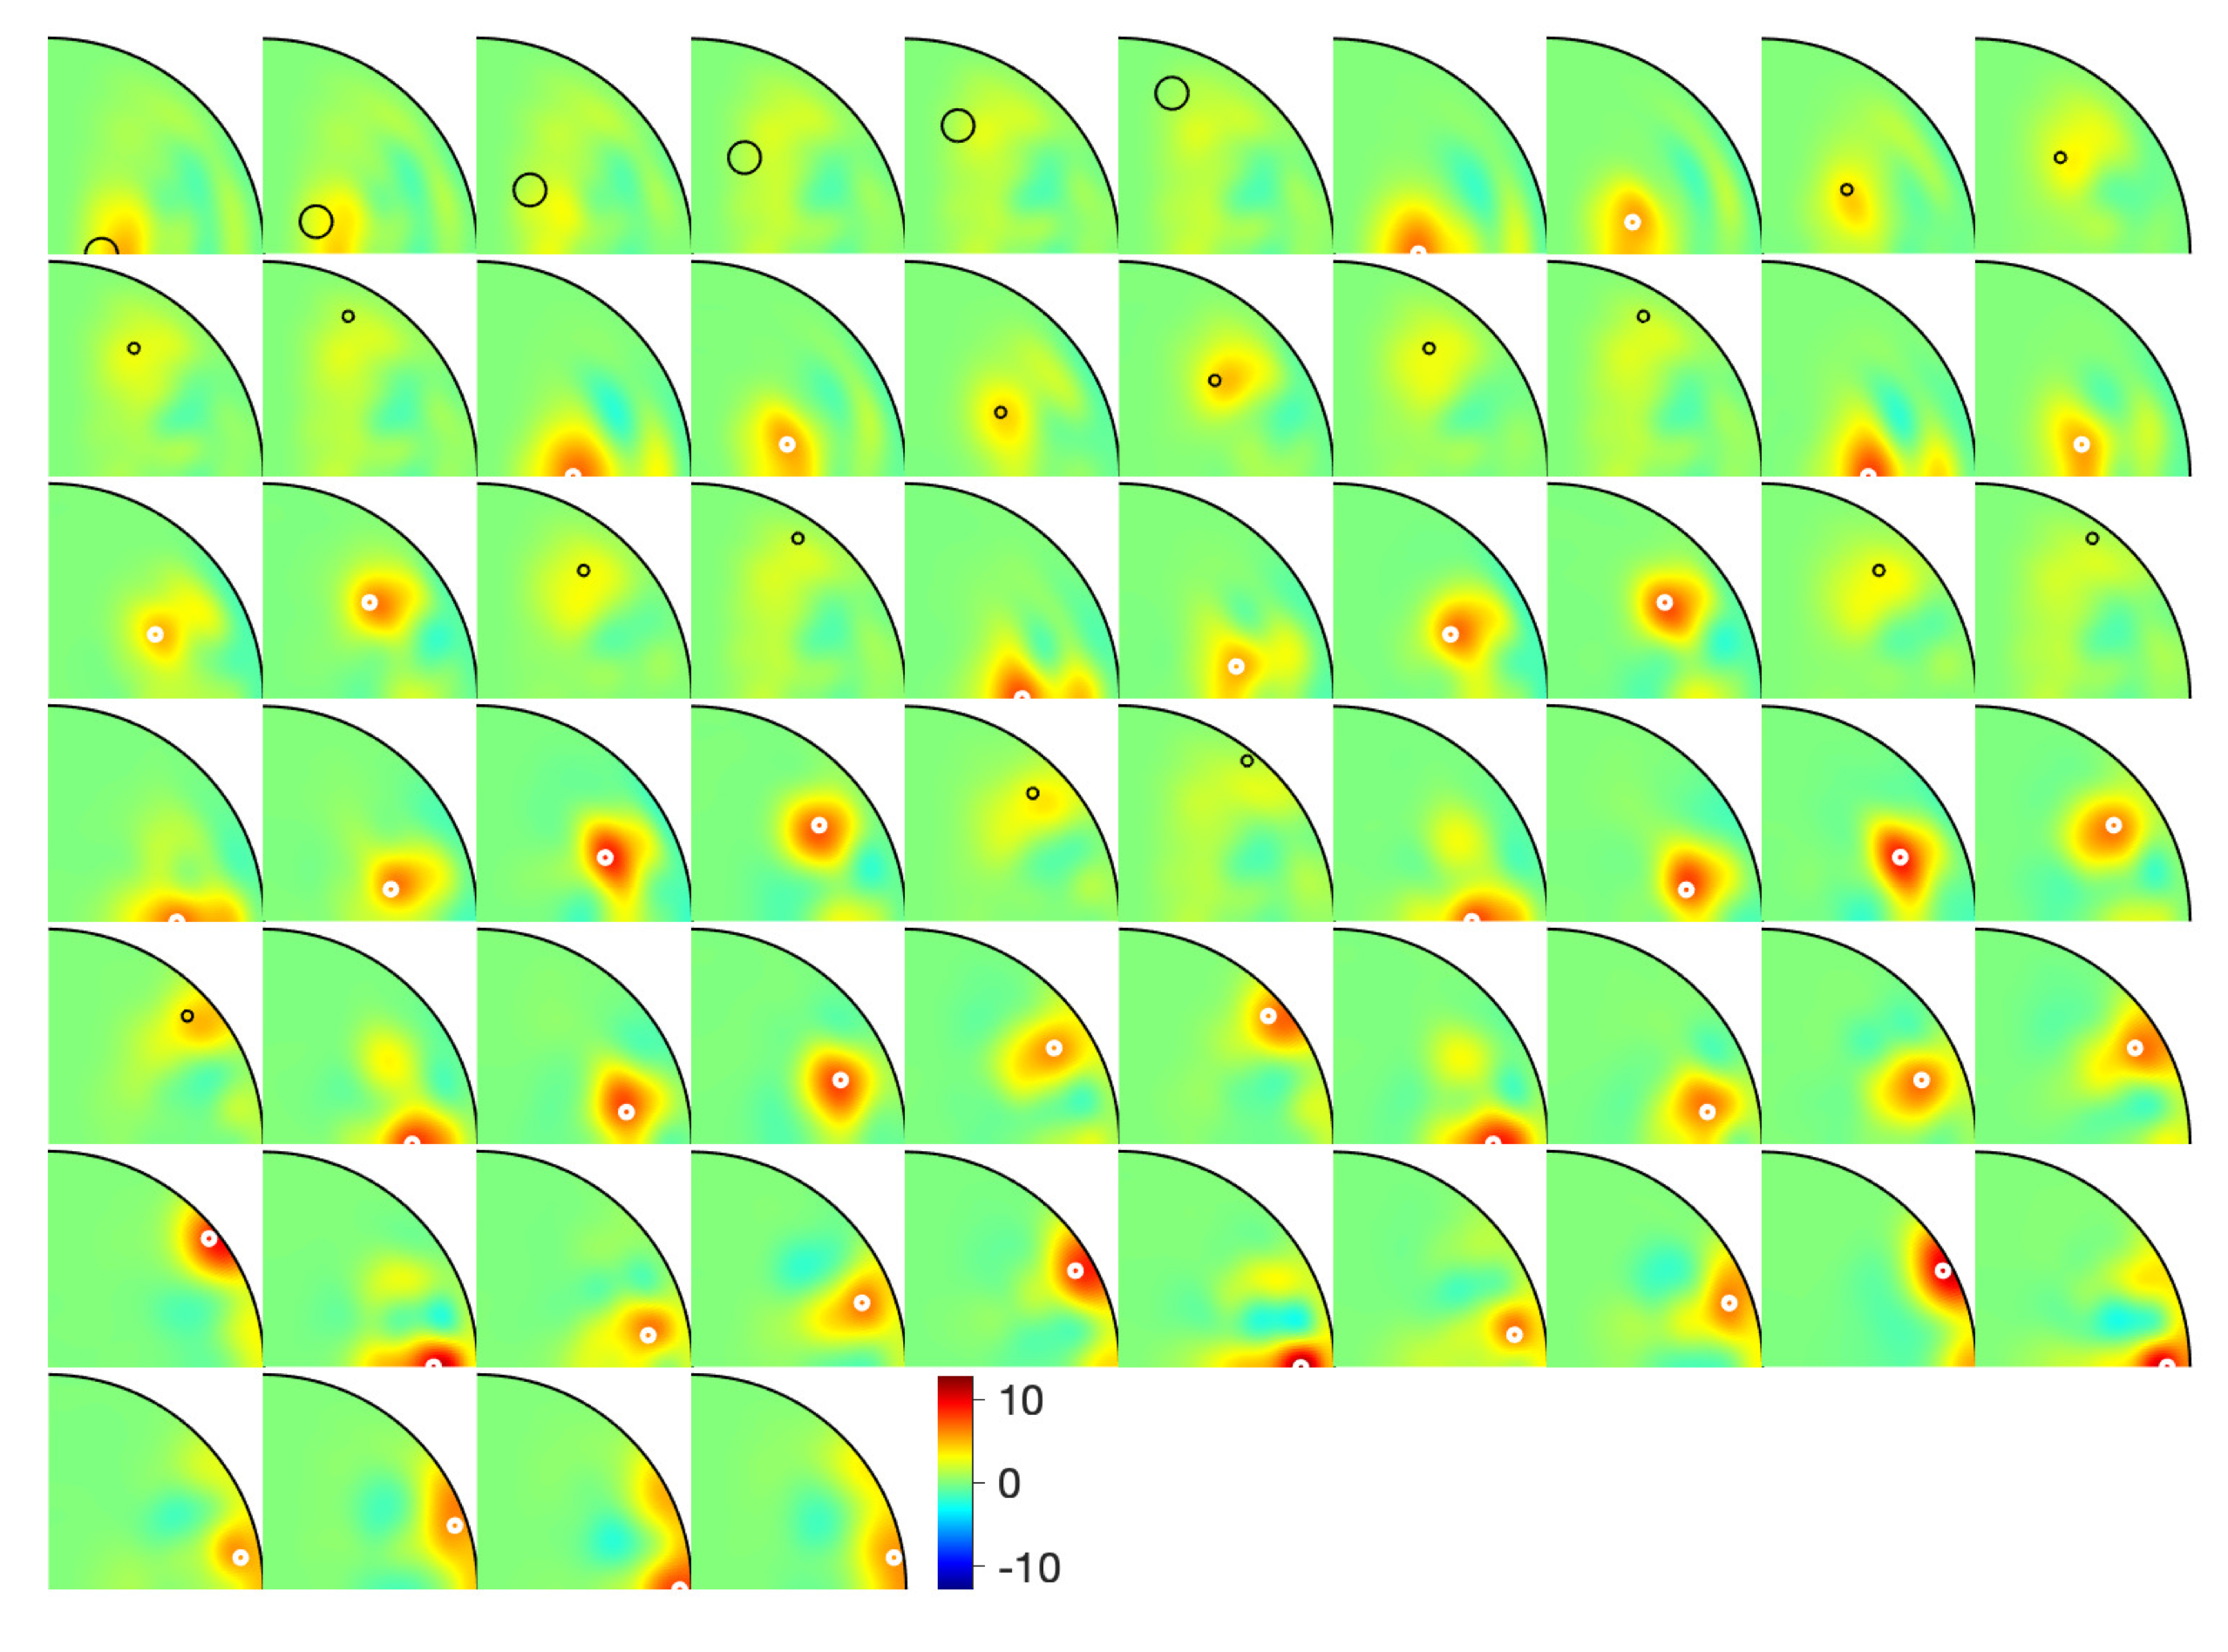
Resolution kernels for libration flow

Slide 15
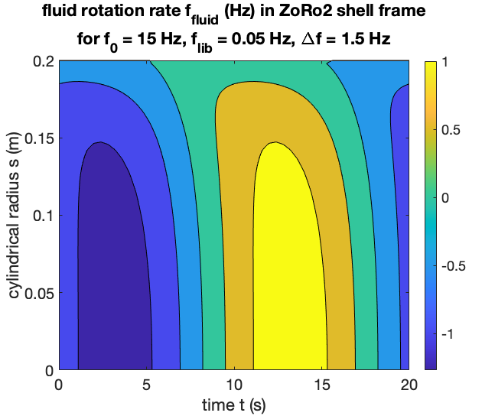
2. Recovering Greenspan’s libration flow
Frequency splitting of singlets ${}_{n}S_{l}^{−m}$ and ${}_{n}S_{l}^{+m}$ can also be produced by fluid flow.
We trigger libration flows in ZoRo and test the model of Greenspan (1968).
The splitting then varies in time.
We repeat a very short chirp targeting a specific doublet, here ${}_{1}S_{3}^{±3}$.
Hz
Libration flow: $f_{shell}(t)=f_{o}+Δfsin(2πf_{lib}t)$
Greenspan, 1968

Slide 16
xP0
120°
xM1
80°
xP0_2
120°
xM3
120°

