Slide 1
A first exomoon candidate revealed by astrometry using VLTI/GRAVITY
Quentin KRAL (+131 other authors)
LIRA

Slide 2
Exomoons: do we know any?
>400 moons in the Solar System
BUT
No exomoon confirmed to date.
Some candidates around:
-Kepler-1625 b (Teachey & Kipping, 2018),
-Kepler-1708 b (Kipping et al. 2022),
-DH Tau B (Lazzoni+20) – Direct imaging of a Jupiter moon around a Brown Dwarf at 10 au.
Neptune-moon candidates
Notes:
However, the interpretation remains contested, with studies attributing the signal to an artifact of the data reduction, stellar activity, or unknown systematics (Heller, Rodenbeck, & Bruno 2019; Kreidberg, Luger, & Bedell 2019)

Slide 3
Exomoons: learning from non-detections
Some upper limits from transit and RV techniques:
Transit: <0.38 moons (analogue to Galilean moons) per planet (0.1-1 au) – Kipping+15, Teachey+18
RV:
-HCI+HR spectro can reach 1-4% moon-planet mass ratio (but Galilean moons mass ratio is 10⁻⁴) at separations close to that of Galilean moons – Ruffio+23
-Msin(i)<2Mjup for moons (periods < 5 days) around HR 8799 planets – Vanderburg & Rodriguez 2021
But limited to transiting close in planets or short period moons with RV…

Slide 4
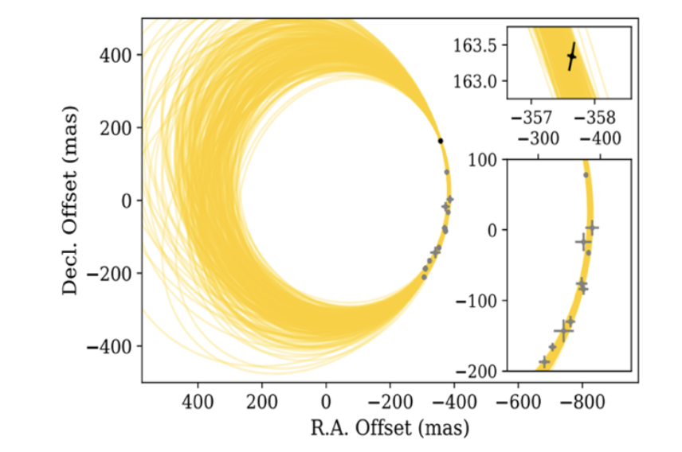
Detecting exomoons with astrometry?
The orbit of massive exoplanets is now accessible with a high accuracy (~50 µas) thanks to VLTI/GRAVITY (e.g. Hinkley+23)
Example of astrometric measurements with GRAVITY for HR 8799e (Gravity Collaboration, Lacour et al. 2019).
Can we target exomoons using GRAVITY?

Slide 5
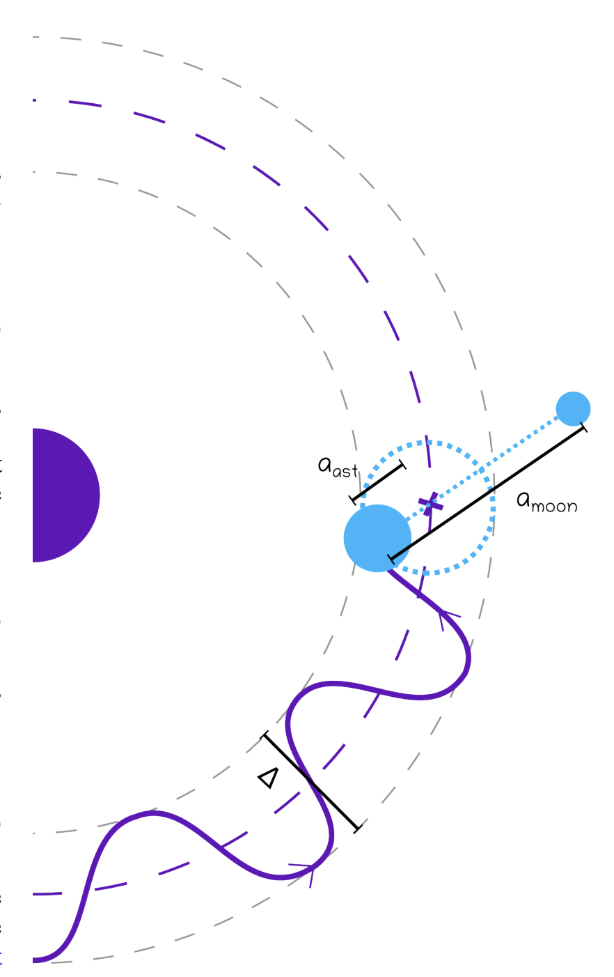


An exomoon would cause the exoplanet to wobble
Following the precise motion of an exoplanet could allow us to infer the presence of a moon
This technique could enable the detection of large moons, ranging in size from that of Earth to that of Jupiter (Kral+26, Winterhalder+26)
Kral+26

Slide 6
The astrometric technique shows great promise for the detection of exomoons
Unlike the transit method, we can directly observe exoplanets located at a great distance (>80 mas) from their star. This allows us to explore a region where moons are more stable (Dobos+21).
The planet’s orbit does not need to have a particular inclination, so no constraints on accessible targets.
Sensitive to wide-orbit moons (with periods of months to years) inaccessible to transit or RV techniques.
Notes:
Close-in planets (<1 au) are poor candidates due to tidal destabilization (Dobos et al. 2021), necessitating focus on wider-orbit systems.
This technique possesses unique advantages. First, it can target planets with different inclinations, where the transit technique cannot, and the RV technique finds results that depend on the (most frequently) unknown sin(i) value. Second, it is ideally suited for searching for moons around directly imaged substellar companions, which typically reside on wide orbits that are more likely to host moons. Transiting planets have short orbital periods and thus small Hill spheres, which could be less favourable to moon retention (Dobos et al. 2021), even if the planet formed further out and migrated inwards (Spalding et al. 2016). Finally, it is sensitive to wide-orbit moons with periods of months to years, which are inaccessible to transit techniques or current RV sensitivities (Ruffio et al. 2023).

Slide 7
Exomoons: The next breakthrough in exoplanetary science ?
Similar to exoplanets where a hot jupiter was first detected in 1995, we could first see the easiest moons to detect, i.e. a massive exomoon with e.g. a Jupiter mass and a long period (months to a year).
Theoretical exomoon formation models (Hansen 2019, Moraes & Vieira Net 2020) now predict they could be massive and that the moon mass could be proportional to Mpla^{1.5} (Batygin & Morbidelli 2020).
Let us look for exomoons around brown dwarfs first then!
Notes:
Theoretical works now support the plausibility of massive exomoons, either via gravitational capture (Hansen 2019) or formation within massive circumplanetary disks (Moraes & Vieira Neto 2020). Notably, moon masses could scale with the host planet mass as M3/2 p (Batygin & Morbidelli 2020), favoring searches around superJovian planets or brown dwarfs, as in this study.

Slide 8
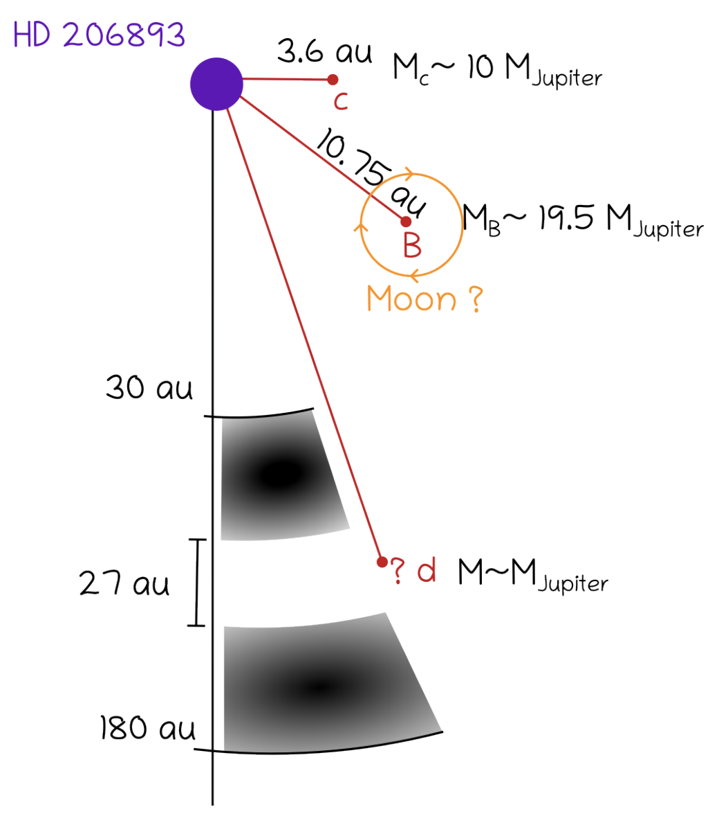
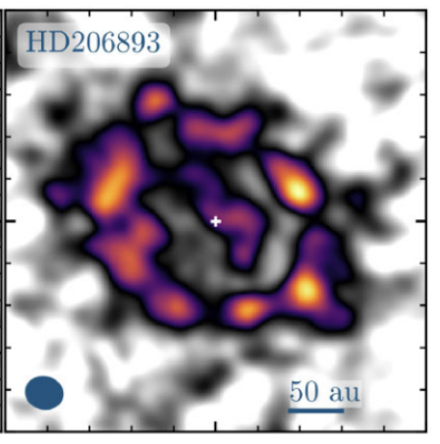
Looking for an exomoon around HD 206893 B
(F5V, ~110 Myr, ~40.8pc)
ALMA (Marino+20)
Kral+26

Slide 9
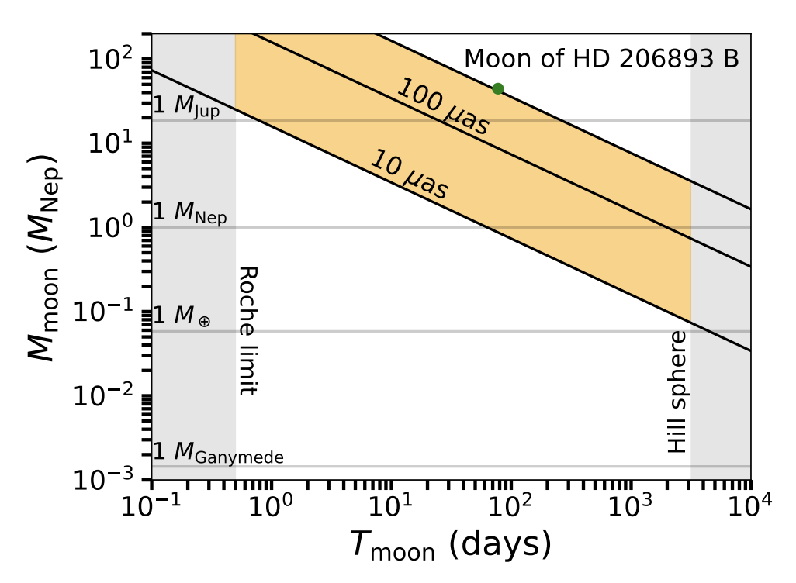
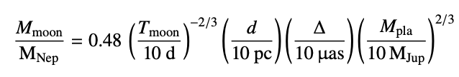
Analytical predictions for moons around HD 206893 B
GRAVITY could detect long period moons up to a few Mearth in theory around HD 206893 B
Kral+26

Slide 10
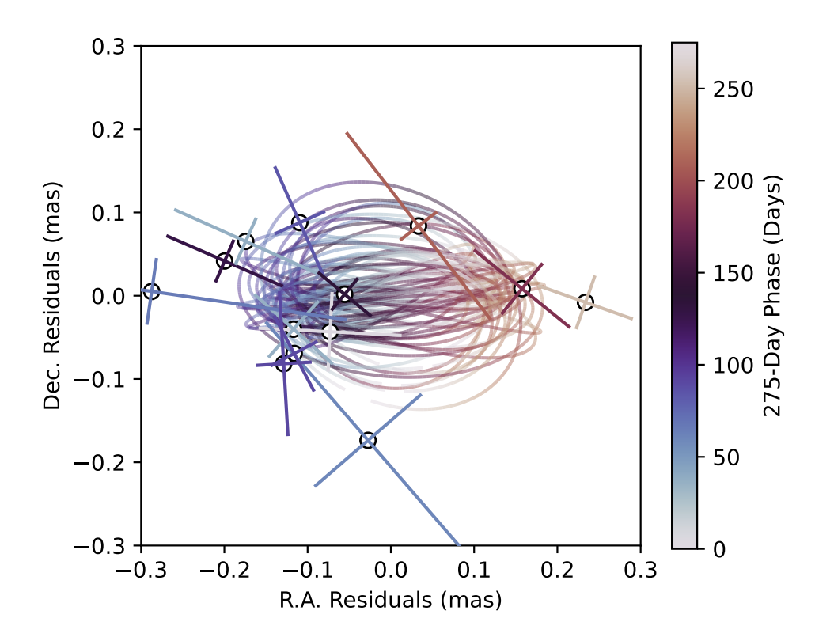
Observations of HD 206893 B with GRAVITY
Posterior distribution fit (ellipses) of data (crosses)
Observations with 4 UTs of VLTI/GRAVITY (8 epochs)
between April and July 2024 (PI: Kral)
+ 5 data points from ExoGRAVITY large program (Lacour+20) and 1 from commissioning of GRAVITY+
Kral+26
The orbit of HD 206893 B fits well with an ellipse with a semi-major axis of 150 µas (0.0056 au, or twice the Earth-Moon distance) and a period of approximately 9 months
Notes:
HD 206893 B was observed with the GRAVITY instrument (GRAVITY Collaboration 2017) at the VLTI during eight epochs between April and July 2024 (Prog. ID 113.26D9.001). These observations complement those obtained as part of the ExoGRAVITY large program (Lacour et al. 2020). A final observation was conducted in June 2025 as part of the commissioning of the new adaptive optics system of GRAVITY+

Slide 11
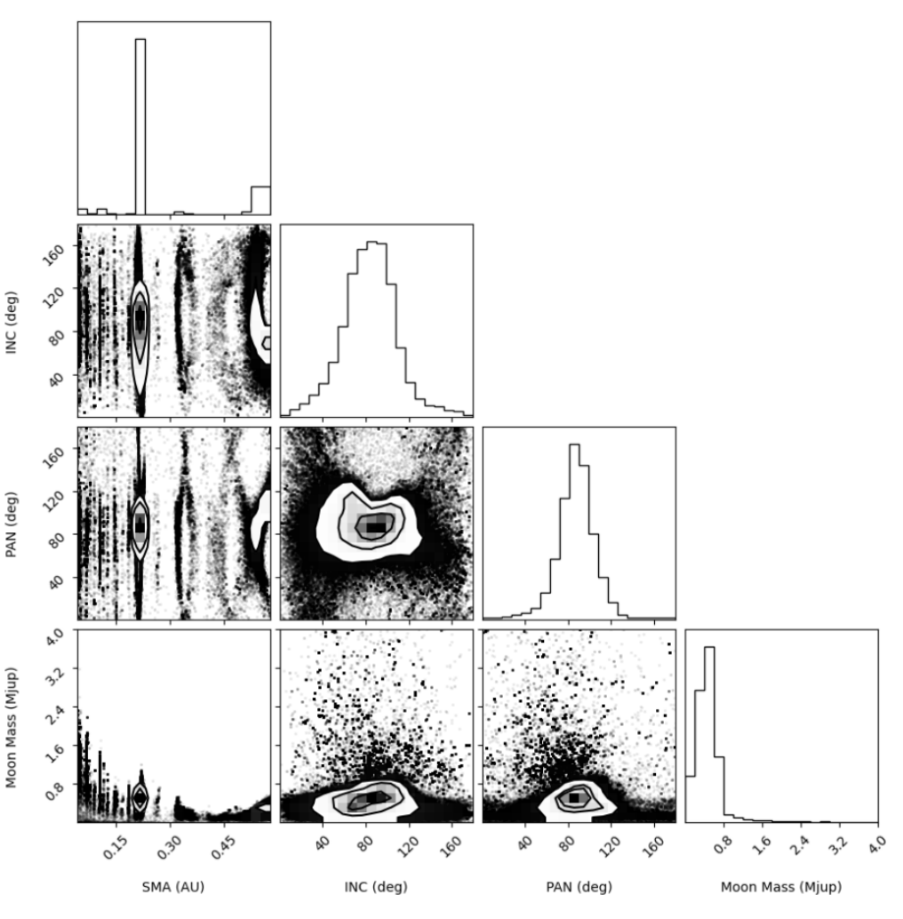
MCMC fit with the code orbitize!
Kral+26
-Peak of moon’s semi-major axis at 0.22 au (~9-month period)
-Upper limit in moon mass at 0.8 M_{jup}
-Inclination of moon moderately constrained around 90 deg (i.e. ~60 deg misaligned from the orbit of B)
Notes:
The inclination (INC) and position angle of the ascending node (PAN) are moderately constrained, with the best-fit values around 90 deg, which would be ∼60 degrees misaligned from the orbit of B.

Slide 12
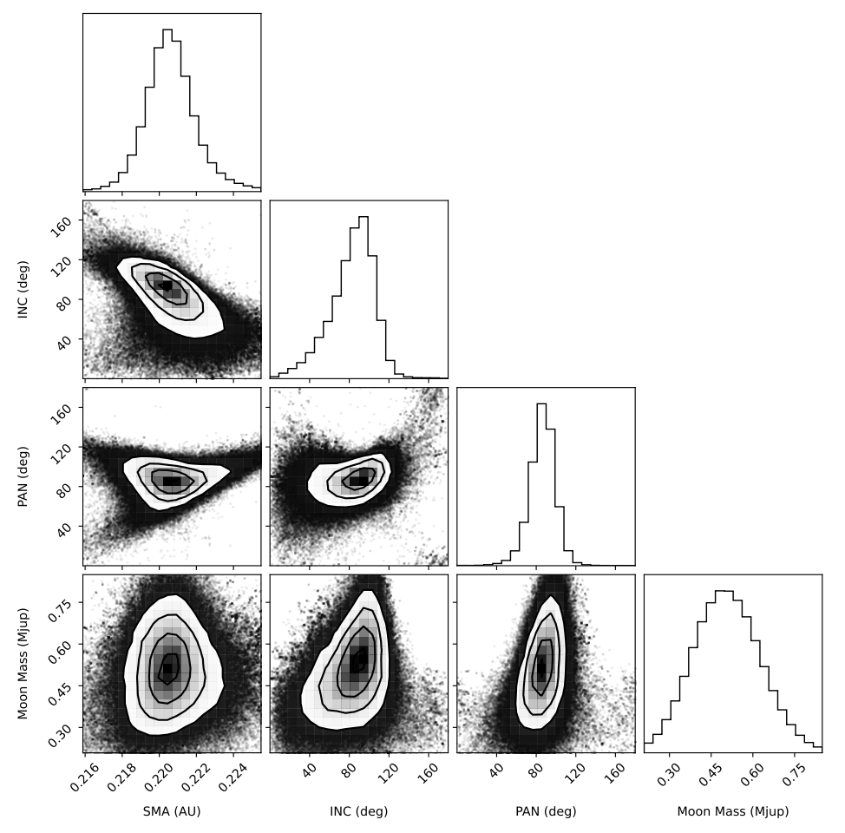
New fit forcing the moon’s sma close to 0.22 au
Kral+26
If the sma peak is real, the motion of HD 206893 B can be explained by the effect of a moon with a mass of approximately 0.5 M_{jup} (~9 M_{nep}) located at a distance of 0.22 au (9-month period)

Slide 13
Need more data to confirm
Used Bayesian Information Criterion (BIC) to differentiate between a no moon and a moon model. The moon model fits better but BIC of 7.4<10 (statistic criterion not passed)
Could still be some systematics? For example: baseline calibration, terrestrial reference frame, optical abberations, …
More GRAVITY data is needed to achieve a BIC greater than 10 and to be able to confirm the moon’s existence with certainty

Slide 14
Conclusion
We find a candidate exomoon around HD 206893 B.
If real, the moon mass would be ~0.5 M_{jup} (9 M_{nep}) and located at a distance of 0.22 au (9-month period) from the brown dwarf.
GRAVITY is capable of detecting exomoons and could prove particularly advantageous, as it allows us to target massive, distant planets, which are more likely to have stable large moons.
GRAVITY could typically target Neptune mass moons around Jupiter-like planets.
New UT5 at the VLTI (Lacour+25), or a future 1-10 km long baseline interferometric facility (Bourdarot & Eisenhauer 2024), would enable detection of even smaller moons.
Notes:
New instruments at the VLTI with greater astrometric precision (e.g., Lacour et al. 2025) or a future kilometer baseline interferometric facility would allow us to reach 1 µas (Bourdarot & Eisenhauer 2024), which would push the detection limits down by more than an order of magnitude.

